Slide 1

CCSE- Center for Computing in Science Education
Økonomi 2023-2026
Hema
UiO

Slide 2
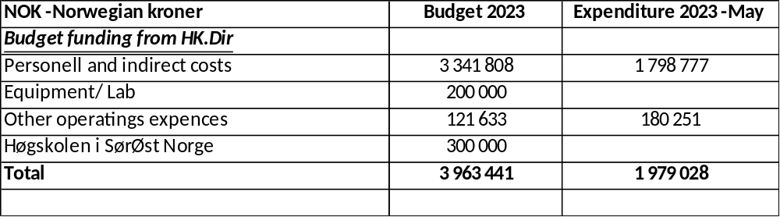
HK-Dir budget and accounting May 2023
Notes:
Avvik i lønnskostnader skyldes at lønn til Caballero Marcos Daniel er belastet feil.

Slide 3
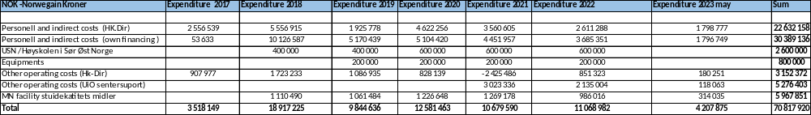
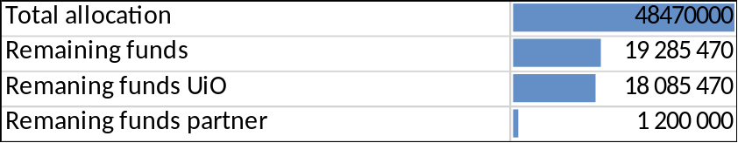
Regnskap 2017-2022

Slide 4
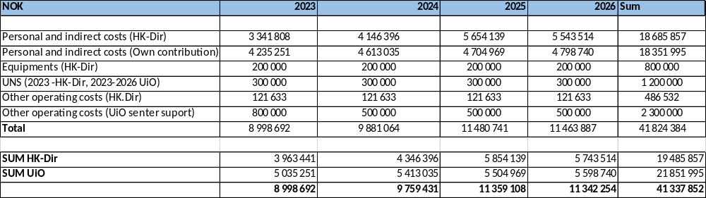
Budget 2023-2026

Slide 5
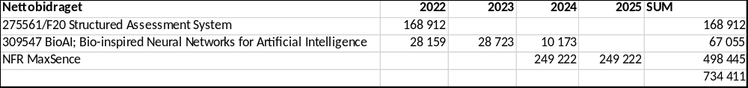
Economic leeway
opening balance 2023 : 2 215 061 NOK
Net contributions form the external projects to CCSE 40% av overhead

Slide 6
Other projectes
Andre eksternt finansierte prosjekter
NFR Structured Assessment System for Improved Student 5,3 MNOK
NFR Intpart BioAL 4,49 MNOK
NFR MAX SENSE – 3 MNOK
Regional forskingsfond – 2 MNOK

