Slide 1
Introduction to programming
DIGHEL4360
Henrik Hillestad Løvold,
Universitetslektor II
Institutt for Informatikk, UiO

Slide 2
What is programmering?
Programming is to make the computer do what you want it to.
The biggest job is to find out what you want to do and formulating it in a precise matter. The second part of programming is communicating this to the computer in a language that it can understand. In our case we will use language Python.

Slide 3
Why should you learn programming?
For your own use
  Handling sets of data
  Looking at trends
  Research
At the workplace
  Understanding how systems work
  Understanding limits in the software you use and identifying errors
Ordering competency
  IT procurement
  Requirements specification
Common knowledge in the future society...?

Slide 4


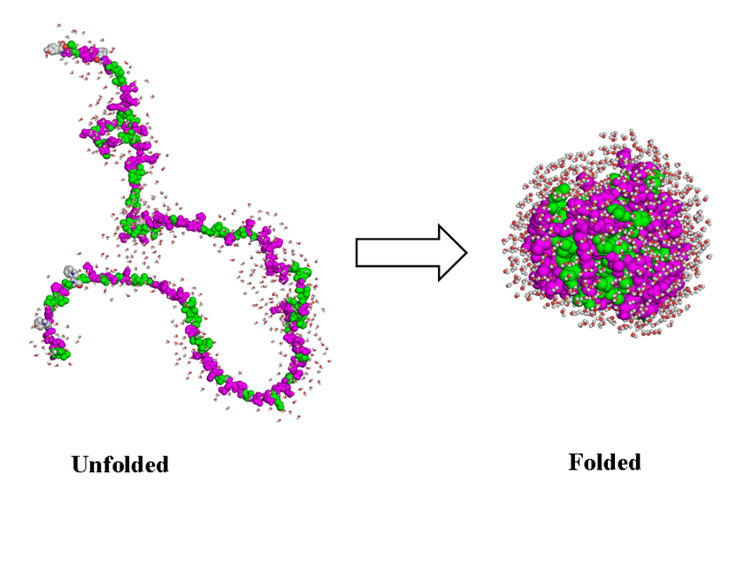


What is programming used for?

Slide 5
Algorithms
What is an algorithm?

Slide 6
Exercise 1
How do you dress up in the morning?

Slide 7
It’s time for programming!

Slide 8
Programming environment

Slide 9
HelloWorld.py

Slide 10
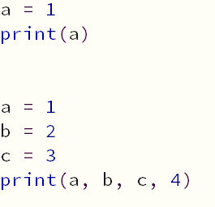
Output = print()
We have to explicitly ask the computer to do what we want. To print a number to the console we cannot just define it. We have to print it to the console using the function print:

Slide 11
Variables

Slide 12
Variables and numbers on the computer
Variables
  To store data
  Have different data types, more on that shortly...
How?
  Declaration and assignment
a = 5
b = ‘Hei’
c = 3.14
Notes:
Livekoding.

Slide 13
Data types
Whole numbers
  Called «int» or «integer»
Decimal numbers
  Called «float» or «floating point numbers»
Text
  Called «str» or «string»
  Declared using quotation marks
Lists
  Can contain collections of variables
3.14 ≠ ‘3.14’
  Be aware of which data type you are working with!
Notes:
Klargjør forskjell og likheter mellom float og desimaltall.
3*0.1 – 0.3
4*0.1 – 0.4

Slide 14
Arithmetic

Slide 15
Arithmetic
Operators
  +
  -
  *
  /
Order of calculation
Just as in maths
  Parenteser -> potenser -> multiplikasjon / divisjon -> addisjon / subtraksjon

Slide 16
Another operator
Another operator is **, and it is used like this: a**b. Try to find out what this operator does by running the following calculations:
2**3
2**4
5**2
10**4
10**5
Try to write 1E3 and 1E-3 as well. What does E mean?

Slide 17
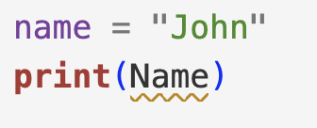
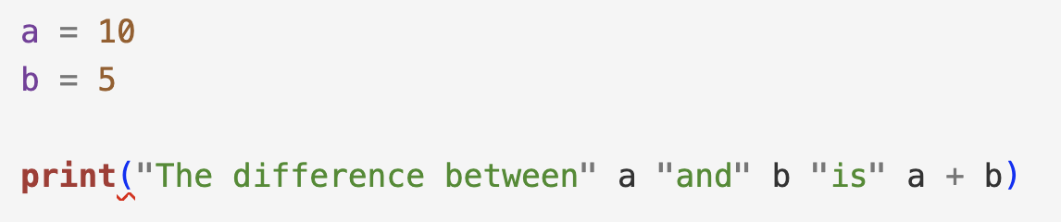
Errors
Why do the following programs not work?
number1 = 1
print(number1 + number2)
number2 = 5
Notes:
Rekkefølge: Lese fra topp til bunn.
Variabelnavn: Stor bokstav er ikke lik liten bokstav.
Komma mellom variabler som skal skrives ut.

Slide 18
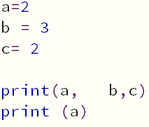
Details, details...?
Spaces?
Notes:
Det handler om estetikk/lesbarhet!

Slide 19
Exercise 1
Task 1
What is the result of:
a = 10
a = a + 5
Explain why and discuss with each other. How is this expression different in programming, from what you know from mathematics?
Task 2
You have two variables a and b, both containing values. Imagine that you are to write a program which moves the contents of a into b, and the content of b into a. How would you proceed to do this? Discuss!

Slide 20
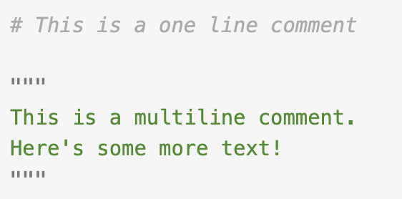
Kommentarer
# = comment
Triple quotation marks are used to make a multiline comment

Slide 21
Input

Slide 22
Communicating with a program
There are multiple ways to «communicate» with a program
We have looked at one of them, now we will look at another
  Directly into the code (writing code)
  As input

Slide 23
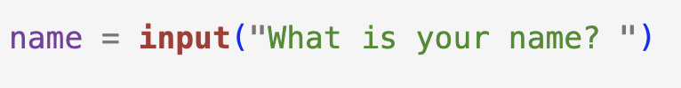
Input
Command: input() which takes a string as argument, e.g. a question for the user.
This allows the user to write an answer into the console, followed by the Enter button. Whatever the user types is stored in the variable, in this case called name.
Notes:
Livekode:
navn = input(«Hva heter du?»)
print(«Hei, navn! Hyggelig å se deg.»)
Livekode før neste lysbilde.
tall1 = input(«skriv inn et tall»)
tall2 = input(«skriv inn et tall til»)
print(«Summen av», tall1, «og», tall2, «er», tall1 + tall2)

Slide 24
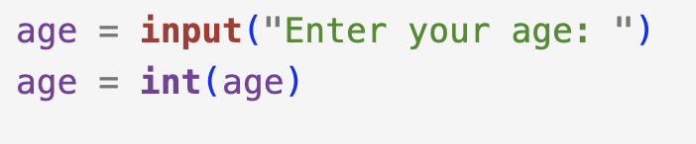
Warning!
Input is automatically stored as a string of text. If you wish to ask for a number you have to convert it to an appropriate datatype:
Notes:
Livekoding: tall1*tall2 når de er tekst. Lære å lese feilmelding.

Slide 25
Exercise 2
Oppgave 1
As part of a new system for journaling, patient data is stored via input. Write a program storing a patient’s name, phone number and diagnosis into variables, and then prints the values accordingly:
        INFO ABOUT PATIENT
        Name: <pat name>
        Number: <pat phone nr.>
        Diagnosis: <pat diagnosis>
Oppgave 2
A patient has undergone a pleurectomy and lung resection. Post op. the patient is given a Marcain blockade going at 6 ml/hr. Write a program which takes the number of hours since the blockade was started, and then calculates the total dosage of Marcain that the patient has been administered.

Slide 26
Exercise 3
Choose a topic from your own practice or research. Formulate a problem and use a program to solve it.

