Slide 1
Data on the computer
DIGHEL4360
Henrik Løvold,
Universitetslektor II
Institutt for Informatikk, UiO

Slide 2
Previous week – recap
if-statements
  For making decisions
  Boolean logic
Loops
  The for-loop
  The while-loop
  Code repetition

Slide 3
Lists

Slide 4

What is a list?
Store many values in one variable
Often used in conjunction with loops
Declared using square brackets
Can contain all sorts of data (but please don’t mix)

Slide 5
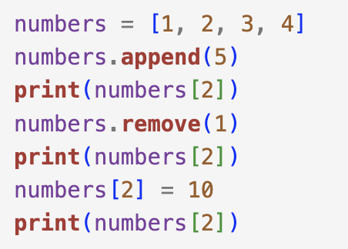
Accessing, editing, adding and deleting
Adding a value
  Append
Accessing a value
  Square brackets with index
  Indexing starts at 0
Editing a value
  Access by square bracket
  Change value just as any other variable
Removing a value
  Remove
  Only removes first occurence of a value
What will the output be...?

Slide 6
Exercise 1
Make a list containing three of your favourite books, movies or series
Print the content of the list
Remove one of them using the remove keyword
Add another book, movie or series
Print the first element
Print the entire list

Slide 7
Lists and loops

Slide 8
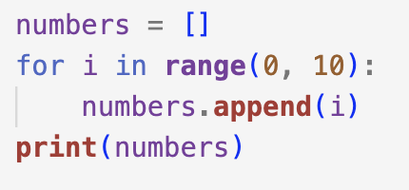
Adding data through loops

Slide 9
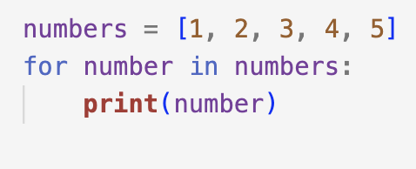
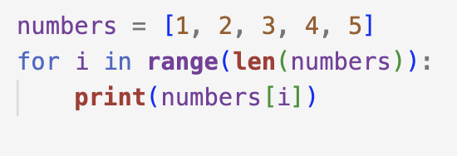
Accessing data through loops

Slide 10
Exercise 2
Make an empty list
Add all even numbers from 0 to 10 to the list using a loop
Print all the values of the list using the for elem in list syntax

Slide 11
Reading data

Slide 12
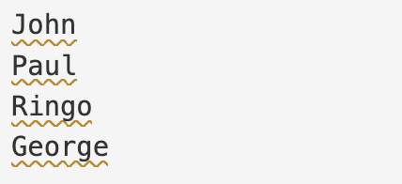
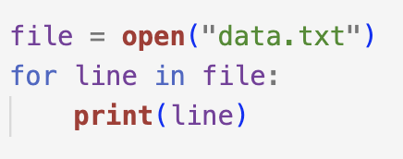
What is data?
Essentially – text files
We can read the text into a program using open(filename)
File has to be located in the same folder as your program
Beware of datatypes! You always read text (string)
  Numbers? Use int() or float()
data.txt
reader.py

Slide 13
Exercise 3
Write a program that reads a file containing numbers. Store all the numbers in a list
Print the content of the list line by line by using a for loop
Calculate the sum of the numbers in the list
Find and print the largest and smallest values in the list
Calculate and print the average of all numbers in the list

