Slide 1
Data Justice in Research Design
Silvia Masiero
silvima@ifi.uio.no
IN5210 – Information Systems
14.10.2025

Slide 2
A preamble…
In this course you have engaged many aspects of information systems research, focusing on theoretical and empirical perspectives
Today’s lecture is more methodological: we are going to learn ways to embed data justice principles in the making of research, in ways that protect the informant, but also the environment and other stakeholders.
We will also deal with crucial perspectives in ensuring a sound research design, responsive to the context and its features!

Slide 3
Overview
What is data justice?
Data justice in Information Systems research
Designing data just research!

Slide 4
What does “data justice” mean to you?

Slide 5
A preamble…
Data justice: «fairness in the way people are made visible, represented and treated as a result of their production of digital data» (Taylor, 2017)
Just as an idea of social justice is needed in a (non-datafied) world to establish the rule of law, an idea of data justice is needed to understand justice in a world that is increasingly datafied.
Made necessary by the sudden availability of digital data on populations that were previously digitally invisible (Taylor, 2017).

Slide 6
For example…
Data fumes are data produced as a by-product of people’s use of technological devices and services, without people being aware of how such data are being collected and used
Taylor, 2017: “granular data sources which allow researchers to infer people’s movements, activities and behaviour have ethical, political and practical implications for the way people are seen and treated by the state and by the private sector (and, importantly, by both acting in combination)”.
Data injustice in people’s visualisation

Slide 7
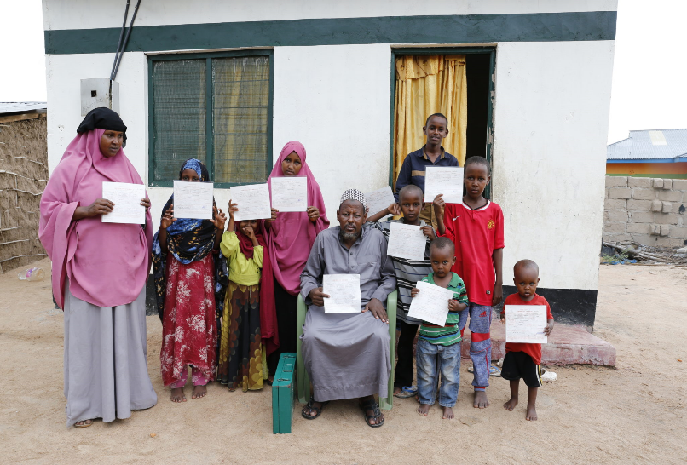
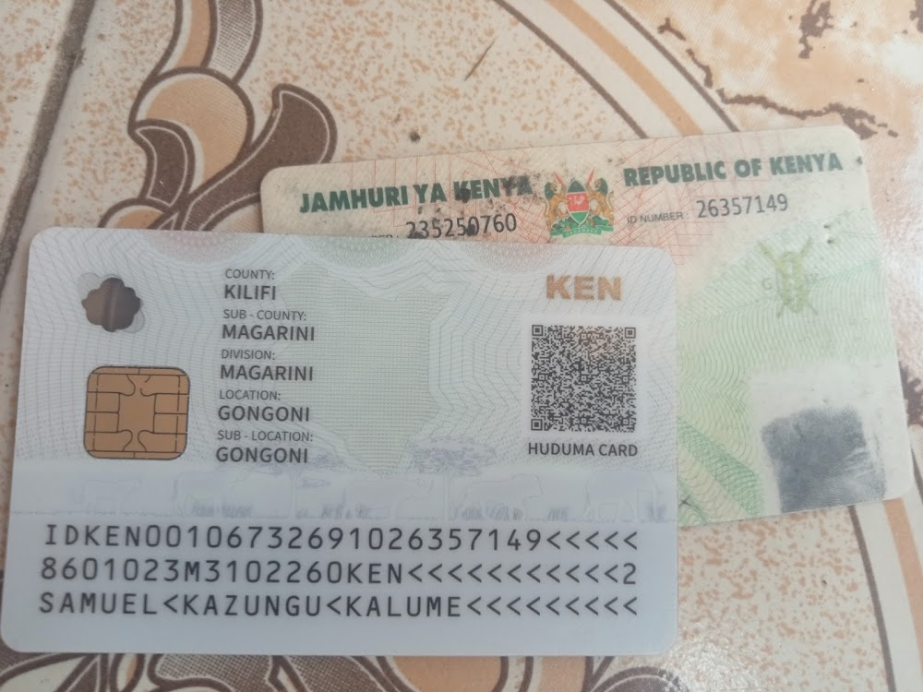
For example…
Weitzberg, 2020: thousands of people in Kenya are affected by “double registration”, a phenomenon for which national Kenyans appear in the biometric register of refugees, originally managed by the UNHCR
Reason: registered as refugees to access food and aid, now denied a Kenyan ID card due to the biometric register making them “visible” to national authorities
The register was made to protect refugees, but it ended up resulting in the denial of citizenship rights, posing over 40,000 people at risk of statelessness.
Data injustice in people’s representation

Slide 8
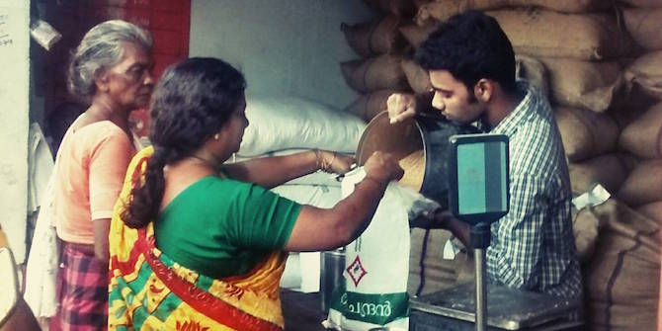
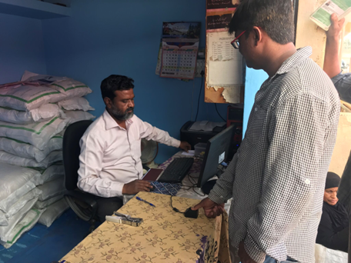
For example…
Masiero, 2020: India’s Public Distribution System is the country’s largest food security scheme, providing subsidised foodgrains to below-poverty-line people
From the 2010s it is being integrated with Aadhaar, India’s biometric population database, through which people can authenticate biometrically and collect food
But: Aadhaar’s introduction has resulted in the exclusion of genuinely entitled people from the system. This is due to fingerprints being misread, or to parts of the PDS fragile technologies not working properly
Data injustice in people’s treatment

Slide 9
Data justice: Different perspectives
Many scholarly understandings of data justice!
Heeks & Renken (2018): four perspectives on data justice
  Instrumental: fair use of data (focus on outcomes)
  Procedural: fair handling of data (focus on process)
  Distributive/rights-based: fair distribution of data
  Structural: data as embedded in the power relations that characterise a given context
A structural approach as the basis for studying data justice in a development context (Heeks & Renken, 2018).

Slide 10
Data justice: Different perspectives
Dencik et al. (2019): the interdisciplinarity of the data justice notion
  How data is generated, collected and used in society has become an issue across disciplines
  Not only information systems, but geography, development, and critical data studies (among others) have acquired a data justice focus.
Data justice as related to datafication:
  The conversion of previously existing processes into data
  Acquires a different meaning when related to populations made more vulnerable by the visualisation, capture and treatment of their data.

Slide 11
Designing data just research!

Slide 12
Data justice in research design
By its definition, doing data justice in research design means ensuring fairness in the way research respondents are visualised, represented and treated through their production of data.
Such data do not have to be digital: we can enact data justice in the context of collecting, analysing or reporting on data, both while on the field and in our narration of what fieldwork has revealed
Data just research design is needed to make sure we do not harm!

Slide 13
Data just design: fair visualisation
Theoretical perspective: “the philosophical stance informing the methodology and providing context for the process and grounding its logic and criteria” (Crotty, 1998)
A theory is first and foremost a way to see the object of research, and by seeing some aspects of it, we unsee other ones.

Slide 14
But...
“Of the 104 theories (the vast majority published in English) listed on the IS Theory Wiki, it is remarkable that when examining the authorship of the original book or article in which a specific theory appeared, 87 involved authors were based in the United States. Non‐US authors hail from the United Kingdom (10), Hong Kong (3), The Netherlands (3), Australia (2), Canada, (2), France (2), and Germany (2) and 1 from each of the following: Austria, Belgium, Cyprus, Finland, Japan, New Zealand, and Norway. Not a single theory has an author from Africa, South or Central America, Asia (except the relatively developed economies of Japan and Hong Kong), or the Pacific Islands, ie, the less economically developed countries of the world, sometimes referred to as the Global South.” (Davison and Díaz-Andrade 2018: 759-760)

Slide 15
So...
We claim to do justice to the perspective of respondents, but we take theoretical approaches that do no, or do not always, reflect their ways of seeing the world!
Scarcity of theories from outside Western countries in the IS field, with the resulting risk of silencing perspectives from less wealthy countries.
Indigenous theory: “a theory of human behaviour or mind that is specific to a context or culture, not imported from other contexts/cultures and purposely designed for the people who live in that context or culture”.
Indigenous theories, such as Buen Vivir (Jimenez & Roberts, 2019) or the pan-African concept of Ubuntu (Tsibolane, 2016) may play a similar role, introducing Indigenous concepts in IS theory.

Slide 16
Data just design: fair representation
Being mindful of epistemic violence: a form of violence exerted on knowledge and through it, by imposing outsider knowledge systems on the studied subjects
For example: silencing respondents’ narratives, by imposing our worldview on the persons, context and situations that we encounter on the field.
The very notion of “global South” can be seen as committing unfair representation: instead of many different realities, we conceive of one big “South” whose traits, people, and appraisal of digital systems are different.
Milan & Trere’ (2019): not one “global South”, but a plethora of “Souths”, each with its context and realities of injustice and resistance

Slide 17
Data just design: fair treatment
How to treat people fairly, avoiding epistemic violence?
Abdelnour & Abu Mohgli (2021): practicing political reflexivity as a route to reparation of epistemic violence on marginalised participants
Political reflexivity: awareness of the researchers’ positionality in relation to the systems of power and decision-making present in a certain context, and how these affect the way the researcher is perceived
Thinking of our work as placed on a “decoloniality continuum”: one extreme is complicity with the maintenance of epistemic violence, and the other are active efforts to voice systematically silenced narratives (through the use of Indigenous theoretical approaches, or other ways to place the informant at the centre of the research narrative).

Slide 18
To recap...
We have encountered data justice as «fairness in the way people are made visible, represented and treated as a result of their production of digital data» (Taylor, 2017)
Considerations of data justice are crucial in designing, conducting and reporting on Information Systems research, a field affected by systemic bias towards Western theoretical approaches
Practicing data justice in research – through political reflexivity, Indigenous theoretical approaches, and problematisation of hegemonic concepts like “global South” – is central in and beyond Information Systems studies.

Slide 19
Thank you!
silvima@ifi.uio.no

Slide 20
References
Core Readings
Taylor, L. (2017). What is data justice? The case for connecting digital rights and freedoms globally. Big Data & Society, 4(2), 1-14.
Supplementary Readings
Costanza-Chock, S. (2020). Design justice: Community-led practices to build the worlds we need. New York: The MIT Press, Chapter 1.
Dencik, L., Hintz, A., Redden, J., & Treré, E. (2019). Exploring data justice: Conceptions, applications and directions. Information, Communication & Society, 22(7), 873-881.
Heeks, R., & Renken, J. (2018). Data justice for development: What would it mean?. Information Development, 34(1), 90-102.

Slide 21
References
Optional readings
Abdelnour, S., & Abu Moghli, M. (2021). Researching violent contexts: A call for political reflexivity. Organization, 1-24.
Davison, R. M., & Díaz Andrade, A. (2018). Promoting indigenous theory. Information Systems Journal, 28(5), 759-764.
Jimenez, A., & Roberts, T. (2019). Decolonising neo-liberal innovation: Using the Andean philosophy of ‘Buen Vivir’ to reimagine innovation hubs. In International Conference on Social Implications of Computers in Developing Countries (pp. 180–191). Springer.
Milan, S., & Treré, E. (2019). Big data from the South(s): Beyond data universalism. Television & New Media, 20(4), 319–335.
Tsibolane, P. (2016). Towards a conceptual framework for social wellbeing through inclusive frugal ICT innovation in postcolonial collectivist contexts. GlobDev Workshop, ICIS 2016.

