Slide 1
Lecture 4 – Message authentication, UF-CMA,
CBC-MAC, CMAC
TEK4500
15.09.2020
Håkon Jacobsen
hakon.jacobsen@its.uio.no

Slide 2

What is cryptography?
Internet
Alice
Bob
M
Adversary
Security goals:
Data privacy: adversary should not be able to read message M

Slide 3
What is cryptography?
Internet
Alice
Bob
M
M'
Adversary
Security goals:
Data privacy: adversary should not be able to read message M
Data integrity: adversary should not be able to modify message M
Data authenticity: message M really originated from Alice

Slide 4
Basic goals of cryptography
 | Message privacy | Message integrity / authentication
Symmetric keys | Symmetric encryption | Message authentication codes (MAC)
Asymmetric keys | Asymmetric encryption (a.k.a. public-key encryption) | Digital signatures

Slide 5
Motivation
Goal: integrity, but not privacy
Examples:
  Protecting OS system files against tampering
  Browser cookies stored by web servers
  Control signals in network management

Slide 6



Encryption ≠ integrity
"Send Bob $10"

Slide 7


Encryption ≠ integrity
1000100 1110 100101100110
$$CTR.Enc(K, ⋅)$$
$$CTR.Dec(K, ⋅)$$
"Send"
"Bob"
"$10"
1001010 1010 000000001010
0001110 0100 100101101100

Slide 8
Encryption ≠ integrity
1000100 1110 100101100110
$$CTR.Enc(K, ⋅)$$
$$CTR.Dec(K, ⋅)$$
"Send"
"Bob"
"$10"
1001010 1010 000000001010
0001110 0100 100101101100
0001110 0100 011001101100
1001010 1010 111100001010
"Send"
"Bob"
"$3850"

Slide 9







Message authentication – idea
Sender
Receiver
VALID
$$M$$
$$T$$
$M$
$M$
$⊥$
INVALID
Generate tag $T$
Verify message-tag pair $\left(M,T\right)$

Slide 10
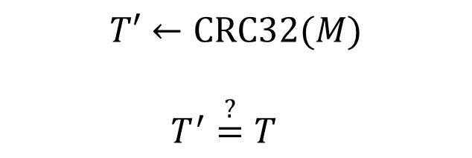


Authentication from error-checking codes
Sender
Receiver
$$M$$
$$T$$
$M$
$M$
$$T←CRC32(M)$$
$$T′←CRC32(M)$$
$$T^{′}\overset{?}{=}T$$

Slide 11

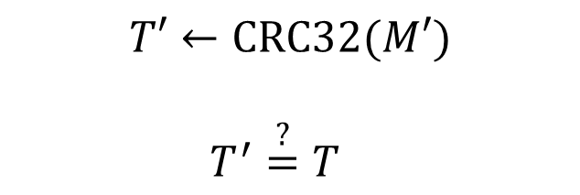





Keyless message integrity doesn't work
Sender
Receiver
$$M$$
$$T$$
$M$
$M′$
$$M′$$
$$T′$$
$$T←CRC32(M)$$
$$T′←CRC32(M′)$$
$$T^{′}\overset{?}{=}T$$
$$T′←CRC32(M′)$$

Slide 12

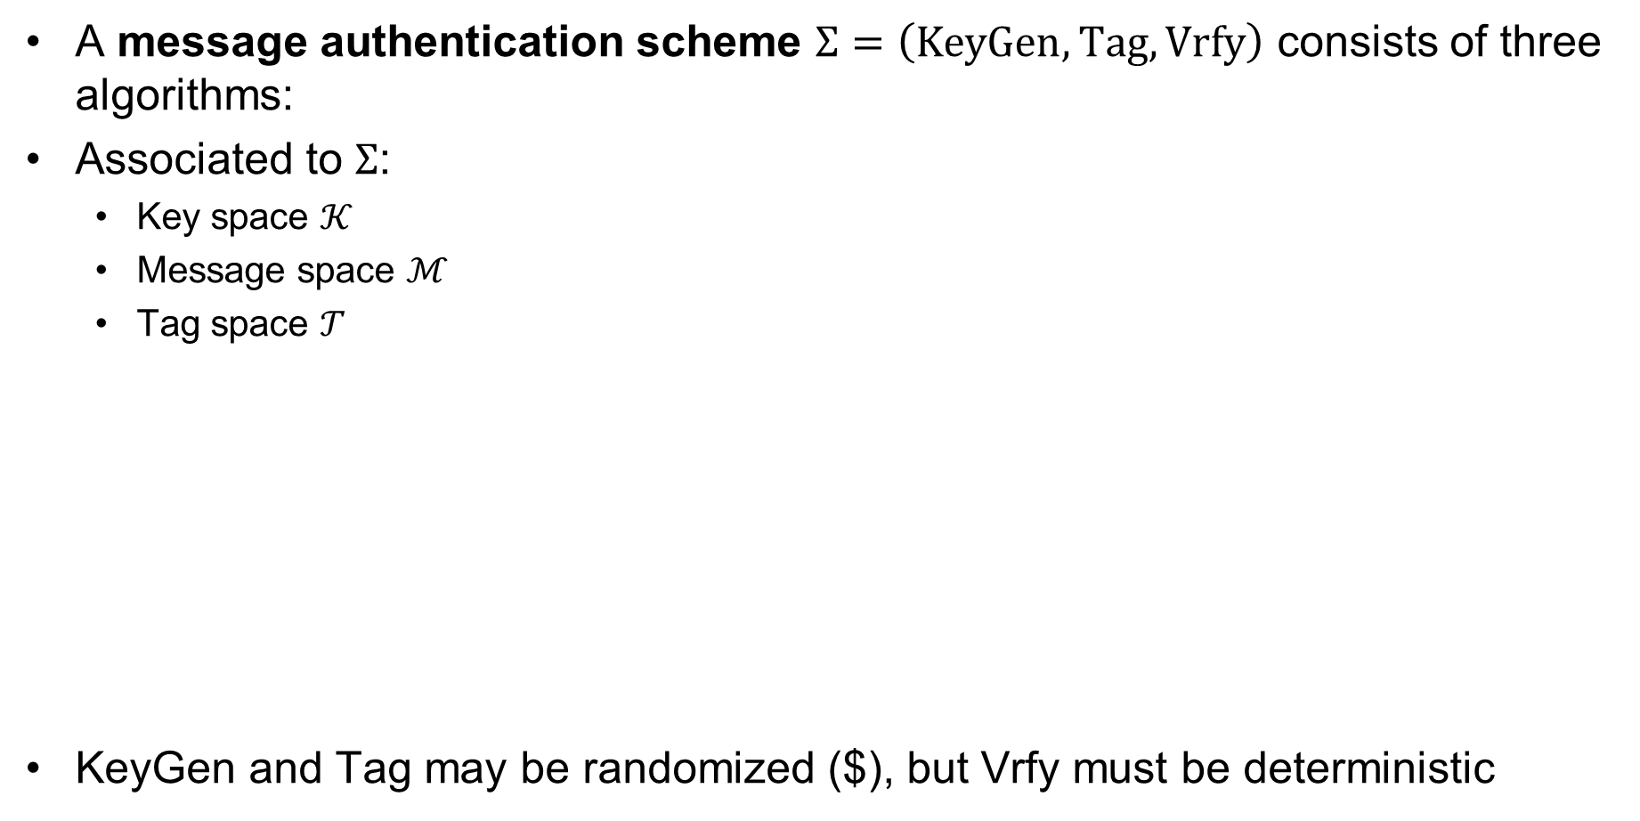

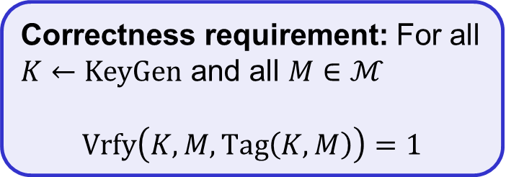






Message authentication schemes – syntax
A message authentication scheme $Σ=\left(KeyGen, Tag, Vrfy\right)$ consists of three algorithms:
Associated to $Σ$:
  Key space $𝒦$
  Message space $ℳ$
  Tag space $𝒯$
KeyGen and Tag may be randomized ($), but Vrfy must be deterministic
Correctness requirement: For all $K←KeyGen$ and all $M∈ℳ$
$$Vrfy\left(K, M, Tag\left(K, M\right)\right)=1$$
$$KeyGen$$
$$\$$$
$K$
$$M, T$$
1 / 0 (VALID/INVALID)
$$Tag$$
$$\$$$
$$Vrfy$$
$$M$$
Notes:
Delivery of K outside the "responsibility" of authentication scheme

Slide 13
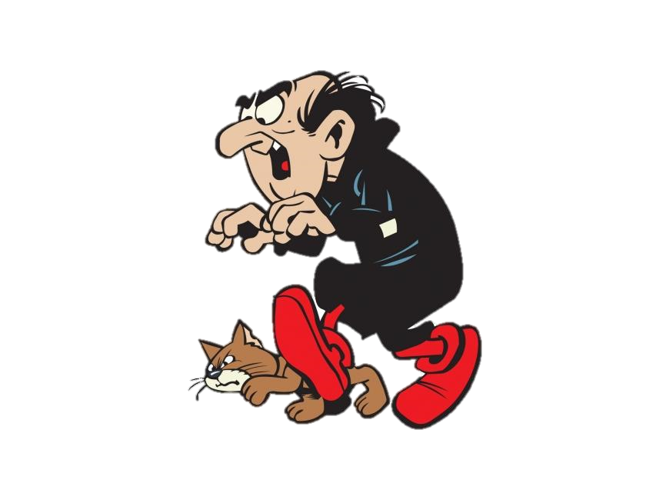
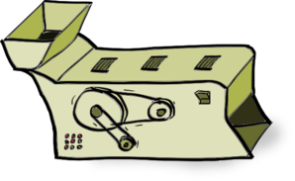
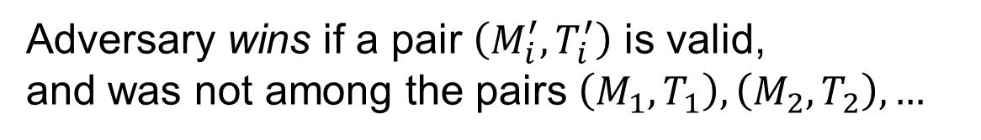






UF-CMA – Unforgability against chosen-message attacks
Challenger
$M_{1},$ $M_{2}, …$
$$Tag(K, ⋅)$$
$T_{1},$ $T_{2}, …$
$\left(M_{1}^{′},T_{1}^{′}\right),$ $\left(M_{2}^{′},T_{2}^{′}\right), …$
$$VF(K, ⋅,⋅)$$
$1/0,$ $1/0, …$
Adversary wins if a pair $\left(M_{i}^{′},T_{i}^{′}\right)$ is valid,
and was not among the pairs $\left(M_{1},T_{1}\right), \left(M_{2},T_{2}\right), …$

Slide 14
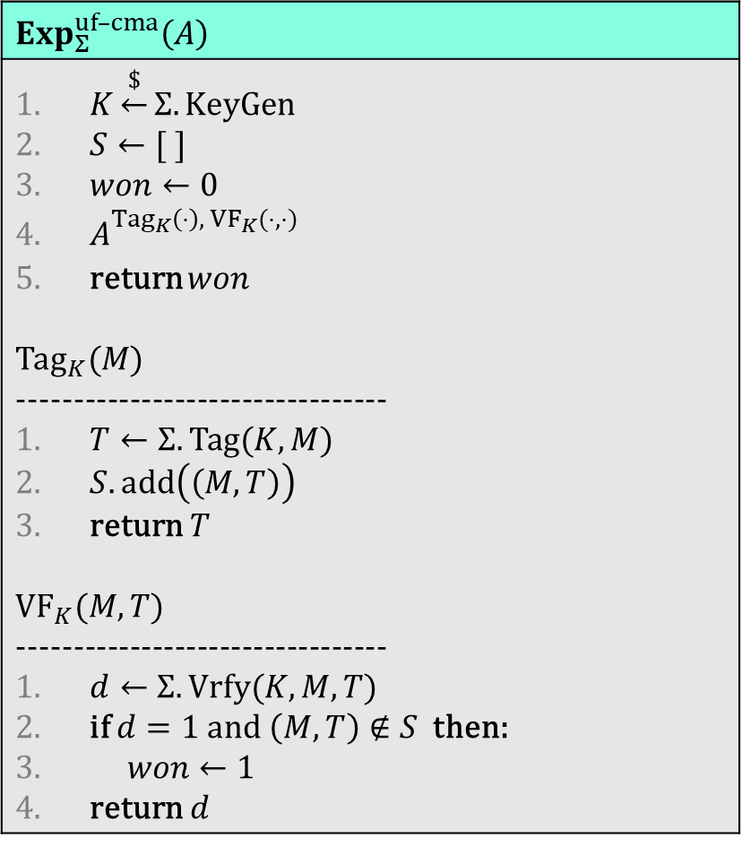
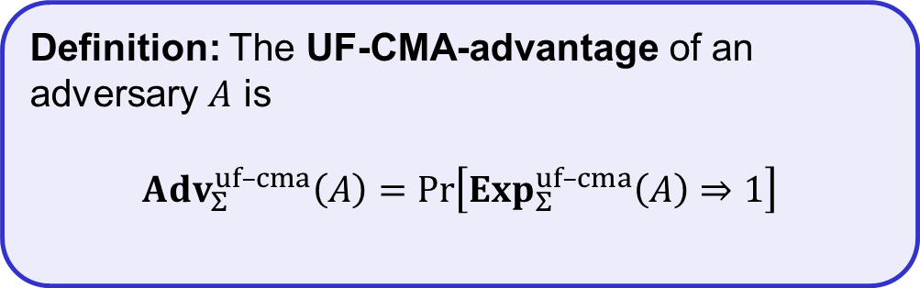
UF-CMA – Unforgability against chosen-message attacks
$$Exp_{Σ}^{uf–cma}\left(A\right)$$
$K\underset{←}{\$}Σ.KeyGen$ $S←[ ]$ $won←0$ $A_{}^{{Tag}_{K}\left(⋅\right), {VF}_{K}(⋅,⋅)}$ return $won$ $${Tag}_{K}(M)$$ --------------------------------- $T←Σ.Tag(K, M)$ $S.add\left(\left(M,T\right)\right)$ return $T$ $${VF}_{K}(M,T)$$ --------------------------------- $d←Σ.Vrfy(K, M, T)$ if $d=1$ and $\left(M,T\right)∉S$ then: $won←1$ return $d$
Challenger
$M_{1},$ $M_{2}, …$
$$Tag(K, ⋅)$$
$T_{1},$ $T_{2}, …$
$\left(M_{1}^{′},T_{1}^{′}\right),$ $\left(M_{2}^{′},T_{2}^{′}\right), …$
$$VF(K, ⋅,⋅)$$
$1/0,$ $1/0, …$
Definition: The UF-CMA-advantage of an adversary $A$ is
$${Adv}_{Σ}^{uf–cma}\left(A\right)=\operatorname{Pr}\left[Exp_{Σ}^{uf–cma}\left(A\right)⇒1\right]$$

Slide 15
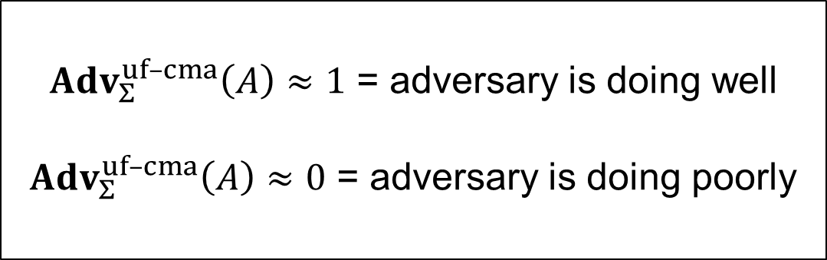

UF-CMA – Unforgability against chosen-message attacks
$$Exp_{Σ}^{uf–cma}\left(A\right)$$
$K\underset{←}{\$}Σ.KeyGen$ $S←[ ]$ $won←0$ $A_{K}^{{Tag}_{K}\left(⋅\right), {VF}_{K}(⋅,⋅)}$ return $won$ $${Tag}_{K}(M)$$ --------------------------------- $T←Σ.Tag(K, M)$ $S.add\left(\left(M,T\right)\right)$ return $T$ $${VF}_{K}(M,T)$$ --------------------------------- $d←Σ.Vrfy(K, M, T)$ if $d=1$ and $\left(M,T\right)∉S$ then: $won←1$ return $d$
Challenger
$M_{1},$ $M_{2}, …$
$$Tag(K, ⋅)$$
${Adv}_{Σ}^{uf–cma}\left(A\right)≈1$ = adversary is doing well
${Adv}_{Σ}^{uf–cma}\left(A\right)≈0$ = adversary is doing poorly
$T_{1},$ $T_{2}, …$
$\left(M_{1}^{′},T_{1}^{′}\right),$ $\left(M_{2}^{′},T_{2}^{′}\right), …$
$$VF(K, ⋅,⋅)$$
$1/0,$ $1/0, …$
Definition: The UF-CMA-advantage of an adversary $A$ is
$${Adv}_{Σ}^{uf–cma}\left(A\right)=\operatorname{Pr}\left[Exp_{Σ}^{uf–cma}\left(A\right)⇒1\right]$$

Slide 16
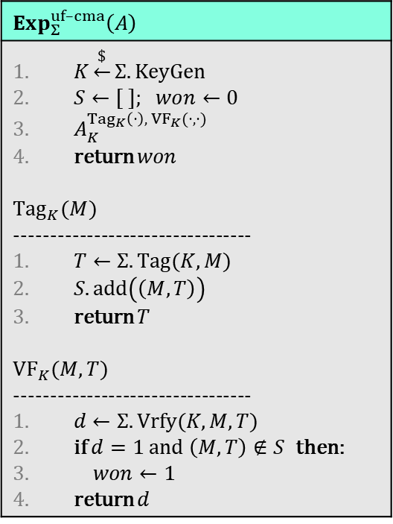
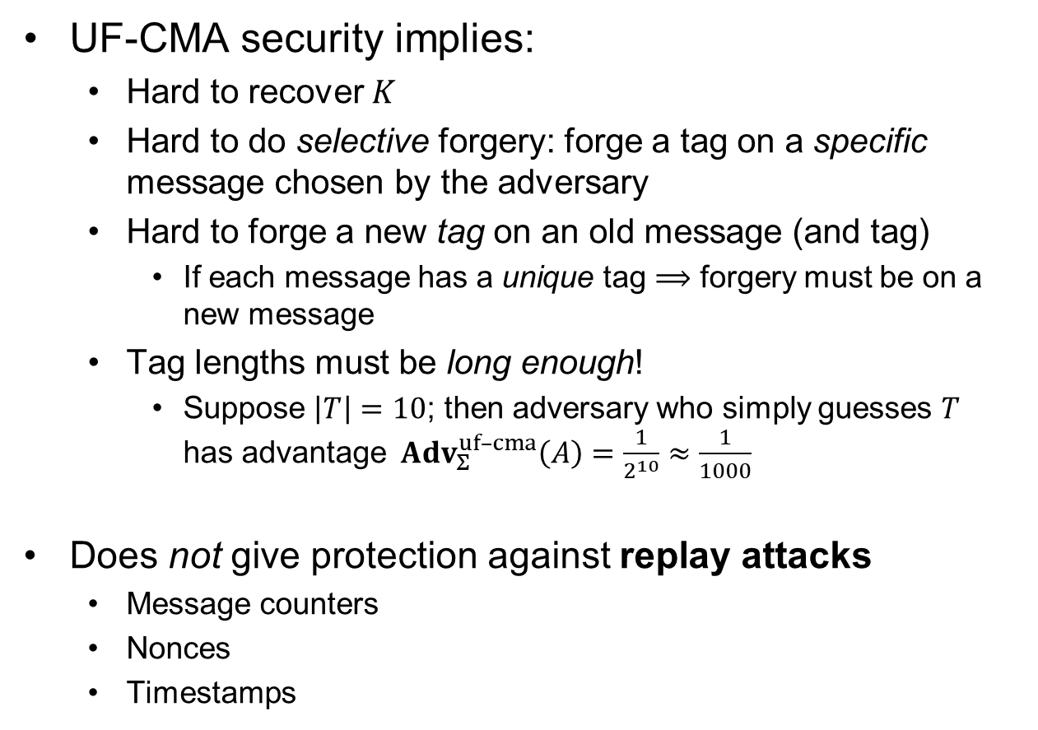

Properties of UF-CMA definition
UF-CMA security implies:
  Hard to recover $K$
  Hard to do selective forgery: forge a tag on a specific message chosen by the adversary
  Hard to forge a new tag on an old message (and tag)
    If each message has a unique tag $⟹$ forgery must be on a new message
  Tag lengths must be long enough!
    Suppose $\left|T\right|=10$; then adversary who simply guesses $T$
    has advantage ${Adv}_{Σ}^{uf–cma}\left(A\right)=\frac{1}{2^{10}}≈\frac{1}{1000}$
Does not give protection against replay attacks
  Message counters
  Nonces
  Timestamps
$$Exp_{Σ}^{uf–cma}\left(A\right)$$
$K\underset{←}{\$}Σ.KeyGen$ $S←[ ]$; $won←0$ $A_{K}^{{Tag}_{K}\left(⋅\right), {VF}_{K}(⋅,⋅)}$ return $won$ $${Tag}_{K}(M)$$ --------------------------------- $T←Σ.Tag(K, M)$ $S.add\left(\left(M,T\right)\right)$ return $T$ $${VF}_{K}(M,T)$$ --------------------------------- $d←Σ.Vrfy(K, M, T)$ if $d=1$ and $\left(M,T\right)∉S$ then: $won←1$ return $d$
$${Adv}_{Σ}^{uf–cma}\left(A\right)=\operatorname{Pr}\left[Exp_{Σ}^{uf–cma}\left(A\right)⇒1\right]$$

Slide 17
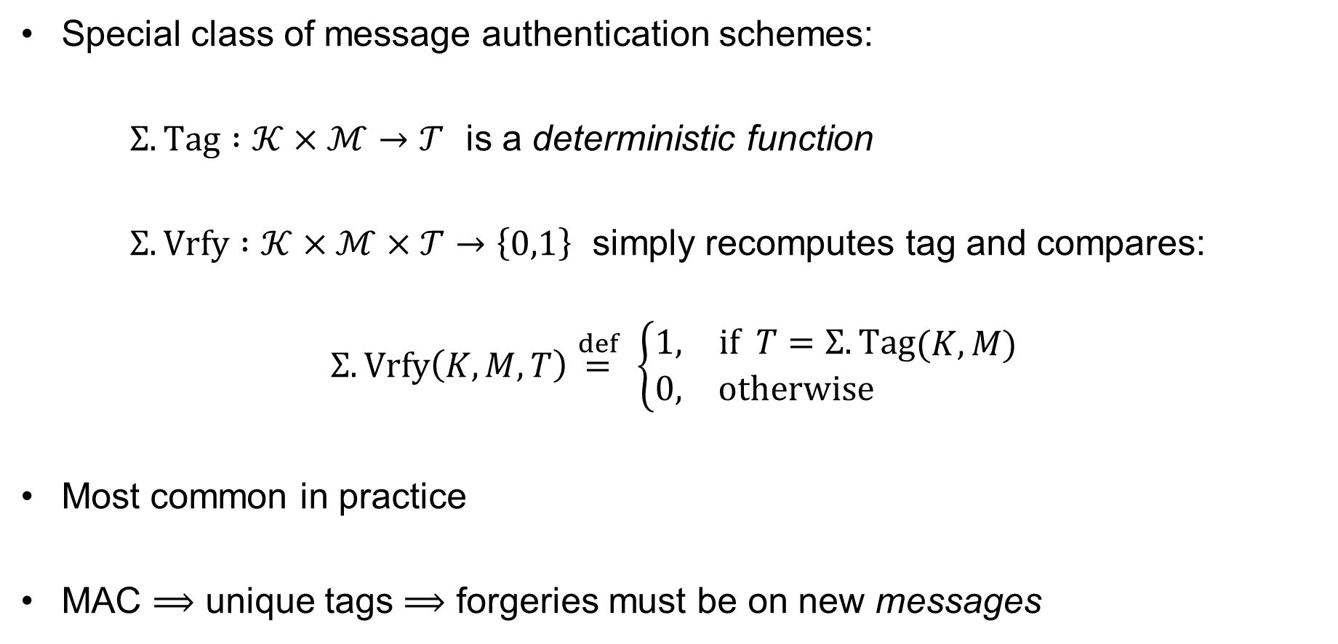
Message authentication codes (MACs)
Special class of message authentication schemes:
$Σ.Tag :𝒦×ℳ→𝒯$ is a deterministic function
$Σ.Vrfy :𝒦×ℳ×𝒯→\left\{0,1\right\}$ simply recomputes tag and compares:
$$Σ.Vrfy\left(K, M, T\right)\overset{def}{=} \left\{\begin{aligned}\begin{matrix}1, & if T=Σ.Tag\end{matrix}(K, M) \\ \begin{matrix}0, & otherwise \end{matrix} \end{aligned}\right.$$
Most common in practice
MAC $⟹$ unique tags $⟹$ forgeries must be on new messages
Notes:
Verification algorithm uniquely determined by Tag algorithm

Slide 18
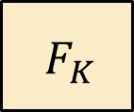
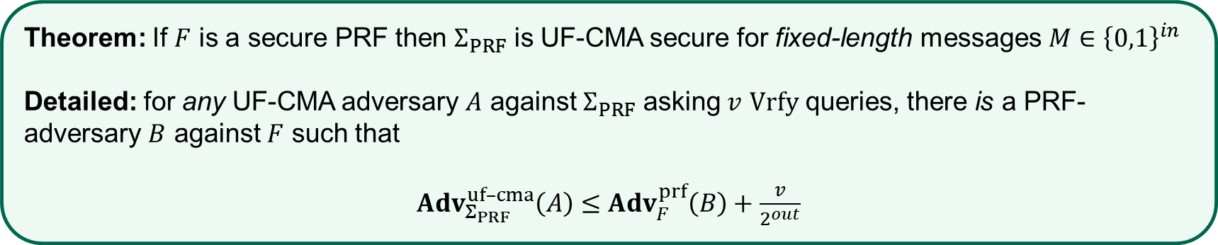

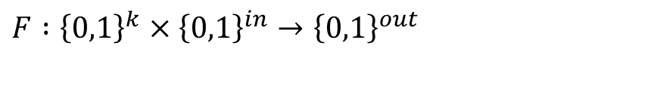
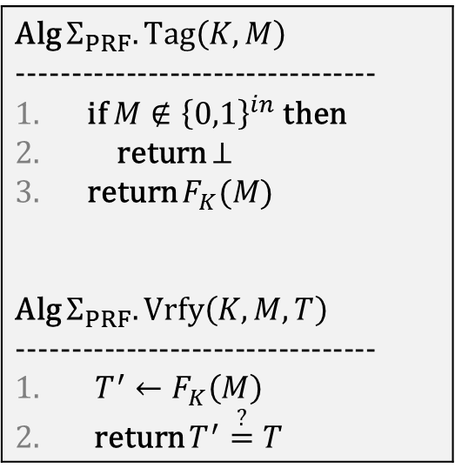

PRFs are good MACs
$$F :{\left\{0,1\right\}}^{k}×{\left\{0,1\right\}}^{in}→{\left\{0,1\right\}}^{out}$$
Alg $Σ_{PRF}.Tag\left(K,M\right)$ --------------------------------- if $M∉{\left\{0,1\right\}}^{in}$ then return $⊥$ return $F_{K}(M)$ Alg $Σ_{PRF}.Vrfy\left(K, M,T\right)$ --------------------------------- $T^{′}←F_{K}\left(M\right)$ return $T^{′}\overset{?}{=}T$
$$M$$
PRF
$${ F}_{K}$$
$$T$$
Theorem: If $F$ is a secure PRF then $Σ_{PRF}$ is UF-CMA secure for fixed-length messages $M∈{\left\{0,1\right\}}^{in}$
Detailed: for any UF-CMA adversary $A$ against $Σ_{PRF}$ asking $v$ $Vrfy$ queries, there is a PRF-adversary $B$ against $F$ such that
$Adv_{Σ_{PRF}}^{uf–cma}\left(A\right)≤$ $Adv_{F}^{prf}\left(B\right)+\frac{v}{2^{out}}$

Slide 19


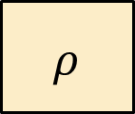
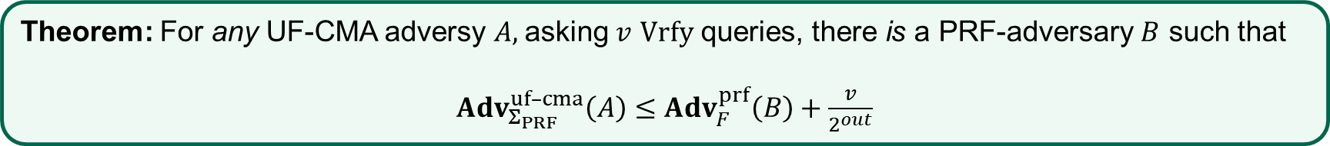



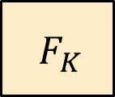

PRFs are good MACs – proof sketch
Theorem: For any UF-CMA adversy $A,$asking $v$ $Vrfy$ queries, there is a PRF-adversary $B$ such that
$Adv_{Σ_{PRF}}^{uf–cma}\left(A\right)≤Adv_{F}^{prf}\left(B\right)+\frac{v}{2^{out}}$
$$M$$
$$M$$
$${ F}_{K}$$
$$≈$$
$$ρ$$
PRF-security
$$T$$
$$T$$
$$ρ\underset{←}{\$}Func\left[in, out\right]$$

Slide 20
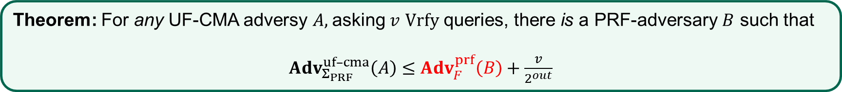
PRFs are good MACs – proof sketch
Theorem: For any UF-CMA adversy $A,$asking $v$ $Vrfy$ queries, there is a PRF-adversary $B$ such that
$Adv_{Σ_{PRF}}^{uf–cma}\left(A\right)≤Adv_{F}^{prf}\left(B\right)+\frac{v}{2^{out}}$
$$M$$
$$M$$
$${ F}_{K}$$
$$≈$$
$$ρ$$
PRF-security
$$T$$
$$T$$
$$ρ\underset{←}{\$}Func\left[in, out\right]$$

Slide 21


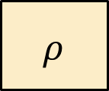

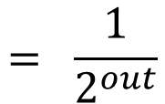
PRFs are good MACs – proof sketch
Theorem: For any UF-CMA adversy $A,$asking $v$ $Vrfy$ queries, there is a PRF-adversary $B$ such that
$Adv_{Σ_{PRF}}^{uf–cma}\left(A\right)≤Adv_{F}^{prf}\left(B\right)+\frac{v}{2^{out}}$
$$M$$
$$M$$
$$M′$$
$$= \frac{1}{2^{out}}$$
$${ F}_{K}$$
$$≈$$
$$ρ$$
$$ρ$$
$$\operatorname{Pr}\left[ρ\left(M^{′}\right)=T^{′}\right]$$
PRF-security
$$T$$
$$T$$
$$T′$$

Slide 22


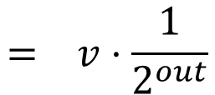

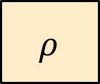
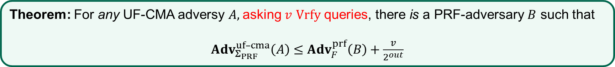






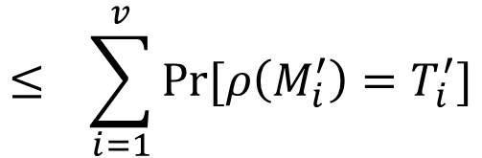
PRFs are good MACs – proof sketch
Theorem: For any UF-CMA adversy $A,$asking $v$ $Vrfy$ queries, there is a PRF-adversary $B$ such that
$Adv_{Σ_{PRF}}^{uf–cma}\left(A\right)≤Adv_{F}^{prf}\left(B\right)+\frac{v}{2^{out}}$
$$M$$
$$M$$
$$M_{1}^{′}$$
$$M′$$
$$M_{v}^{′}$$
$$M_{2}^{′}$$
$$= \frac{1}{2^{out}}$$
$$⋯$$
$${ F}_{K}$$
$$≈$$
$$ρ$$
$$ρ$$
$$ρ$$
$$ρ$$
$$\operatorname{Pr}\left[ρ\left(M^{′}\right)=T^{′}\right]$$
$$ρ$$
PRF-security
$$T$$
$$T$$
$$T_{1}^{′}$$
$$T′$$
$${ T}_{2}^{′}$$
$${ T}_{v}^{′}$$
$$≤ \sum_{i=1}^{v}{\operatorname{Pr}{[ρ\left(M_{i}^{′}\right)=T_{i}^{′}]}}$$
$$= v⋅\frac{1}{2^{out}}$$
$$\operatorname{Pr}\left[ρ\left(M_{1}^{′}\right)=T_{1}^{′} ∨ ⋯∨ ρ\left(M_{v}^{′}\right)=T_{v}^{′}\right]$$

Slide 23
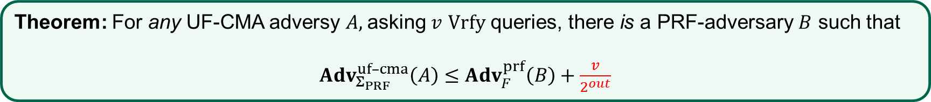
PRFs are good MACs – proof sketch
Theorem: For any UF-CMA adversy $A,$asking $v$ $Vrfy$ queries, there is a PRF-adversary $B$ such that
$Adv_{Σ_{PRF}}^{uf–cma}\left(A\right)≤Adv_{F}^{prf}\left(B\right)+\frac{v}{2^{out}}$
$$M$$
$$M$$
$$M_{1}^{′}$$
$$M_{2}^{′}$$
$$M_{v}^{′}$$
$${ F}_{K}$$
$$≈$$
$$ρ$$
$$ρ$$
$$ρ$$
$$⋯$$
$$ρ$$
PRF-security
$$T$$
$$T$$
$$T_{1}^{′}$$
$${ T}_{2}^{′}$$
$${ T}_{v}^{′}$$
$$≤ \sum_{i=1}^{v}{\operatorname{Pr}{[ρ\left(M_{i}^{′}\right)=T_{i}^{′}]}}$$
$$= v⋅\frac{1}{2^{out}}$$
$$\operatorname{Pr}\left[ρ\left(M_{1}^{′}\right)=T_{1}^{′} ∨ ⋯∨ ρ\left(M_{v}^{′}\right)=T_{v}^{′}\right]$$

Slide 24


MACs for long messages

Slide 25
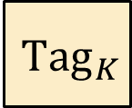













Attempt 1
$$M$$
$${ M}_{1}$$
$${ M}_{2}$$
$${ M}_{3}$$
$${ M}_{4}$$
$${ Tag}_{K}$$
$${ Tag}_{K}$$
$${ Tag}_{K}$$
$${ Tag}_{K}$$
$${ T}_{1}$$
$$T_{2}$$
$${ T}_{3}$$
$${ T}_{4}$$
$${T=T}_{1}||T_{2}||T_{3}||T_{4}$$

Slide 26





Attempt 1 – an attack
$${ M}_{1}$$
$${ M}_{3}$$
$${ M}_{2}$$
$${ M}_{4}$$
$${ Tag}_{K}$$
$${ Tag}_{K}$$
$${ Tag}_{K}$$
$${ Tag}_{K}$$
$${ T}_{1}$$
$$T_{3}$$
$${ T}_{2}$$
$${ T}_{4}$$
$${T=T}_{1}||T_{3}||T_{2}||T_{4}$$

Slide 27







Attempt 2
$$M$$
$${ M}_{1}$$
$${ M}_{2}$$
$${ M}_{3}$$
$${ M}_{4}$$
$${ Tag}_{K}$$
$$T$$

Slide 28


Attempt 2 – an attack
$${ M}_{1}$$
$${ M}_{3}$$
$${ M}_{2}$$
$${ M}_{4}$$
$${ Tag}_{K}$$
$$T$$

Slide 29












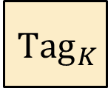

Attempt 3
$$M$$
$${ 1||M}_{1}$$
$${ 2||M}_{2}$$
$${ 3||M}_{3}$$
$${ 4||M}_{4}$$
$${ Tag}_{K}$$
$${ Tag}_{K}$$
$${ Tag}_{K}$$
$${ Tag}_{K}$$
$${ T}_{1}$$
$$T_{2}$$
$${ T}_{3}$$
$${ T}_{4}$$
$${T=T}_{1}||T_{2}||T_{3}||T_{4}$$

Slide 30










Attempt 3 – an attack
$$M=M_{1}||M_{2}||M_{3}||M_{4} \underset{↦}{ {Tag}_{K} }{ T}_{1}||T_{2}||T_{3}||T_{4}$$
$$M′=M_{1}^{′}||M_{2}^{′}||M_{3}^{′}||M_{4}^{′} \underset{↦}{ {Tag}_{K} }{ T}_{1}^{′}||T_{2}^{′}||T_{3}^{′}||T_{4}^{′}$$
$${ 1||M}_{1}$$
$${ 2||M}_{2}^{′}$$
$${ 3||M}_{3}$$
$${ 4||M}_{4}$$
$${ Tag}_{K}$$
$${ Tag}_{K}$$
$${ Tag}_{K}$$
$${ Tag}_{K}$$
$${ T}_{1}$$
$$T_{2}^{′}$$
$${ T}_{3}$$
$${ T}_{4}$$
$${T=T}_{1}||T_{2}^{′}||T_{3}||T_{4}$$

Slide 31
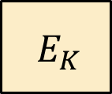
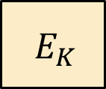







CBC-MAC
$$M$$
$${ M}_{1}$$
$${ M}_{2}$$
$${ M}_{3}$$
$${ M}_{4}$$
$${ E}_{K}$$
$${ E}_{K}$$
$${ E}_{K}$$
$${ E}_{K}$$
$$T$$

Slide 32
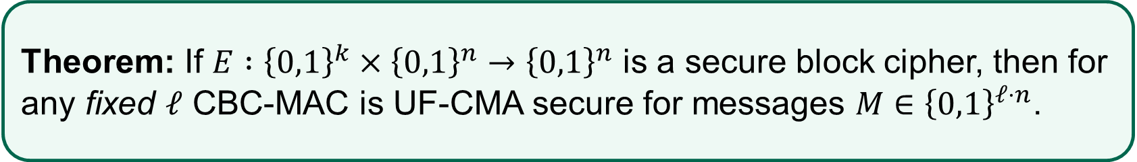
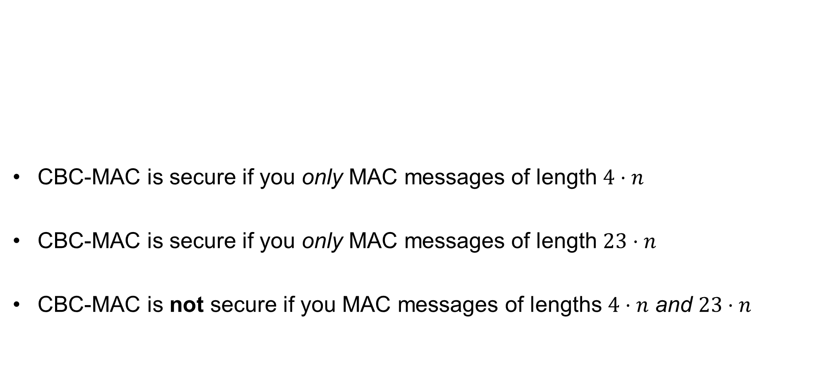
CBC-MAC – security
CBC-MAC is secure if you only MAC messages of length $4⋅n$
CBC-MAC is secure if you only MAC messages of length $23⋅n$
CBC-MAC is not secure if you MAC messages of lengths $4⋅n$ and $23⋅n$
Theorem: If $E :{\left\{0,1\right\}}^{k}×{\left\{0,1\right\}}^{n}→{\left\{0,1\right\}}^{n}$ is a secure block cipher, then for any fixed $ℓ$ CBC-MAC is UF-CMA secure for messages $M∈{\left\{0,1\right\}}^{ℓ⋅n}$.

Slide 33
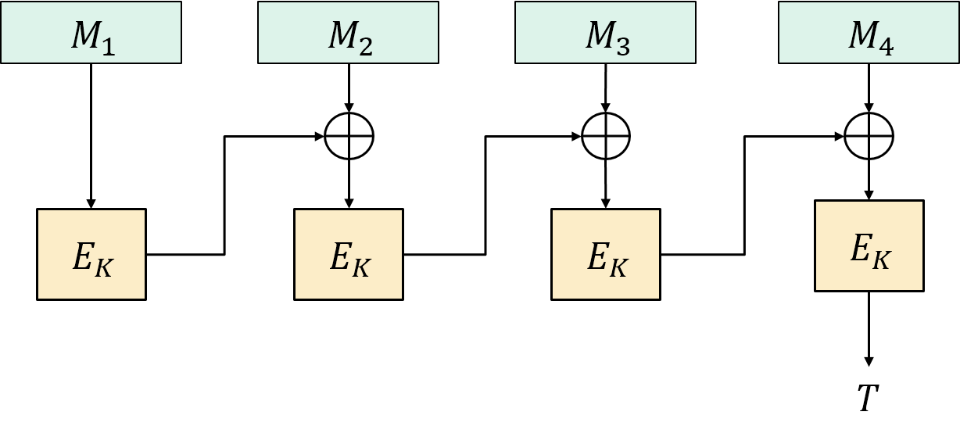






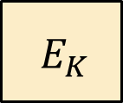





CBC-MAC – pitfalls; variable-length messages
$$M$$
$$M$$
$$M⊕T$$
$${ E}_{K}$$
$${ E}_{K}$$
$${ E}_{K}$$
$$T$$
$$T$$
$$CBC.Tag\left(K, M||M⊕T\right)=E_{K}\left(E_{K}\left(M\right)⊕\left(M⊕T\right)\right)$$
$${=E}_{K}\left(T⊕\left(M⊕T\right)\right)$$
$$Adv_{CBC–MAC}^{uf–cma}\left(A\right)=1$$
$${=E}_{K}\left(M\right)$$
$$=T$$

Slide 34




















CBC-MAC vs. CBC$-encryption
CBC-MAC
CBC$-encryption
$${ M}_{1}$$
$${ M}_{2}$$
$${ M}_{3}$$
$${ M}_{4}$$
$$IV$$
$${ M}_{1}$$
$${ M}_{2}$$
$${ M}_{3}$$
$${ E}_{K}$$
$${ E}_{K}$$
$${ E}_{K}$$
$${ E}_{K}$$
$${ E}_{K}$$
$${ E}_{K}$$
$${ E}_{K}$$
$$T$$
$${ C}_{0}$$
$${ C}_{1}$$
$${ C}_{2}$$
$${ C}_{3}$$

Slide 35














CBC$-MAC – pitfalls; randomized IV
$$IV$$
$${ M}_{1}$$
$${ M}_{2}$$
$${ M}_{3}$$
$$0^{n}$$
$$M_{1}⊕IV$$
$${ M}_{2}$$
$${ M}_{3}$$
$${ E}_{K}$$
$${ E}_{K}$$
$${ E}_{K}$$
$${ E}_{K}$$
$${ E}_{K}$$
$${ E}_{K}$$
$$IV$$
$$T$$
$$0^{n}$$
$$T$$

Slide 36




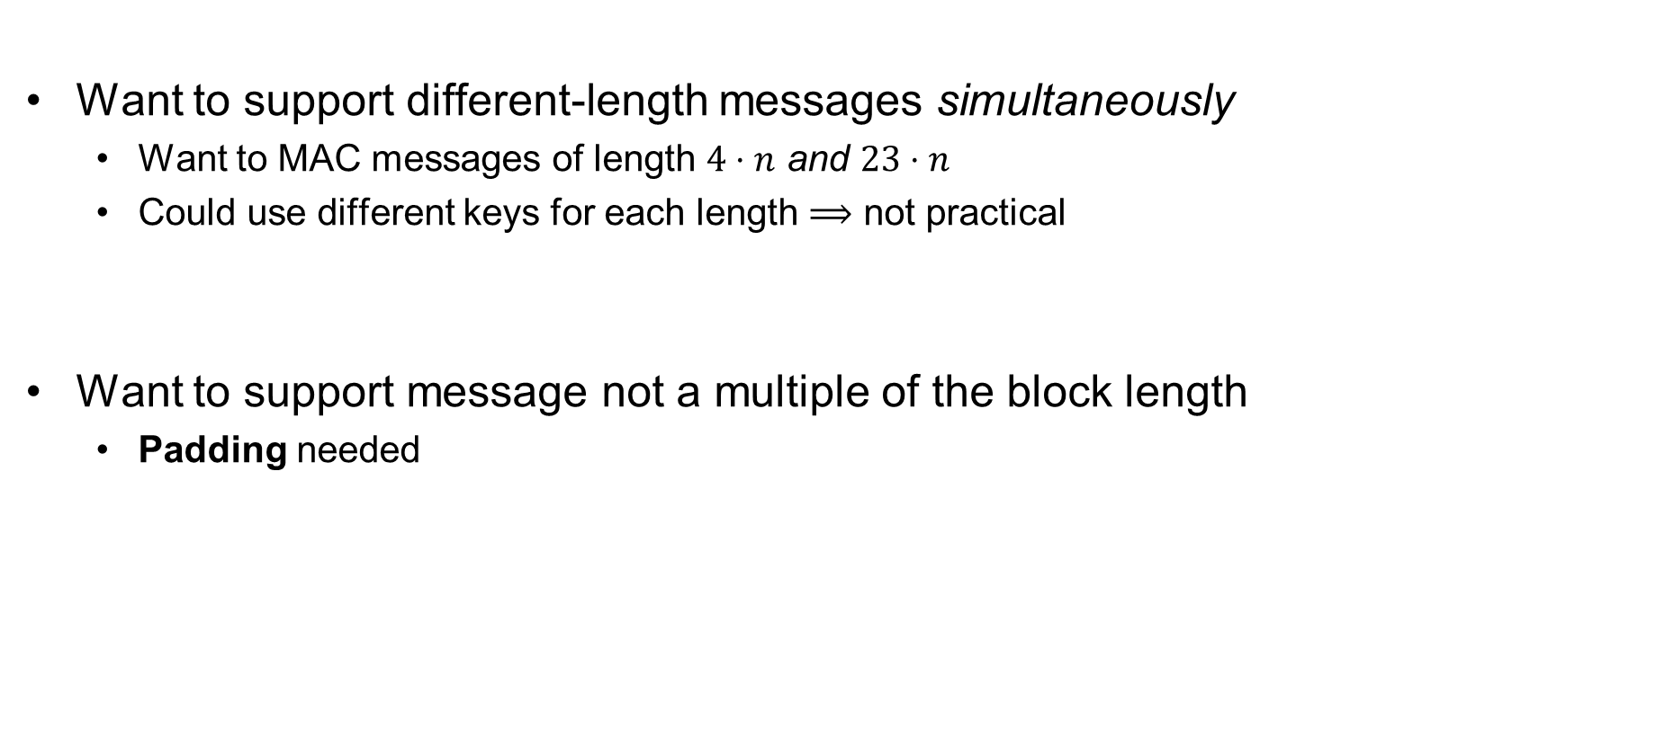






Allowing variable-length messages
Want to support different-length messages simultaneously
  Want to MAC messages of length $4⋅n$ and $23⋅n$
  Could use different keys for each length $⟹$ not practical
Want to support message not a multiple of the block length
  Padding needed
$${ M}_{1}$$
$${ M}_{2}$$
$${ M}_{1}$$
$${ M}_{2}$$
$$1000$$
$${ M}_{1}$$
$${ M}_{2}$$
$${ M}_{1}$$
$${ M}_{2}$$
$$100000000$$

Slide 37





CBC-MAC for variable-length messages
$$M$$
$$|M|$$
$${ M}_{1}$$
$${ M}_{2}$$
$${ M}_{3}$$
$${ E}_{K}$$
$${ E}_{K}$$
$${ E}_{K}$$
$${ E}_{K}$$
$$T$$
Theorem: If $E$ is a secure PRP then length-prepended CBC-MAC is UF-CMA secure
What if you append the length of $M$ at the end rather than at the beginning?
Notes:
Length of M needed before MACing can start
Question: make 4 Tag queries

Slide 38

















ECBC-MAC
$${ M}_{1}$$
$${ M}_{2}$$
$${ M}_{3}$$
$${ M}_{1}$$
$${ M}_{2}$$
$$M_{3}$$ | $$pad$$
$${ E}_{K_{1}}$$
$${ E}_{K_{1}}$$
$${ E}_{K_{1}}$$
$${ E}_{K_{1}}$$
$${ E}_{K_{1}}$$
$${ E}_{K_{1}}$$
$${ E}_{K_{2}}$$
$${ E}_{K_{3}}$$
$$\left(K_{1},K_{2},K_{3}\right)$$
$$T$$
$$T$$
Notes:
Use of K_2 and K_3 in F requires one additional run of key expansion function (say in AES) => bad for pipelining

Slide 39





FCBC-MAC
$${ M}_{1}$$
$${ M}_{2}$$
$${ M}_{3}$$
$${ M}_{1}$$
$${ M}_{2}$$
$$M_{3}$$ | $$pad$$
$${ E}_{K_{1}}$$
$${ E}_{K_{1}}$$
$${ E}_{K_{2}}$$
$${ E}_{K_{1}}$$
$${ E}_{K_{1}}$$
$${ E}_{K_{3}}$$
$$T$$
$$T$$
$$\left(K_{1},K_{2},K_{3}\right)$$

Slide 40


XCBC-MAC
$${ M}_{1}$$
$${ M}_{2}$$
$${ M}_{3}$$
$${ M}_{1}$$
$${ M}_{2}$$
$$M_{3}$$ | $$pad$$
$$K_{2}$$
$$K_{3}$$
$${ E}_{K_{1}}$$
$${ E}_{K_{1}}$$
$${ E}_{K_{1}}$$
$${ E}_{K_{1}}$$
$${ E}_{K_{1}}$$
$${ E}_{K_{1}}$$
$$T$$
$$T$$
$$\left(K_{1},K_{2},K_{3}\right)$$
Notes:
3 keys needed

Slide 41








CMAC a.k.a. One-key MAC (OMAC)
$${ M}_{1}$$
$${ M}_{2}$$
$${ M}_{3}$$
$${ M}_{1}$$
$${ M}_{2}$$
$$M_{3}$$ | $$pad$$
$$K_{2}$$
$$K_{3}$$
$${ E}_{K}$$
$${ E}_{K}$$
$${ E}_{K}$$
$${ E}_{K}$$
$${ E}_{K}$$
$${ E}_{K}$$
$$T$$
$$T$$
$$K_{2}=2⋇E_{K}\left(0^{n}\right)$$
$$K_{3}=4⋇E_{K}\left(0^{n}\right)$$

Slide 42
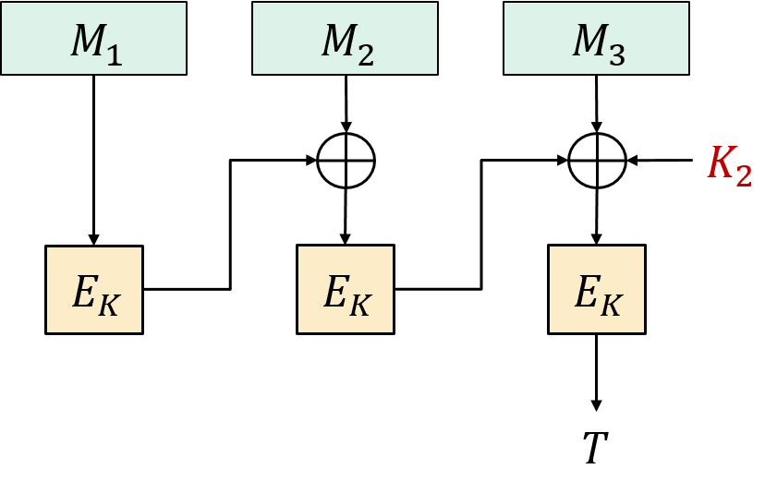
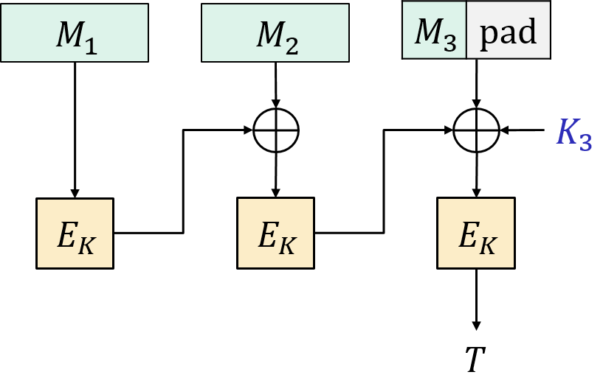

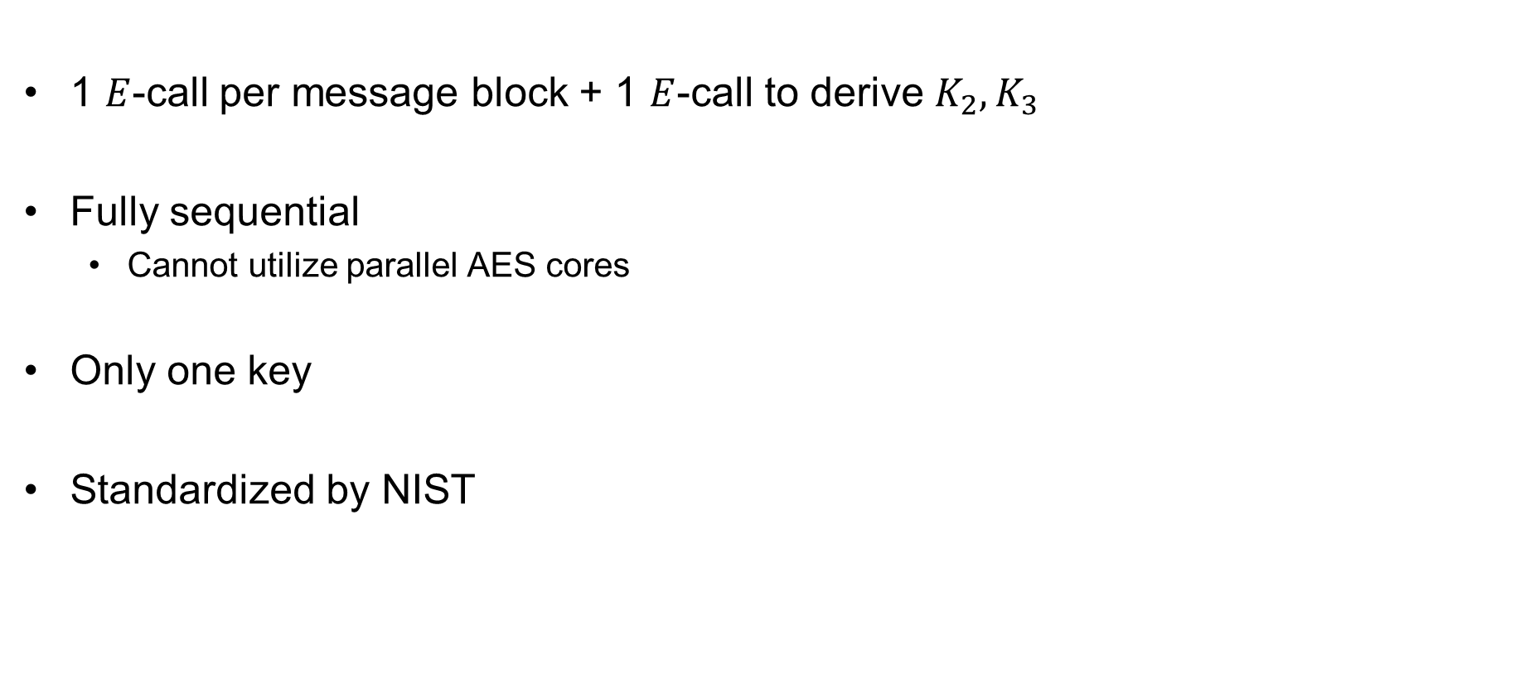

CMAC
1 $E$-call per message block + 1 $E$-call to derive $K_{2}, K_{3}$
Fully sequential
  Cannot utilize parallel AES cores
Only one key
Standardized by NIST
$$K_{2}=2⋇F_{K}\left(0^{n}\right)$$
$$K_{3}=4⋇F_{K}\left(0^{n}\right)$$

Slide 43
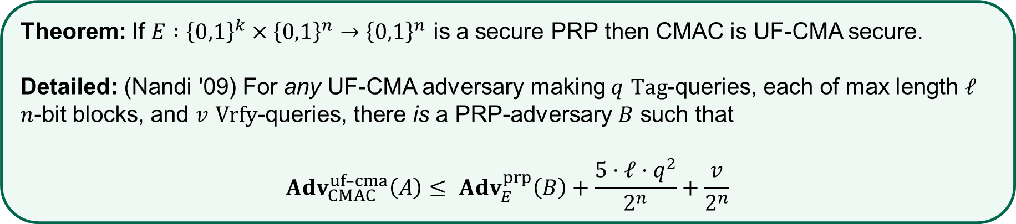
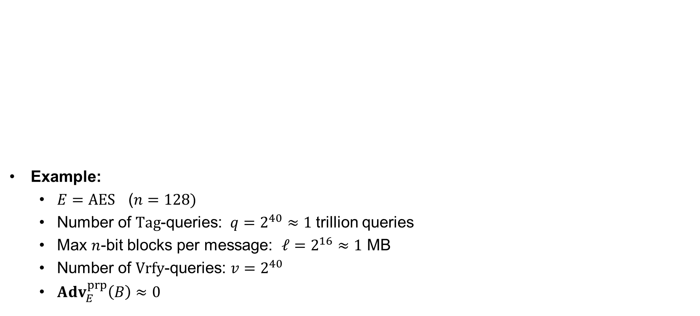
CMAC security
Example:
  $E=AES$ ($n=128)$
  Number of $Tag$-queries: $q=2^{40}≈1$trillion queries
  Max $n$-bit blocks per message: $ℓ=2^{16}≈1$ MB
  Number of $Vrfy$-queries: $v=2^{40}$
  $Adv_{E}^{prp}\left(B\right)≈0$
Theorem: If $E :{\left\{0,1\right\}}^{k}×{\left\{0,1\right\}}^{n}→{\left\{0,1\right\}}^{n}$ is a secure PRP then CMAC is UF-CMA secure.
Detailed: (Nandi '09) For any UF-CMA adversary making $q$ $Tag$-queries, each of max length $ℓ$ $n$-bit blocks, and $v$ $Vrfy$-queries, there is a PRP-adversary $B$ such that
$$Adv_{CMAC}^{uf–cma}\left(A\right)≤ Adv_{E}^{prp}\left(B\right)+\frac{5⋅ℓ⋅q^{2}}{2^{n}}+\frac{v}{2^{n}}$$
  $$Adv_{AES–MAC}^{uf–cma}\left(A\right)≤\frac{5⋅2^{16}⋅{\left(2^{40}\right)}^{2}}{2^{128}}+\frac{2^{40}}{2^{128}}≈\frac{2^{3+16+80}}{2^{128}}=\frac{1}{2^{29}}$$

Slide 44
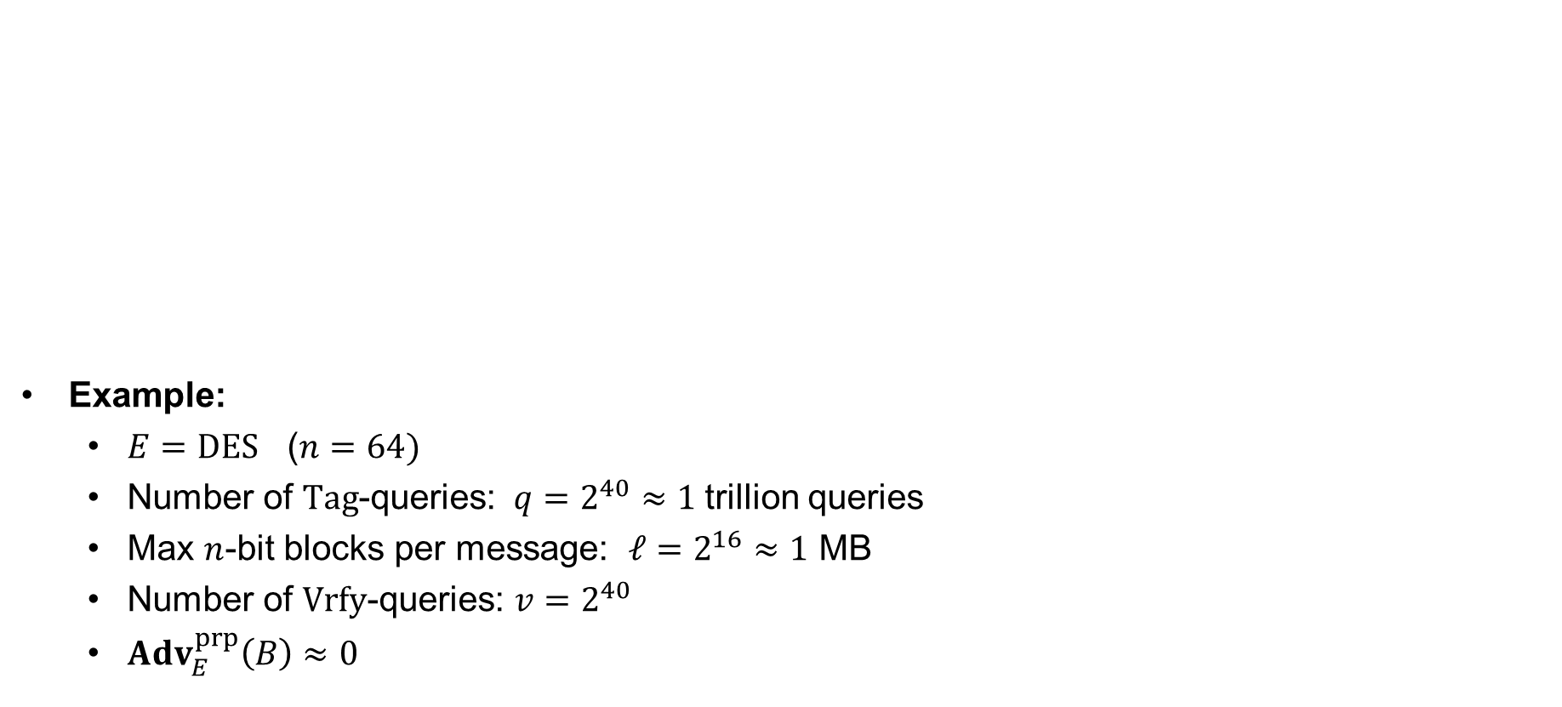
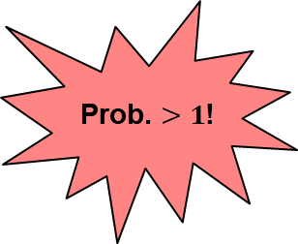
CMAC security
Example:
  $E=DES$ ($n=64)$
  Number of $Tag$-queries: $q=2^{40}≈1$trillion queries
  Max $n$-bit blocks per message: $ℓ=2^{16}≈1$ MB
  Number of $Vrfy$-queries: $v=2^{40}$
  $Adv_{E}^{prp}\left(B\right)≈0$
Theorem: If $E :{\left\{0,1\right\}}^{k}×{\left\{0,1\right\}}^{n}→{\left\{0,1\right\}}^{n}$ is a secure PRP then CMAC is UF-CMA secure.
Detailed: (Nandi '09) For any UF-CMA adversary making $q$ $Tag$-queries, each of max length $ℓ$ $n$-bit blocks, and $v$ $Vrfy$-queries, there is a PRP-adversary $B$ such that
$$Adv_{CMAC}^{uf–cma}\left(A\right)≤ Adv_{E}^{prp}\left(B\right)+\frac{5⋅ℓ⋅q^{2}}{2^{n}}+\frac{v}{2^{n}}$$
Prob. $>1$!
  $$Adv_{DES–CMAC}^{uf–cma}\left(A\right)≤\frac{5⋅2^{16}⋅{\left(2^{40}\right)}^{2}}{2^{64}}+\frac{2^{40}}{2^{64}}≈\frac{2^{3+16+80}}{2^{64}}=2^{35}$$

Slide 45
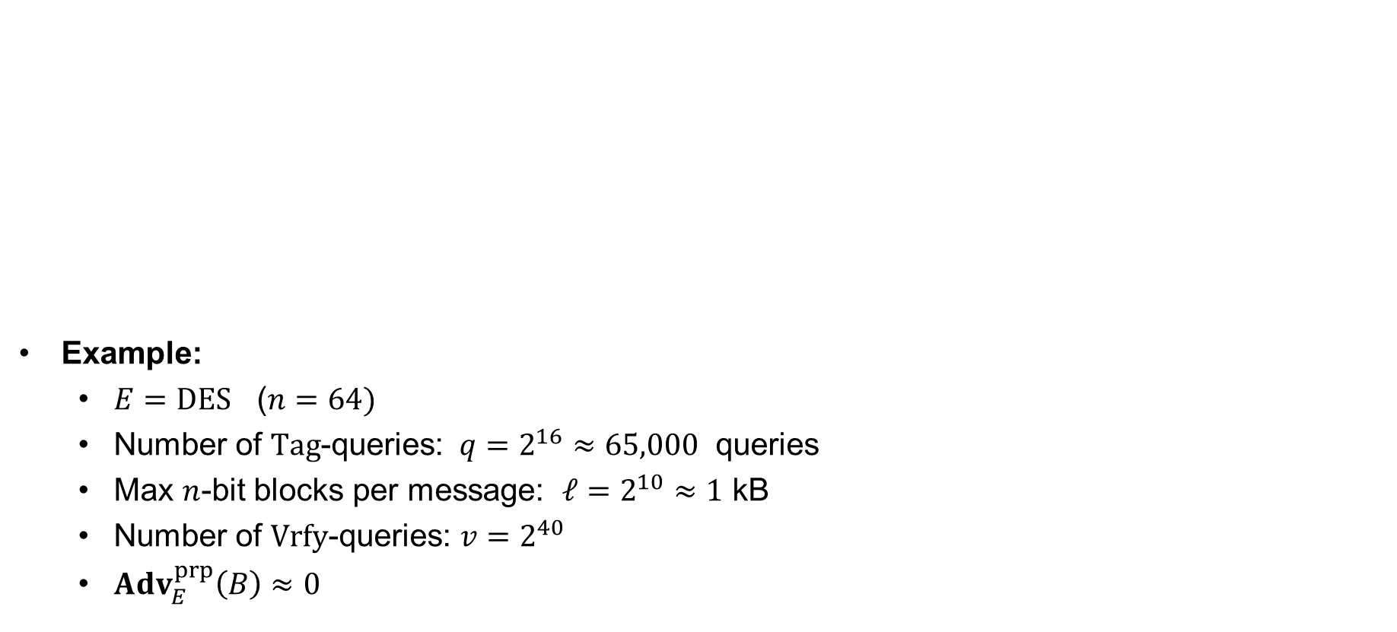
CMAC security
Example:
  $E=DES$ ($n=64)$
  Number of $Tag$-queries: $q=2^{16}≈65,000$ queries
  Max $n$-bit blocks per message: $ℓ=2^{10}≈1$ kB
  Number of $Vrfy$-queries: $v=2^{40}$
  $Adv_{E}^{prp}\left(B\right)≈0$
Theorem: If $E :{\left\{0,1\right\}}^{k}×{\left\{0,1\right\}}^{n}→{\left\{0,1\right\}}^{n}$ is a secure PRP then CMAC is UF-CMA secure.
Detailed: (Nandi '09) For any UF-CMA adversary making $q$ $Tag$-queries, each of max length $ℓ$ $n$-bit blocks, and $v$ $Vrfy$-queries, there is a PRP-adversary $B$ such that
$$Adv_{CMAC}^{uf–cma}\left(A\right)≤ Adv_{E}^{prp}\left(B\right)+\frac{5⋅ℓ⋅q^{2}}{2^{n}}+\frac{v}{2^{n}}$$
  $$Adv_{DES–CMAC}^{uf–cma}\left(A\right)≤\frac{5⋅2^{10}⋅{\left(2^{16}\right)}^{2}}{2^{64}}+\frac{2^{40}}{2^{64}}≈\frac{2^{3+10+32}}{2^{64}}=\frac{1}{2^{19}}$$

Slide 46






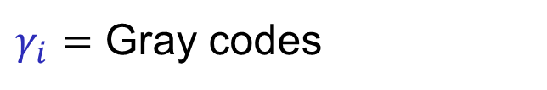







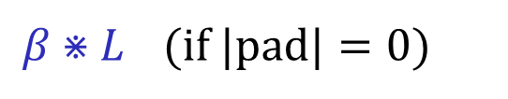
PMAC
$${ M}_{1}$$
$${ M}_{2}$$
$${ M}_{3}$$
$$M_{4}$$ | $$pad$$
$$γ_{1}⋇L$$
$$γ_{2}⋇L$$
$$γ_{3}⋇L$$
$${ E}_{K}$$
$${ E}_{K}$$
$${ E}_{K}$$
$β⋇L$ (if $|pad|=0)$
$$L=F_{K}\left(0^{n}\right)$$
$${ E}_{K}$$
$γ_{i}=$ Gray codes
$$T$$

Slide 47
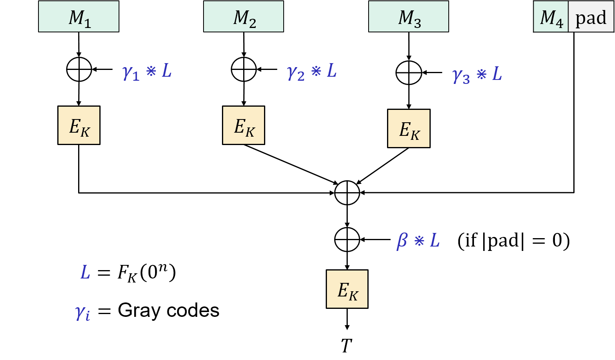







PMAC properties
Fully parallelizable
Incremental
One key
UF-CMA secure
…not used in practice
$$T_{2}^{′}$$
$$T_{2}$$
$$PMAC\left(K, M_{1}||M_{2}||…||M_{1000}\right)=T$$
$$PMAC\left(K, M_{1}||M_{2}^{′}||…||M_{1000}\right)=$$
$$E_{K}\left(E_{K}^{−1}\left(T\right)⊕T_{2}⊕T_{2}^{′} \right)$$
$${T_{2}=E}_{K}\left(M_{2}⊕γ_{2}⋇L\right)$$
$${T_{2}^{′}=E}_{K}\left(M_{2}^{′}⊕γ_{2}⋇L\right)$$

Slide 48
Summary
UF-CMA the right security notion for message integrity
  Does not cover replay attacks
PRFs are good MACs
  But usually of short (fixed) input length
CBC-MAC good MAC for messages of a single fixed length
CMAC upgrades CBC-MAC to variable-length messages

