Slide 1
Lecture 6 – Hash functions
TEK4500
29.09.2020
Håkon Jacobsen
hakon.jacobsen@its.uio.no

Slide 2
Hash function applications
File storage verification
Data authentication (MACs and digital signatures)
Certificates
Randomness extraction and key derivation (PRFs)
Password hashing
Quantum-resistant signatures
Hash chains (Bitcoin)

Slide 3



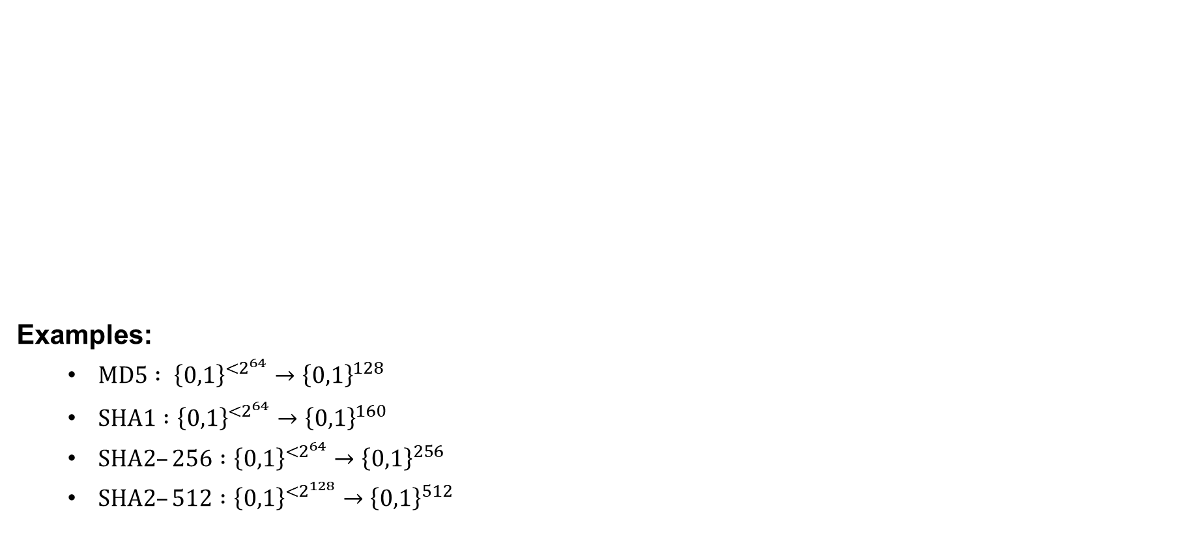






Hash functions
$$ℳ$$
Examples:
  $MD5 : {\left\{0,1\right\}}^{<2^{64}}→{\left\{0,1\right\}}^{128}$
  $SHA1 :{\left\{0,1\right\}}^{{<2}^{64}}→{\left\{0,1\right\}}^{160}$
  $SHA2–256 :{\left\{0,1\right\}}^{<2^{64}}→{\left\{0,1\right\}}^{256}$
  $SHA2–512 :{\left\{0,1\right\}}^{{<2}^{128}}→{\left\{0,1\right\}}^{512}$
$$H :ℳ→𝒴$$
$$\left|ℳ\right|$$
$$>$$
$$\left|𝒴\right|$$
$$≫$$
$$𝒴$$
$$H$$
Keyless function
Compressing
Collision!
$${\left\{0,1\right\}}^{{<2}^{64}}≈{\left\{0,1\right\}}^{∗}$$

Slide 4
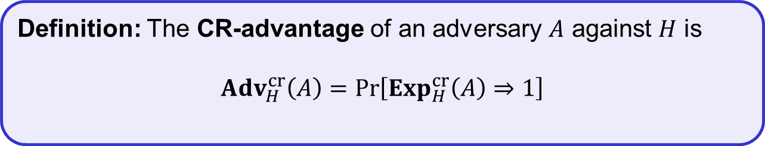
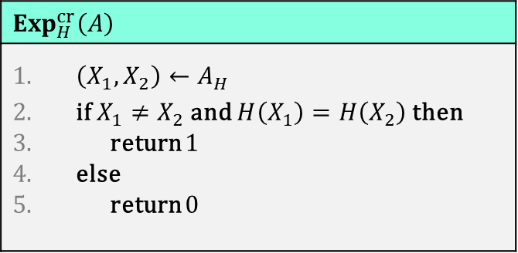
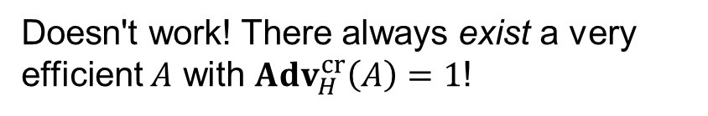
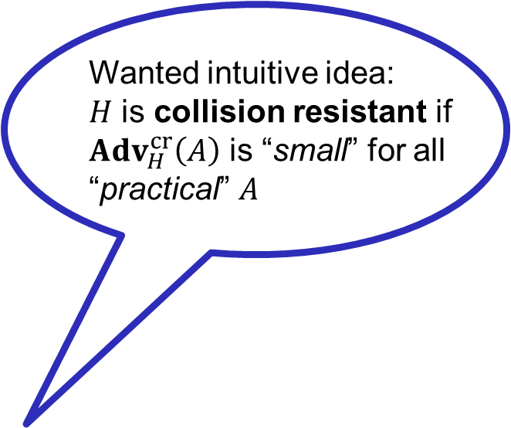
Collision resistance
$$Exp_{H}^{cr}\left(A\right)$$
$\left(X_{1},X_{2}\right)←A_{H}$ if $X_{1}≠X_{2}$ and $H\left(X_{1}\right)=H\left(X_{2}\right)$ then return $1$ else return $0$
Wanted intuitive idea:
$H$ is collision resistant if
${Adv}_{H}^{cr}\left(A\right)$ is “small” for all
“practical” $A$
Doesn't work! There always exist a very efficient $A$ with ${Adv}_{H}^{cr}\left(A\right)=1$!
Definition: The CR-advantage of an adversary $A$ against $H$ is
$${Adv}_{H}^{cr}\left(A\right)=\operatorname{Pr}\left[Exp_{H}^{cr}\left(A\right)⇒1\right]$$

Slide 5



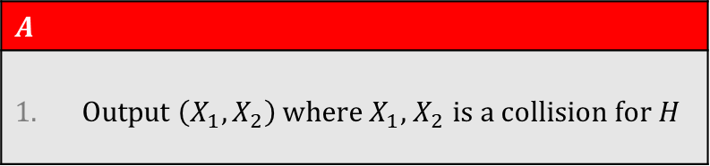
Collision resistance
$$Exp_{H}^{cr}\left(A\right)$$
$\left(X_{1},X_{2}\right)←A_{H}$ if $X_{1}≠X_{2}$ and $H\left(X_{1}\right)=H\left(X_{2}\right)$ then return $1$ else return $0$
$$A$$
Output $\left(X_{1},X_{2}\right)$ where $X_{1}$, $X_{2}$ is a collision for $H$
$X_{1},X_{2}$ must exist since $\left|ℳ\right|≫\left|𝒴\right|$
hence ${Adv}_{H}^{cr}\left(A\right)=1$
…but how do we actually find $X_{1},X_{2}?!$
Definition: The CR-advantage of an adversary $A$ against $H$ is
$${Adv}_{H}^{cr}\left(A\right)=\operatorname{Pr}\left[Exp_{H}^{cr}\left(A\right)⇒1\right]$$

Slide 6

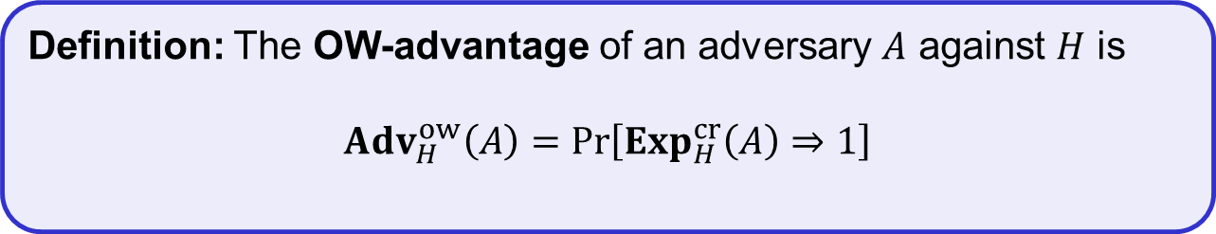

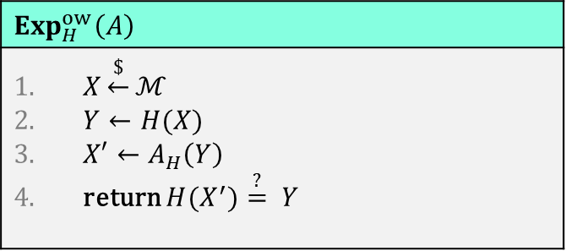

One-way security
$$ℳ$$
$$Exp_{H}^{ow}\left(A\right)$$
$X\underset{←}{\$}ℳ$ $Y←H(X)$ $X′←A_{H}\left(Y\right)$ return ${H(X}^{′})\overset{?}{=} Y$
$$𝒴$$
$$H$$
$$X$$
$$Y$$
$$X′$$
Definition: The OW-advantage of an adversary $A$ against $H$ is
$${Adv}_{H}^{ow}\left(A\right)=\operatorname{Pr}\left[Exp_{H}^{cr}\left(A\right)⇒1\right]$$

Slide 7
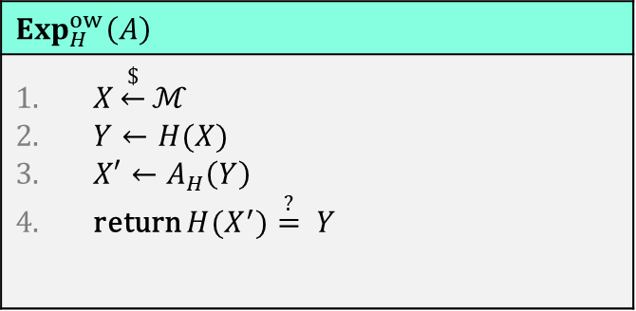

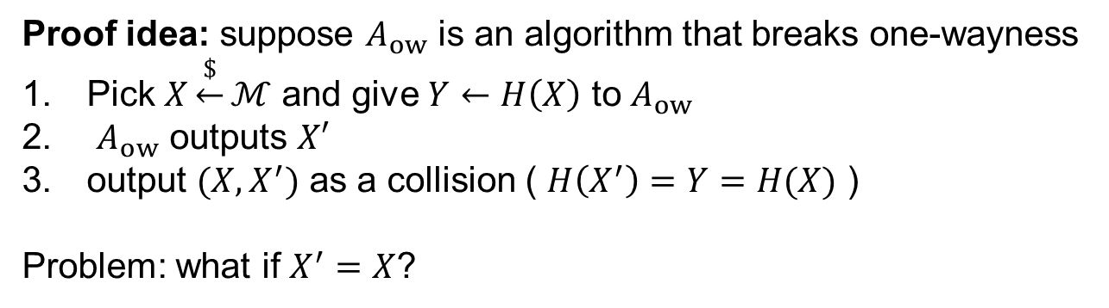

Relation between notions
$$Exp_{H}^{cr}\left(A\right)$$
$\left(X_{1},X_{2}\right)←A_{H}$ if $X_{1}≠X_{2}$ and $H\left(X_{1}\right)=H\left(X_{2}\right)$ then return $1$ else return $0$
$$Exp_{H}^{ow}\left(A\right)$$
$X\underset{←}{\$}ℳ$ $Y←H(X)$ $X′←A_{H}\left(Y\right)$ return ${H(X}^{′})\overset{?}{=} Y$
Collision-resistance $⟹$ One-wayness
Proof idea: suppose $A_{ow}$ is an algorithm that breaks one-wayness
Pick $X\underset{←}{\$}ℳ$ and give $Y←H\left(X\right)$ to $A_{ow}$
$A_{ow}$ outputs $X′$
output $(X,X^{′})$ as a collision ( $H\left(X^{′}\right)=Y=H(X)$ )
Problem: what if $X^{′}=X$?
Very unlikely assuming $\left|ℳ\right|≫\left|𝒴\right|$

Slide 8


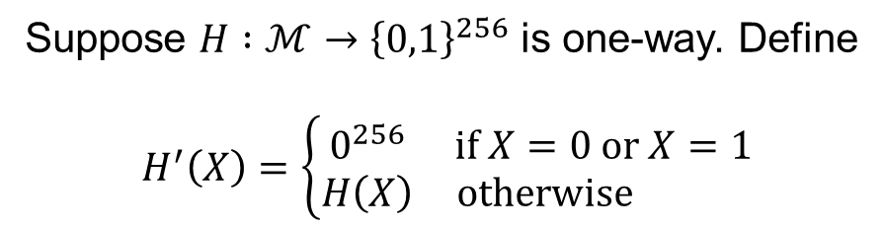

Relation between notions
$$Exp_{H}^{cr}\left(A\right)$$
$\left(X_{1},X_{2}\right)←A_{H}$ if $X_{1}≠X_{2}$ and $H\left(X_{1}\right)=H\left(X_{2}\right)$ then return $1$ else return $0$
$$Exp_{H}^{ow}\left(A\right)$$
$X\underset{←}{\$}ℳ$ $Y←H(X)$ $X′←A_{H}\left(Y\right)$ return ${H(X}^{′})\overset{?}{=} Y$
Collision-resistance $⟹$ One-wayness
Collision-resistance $⟸$ One-wayness
Suppose $H :ℳ→{\left\{0,1\right\}}^{256}$ is one-way. Define
$$H^{′}\left(X\right)=\left\{\begin{matrix}0^{256} & if X=0 or X=1 \\ H\left(X\right) & otherwise \end{matrix}\right.$$
$H′$ is one-way
$H′$ is not collision-resistant

Slide 9
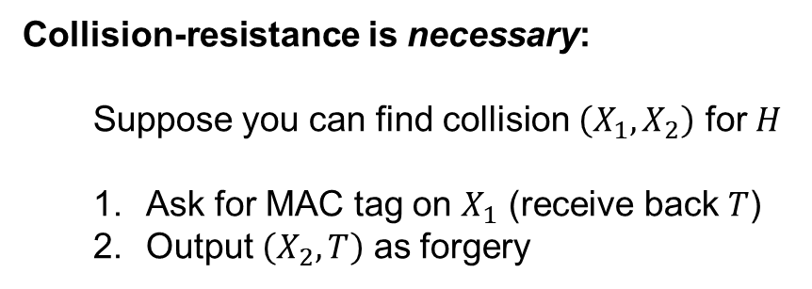

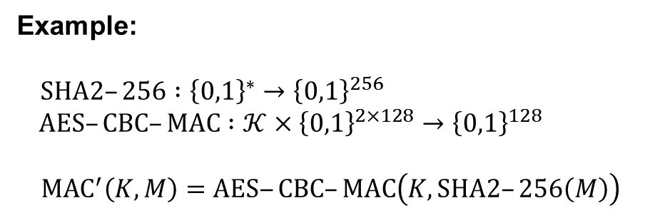



Collision resistance application – MAC domain extension
$$MAC :𝒦×{\left\{0,1\right\}}^{n}→𝒯$$
$$H :{\left\{0,1\right\}}^{∗}→{\left\{0,1\right\}}^{n}$$
$$MAC′ :𝒦×{\left\{0,1\right\}}^{∗}→𝒯$$
$${MAC}^{′}\left(K, M\right)=MAC\left(K, H\left(M\right)\right)$$
Hash-then-MAC paradigm
Theorem: If $H$ is collision-resistant and $MAC$ is UF-CMA secure, then $MAC′$ is UF-CMA secure
Example:
$SHA2–256 :{\left\{0,1\right\}}^{∗}→{\left\{0,1\right\}}^{256}$
$AES–CBC–MAC :𝒦×{\left\{0,1\right\}}^{2×128}→{\left\{0,1\right\}}^{128}$
$${MAC}^{′}\left(K,M\right)=AES‒CBC–MAC\left(K,SHA2–256\left(M\right)\right)$$
Collision-resistance is necessary:
  Suppose you can find collision $\left(X_{1}, X_{2}\right)$ for $H$
  Ask for MAC tag on $X_{1}$ (receive back $T$)
  Output $\left(X_{2},T\right)$ as forgery

Slide 10
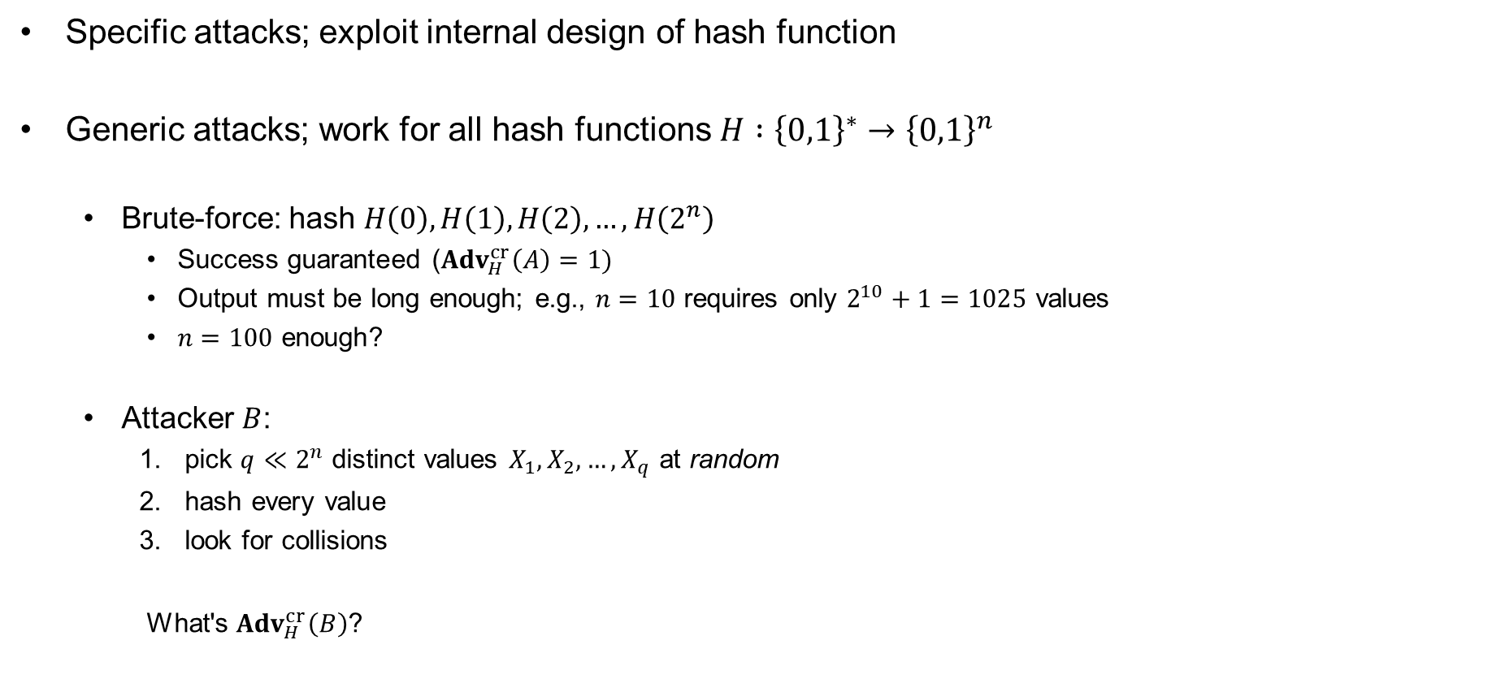
Attacks on hash functions
Specific attacks; exploit internal design of hash function
Generic attacks; work for all hash functions $H :{\left\{0,1\right\}}^{∗}→{\left\{0,1\right\}}^{n}$
  Brute-force: hash $H\left(0\right), H\left(1\right), H\left(2\right), …, H\left(2^{n}\right)$
    Success guaranteed (${Adv}_{H}^{cr}\left(A\right)=1)$
    Output must be long enough; e.g., $n=10$ requires only $2^{10}+1=1025$ values
    $n=100$ enough?
  Attacker $B$:
    pick $q≪2^{n}$ distinct values $X_{1}, X_{2}, …, X_{q}$ at random
    hash every value
    look for collisions
    What's ${Adv}_{H}^{cr}\left(B\right)$?

Slide 11























Birthday attack
$0$ $1$ $⋯$
$$N$$
$${ Y}_{3}$$
$${ Y}_{1}$$
$${ Y}_{6}$$
$${ Y}_{2}$$
$${ Y}_{q}$$
$${ Y}_{5}$$
$${ Y}_{4}$$
$${ Y}_{i}$$
$Y_{1}←H(X_{1})$
$Y_{2}←H(X_{2})$
$$\operatorname{Pr}\left[∃i≠j :H\left(X_{i}\right)=H(X_{j})\right]$$
$${Adv}_{H}^{cr}\left(B\right)=Pr\left[coll\right]=$$
$$\operatorname{Pr}\left[∃i≠j :ρ\left(X_{i}\right)=ρ(X_{j})\right]$$
$${Adv}_{ρ}^{cr}\left(B\right)=Pr\left[coll\right]=$$
$Y_{3}←H(X_{3})$
$Y_{4}←H(X_{4})$
$Y_{5}←H(X_{5})$
$Y_{6}←H(X_{6})$
$X_{1}, X_{2}, …, X_{q}$ are distinct
$Y_{i}←H(X_{i})$
$Y_{q}←H(X_{q})$

Slide 12











Birthday attack
$0$ $1$ $⋯$
$$N$$
$${ Y}_{3}$$
$${ Y}_{1}$$
$${ Y}_{6}$$
$${ Y}_{2}$$
$${ Y}_{q}$$
$${ Y}_{5}$$
$${ Y}_{4}$$
$${ Y}_{i}$$
$$Y_{1}←\$ 𝒴$$
$$Y_{2}←\$ 𝒴$$
$${Adv}_{ρ}^{cr}\left(B\right)=Pr\left[coll\right]=$$
$$\operatorname{Pr}\left[∃i≠j :ρ\left(X_{i}\right)=ρ(X_{j})\right]$$
$$=\operatorname{Pr}\left[∃i≠j :Y_{i}=Y_{j}\right]$$
$$Y_{3}←\$ 𝒴$$
$$Y_{4}←\$ 𝒴$$
$$Y_{5}←\$ 𝒴$$
$$Y_{6}←\$ 𝒴$$
$X_{1}, X_{2}, …, X_{q}$ are distinct
$$Y_{i}←\$ 𝒴$$
$$Y_{q}←\$ 𝒴$$

Slide 13


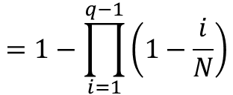





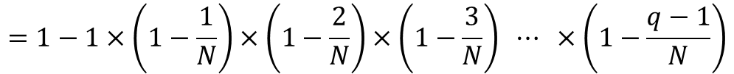














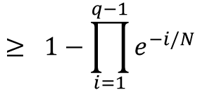



Birthday attack
$0$ $1$ $⋯$
$0$ $1$ $⋯$
$$N$$
$$N$$
$${ R}_{3}$$
$${ R}_{1}$$
$${ R}_{6}$$
$${ R}_{2}$$
$${ R}_{q}$$
$${ R}_{5}$$
$${ R}_{4}$$
$${ Y}_{3}$$
$${ Y}_{1}$$
$${ Y}_{6}$$
$${ Y}_{2}$$
$${ Y}_{q}$$
$${ Y}_{5}$$
$${ Y}_{4}$$
$${ R}_{i}$$
$${ Y}_{i}$$
$$\operatorname{Pr}\left[coll\right]=\operatorname{Pr}\left[∃i≠j :Y_{i}=Y_{j}\right]$$
$$=1−\operatorname{Pr}\left[∀i≠j :Y_{i}≠Y_{j}\right]$$
$$e^{−x}≥1−x$$
$$x≥0$$
$$\frac{N−1}{N}$$
$$×\frac{N−2}{N}$$
$$×\frac{N−3}{N}$$
$$⋯$$
$$×\frac{N−\left(q−1\right)}{N}$$
$$=1−1×$$
$$x=i/N$$
$$=1−1×\left(1−\frac{1}{N}\right)×\left(1−\frac{2}{N}\right)×\left(1−\frac{3}{N}\right) ⋯ ×\left(1−\frac{q−1}{N}\right)$$
$$e^{−x}=1−\frac{x}{1!}+\frac{x^{2}}{2!}−\frac{x^{3}}{3!}+\frac{x^{4}}{4!}+⋯$$
$$=1−\prod_{i=1}^{q−1}{\left(1−\frac{i}{N}\right)}$$
$$≥ 1−\prod_{i=1}^{q−1}{e^{−i/N}}$$
$$≥0.3×\frac{q\left(q−1\right)}{2N}$$
$$=1−e^{−\left(1+2+⋯+q−1\right)/N}$$
$$=1−e^{−q(q−1)/2N}$$
$$q≤\sqrt{2N}$$

Slide 14





Birthday attack
$0$ $1$ $⋯$
$0$ $1$ $⋯$
$$N$$
$$N$$
$${ R}_{3}$$
$${ R}_{1}$$
$${ R}_{6}$$
$${ R}_{2}$$
$${ R}_{q}$$
$${ R}_{5}$$
$${ R}_{4}$$
$${ Y}_{3}$$
$${ Y}_{1}$$
$${ Y}_{6}$$
$${ Y}_{2}$$
$${ Y}_{q}$$
$${ Y}_{5}$$
$${ Y}_{4}$$
$${ R}_{i}$$
$${ Y}_{i}$$
$$0.3×\frac{q\left(q−1\right)}{2N}≤\operatorname{Pr}\left[coll\right]$$
$$=\operatorname{Pr}{[Y_{1}∨Y_{2}∨⋯∨Y_{q}]}$$
$$≤\operatorname{Pr}\left[Y_{1}\right]+\operatorname{Pr}\left[Y_{2}\right]+⋯+\operatorname{Pr}\left[Y_{q}\right]$$
$$≤\frac{0}{N}+\frac{1}{N}+⋯+\frac{q−1}{N}$$
$$=\frac{q\left(q−1\right)}{2N}$$

Slide 15

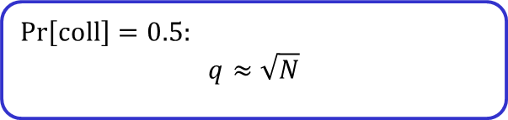
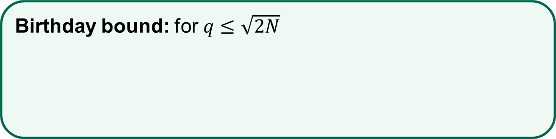
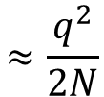
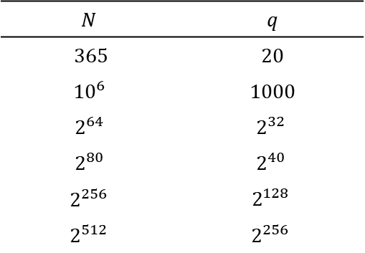
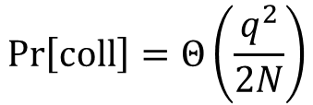
Birthday attack
$0$ $1$ $⋯$
$0$ $1$ $⋯$
$$N$$
$$N$$
$${ R}_{3}$$
$${ R}_{1}$$
$${ R}_{6}$$
$${ R}_{2}$$
$${ R}_{q}$$
$${ R}_{5}$$
$${ R}_{4}$$
$${ Y}_{3}$$
$${ Y}_{1}$$
$${ Y}_{6}$$
$${ Y}_{2}$$
$${ Y}_{q}$$
$${ Y}_{5}$$
$${ Y}_{4}$$
$${ R}_{i}$$
$${ Y}_{i}$$
$$\operatorname{Pr}\left[coll\right]=0.5:$$
$$q≈\sqrt{N}$$
$$0.3×\frac{q\left(q−1\right)}{2N}≤\operatorname{Pr}\left[coll\right]$$
$$≤\frac{q\left(q−1\right)}{2N}$$
$$N$$ | $$q$$
365 | 20
$${10}^{6}$$ | 1000
$$2^{64}$$ | $$2^{32}$$
$$2^{80}$$ | $$2^{40}$$
$$2^{256}$$ | $$2^{128}$$
$$2^{512}$$ | $$2^{256}$$
Birthday bound: for $q≤\sqrt{2N}$
$$\operatorname{Pr}\left[coll\right]=Θ\left(\frac{q^{2}}{2N}\right)$$
$$≈\frac{q^{2}}{2N}$$

Slide 16
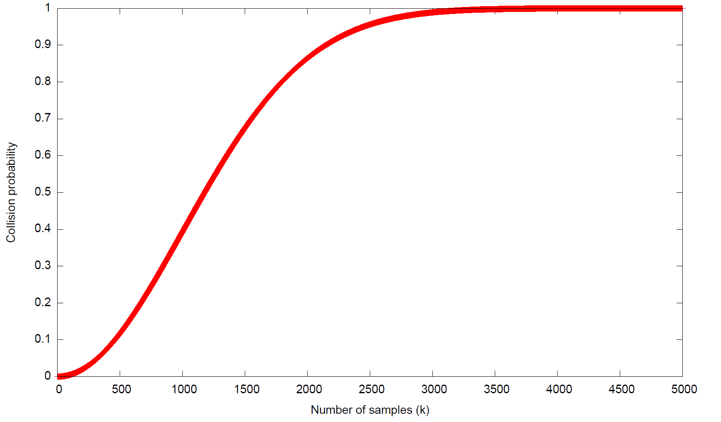


$$N={10}^{6}$$
$$\left(q\right)$$

Slide 17
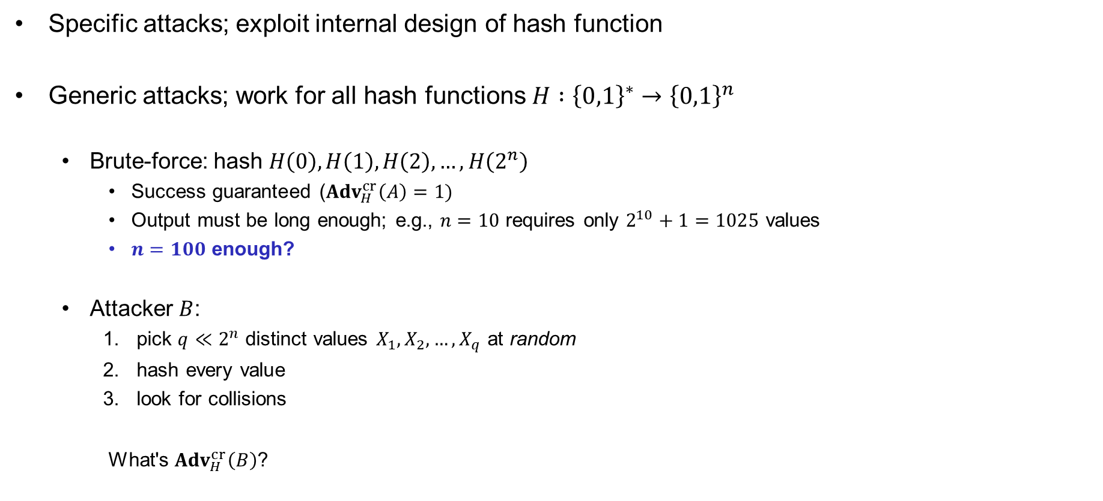
Attacks on hash functions
Specific attacks; exploit internal design of hash function
Generic attacks; work for all hash functions $H :{\left\{0,1\right\}}^{∗}→{\left\{0,1\right\}}^{n}$
  Brute-force: hash $H\left(0\right), H\left(1\right), H\left(2\right), …, H\left(2^{n}\right)$
    Success guaranteed (${Adv}_{H}^{cr}\left(A\right)=1)$
    Output must be long enough; e.g., $n=10$ requires only $2^{10}+1=1025$ values
    $n=100$ enough?
  Attacker $B$:
    pick $q≪2^{n}$ distinct values $X_{1}, X_{2}, …, X_{q}$ at random
    hash every value
    look for collisions
    What's ${Adv}_{H}^{cr}\left(B\right)$?
No! Must take birthday attack into account: $n / 2$ must be large enough

Slide 18


Designing hash functions

Slide 19
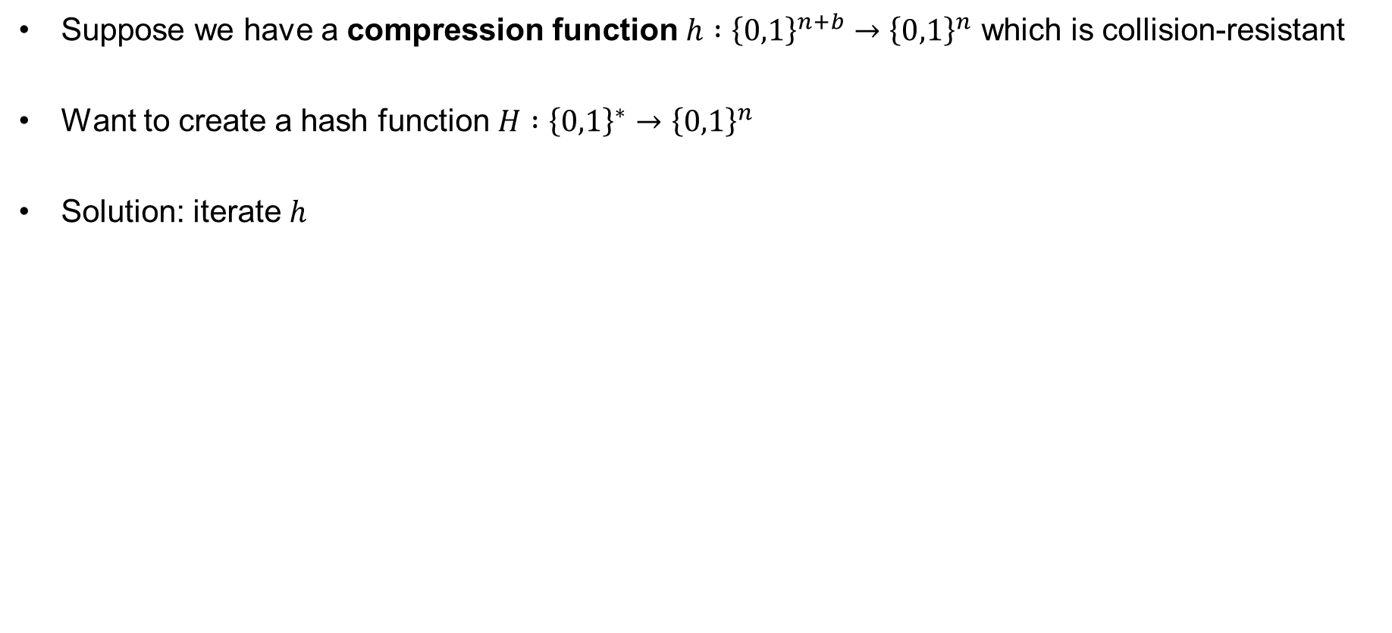
Merkle-Damgård
Suppose we have a compression function $h :{\left\{0,1\right\}}^{n+b}→{\left\{0,1\right\}}^{n}$ which is collision-resistant
Want to create a hash function $H :{\left\{0,1\right\}}^{∗}→{\left\{0,1\right\}}^{n}$
Solution: iterate $h$

Slide 20




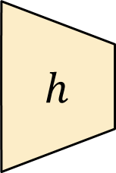
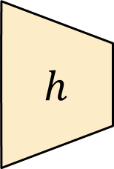



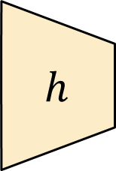

Merkle-Damgård
$$H :{\left\{0,1\right\}}^{∗}→{\left\{0,1\right\}}^{n}$$
$$H\left(M\right)=h\left(h\left( ⋯h\left(h\left(IV||M_{1}\right) || M_{2}\right) ⋯ || M_{n−1}\right) || M_{n}\right)$$
$${ M}_{1}$$
$${ M}_{2}$$
$${ M}_{3}$$
$${ M}_{4}$$
$$h$$
$$h$$
$$h$$
$$h$$
$$IV$$
$$h :{\left\{0,1\right\}}^{n+b}→{\left\{0,1\right\}}^{n}$$

Slide 21

Merkle-Damgård
$$H :{\left\{0,1\right\}}^{∗}→{\left\{0,1\right\}}^{n}$$
$$H\left(M\right)=h\left(h\left( ⋯h\left(h\left(IV||M_{1}\right) || M_{2}\right) ⋯ || M_{n−1}\right) || M_{n}\right)$$
$${ M}_{1}$$
$${ M}_{2}$$
$${ M}_{3}$$
$${ M}_{4}|| pad\left(M\right)$$
$$h$$
$$h$$
$$h$$
$$h$$
$$IV$$
$$h :{\left\{0,1\right\}}^{n+b}→{\left\{0,1\right\}}^{n}$$

Slide 22
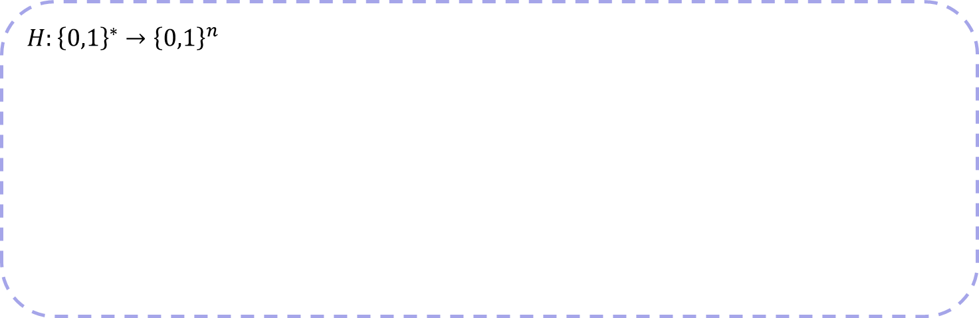
Merkle-Damgård
$$H :{\left\{0,1\right\}}^{∗}→{\left\{0,1\right\}}^{n}$$
$$H\left(M\right)=h\left(h\left( ⋯h\left(h\left(IV||M_{1}\right) || M_{2}\right) ⋯ || M_{n−1}\right) || M_{n}\right)$$
$$H:{\left\{0,1\right\}}^{∗}→{\left\{0,1\right\}}^{n}$$
$${ M}_{1}$$
$${ M}_{2}$$
$${ M}_{3}$$
$${ M}_{4}|| pad\left(M\right)$$
$$h$$
$$h$$
$$h$$
$$h$$
$$IV$$
$$h :{\left\{0,1\right\}}^{n+b}→{\left\{0,1\right\}}^{n}$$

Slide 23

Merkle-Damgård
$$H :{\left\{0,1\right\}}^{∗}→{\left\{0,1\right\}}^{n}$$
$$H\left(M\right)=h\left(h\left( ⋯h\left(h\left(IV||M_{1}\right) || M_{2}\right) ⋯ || M_{n−1}\right) || M_{n}\right)$$
$${ M}_{1}$$
$${ M}_{2}$$
$${ M}_{3}$$
$${ M}_{4}|| \left|M\right|$$
$$h$$
$$h$$
$$h$$
$$h$$
$$IV$$
$$h :{\left\{0,1\right\}}^{n+b}→{\left\{0,1\right\}}^{n}$$

Slide 24
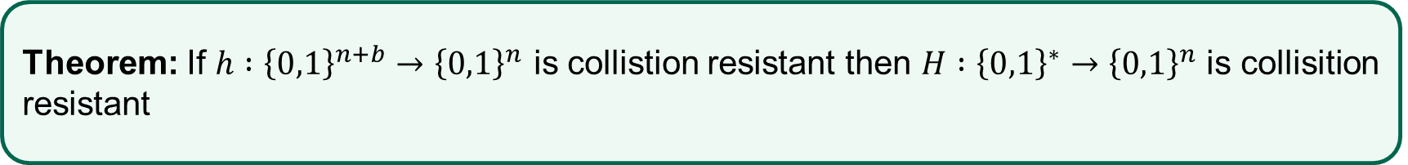
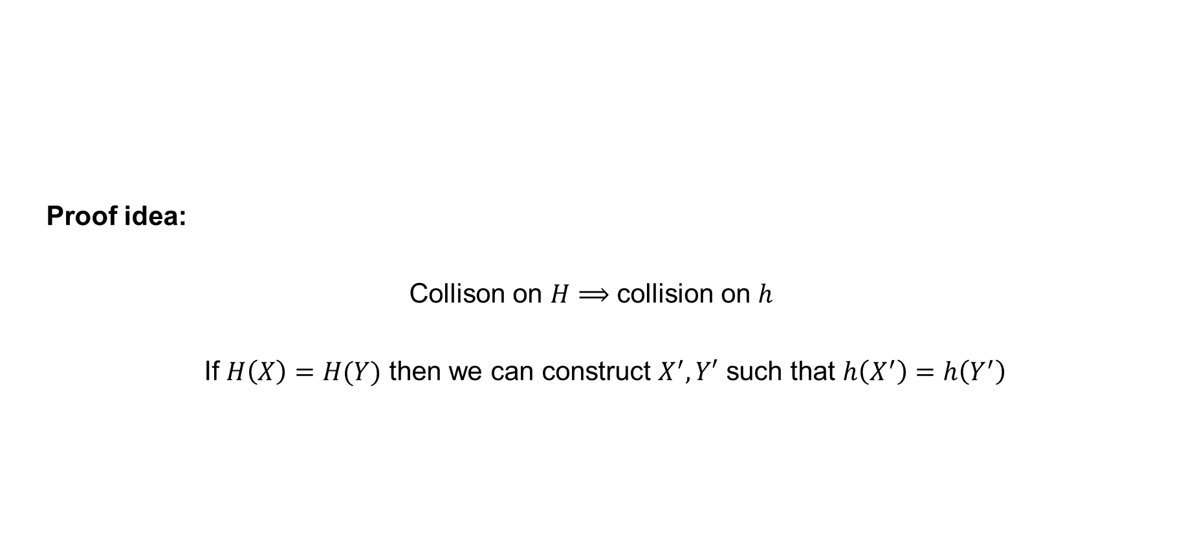
Merkle-Damgård – security
Proof idea:
Collison on $H⟹$ collision on $h$
If $H\left(X\right)=H(Y)$ then we can construct $X^{′}, Y′$ such that $h\left(X^{′}\right)=h\left(Y^{′}\right)$
Theorem: If $h :{\left\{0,1\right\}}^{n+b}→{\left\{0,1\right\}}^{n}$ is collistion resistant then $H :{\left\{0,1\right\}}^{∗}→{\left\{0,1\right\}}^{n}$ is collisition resistant

Slide 25


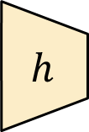



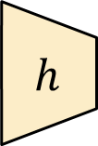


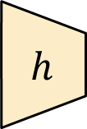


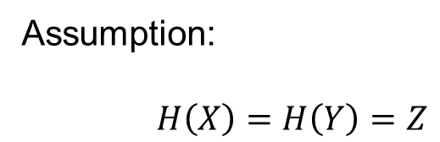
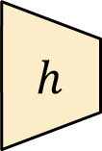



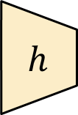
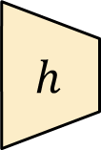



Merkle-Damgård – security
$${ X}_{1}$$
$${ X}_{2}$$
$${ X}_{18}$$
$${ X}_{19}$$
$${ X}_{20}$$
$$h$$
$$h$$
$$h$$
$$h$$
$$h$$
$$⋯$$
$$Z$$
$$IV$$
Assumption:
$H\left(X\right)=H\left(Y\right)=Z$
$${ Y}_{1}$$
$$Y_{2}$$
$${ Y}_{3}$$
$$h$$
$$h$$
$$h$$
$$IV$$
$$Z$$

Slide 26


Merkle-Damgård – security
$${ X}_{1}$$
$${ X}_{2}$$
$${ X}_{18}$$
$${ X}_{19}$$
$$… || \left|X\right|$$
$$h$$
$$h$$
$$h$$
$$h$$
$$h$$
$$⋯$$
$$Z$$
$$IV$$
Assumption:
$H\left(X\right)=H\left(Y\right)=Z$
$${ Y}_{1}$$
$$Y_{2}$$
$$… || \left|Y\right|$$
$$h$$
$$h$$
$$h$$
$$IV$$
$$Z$$

Slide 27







Merkle-Damgård – security
$${ X}_{1}$$
$${ X}_{2}$$
$${ X}_{18}$$
$${ X}_{19}$$
$${ X}_{20}$$
$$h$$
$$h$$
$$h$$
$$h$$
$$h$$
$$⋯$$
$$Z$$
$$IV$$
$${ Y}_{1}$$
$${ Y}_{2}$$
$${ Y}_{18}$$
$${ Y}_{19}$$
$${ Y}_{20}$$
$$h$$
$$h$$
$$h$$
$$h$$
$$h$$
$$⋯$$
$$Z$$
$$IV$$

Slide 28






















Merkle-Damgård – security
$${ X}_{1}$$
$${ X}_{2}$$
$${ X}_{18}$$
$${ X}_{19}$$
$${ X}_{20}$$
$$h$$
$$h$$
$$h$$
$$h$$
$$h$$
$$⋯$$
$$Z$$
$$IV$$
$$V_{20}$$
$${ Y}_{1}$$
$${ Y}_{2}$$
$${ Y}_{18}$$
$${ Y}_{19}$$
$${ Y}_{20}$$
$$h$$
$$h$$
$$h$$
$$h$$
$$h$$
$$⋯$$
$$Z$$
$$IV$$
$$V_{20}^{′}$$

Slide 29



Merkle-Damgård – security
$${ X}_{1}$$
$${ X}_{2}$$
$${ X}_{18}$$
$${ X}_{19}$$
$${ X}_{20}$$
$$h$$
$$h$$
$$h$$
$$h$$
$$h$$
$$⋯$$
$$Z$$
$$IV$$
$$V_{20}$$
$$h\left(X_{20}||V_{20}\right)=h\left(Y_{20}||V_{20}^{′}\right)$$
$${ Y}_{1}$$
$${ Y}_{2}$$
$${ Y}_{18}$$
$${ Y}_{19}$$
$${ Y}_{20}$$
$$h$$
$$h$$
$$h$$
$$h$$
$$h$$
$$⋯$$
$$Z$$
$$IV$$
$$V_{20}^{′}$$

Slide 30

Merkle-Damgård – security
$${ X}_{1}$$
$${ X}_{2}$$
$${ X}_{18}$$
$${ X}_{19}$$
$$h$$
$$h$$
$$h$$
$$h$$
$$h$$
$$⋯$$
$$Z$$
$$IV$$
$$V_{20}$$
$${ Y}_{1}$$
$${ Y}_{2}$$
$${ Y}_{18}$$
$${ Y}_{19}$$
$$h$$
$$h$$
$$h$$
$$h$$
$$h$$
$$⋯$$
$$Z$$
$$IV$$
$$V_{20}$$

Slide 31






Merkle-Damgård – security
$${ X}_{1}$$
$${ X}_{2}$$
$${ X}_{18}$$
$${ X}_{19}$$
$$h$$
$$h$$
$$h$$
$$h$$
$$h$$
$$⋯$$
$$Z$$
$$IV$$
$$V_{19}$$
$$V_{20}$$
$${ Y}_{1}$$
$${ Y}_{2}$$
$${ Y}_{18}$$
$${ Y}_{19}$$
$$h$$
$$h$$
$$h$$
$$h$$
$$h$$
$$⋯$$
$$Z$$
$$IV$$
$$V_{19}^{′}$$
$$V_{20}$$

Slide 32



Merkle-Damgård – security
$${ X}_{1}$$
$${ X}_{2}$$
$${ X}_{18}$$
$${ X}_{19}$$
$$h$$
$$h$$
$$h$$
$$h$$
$$h$$
$$⋯$$
$$Z$$
$$IV$$
$$V_{19}$$
$$V_{20}$$
$$h\left(X_{19}||V_{19}\right)=h\left(Y_{19}||V_{19}^{′}\right)$$
$${ Y}_{1}$$
$${ Y}_{2}$$
$${ Y}_{18}$$
$${ Y}_{19}$$
$$h$$
$$h$$
$$h$$
$$h$$
$$h$$
$$⋯$$
$$Z$$
$$IV$$
$$V_{19}^{′}$$
$$V_{20}$$

Slide 33

Merkle-Damgård – security
$${ X}_{1}$$
$${ X}_{2}$$
$${ X}_{18}$$
$$h$$
$$h$$
$$h$$
$$h$$
$$h$$
$$⋯$$
$$Z$$
$$IV$$
$$V_{19}$$
$$V_{20}$$
$${ Y}_{1}$$
$${ Y}_{2}$$
$${ Y}_{18}$$
$$h$$
$$h$$
$$h$$
$$h$$
$$h$$
$$⋯$$
$$Z$$
$$IV$$
$$V_{19}$$
$$V_{20}$$

Slide 34






Merkle-Damgård – security
$${ X}_{1}$$
$${ X}_{2}$$
$${ X}_{18}$$
$$h$$
$$h$$
$$h$$
$$h$$
$$h$$
$$⋯$$
$$Z$$
$$IV$$
$$V_{19}$$
$$V_{20}$$
$${ Y}_{1}$$
$${ Y}_{2}$$
$${ Y}_{18}$$
$$h$$
$$h$$
$$h$$
$$h$$
$$h$$
$$⋯$$
$$Z$$
$$IV$$
$$V_{19}$$
$$V_{20}$$

Slide 35













Merkle-Damgård – security
$$X$$
$$Y$$
$$X_{1}=Y_{1} ⟹ X_{1}||X_{2}||⋯||X_{n}=Y_{1}||Y_{2}||⋯||Y_{n}$$
Contradiction! Assumed $X≠Y$
$${ X}_{1}$$
$$h$$
$$h$$
$$h$$
$$h$$
$$h$$
$$⋯$$
$$Z$$
$$IV$$
$$V_{2}$$
$$V_{19}$$
$$V_{20}$$
$${ Y}_{1}$$
$$h$$
$$h$$
$$h$$
$$h$$
$$h$$
$$⋯$$
$$Z$$
$$IV$$
$$V_{2}$$
$$V_{19}$$
$$V_{20}$$

Slide 36
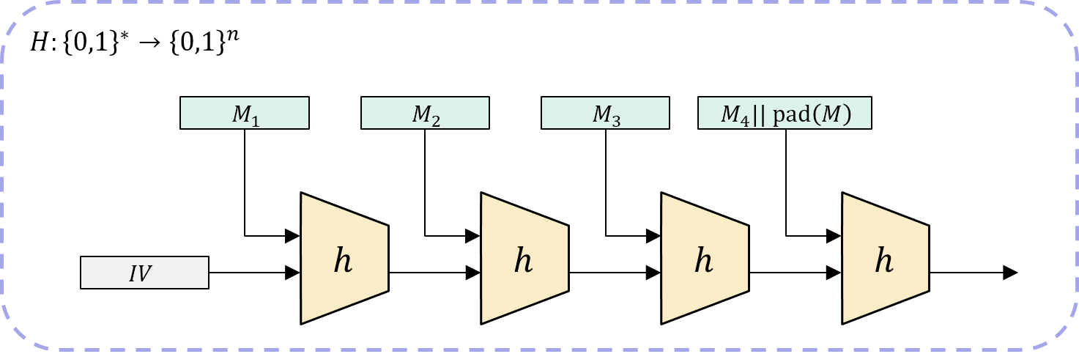
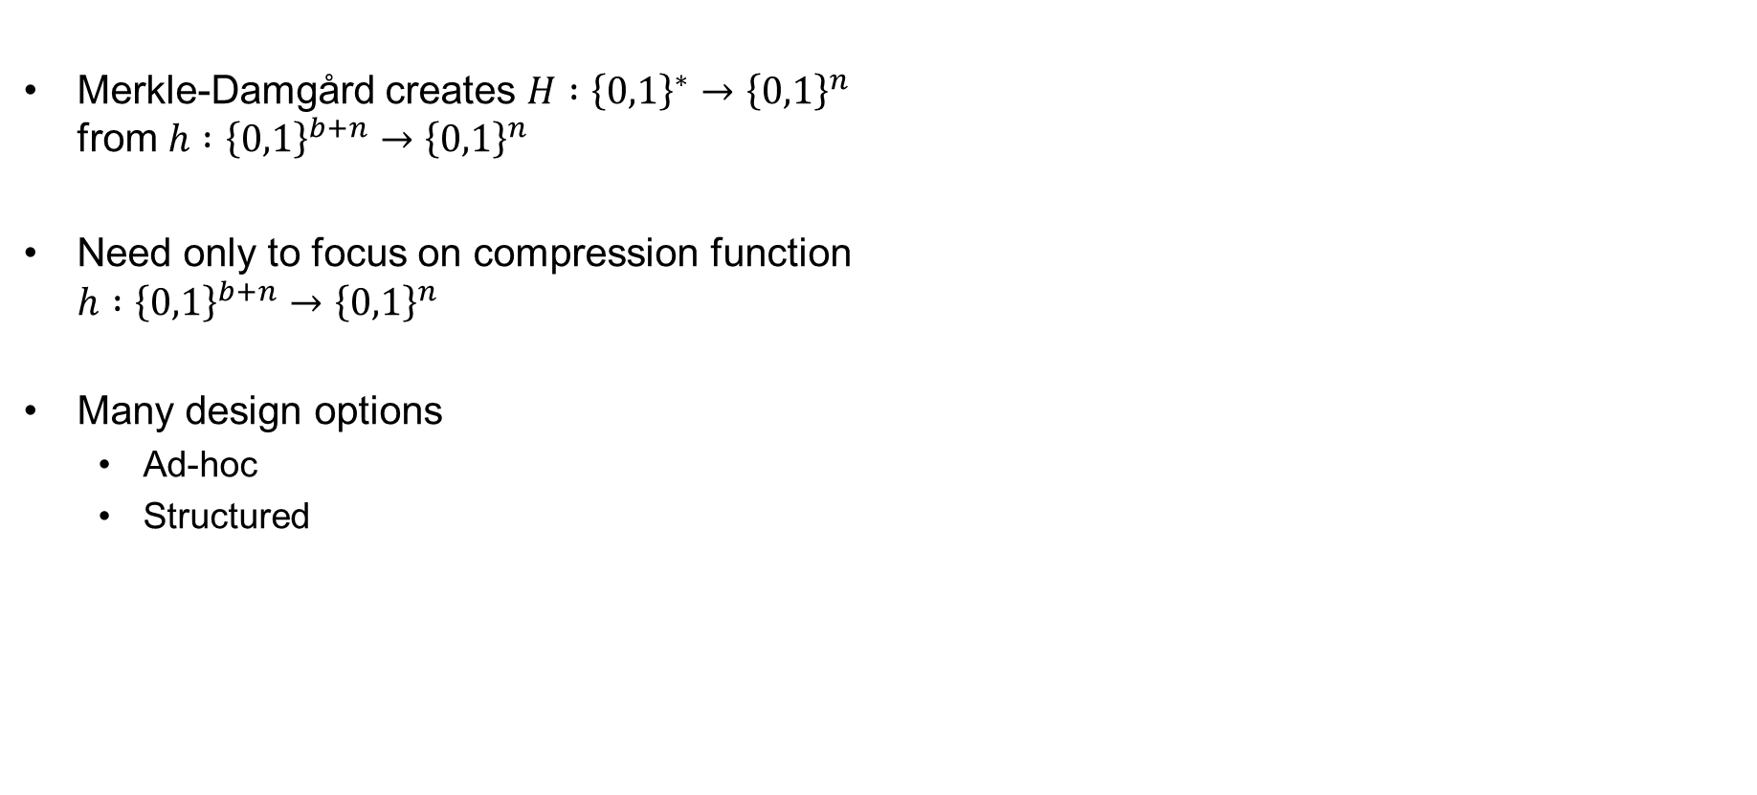
Compression function designs
Merkle-Damgård creates $H :{\left\{0,1\right\}}^{∗}→{\left\{0,1\right\}}^{n}$
from $h :{\left\{0,1\right\}}^{b+n}→{\left\{0,1\right\}}^{n}$
Need only to focus on compression function
$h :{\left\{0,1\right\}}^{b+n}→{\left\{0,1\right\}}^{n}$
Many design options
  Ad-hoc
  Structured

Slide 37

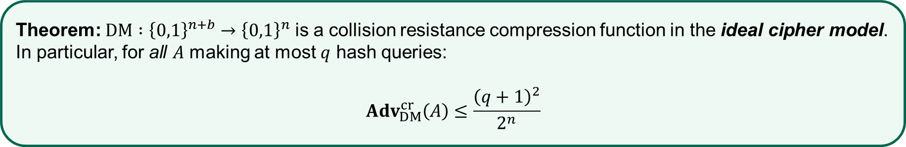
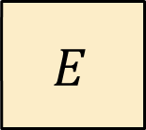


Compression functions from block ciphers – Davies-Meyer
$${ M}_{i}$$
$$E$$
$$V_{i+1}$$
$${ V}_{i}$$
$$DM\left(V_{i} || M_{i}\right)=E\left(M_{i}, V_{i}\right)⊕V_{i}=V_{i+1}$$
Theorem: $DM :{\left\{0,1\right\}}^{n+b}→{\left\{0,1\right\}}^{n}$ is a collision resistance compression function in the ideal cipher model. In particular, for all $A$ making at most $q$ hash queries:
$${Adv}_{DM}^{cr}\left(A\right)≤\frac{{\left(q+1\right)}^{2}}{2^{n}}$$

Slide 38
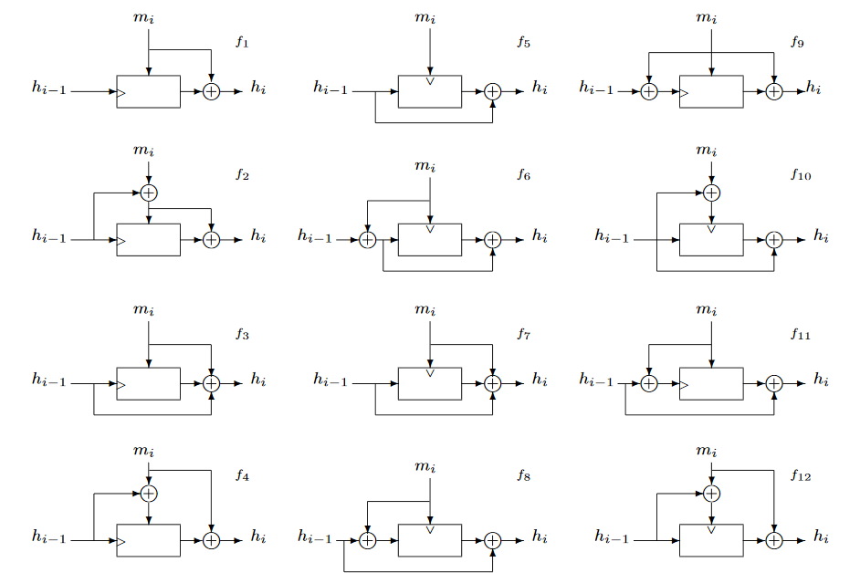
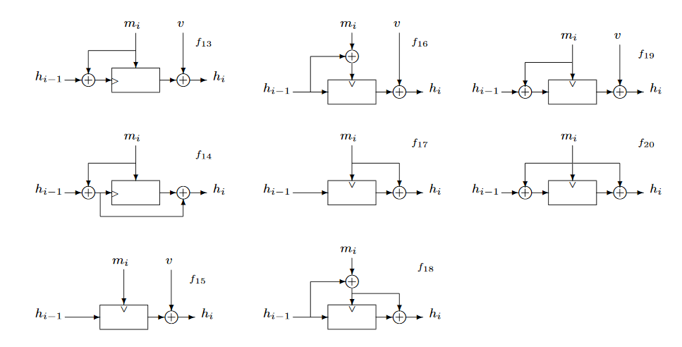
Alternatives…
Black, Rogaway & Shrimpton: Black-Box Analysis of the Block-Cipher-Based Hash-Function Constructions from PGV; CRYPTO'02

Slide 39
SHA – Secure Hash Algorithm
Family of hash functions published by NIST
  SHA1 in 1995
  SHA2-256 and SHA2-512 in 2001
    Also truncated versions: SHA2-224, SHA2-384
  SHA3-256 and SHA3-512 in 2015
SHA1 and SHA2 designed by NSA
  Merkle-Damgård + Davies-Meyer designs
SHA3 designed by Belgian cryptographers
  Sponge design

Slide 40
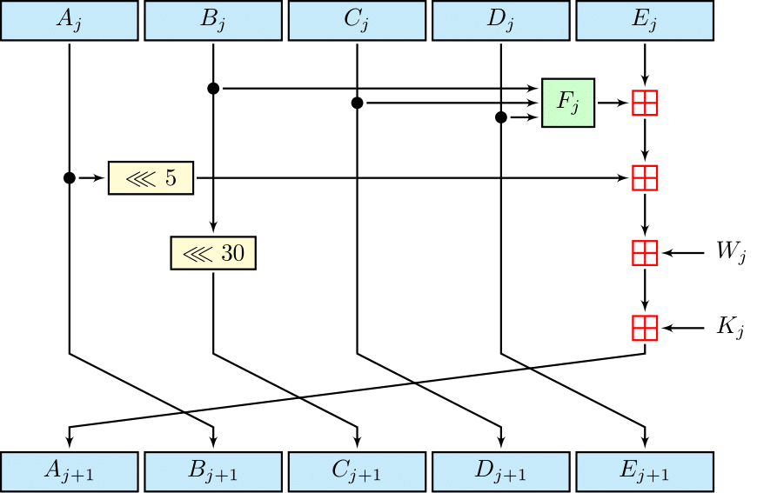


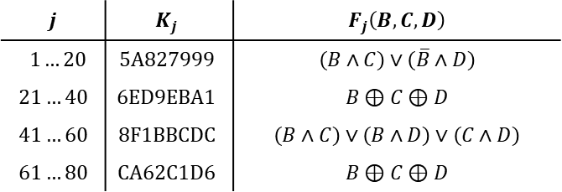
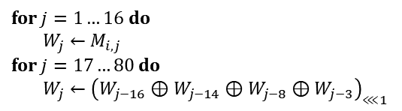

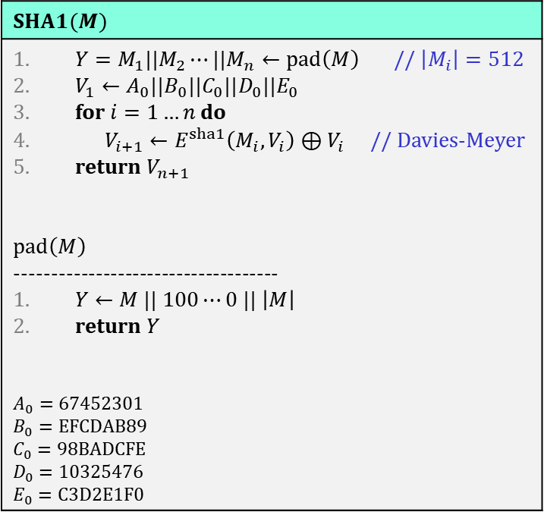
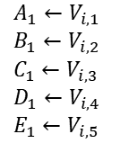




SHA1
$$SHA1(M)$$
$Y=M_{1}||M_{2}⋯||M_{n}←pad\left(M\right)$ // $\left|M_{i}\right|=512$ $V_{1}←A_{0}||B_{0}||C_{0}||D_{0}||E_{0}$ for $i=1…n$ do $V_{i+1}←E^{sha1}\left(M_{i}, V_{i}\right)⊕V_{i}$ // Davies-Meyer return $V_{n+1}$ $$pad\left(M\right)$$ ------------------------------------ $Y←M || 100⋯0 || \left|M\right|$ return $Y$ $$A_{0}=\text{67452301}$$ $$B_{0}=\text{EFCDAB}\text{89}$$ $$C_{0}=\text{98}\text{BADCFE}$$ $$D_{0}=\text{10325476}$$ $$E_{0}=\text{C}\text{3}\text{D}\text{2}\text{E}\text{1}\text{F}\text{0}$$
$$E^{sha1}(M_{i}, V_{i})$$
$$A_{1}←V_{i,1}$$
$$B_{1}←V_{i,2}$$
$$C_{1}←V_{i,3}$$
$$D_{1}←V_{i,4}$$
$$E_{1}←V_{i,5}$$
for $j=1…16$ do
$W_{j}←M_{i,j}$
for $j=17…80$ do
$W_{j}←{\left(W_{j−16}⊕W_{j−14}⊕W_{j−8}⊕W_{j−3}\right)}_{⋘1}$
$$j$$
Repeat 80 times
$${frac}_{32}\left(\sqrt{2}\right)$$
$${frac}_{32}\left(\sqrt{3}\right)$$
$$j$$ | $$K_{j}$$ | $$F_{j}\left(B, C,D\right)$$
$$1…20$$ | $$\text{5}\text{A}\text{827999}$$ | $$\left(B∧C\right)∨\left(\overline{B}∧D\right)$$
$$21…40$$ | $$\text{6}\text{ED}\text{9}\text{EBA}\text{1}$$ | $$B⊕C⊕D$$
$$41…60$$ | $$\text{8}\text{F}\text{1}\text{BBCDC}$$ | $$\left(B∧C\right)∨\left(B∧D\right)∨\left(C∧D\right)$$
$$61…80$$ | $$\text{CA}\text{62}\text{C}\text{1}\text{D}\text{6}$$ | $$B⊕C⊕D$$
$$E^{sha1} :{\left\{0,1\right\}}^{512}×{\left\{0,1\right\}}^{160}→{\left\{0,1\right\}}^{160}$$
$${frac}_{32}\left(\sqrt{5}\right)$$
$${frac}_{32}\left(\sqrt{10}\right)$$

Slide 41
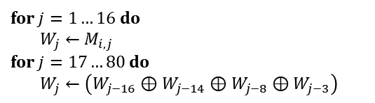


SHA0
$$SHA0(M)$$
$Y=M_{1}||M_{2}⋯||M_{n}←pad\left(M\right)$ // $\left|M_{i}\right|=512$ $V_{1}←A_{0}||B_{0}||C_{0}||D_{0}||E_{0}$ for $i=1…n$ do $V_{i+1}←E^{sha0}\left(M_{i}, V_{i}\right)⊕V_{i}$ // Davies-Meyer return $V_{n+1}$ $$pad\left(M\right)$$ ------------------------------------ $Y←M || 100⋯0 || \left|M\right|$ return $Y$ $$A_{0}=\text{67452301}$$ $$B_{0}=\text{EFCDAB}\text{89}$$ $$C_{0}=\text{98}\text{BADCFE}$$ $$D_{0}=\text{10325476}$$ $$E_{0}=\text{C}\text{3}\text{D}\text{2}\text{E}\text{1}\text{F}\text{0}$$
$$E^{sha0}(M_{i}, V_{i})$$
$$A_{1}←V_{i,1}$$
$$B_{1}←V_{i,2}$$
$$C_{1}←V_{i,3}$$
$$D_{1}←V_{i,4}$$
$$E_{1}←V_{i,5}$$
for $j=1…16$ do
$W_{j}←M_{i,j}$
for $j=17…80$ do
$W_{j}←\left(W_{j−16}⊕W_{j−14}⊕W_{j−8}⊕W_{j−3}\right)$
$$j$$
Repeat 80 times
$$j$$ | $$K_{j}$$ | $$F_{j}\left(B, C,D\right)$$
$$1…20$$ | $$\text{5}\text{A}\text{827999}$$ | $$\left(B∧C\right)∨\left(\overline{B}∧D\right)$$
$$21…40$$ | $$\text{6}\text{ED}\text{9}\text{EBA}\text{1}$$ | $$B⊕C⊕D$$
$$41…60$$ | $$\text{8}\text{F}\text{1}\text{BBCDC}$$ | $$\left(B∧C\right)∨\left(B∧D\right)∨\left(C∧D\right)$$
$$61…80$$ | $$\text{CA}\text{62}\text{C}\text{1}\text{D}\text{6}$$ | $$B⊕C⊕D$$
$$E^{sha0} :{\left\{0,1\right\}}^{512}×{\left\{0,1\right\}}^{160}→{\left\{0,1\right\}}^{160}$$

Slide 42

SHA – Secure Hash Algorithm
Family of hash functions published by NIST
  SHA0 in 1993
  SHA1 in 1995
  SHA2-256 and SHA2-512 in 2001
    Also truncated versions: SHA2-224, SHA2-384
  SHA3-256 and SHA3-512 in 2015
SHA1 and SHA2 designed by NSA
  Merkle-Damgård + Davies-Meyer designs
SHA3 designed by Belgian cryptographers
  Sponge design
Attacks against SHA0
Chabaud & Joux '98: SHA0 can be attacked in $2^{61}$ operations
Biham & Chen '04: Broke 62 / 80 rounds
Joux, et al. '04: First collision found taking $2^{51}$ operations
Wang et al. '04: Second collision found taking $2^{40}$ operations
Wang et al. '05: Collisions in $2^{39}$ operations
Manuel & Peyrin '08: Collisions in $2^{33.6}$ operations

Slide 43



Attacks against SHA1
Rijemen & Oswald '05: Broke 53 / 80 rounds
Wang et al. '05: "Collisions can be found in $2^{63}$ operations" ('04: SHA0 collision found)
'06-'10: various theoretical improvements
Stevens, Karpman & Peyrin '15: Freestart collision in $2^{57}$ operations
Stevens & Karpman + Google 2017: First SHA1 collision found ($2^{63.1}$ operations)

Slide 44






SHA2-256
$$E^{sha2}(M_{i}, V_{i})$$
$$SHA2–256(M)$$
$Y=M_{1}||M_{2}⋯||M_{n}←pad\left(M\right)$ // $\left|M_{i}\right|=512$ $V_{1}←A_{0}||B_{0}||C_{0}||D_{0}||E_{0}$ for $i=1…n$ do $V_{i+1}←E^{sha2}\left(M_{i}, V_{i}\right)⊞V_{i}$ // Davies-Meyer return $V_{n+1}$ $$pad\left(M\right)$$ ------------------------------------ $Y←M || 100⋯0 || \left|M\right|$ return $Y$
$A_{0}=$ 6A09E667 $B_{0}=$ BB67AE85 $C_{0}=$ 3C6EF372 $D_{0}=$ A54FF53A | $E_{0}=$ 510E527F $F_{0}=$ 9B05688C $G_{0}=$ 1F83D9AB $H_{0}=$ 5BE0CD19
$$A_{1}←V_{i,1}$$
$$B_{1}←V_{i,2}$$
$$C_{1}←V_{i,3}$$
$$D_{1}←V_{i,4}$$
for $j=1…16$ do
$W_{j}←M_{i,j}$
for $j=17…64$ do
$σ_{0}←{ROTR^{7}(W}_{j−15})⊕{ROTR^{18}(W}_{j−15})⊕{{SHR}^{3}(W}_{j−15})$
$σ_{1}←{ROTR^{17}(W}_{j−2})⊕{ROTR^{19}(W}_{j−2})⊕{{SHR}^{10}(W}_{j−2})$
$W_{j}←W_{j−16}+σ_{0}+W_{i−7}+σ_{1}$
$$E_{1}←V_{i,5}$$
$$F_{1}←V_{i,6}$$
$$G_{1}←V_{i,7}$$
$$H_{1}←V_{i,8}$$
$$j$$
Repeat 64 times
$$E^{sha2} :{\left\{0,1\right\}}^{512}×{\left\{0,1\right\}}^{256}→{\left\{0,1\right\}}^{256}$$

Slide 45









MACs from hash functions – $H(K || M)$
Doesn't work in general
Length-extension attacks on Merkle-Damgård hash functions
$$H\left(K||M\right)$$
$$K$$
$$M$$
$$pad\left(K|M\right)$$
$$h$$
$$h$$
$$h$$
$$IV$$
$$T$$

Slide 46








MACs from hash functions – $H(K || M)$
Doesn't work in general
Length-extension attacks on Merkle-Damgård hash functions
$$H\left(K||M\right)$$
$$H\left(K||M||pad\left(K|M\right)\right)$$
$$K$$
$$M$$
$$pad\left(K|M\right)$$
$$pad\left(K|M|pad\left(K|M\right)\right)$$
$$h$$
$$h$$
$$h$$
$$h$$
$$IV$$
$$T$$
$$T′$$

Slide 47









MACs from hash functions – $H(K || M)$
Doesn't work in general
Length-extension attacks on Merkle-Damgård hash functions
$$H\left(K||M\right)$$
$$H\left(K||M||pad\left(K|M\right)||X_{1}||X_{2}||⋯||X_{t}\right)$$
$$K$$
$$M$$
$$pad\left(K|M\right)$$
$$X_{1}$$
$$X_{2}$$
$$X_{t}$$
$$pad\left(…\right)$$
$$h$$
$$h$$
$$h$$
$$h$$
$$h$$
$$h$$
$$h$$
$$IV$$
$$T$$
$$T′$$

Slide 48













NMAC
$$M_{1}$$
$$M_{2}$$
$$M_{t}||{pad}_{i}$$
$$h$$
$$h$$
$$⋯$$
$$h$$
$$K_{1}^{′}$$
$$T^{′}||{pad}_{o}$$
$$h$$
$$K_{2}^{′}$$
$$T$$
Theorem (Gaži, Pietrzak, Rybár ‘2014):
If $h :{\left\{0,1\right\}}^{n}×{\left\{0,1\right\}}^{b}→{\left\{0,1\right\}}^{n}$ is a secure PRF then $NMAC :{\left\{0,1\right\}}^{n}×{\left\{0,1\right\}}^{∗}→{\left\{0,1\right\}}^{n}$ is a secure PRF.
Detailed: for any adversary $A$ against $NMAC$ making $q$ PRF oracle queries of at most $ℓ$ blocks, there is an adversary $B$ against $h$ such that:
$${Adv}_{NMAC}^{prf}\left(A\right)≤\left(qℓ+q+1\right)⋅{Adv}_{h}^{prf}\left(B\right)+\frac{q^{2}}{2^{n}}$$

Slide 49















HMAC
$$H\left(K⊕ipad || M\right)$$
$$K_{1}$$
$$M_{1}$$
$$M_{2}$$
$$M_{t}||{pad}_{i}$$
$$h$$
$$h$$
$$h$$
$$⋯$$
$$h$$
$$IV$$
$$K_{1}^{′}$$
$$H\left(K⊕opad || …\right)$$
$$ipad$$
$$K_{2}$$
$$T^{′}||{pad}_{o}$$
$$K_{1}=K⊕0x36363636⋯$$
$$h$$
$$h$$
$$IV$$
$$T$$
$$K_{2}=K⊕0x5c5c5c5c⋯$$
$$K_{2}^{′}$$
$$opad$$
$$HMAC\left(K,M\right)=H\left( K⊕opad || H\left(K⊕ipad || M\right)\right)$$

Slide 50


HMAC
Very widely used
  TLS
  IPsec
  SSH
  LTE
  …
Standardized by NIST and IETF (RFC 2104)
Security proof for NMAC can be lifted to HMAC:
  ++ assume $h$ is a secure dual PRF ($h$ keyed through the message is also a secure PRF)
  ++ assume $h$ is secure against related-key attacks (since $K_{1}, K_{2}$ are derived from $K$)
  very tricky proof; controversies

Slide 51


SHA3
$f :{\left\{0,1\right\}}^{1600}→{\left\{0,1\right\}}^{1600}$
Absorption phase
Squeezing phase

Slide 52
End of PART 1
(symmetric Crypto)

Slide 53

Summary of symmetric cryptography
Primitive | Functionality + syntax | Security goal | Acronym | Examples
Pseudorandom function | Keyed function mapping fixed-length input to fixed-length output $$F :𝒦×{\left\{0,1\right\}}^{in}→{\left\{0,1\right\}}^{out}$$ | Indistinguishability from random function | PRF | AES HMAC
Block cipher / pseudorandom permutation | Encrypt fixed-length block $$E :𝒦×{\left\{0,1\right\}}^{n}→{\left\{0,1\right\}}^{n}$$ | Indistinguishability from random permutation | PRP | AES
Encryption | Encrypt variable-length input $$Enc :𝒦×ℳ→𝒞$$ $Enc :𝒦×𝒩×ℳ→𝒞$ (nonce-based) | Confidentiality: attacker should learn nothing about plaintext (except length) from ciphertexts | IND-CPA, IND$-CPA IND-CCA | CTR$ CBC$
MAC | Produce fixed-length tag on variable-length message $$Tag :𝒦×ℳ→𝒯$$ $$Vrfy :𝒦×ℳ×𝒯→\left\{Valid, Invalid\right\}$$ | Integrity: attacker shouldn't be able to forge messages, i.e., create new messages with valid tags | UF-CMA | CBC-MAC CMAC HMAC
Authenticated encryption | Encrypt variable-length input $Enc :𝒦×ℳ→𝒞$ $$Dec :𝒦×𝒞→ℳ∪\left\{⊥\right\}$$ With associated data + nonces (AEAD) $$Enc :𝒦×𝒩×𝒜×ℳ→𝒞$$ $$Enc :𝒦×𝒩×𝒜×𝒞→ℳ∪\{⊥\}$$ | Confidentiality + ciphertext integrity Confidentiality (message) + ciphertext integrity + AD integrity | AE | EtM GCM OCB CCM
Hash function | Keyless function mapping variable-length messages to fixed-length tags $H :ℳ→𝒴$ $$H :{\left\{0,1\right\}}^{∗}→{\left\{0,1\right\}}^{n}$$ | Collision-resistance + one-wayness |  | SHA1 SHA2-256 SHA2-512 SHA3

Slide 54
Midterm exam
Home-exam
Published on Canvas after next week’s lecture (Tuesday 6. October)
Due: Tuesday 20. October (2 weeks)
Pass/fail
Must pass in order to take final exam

Slide 55
Next week – October 6
Guest lecture (I’m away)

