Slide 1
Lecture 14 – Course recap
TEK4500
24.11.2021
Håkon Jacobsen
hakon.jacobsen@its.uio.no

Slide 2

What is cryptography?
Internet
Alice
Bob
M
Adversary
Security goals:
Data privacy: adversary should not be able to read message M

Slide 3
What is cryptography?
Internet
Alice
Bob
M
M'
Adversary
Security goals:
Data privacy: adversary should not be able to read message M
Data integrity: adversary should not be able to modify message M
Data authenticity: message M really originated from Alice

Slide 4
Ideal solution: secure channels
But how to build?
Internet
Alice
Bob
M
Adversary
Security goals:
Data privacy: adversary should not be able to read message M ✓
Data integrity: adversary should not be able to modify message M ✓
Data authenticity: message M really originated from Alice ✓

Slide 5



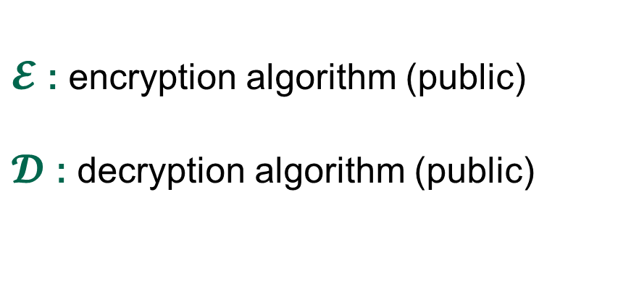
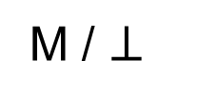
Creating secure channels: encryption schemes
Internet
Alice
Bob
K
K
$$ℰ$$
C
$$𝒟$$
M
M / $⊥$
Adversary
$𝓔$ : encryption algorithm (public)
$𝓓$ : decryption algorithm (public)
/ decryption
K : encryption key (secret)

Slide 6
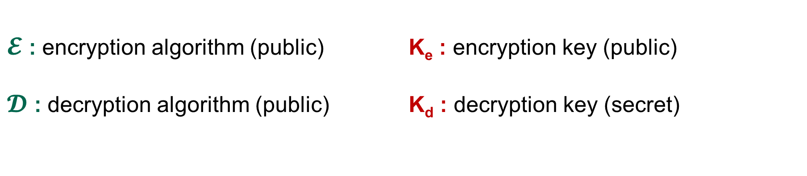
Creating secure channels: encryption schemes
Internet
Alice
Bob
K_{e}
K_{d}
$$ℰ$$
C
$$𝒟$$
M
M / $⊥$
Adversary
$𝓔$ : encryption algorithm (public) K_{e} : encryption key (public)
$𝓓$ : decryption algorithm (public) K_{d} : decryption key (secret)

Slide 7
Basic goals of cryptography
IND-CPA, IND-CCA
UF-CMA
AE
 | Message privacy | Message integrity / authentication
Symmetric keys | Symmetric encryption | Message authentication codes (MAC)
Asymmetric keys | Asymmetric encryption (a.k.a. public-key encryption) | Digital signatures
Enough
min-entropy
True random
generators
Pseudrandom
generators
PRG
Key exchange
IND-CPA, IND-CCA
UF-CMA
Unkeyed primitives
Hash functions
Collision resistance, one-wayness

Slide 8
Basic goals of cryptography
Encrypt-then-MAC
AES-GCM
AES-CCM
AES-OCB
AES-CTR, AES-CTR$
AES-CBC$
CBC-MAC, CMAC,
HMAC
 | Message privacy | Message integrity / authentication
Symmetric keys | Symmetric encryption | Message authentication codes (MAC)
Asymmetric keys | Asymmetric encryption (a.k.a. public-key encryption) | Digital signatures
Ring-oscillators,
lava lamps,
quantum effects, ...
True random
generators
Pseudrandom
generators
CTR mode
Key exchange
Diffie-Hellman
ElGamal, Padded RSA
Schnorr, ECDSA, Hashed RSA
Unkeyed primitives
Hash functions
SHA2-256, SHA2-512
SHA3-256, SHA3-512

Slide 9

Constructions and relations
PRG
GCM++, CCM, OCB++
CTR
CTR
Symmetric-key encryption
PRF
AE
AEAD
CBC$
EtM
AES
Feistel
Thm.
PRP
MAC schemes
CBC-MAC, CMAC, PMAC
Protocols
TLS, SSH, IPsec, What's App
Davies-Mayer
HMAC
ElGamal
SHA2
Hash functions
Public-key encryption
Merkle-
Damgård
ElGamal
Key exchange
Schnorr, ECDSA
Diffie-Hellman
$$\left(Z_{p}^{∗} , .⋅.\right)$$
$$\left(E\left(F_{p}\right),+\right)$$
Digital signatures
One-Way Trapdoor
function
RSA

Slide 10
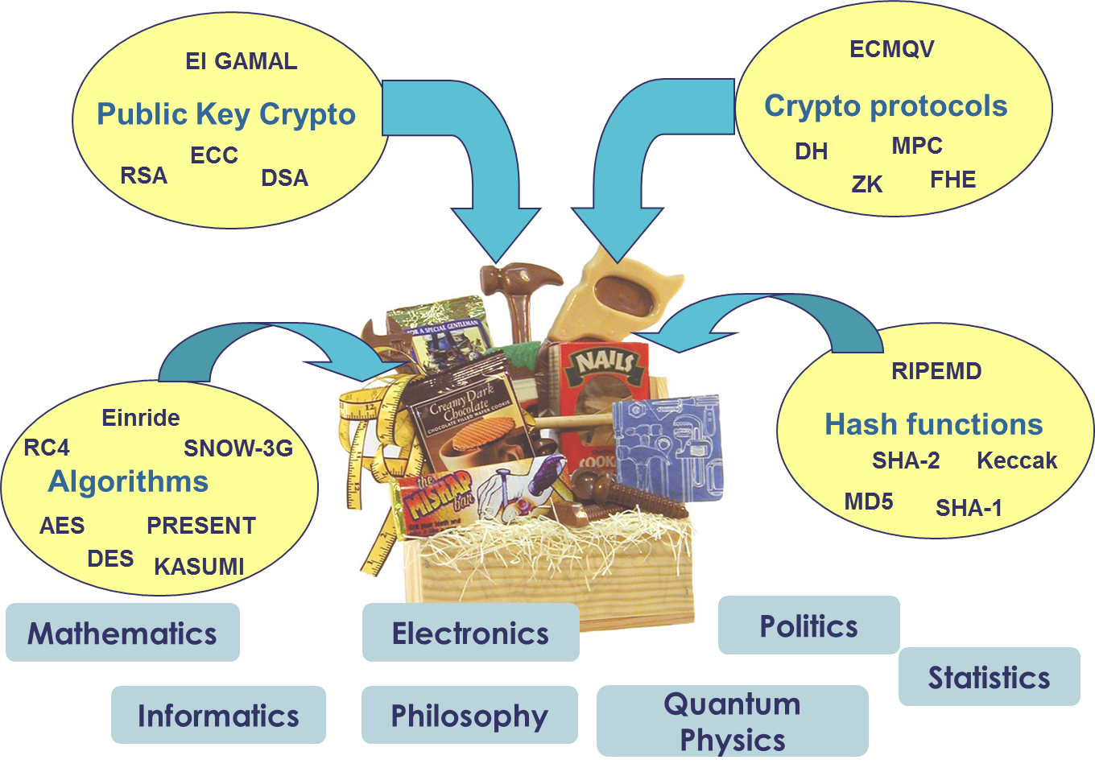
The crypto toolbox

Slide 11
Exam
Wednesday December 08, 15:00-19:00 (4 hours)
Digital on-campus exam
Closed-book exam

