Slide 1
Lecture 7 – Randomness, entropy,
TRNG/PRNGs, stream ciphers
TEK4500
01.10.2025
Håkon Jacobsen
hakon.jacobsen@its.uio.no

Slide 2
Midterm exam
Available on Canvas today (Wednesday, October 1)
Due: two weeks later (Wednesday, October 15, 23:59)
Take-home exam
Individual: collaboration is not allowed
Mandatory: need to pass in order to be eligible for the exam
All sources allowed (save for explicitly searching for the solution)
Submission: Canvas (file type = PDF; strongly prefer if you use provided LaTex template)
Start early! The assignment may be more challenging than you expect

Slide 3
Basic goals of cryptography
 | Message privacy | Message integrity / authentication
Symmetric keys | Symmetric encryption | Message authentication codes (MAC)
Asymmetric keys | Asymmetric encryption (a.k.a. public-key encryption) | Digital signatures
PRNG
Unkeyed
Hash functions
TRNG

Slide 4
Outline
How to generate (lots) of randomness?
PRNGs
  Stream ciphers
Randomness – what is it?
  Entropy
TRNGs
Key derivation

Slide 5


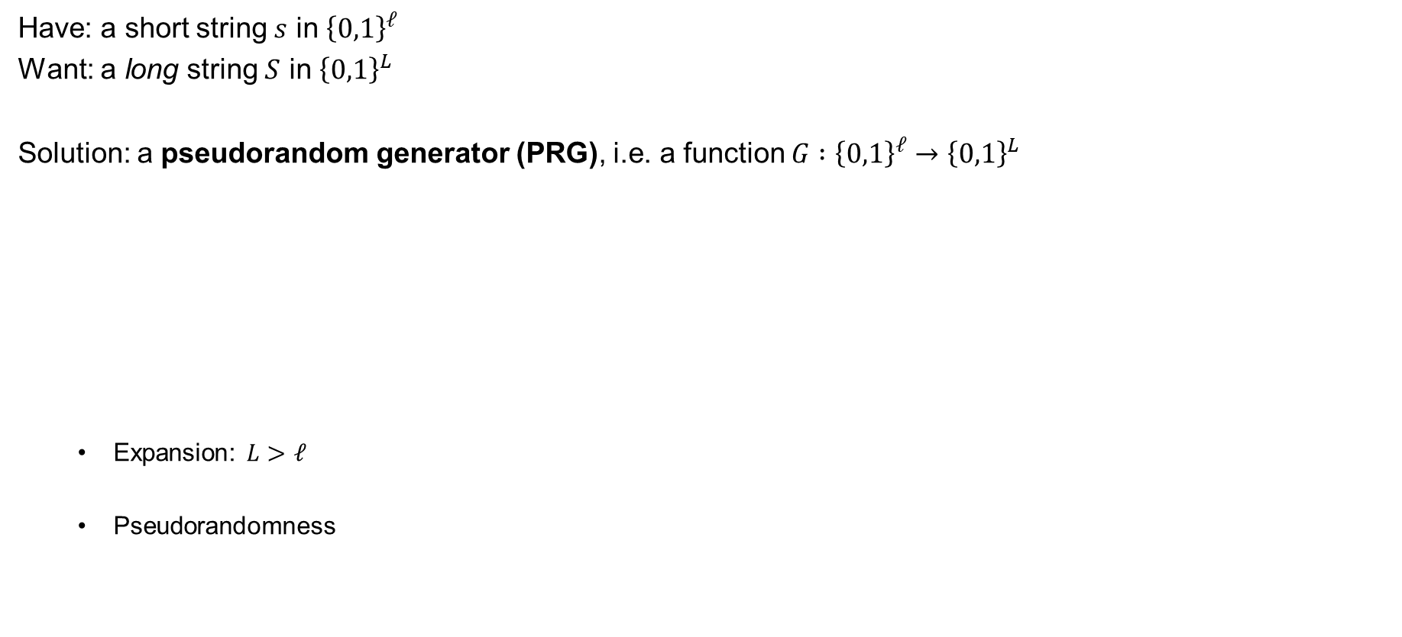
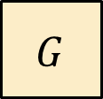

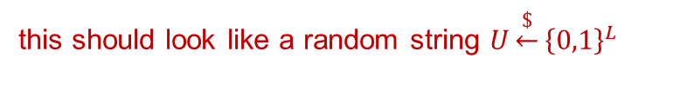
Pseudorandom generators (PRG) – syntax
Have: a short string $s$ in ${\left\{0,1\right\}}^{ℓ}$
Want: a long string $S$ in ${\left\{0,1\right\}}^{L}$
Solution: a pseudorandom generator (PRG), i.e. a function $G :{\left\{0,1\right\}}^{ℓ}→{\left\{0,1\right\}}^{L}$
  Expansion: $L>ℓ$
  Pseudorandomness
(uniform and independently distributed)
(uniform and independently distributed)
$$ℓ$$
$$L$$
$$G$$
$$s$$
$$G\left(s\right)$$
this should look like a random string $U\underset{←}{\$}{\left\{0,1\right\}}^{L}$

Slide 6






Pseudorandomness
$$G(s)$$
PRNG sec.
$${\left\{0,1\right\}}^{ℓ}$$
$$≈$$
$${\left\{0,1\right\}}^{L}$$
$${\left\{0,1\right\}}^{L}$$

Slide 7

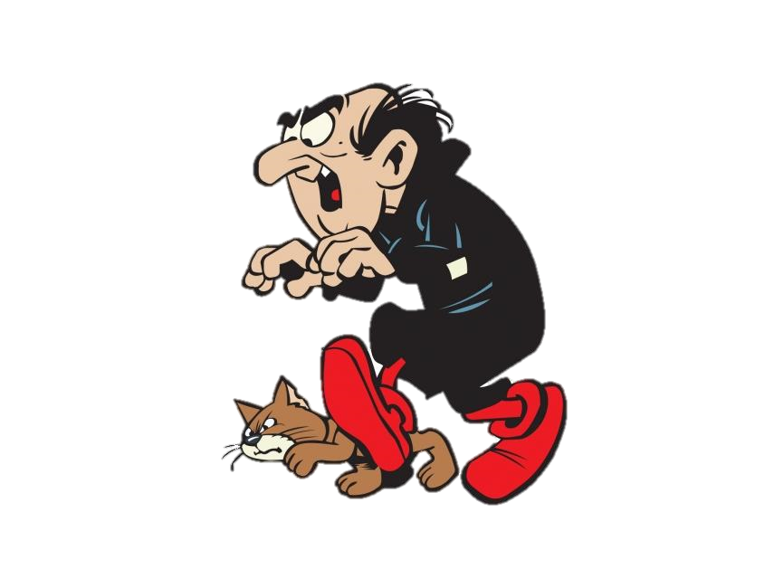
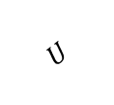
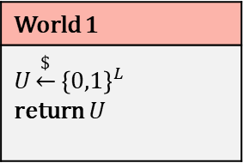
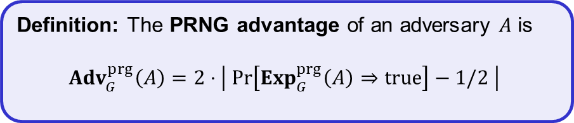
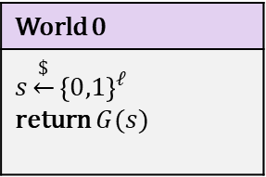
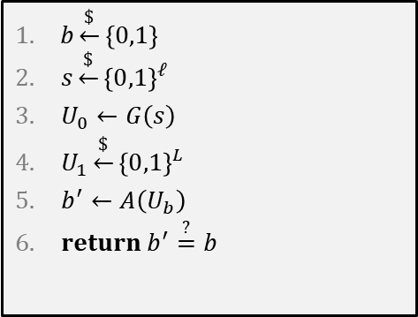
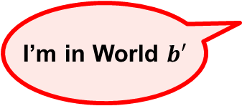
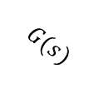

PRNG – security definition
$$Exp_{G}^{prg}\left(A\right)$$
World 0
$$s\underset{←}{\$}{\left\{0,1\right\}}^{ℓ}$$ return $G(s)$
World 1
$$U\underset{←}{\$}{\left\{0,1\right\}}^{L}$$ return $U$
$b\underset{←}{\$}\left\{0,1\right\}$
$s\underset{←}{\$}{\left\{0,1\right\}}^{ℓ}$
$U_{0}←G\left(s\right)$
$U_{1}\underset{←}{\$}{\left\{0,1\right\}}^{L}$
$b^{′}←A\left(U_{b}\right)$
$return b^{′}\overset{?}{=}b$
$$G(s)$$
$$U$$
I’m in World $b′$
Definition: The PRNG advantage of an adversary $A$ is
$${Adv}_{G}^{prg}\left(A\right)=2⋅\left|\operatorname{Pr}\left[Exp_{G}^{prg}\left(A\right)⇒true\right]−1/2 \right|$$

Slide 8










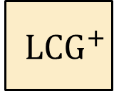
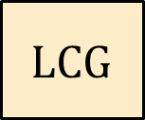

Linear Congruential Generator
$a$, $b$, $M$ are public
$$aX_{2}+b$$
$$aX_{1}+b$$
$$X_{n}←aX_{n−1}+b \left(\operatorname{mod}{M}\right)$$
$$aX_{0}+b$$
Completely insecure!
$$LCG$$
$$X_{0}$$
$$X_{1} X_{2} X_{3} ⋯ X_{ℓ}$$
(Learning $X_{1}$ reveals all other $X_{2}$, $X_{3}$, $…$ )
$${ LCG}^{+}$$
$$X_{0}$$
$$Y_{1} Y_{2} Y_{3} ⋯ Y_{ℓ}$$
Still completely insecure!
$$Y_{i}←top 32 bits of X_{i}$$
(Learning a few $Y_{i}$ reveals all other $Y_{j}$ )

Slide 9








Creating PRNGs – CTR-mode
pick randomly
ctr
ctr+1
ctr+2
ctr+3
ctr+4
ctr+5
$${ E}_{K}$$
$${ E}_{K}$$
$${ E}_{K}$$
$${ E}_{K}$$
$${ E}_{K}$$
$$⋯$$
keystream
$$M$$
=
$$C_{0}$$
$$C$$

Slide 10




Stream ciphers
Security requirement: For all $N$ the function $G^{N}(⋅)$ is a secure PRG
$$N$$
not IND-CPA secure!
$$G$$
$$s$$
$$S$$
$$M$$
=
$$C$$
$$Enc :𝒦×𝒩×ℳ→𝒞$$
$$Enc_{K}^{N}\left(M\right)=N || G^{N}\left(K\right)⊕M$$
Stream cipher

Slide 11




Stream ciphers – CTR-mode
Stream cipher
PRNG
Nonce
Seed / key
ctr
ctr+1
ctr+2
ctr+3
ctr+4
ctr+5
$${ E}_{K}$$
$${ E}_{K}$$
$${ E}_{K}$$
$${ E}_{K}$$
$${ E}_{K}$$
$$⋯$$
keystream
$$M$$
=
$$C_{0}$$
$$C$$

Slide 12

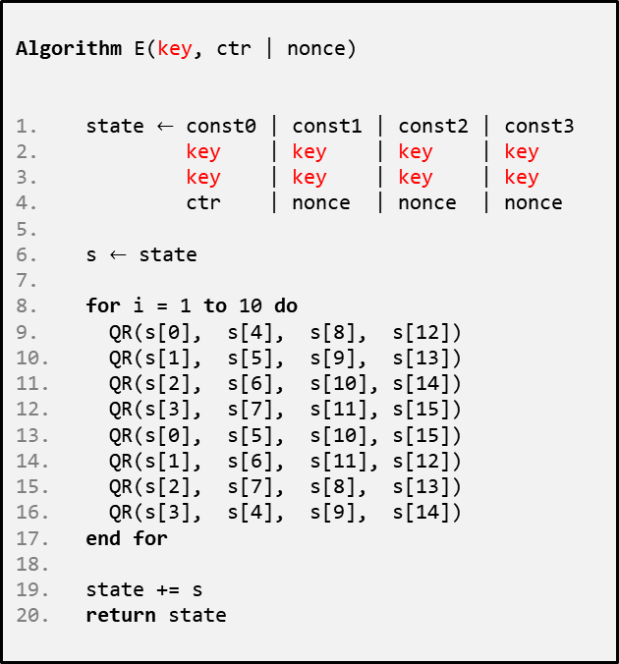


ChaCha20
$$E :{\left\{0,1\right\}}^{256}×{\left\{0,1\right\}}^{128}→{\left\{0,1\right\}}^{512}$$
Algorithm E(key, ctr | nonce)
state $←$ const0 | const1 | const2 | const3
$←$ key | key | key | key
$←$ key | key | key | key
$←$ ctr | nonce | nonce | nonce
s $←$ state
for i = 1 to 10 do
QR(s[0], s[4], s[8], s[12])
QR(s[1], s[5], s[9], s[13])
QR(s[2], s[6], s[10], s[14])
QR(s[3], s[7], s[11], s[15])
QR(s[0], s[5], s[10], s[15])
QR(s[1], s[6], s[11], s[12])
QR(s[2], s[7], s[8], s[13])
QR(s[3], s[4], s[9], s[14])
end for
state += s
return state
0
1
2
3
s =
4
5
6
7
8
9
10
11
12
13
14
15
Algorithm QR(a, b, c , d)
a += b; d ^= a; d <<<= 16;
c += d; b ^= c; b <<<= 12;
a += b; d ^= a; d <<<= 8;
c += d; b ^= c; b <<<= 7;
ChaCha20:
1|nonce
2|nonce
3|nonce
4|nonce
$${ E}_{K}$$
$${ E}_{K}$$
$${ E}_{K}$$
$${ E}_{K}$$
$$⋯$$
keystream

Slide 13
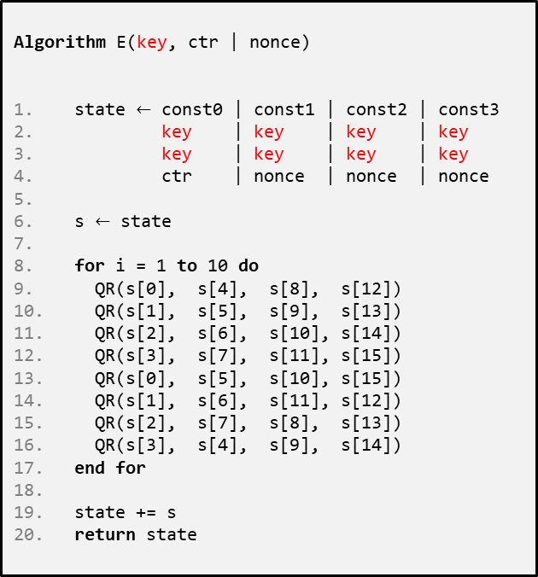
ChaCha20
Extremely simple
  only ARX operations (add-rotate-xor)
Very fast in SW
  no HW support required
  faster than AES(-CTR) without AES-NI instructions
Constant time – no tables
No key-setup, no subkeys
Often combined with the MAC Poly1305 to create an AEAD
Designed by Daniel J. Bernstein
Algorithm E(key, ctr | nonce)
state $←$ const0 | const1 | const2 | const3
$←$ key | key | key | key
$←$ key | key | key | key
$←$ ctr | nonce | nonce | nonce
s $←$ state
for i = 1 to 10 do
QR(s[0], s[4], s[8], s[12])
QR(s[1], s[5], s[9], s[13])
QR(s[2], s[6], s[10], s[14])
QR(s[3], s[7], s[11], s[15])
QR(s[0], s[5], s[10], s[15])
QR(s[1], s[6], s[11], s[12])
QR(s[2], s[7], s[8], s[13])
QR(s[3], s[4], s[9], s[14])
end for
state += s
return state

Slide 14

Randomness

Slide 15
Statistical tests
What does that even mean?
Suggestions:
  A random string should have roughly 50% zeros and ones (how much can you deviate?)
  A continuous run of zeros (or ones) shouldn't be too long (how long?)
  ≈ 25% of 2-bit substrings should be 00, 25% should be 01, …
  ≈ 12.5% of 3-bit substrings should be 000, 12.5% should be 001, ….
  …
Is this a random string?
10101001110101100010010001111100001010100000000101001111111001110111101
00000000000000000000000000000000001111111111111111111111111111111111111111
What about this?
Our answer: question not valid!
Notes:
Randomness is about the process that generated the string, not the string itself! Hence, it does not make sense to ask whether a given string 110101010 is random. However, we can ask about the randomness of the process that produced this string. As an extension, it makes sense to talk about the randomness (a.k.a., the entropy) of a random variable $X$ (drawn from some probability distribution), without "looking" at the value of the random variable. However, once we "look" at the value of $X$ and determine its value, we can no longer talk about it being random or not. It simply is a value at this point.

Slide 16
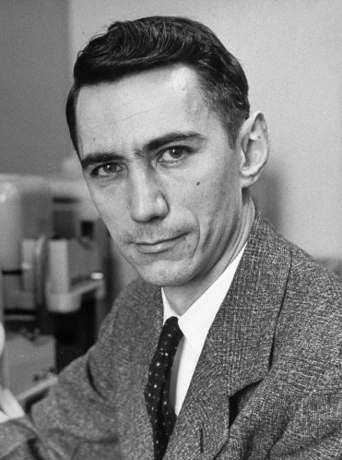


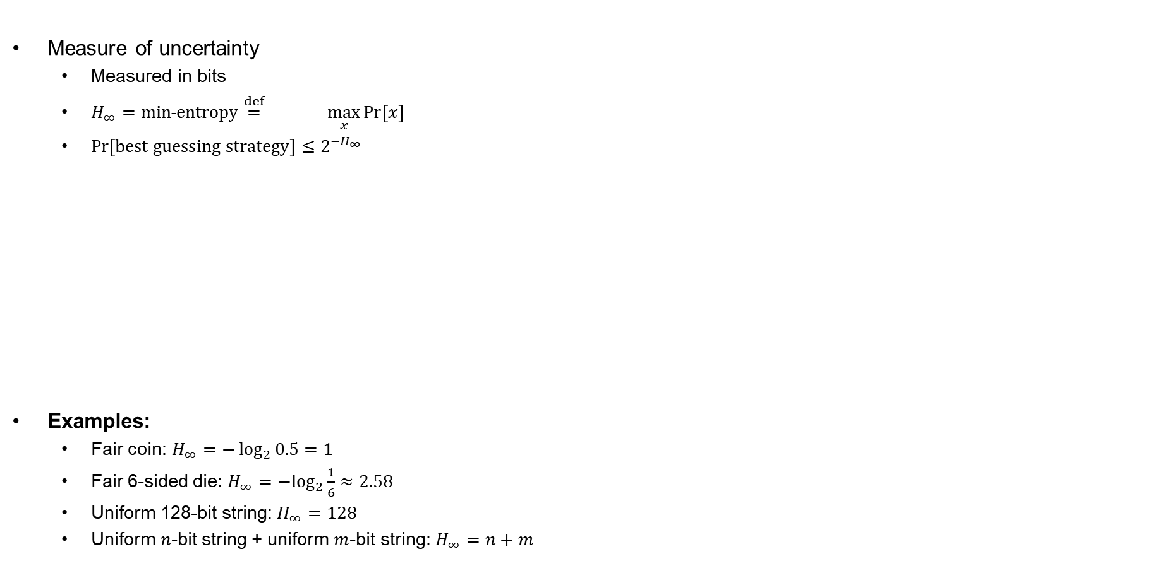



Entropy
Measure of uncertainty
  Measured in bits
  $H_{∞}=min˗entropy\overset{def}{=} \max_{x}{\operatorname{Pr}\left[x\right]}$
  $\operatorname{Pr}\left[best guessing strategy\right]≤2^{−H_{∞}}$
Examples:
  Fair coin: $H_{∞}=−\log_{2}{0.5=1}$
  Fair 6-sided die: $H_{∞}={−log}_{2}{\frac{1}{6}}≈2.58$
  Uniform 128-bit string: $H_{∞}=128$
  Uniform $n$-bit string + uniform $m$-bit string: $H_{∞}=n+m$
$$\log_{2}\left(\max_{x}{\operatorname{Pr}{[x]}}\right)$$
$$−$$
$$H_{∞}=−\log_{2}{0.25=2}$$
$$H_{∞}=−\log_{2}{0.5=1}$$
$$H_{∞}=−\log_{2}{1=0}$$
Claude Shannon

Slide 17
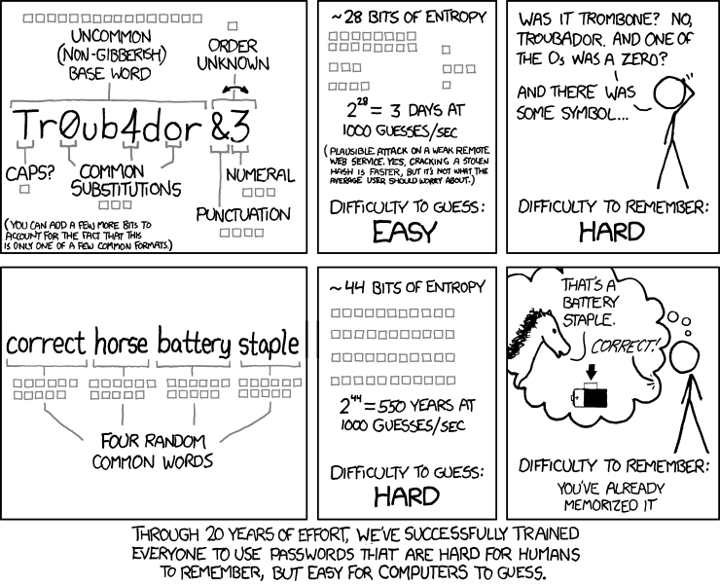
Password strength
https://xkcd.com/936
Notes:
Uncommon word list of size 65000 = 16 bits
0,a,o transformations $≈$ 3-4 bits
Capitalize or not = 1 bit
Unknown order of trailing number odd special character = 1 bit
Number $≈$ 3 bits
Special character = 3 bits
Unknown punctuation $≈$ 4 bits
Total = 16 + 3 + 1 +1 + 3 + 4 = 28 bits
Four random words from words list of size 2048 (11 bits) = 11 + 11 + 11 + 11 = 44 bits

Slide 18
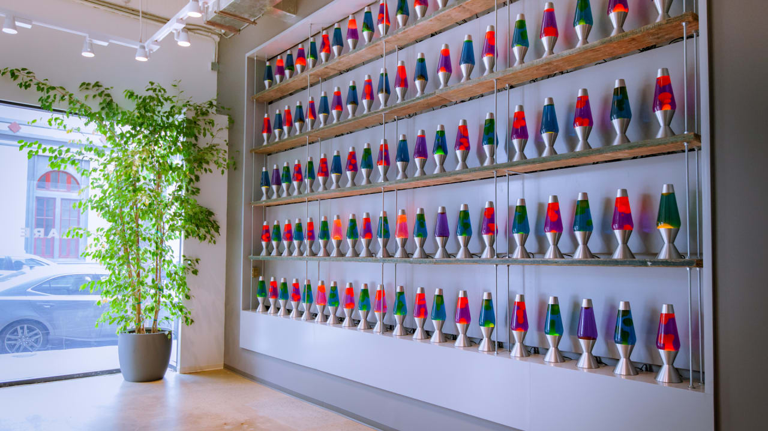
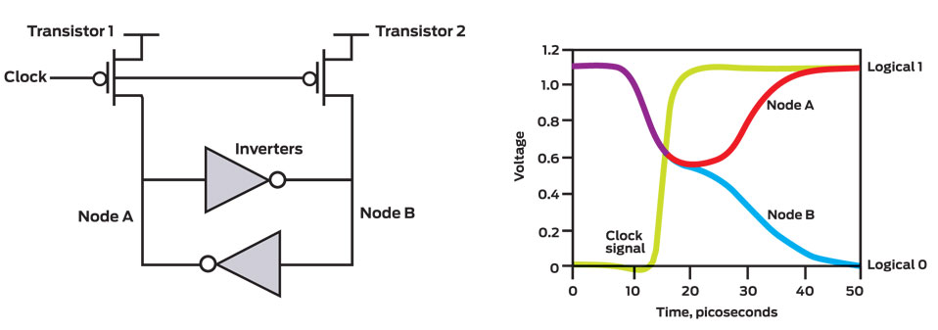
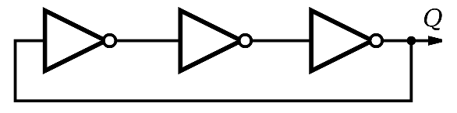
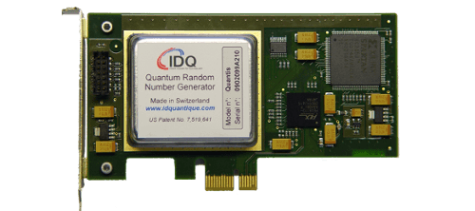

TRNG
Thermal noise
Entropy sources
https://www.cloudflare.com/learning/ssl/lava-lamp-encryption/
Ring oscillators
Quantum magic
(radioactive decay, quantum tunneling, etc…)

Slide 19

Ring-oscillators
Shot noise
Thermal agitation
Clock
sample
sample
sample

Slide 20
Ring-oscillators
Clock
sample
sample
sample

Slide 21
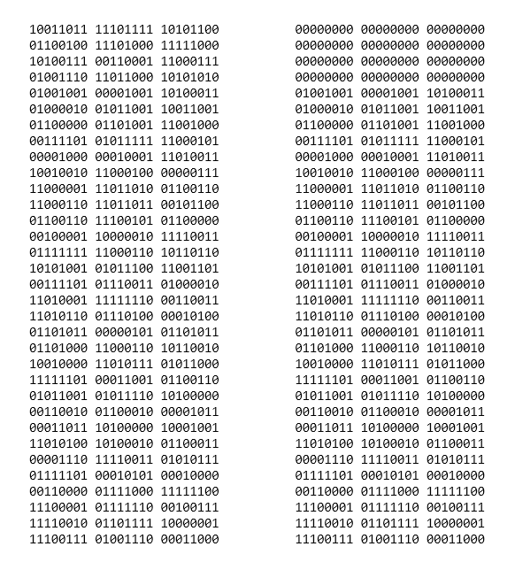
High entropy = good keys?
Have a (long) string X with 128 bits of min-entropy
Want 128 bits for AES key Y. How do you choose Y?
X
Y

Slide 22
High entropy = good keys?
Have a (long) string X with 128 bits of min-entropy
Want 128 bits for AES key Y. How do you choose Y?
Bits of X may be biased and dependent
Want to "concentrate" the entropy in X into a string Y of only 128 bits
Bits of Y should be non-biased and independent
X
Y

Slide 23
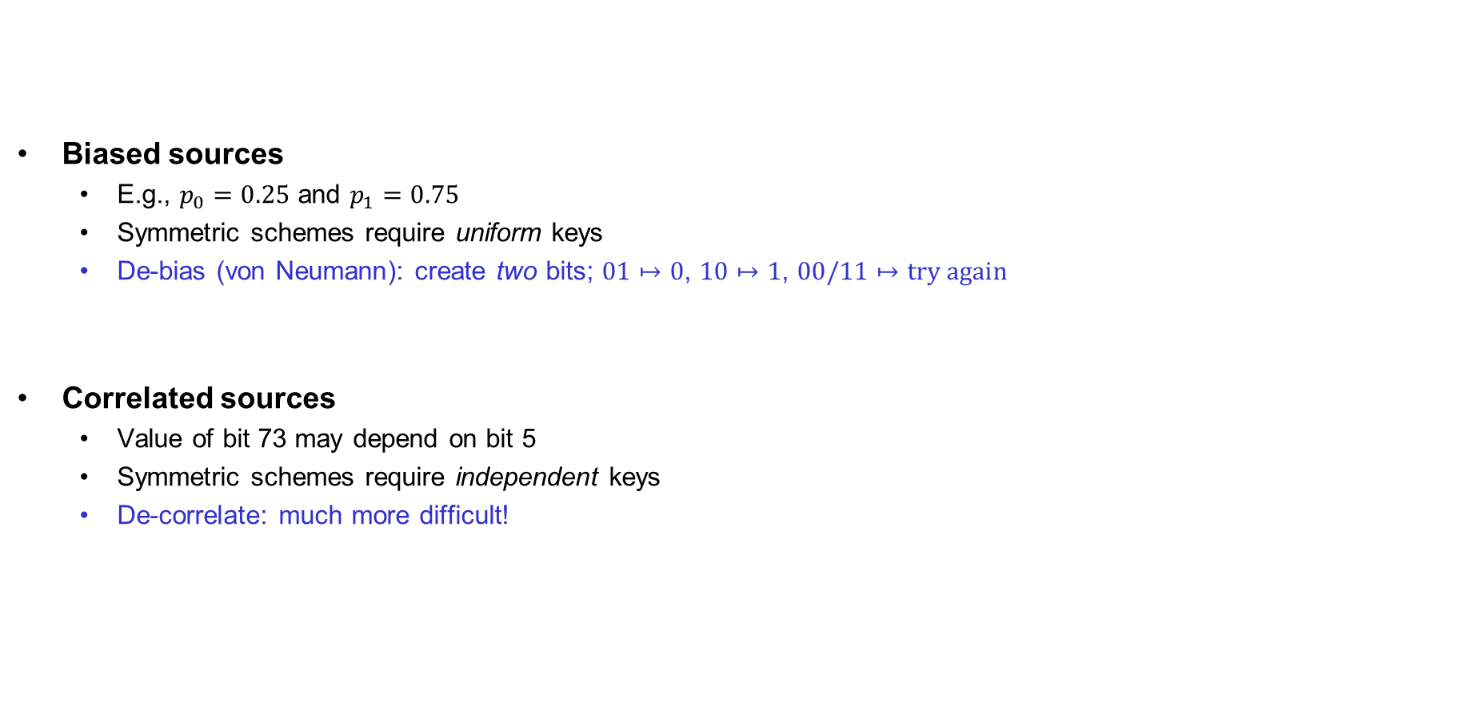
Problems with TRNGs
…and slow!
Biased sources
  E.g., $p_{0}=0.25$ and $p_{1}=0.75$
  Symmetric schemes require uniform keys
  De-bias (von Neumann): create two bits; $01↦0$, $10↦1$, $00/11↦try again$
Correlated sources
  Value of bit 73 may depend on bit 5
  Symmetric schemes require independent keys
  De-correlate: much more difficult!
(in practice: hash with SHA2-256)
(in practice: hash with SHA2-256)

Slide 24

Random generators
Common design:
  TRNG generates random bits with high entropy
  Short uniform seed extracted from random bits
  PRNG expands seed to “infinite” length
Examples:
  /dev/urandom
  CryptGenRandom
  Intel RDRAND
Debian OpenSSL RNG bug
  // MD_Update(&m,buf,j);
  Only 32,767 possibilities for seed ≈ 15 bits of entropy
RNG
TRNG
Entropy sources
$$⋯$$
Health
tests
Secret
state
Mixing
Sampling
Conditioning
(post-processing)
PRNG

Slide 25
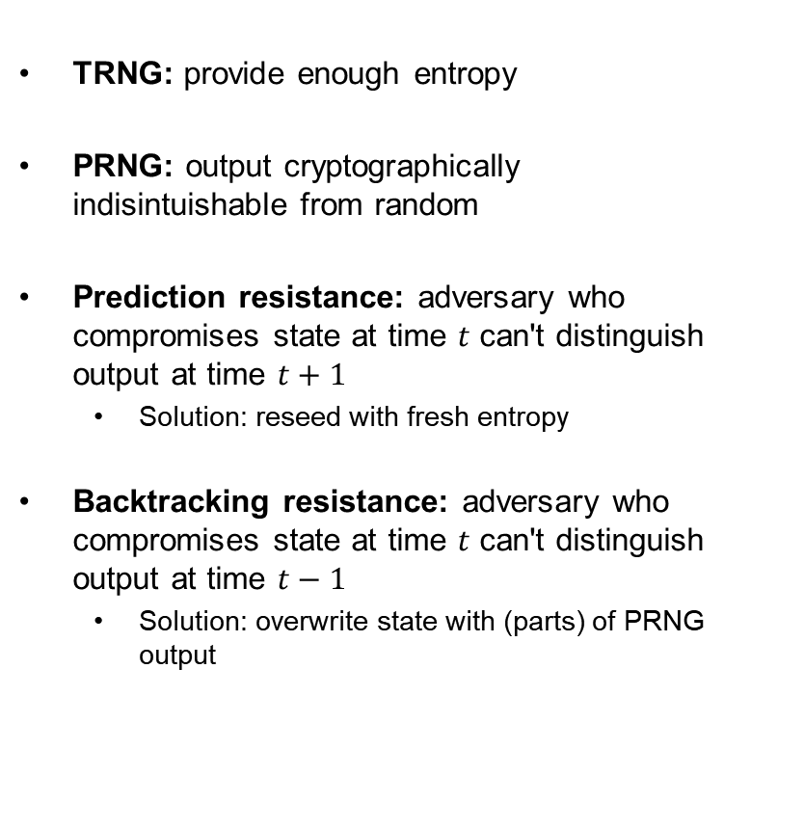
Random generators – security properties and threats
TRNG: provide enough entropy
PRNG: output cryptographically
indisintuishable from random
Prediction resistance: adversary who compromises state at time $t$ can't distinguish output at time $t+1$
  Solution: reseed with fresh entropy
Backtracking resistance: adversary who compromises state at time $t$ can't distinguish output at time $t−1$
  Solution: overwrite state with (parts) of PRNG output
RNG
TRNG
Entropy sources
$$⋯$$
Health
tests
Secret
state
Mixing
Sampling
Conditioning
(post-processing)
PRNG

Slide 26
Key derivation functions (KDF)
Applications typically need many keys
  Traffic encryption keys (send + receive)
  Traffic MAC keys (send + receive)
  Data storage keys
  …
KDF: transform a source of keying material into one or more pseudorandom keys
Common paradigm: extract-then-expand
  Extract: compress high-entropy input key material into short uniform key with high entropy
  Expand: expand short key into many using a PRNG

Slide 27

















Recap: HMAC
$$K_{1}$$
$$M_{1}$$
$$M_{2}$$
$$M_{t}||pad$$
$$h$$
$$h$$
$$h$$
$$⋯$$
$$h$$
$$IV$$
$$T′$$
$$K_{2}$$
$$T^{′}||pad$$
$$h$$
$$h$$
$$IV$$
$$T$$
$${HMAC}_{K}\left(M\right)=H\left( K⊕opad || H\left(K⊕ipad || M\right)\right)$$

Slide 28
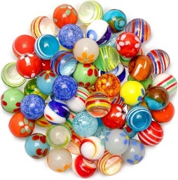



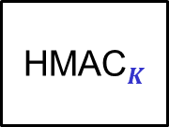








HKDF – HMAC-based KDF
Entropy
$$1$$
$$2$$
$$3$$
salt
HMAC$S$
HMAC$K$
HMAC$K$
HMAC$K$
$$⋯$$
$$K$$
$${ K}_{1}$$
$${ K}_{2}$$
$${ K}_{3}$$
Extract
Expand

Slide 29
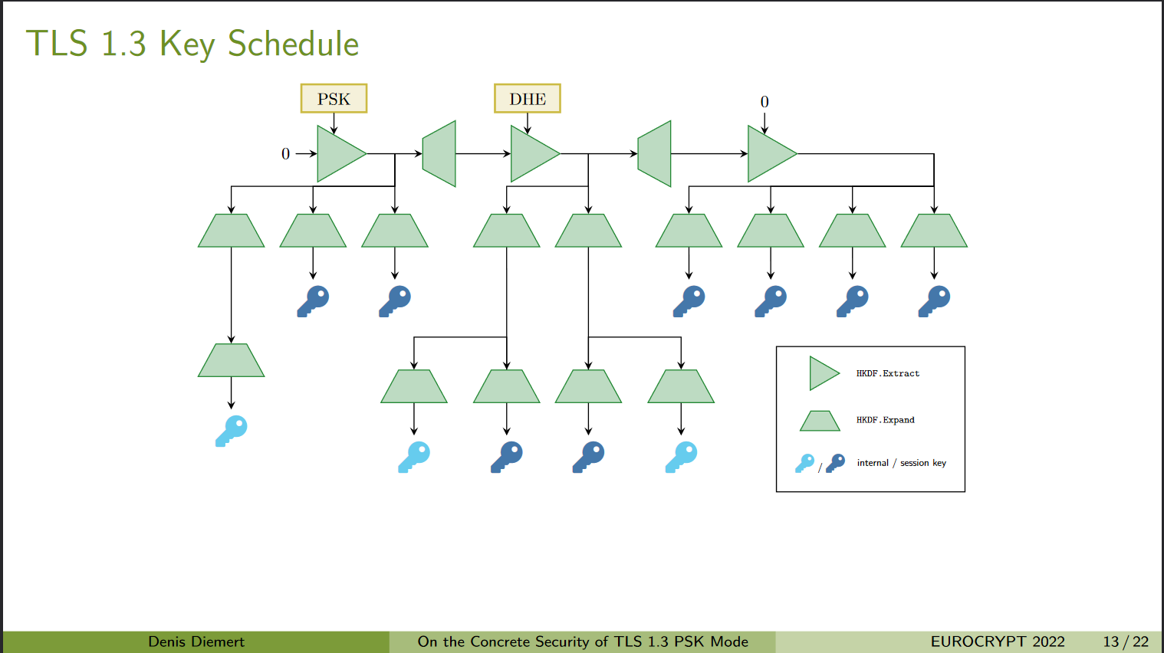
Key derivations in practice

Slide 30
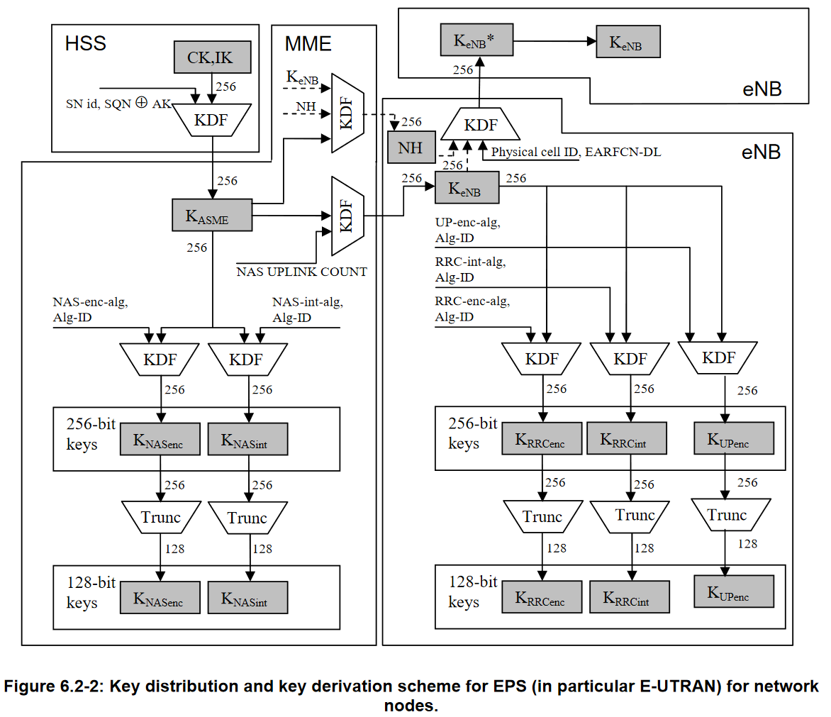
LTE key derivation

Slide 31

End of PART 1
(symmetric Crypto)

Slide 32
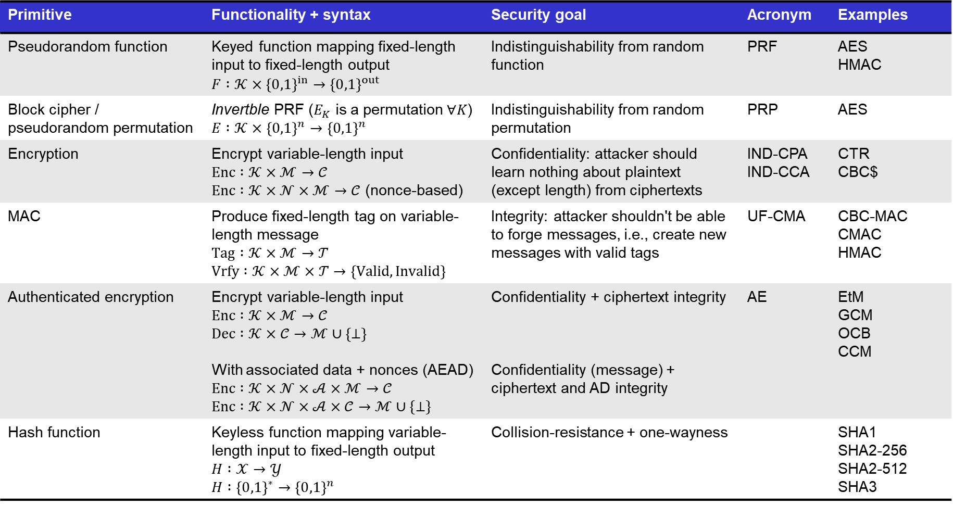
Summary of symmetric cryptography
Primitive | Functionality + syntax | Security goal | Acronym | Examples
Pseudorandom function | Keyed function mapping fixed-length input to fixed-length output $$F :𝒦×{\left\{0,1\right\}}^{in}→{\left\{0,1\right\}}^{out}$$ | Indistinguishability from random function | PRF | AES HMAC
Block cipher / pseudorandom permutation | Invertble PRF ($E_{K}$ is a permutation $∀K$) $$E :𝒦×{\left\{0,1\right\}}^{n}→{\left\{0,1\right\}}^{n}$$ | Indistinguishability from random permutation | PRP | AES
Encryption | Encrypt variable-length input $$Enc :𝒦×ℳ→𝒞$$ $Enc :𝒦×𝒩×ℳ→𝒞$ (nonce-based) | Confidentiality: attacker should learn nothing about plaintext (except length) from ciphertexts | IND-CPA IND-CCA | CTR CBC$
MAC | Produce fixed-length tag on variable-length message $$Tag :𝒦×ℳ→𝒯$$ $$Vrfy :𝒦×ℳ×𝒯→\left\{Valid, Invalid\right\}$$ | Integrity: attacker shouldn't be able to forge messages, i.e., create new messages with valid tags | UF-CMA | CBC-MAC CMAC HMAC
Authenticated encryption | Encrypt variable-length input $Enc :𝒦×ℳ→𝒞$ $$Dec :𝒦×𝒞→ℳ∪\left\{⊥\right\}$$ With associated data + nonces (AEAD) $$Enc :𝒦×𝒩×𝒜×ℳ→𝒞$$ $$Enc :𝒦×𝒩×𝒜×𝒞→ℳ∪\{⊥\}$$ | Confidentiality + ciphertext integrity Confidentiality (message) + ciphertext and AD integrity | AE | EtM GCM OCB CCM
Hash function | Keyless function mapping variable-length input to fixed-length output $H :𝒳→𝒴$ $$H :{\left\{0,1\right\}}^{∗}→{\left\{0,1\right\}}^{n}$$ | Collision-resistance + one-wayness |  | SHA1 SHA2-256 SHA2-512 SHA3

Slide 33
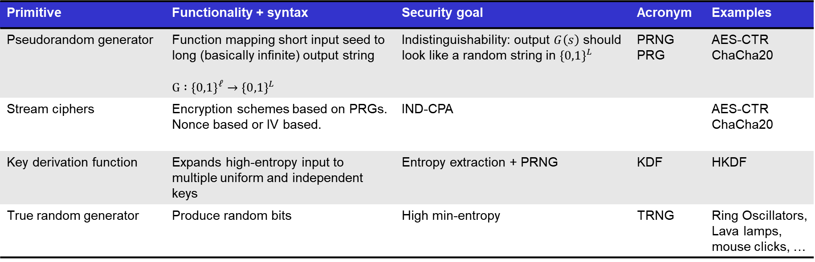
Summary of symmetric cryptography
Primitive | Functionality + syntax | Security goal | Acronym | Examples
Pseudorandom generator | Function mapping short input seed to long (basically infinite) output string $$G :{\left\{0,1\right\}}^{ℓ}→{\left\{0,1\right\}}^{L}$$ | Indistinguishability: output $G\left(s\right)$ should look like a random string in ${\left\{0,1\right\}}^{L}$ | PRNG PRG | AES-CTR ChaCha20
Stream ciphers | Encryption schemes based on PRGs. Nonce based or IV based. | IND-CPA |  | AES-CTR ChaCha20
Key derivation function | Expands high-entropy input to multiple uniform and independent keys | Entropy extraction + PRNG | KDF | HKDF
True random generator | Produce random bits | High min-entropy | TRNG | Ring Oscillators, Lava lamps, mouse clicks, …

