Slide 1
KJM 3110 Electrochemistry
Chapter 4. Electrosynthesis

Slide 2
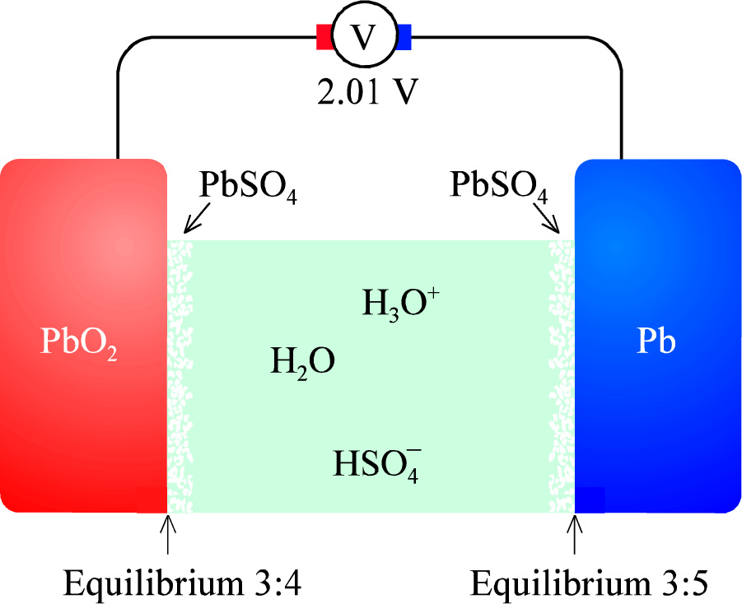
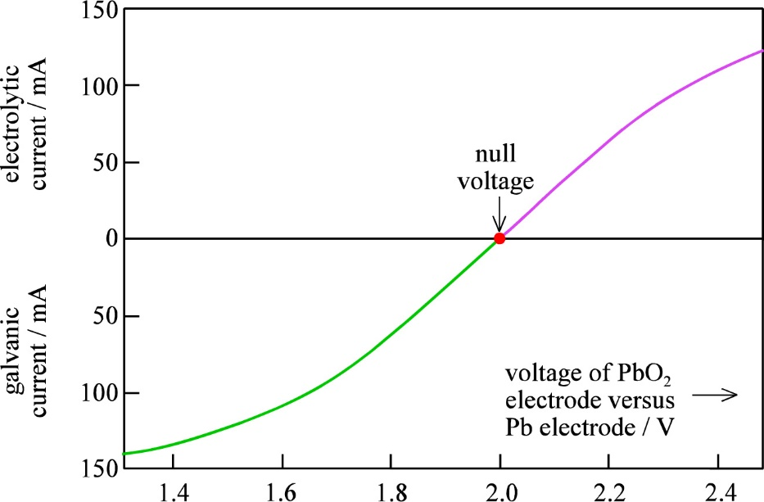
Recap exercise from Ch. 3 Electrochemical cells
Take the lead-acid cell as example.
What is the situation, driving force(s), and processes going on in each of the following cases:
Standard state. (a₁ = a₂ = a₃ … = Q = 1)
  Open circuit.
  Short circuit.
Actual lead-acid battery
  Overall equilibrium (OCV = 0)
  Local electrode equilibrium
    I = 0 (OCV = ?)
  Galvanic operation
    I > 0
  Electrolytic operation
    I < 0

Slide 3


Recap from Ch. 3 Electrochemical cells - Summary
Equilibrium
  I = 0
Galvanic operation
  I > 0
Electrolytic operation
  I < 0

Slide 4
Ch. 4 - Electrosynthesis
Many materials and chemicals can be fabricated most efficiently by electrolysis – electrosynthesis.
For many, it is the only known way.
  Electrowinning from ore
  Exclusive: Li, Na, K, Mg, Ca, Sr, Ba, Ra, Al, Ta (+ F₂, Cl₂)
  Competitive: Cr, Mn, Co, Ni, Cu, Ag, Au, Zn, Cd, Ga, In, Tl
In this chapter we familiarize ourselves with such processes.
This will make us understand further the importance of electrochemistry
and strengthen our understanding of electrolytic cells and processes

Slide 5



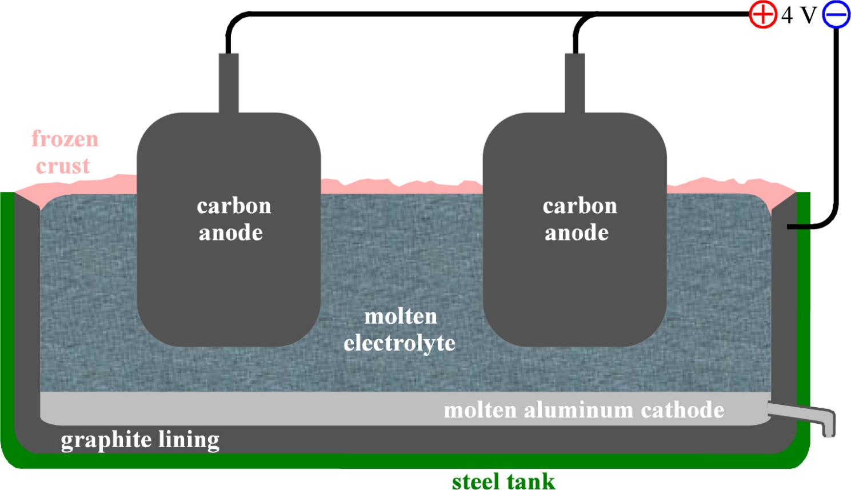
Metal production – example: Al by Hall-Hèrault
Al₂O₃ dissolved in melt of cryolite Na₃AlF₆ (+CaF₂):
Al₂O₃ + 8F⁻ = 2AlF₄⁻ + 3O²⁻ |2
|4
|3

Slide 6
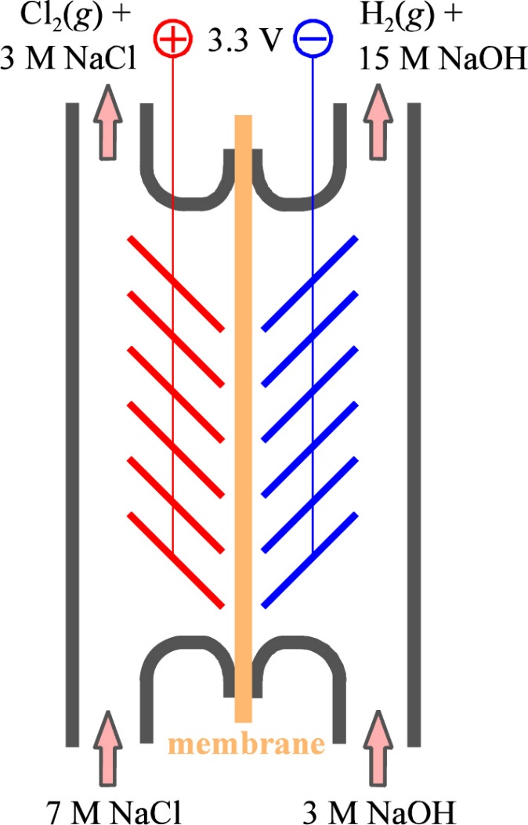

Chloralkali industry
NaCl(aq) + electricity
Products are Cl₂ and H₂ and OH⁻
OH⁻ (NaOH) recycled
Role of membrane?
Many further products
  OCl⁻, ClO₃⁻, ClO₄⁻
Check equations 4.6-4.11

Slide 7


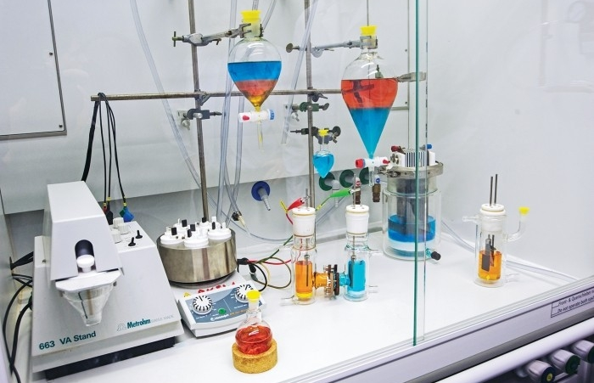
Organic electrosynthetic chemistry
Relatively new field of electrochemistry
Nylon
  Hydrogenation step on Cd electrode; acrylonitride to adiponitrile

Slide 8
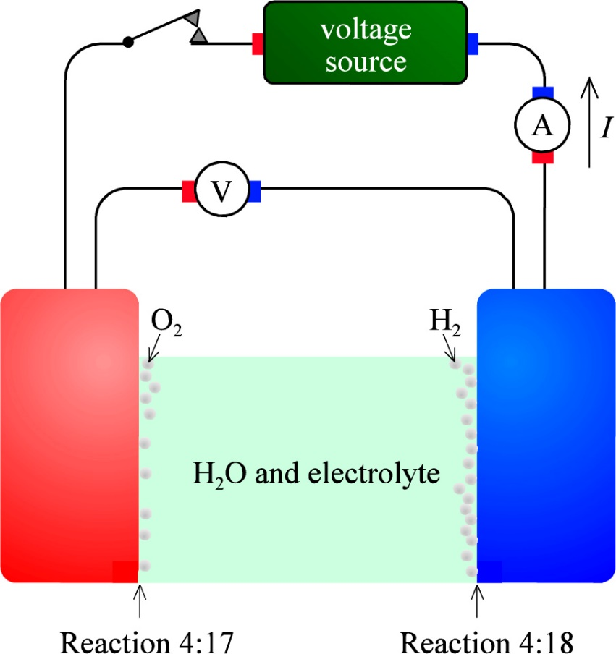
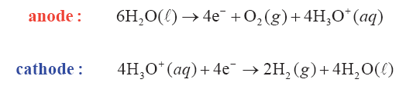

Electrolysis of water
ΔG⁰ = 474.2 kJ/mol E⁰ = 1.229 V

Slide 9



Electrolysis of water - negatrode
Hg, Ag, Pb, Cu, Fe:
Mo, W, Ti, Ta:
Pd, Rh, Ir:
Negatrode

Slide 10
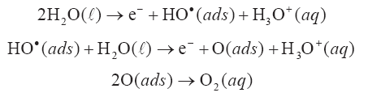
Electrolysis of water - positrode
Metals
  suggested steps, via HO. (or OH.) radicals:
Electrolysis can also be done in alkaline electrolyser to produce H₂ and O₂
Alternative catalysts can produce intermediate peroxy species at one or both electrodes, e.g.
Positrode
Negatrode

Slide 11
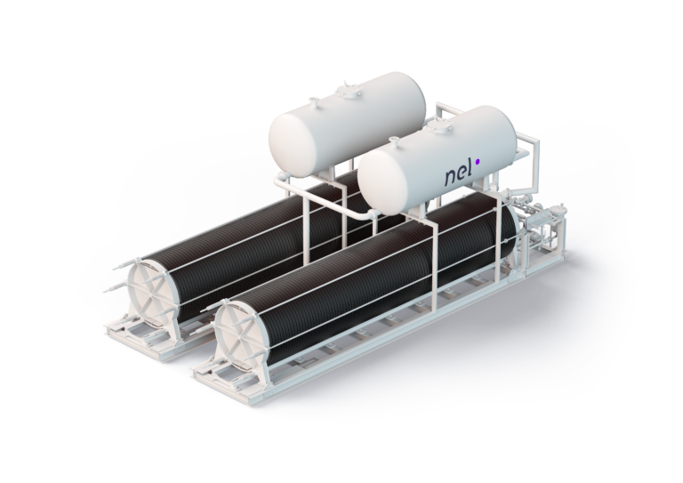
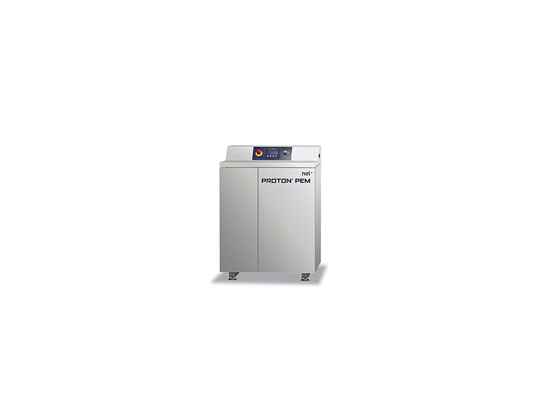
Alkaline (OH⁻) and PEM (H₃O⁺) electrolysers
NEL (Norway) one of the World’s leading suppliers
  Originated from Norsk Hydro’s electrolysers for ammonia production
  Product line: https://nelhydrogen.com/water-electrolysers-hydrogen-generators/
Medium sized to large alkaline electrolysers
Small to medium sized PEM electrolysers

Slide 12
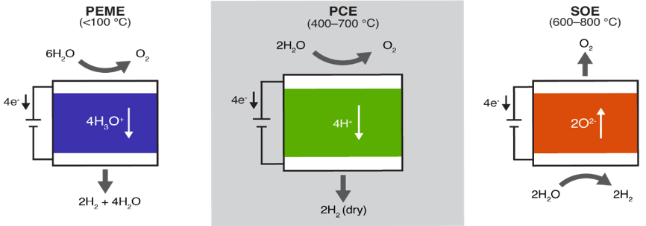
Steam electrolysis
Norway has expertise in solid-state high-temperature (ceramic) electrolytes
Enables electrolysis of steam rather than liquid water
Thermodynamically more beneficial if steam and/or heat is free and available
Main features of PEM, proton ceramic, and solid oxide electrolysers:
Vøllestad, E. et al., Nature Materials 2019

Slide 13
Heat balance of electrochemical processes;
Steam electrolysis
ΔH_{react} + q + w_{el} = ΔH_{prod}
H₂O = H₂ + ½ O₂
H₂O(g) = H₂(g) + ½ O₂(g)
H₂O(l) = H₂(g) + ½ O₂(g)
Electrical efficiency:
f_{el} = w_{el}/(ΔH_{prod} - ΔH_{react})
At q=0: w_{el} = ΔG_{r} and f_{el} = ΔG_{r} /ΔH_{r}
= (ΔH_{r} – TΔS_{r})/ΔH_{r} = 1 – TΔS_{r}/ΔH_{r}
Faradaic efficiency f_{f} = ratio of product rate over current
Total efficiency f_{t} = f_{el} * f_{f}
q = 0: Thermoneutral
q
Electrochemical cell
ΔH_{react}
ΔH_{prod}
w_{el}

Slide 14
Exercise
In the previous slide, what contributes to the heat exchange q?
At thermoneutral operation, q = 0. Express this situation with words.
Why – qualitatively – is steam electrolysis thermodynamically better than water electrolysis?

Slide 15
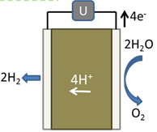

3 unique technologies by proton ceramics for H₂
Steam electrolysis & compressor
  2H₂O = O₂ + 2H₂
      Duan, C. et al., Nature Energy 2019
      Vøllestad, E. et al., Nature Materials 2019
Methane dehydroaromatization (MDA); GTL
  6CH₄ = C₆H₆ + 9H₂
      Morejudo, S. et al., Science 2016
Proton membrane reforming (PMR)
  CH₄ + 2H₂O = CO₂ + 4H₂
      Malerød-Fjeld, H. et al., Nature Energy 2017
U
8H⁺
6CH₄
9H₂
C₆H₆
U
8H⁺
CH₄+2H₂O
4H₂
CO₂

Slide 16
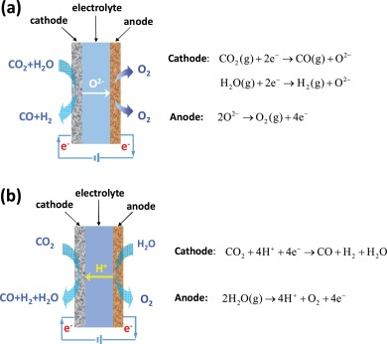
CO₂ utilisation hype: CO₂ + H₂O co-electrolysis
Zhang et al. describes co-electrolysis using O²⁻ or H⁺ conducting high-temperature solid-state electrolytes
One produces dry, the other wet synthesis gas (CO + H₂)
X. Zhang et al., J. Energy Chemistry, 26 [5] (2017), 839-853

Slide 17
Exercise
What is syngas, and what is it used for?
In the previous slide, the O²⁻ ion conductor provides a better process than the H⁺ conductor, because the syngas is preferably dry
Can the H⁺ conducting cell be improved by a different stoichiometry (mix) of the reactants?
Can a material with mixed O²⁻ and H⁺ conduction be used as electrolyte? Sketch its operation.
Check out https://www.youtube.com/watch?v=Y2DUMJMba2E&feature=youtu.be

Slide 18
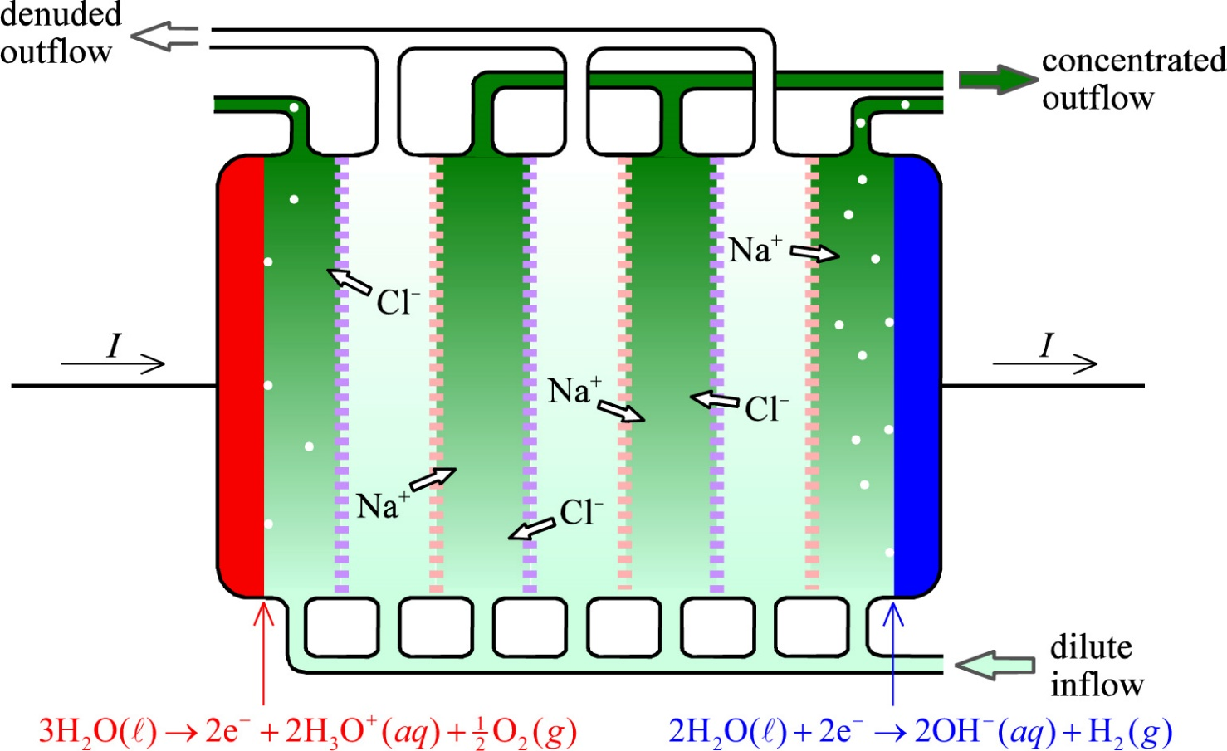
Use of ion-selective membranes; Electrodialysis
Example: NaCl solution inflow split in denuded and concentrated outflows

Slide 19
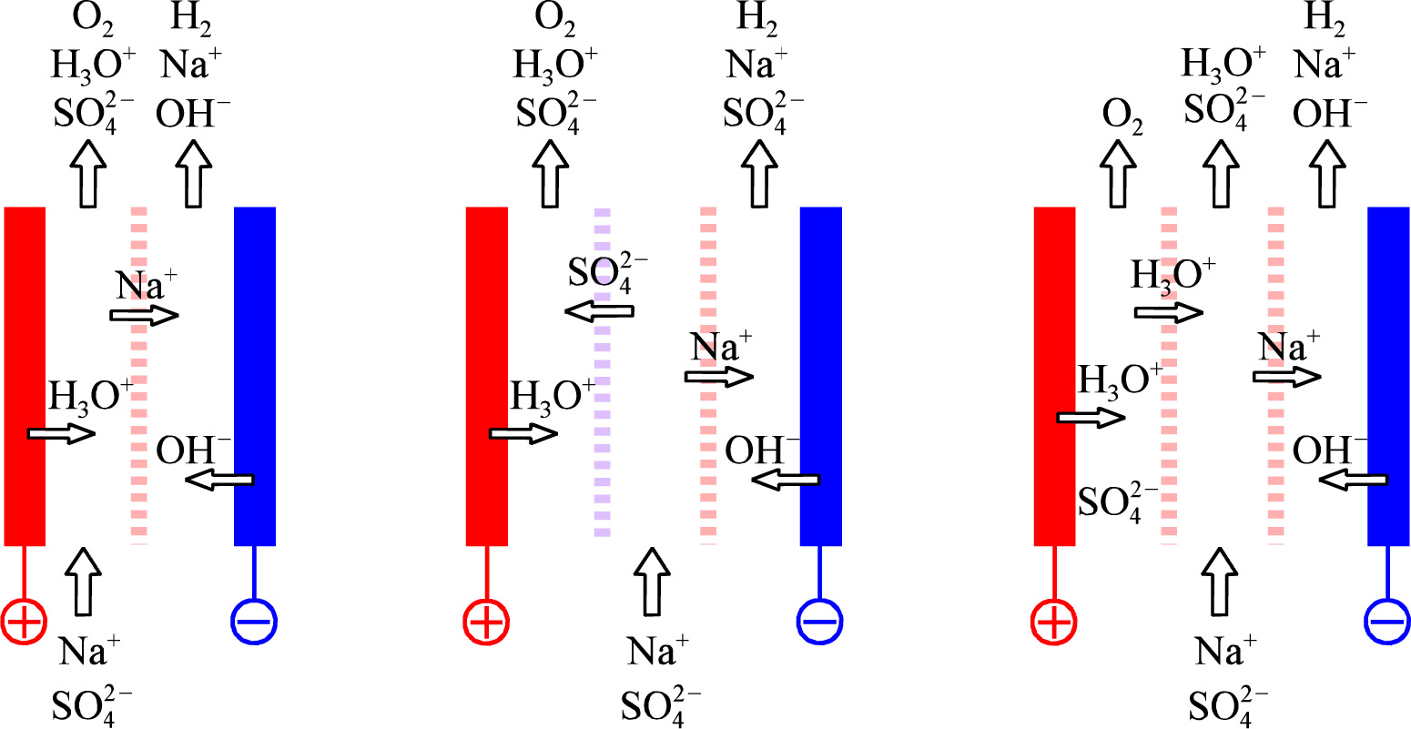
Salt splitting with various ion-selective membranes
H₂ and O₂ evolved as byproducts. Example Na₂SO₄

Slide 20
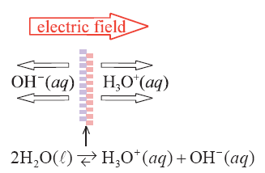
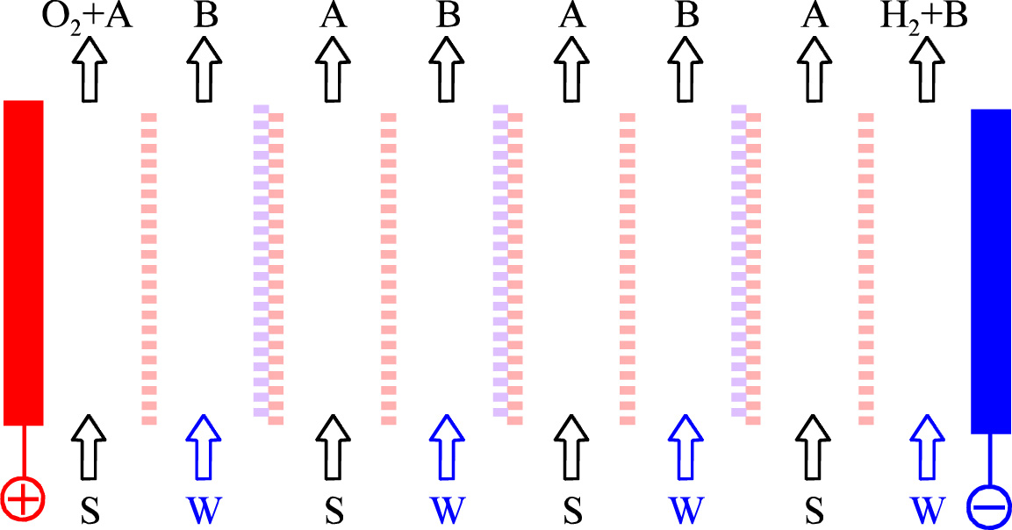
Salt splitting with bipolar membranes
Salt + Water becomes Acid + Base
NaCl(aq) + H₂O = HCl(aq) + NaOH(aq)

Slide 21
Ch. 4 Electrosynthesis - Summary
We have seen some industrial examples of electrolytic operation of electrochemical cells for production of high-energy fuels and chemicals
  Some important
    Hall-Hèrault for aluminium
    Chlor-alkali for chlorine products
    Electrolysis for H₂
  Some new trends
    Organic electrosynthesis
Applications of high-temperature solid electrolytes pursued at UiO
Ion-selective membranes give additional possibilities
In electrosynthesis, otherwise impossible reactions become possible
  The electronic energy adds to or – more typically – overpowers the chemical energy
    Thermodynamic
    Kinetic (can also give unique selectivities)
“Control chemistry by controlling electrons”

