Slide 1
KJM 3110 Electrochemistry
Chapter 5. Electrochemical power

Slide 2
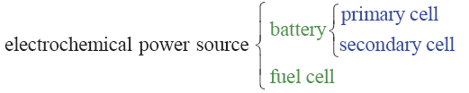
Electrochemical power
Previous chapter: Electrical energy to chemical (Gibbs) energy
  Electrolysis
  Charging battery
    Secondary cells; Accumulators, rechargeable batteries)
This chapter: Chemical (Gibbs) energy to electrical energy
  Fuel cell
  Discharging battery
    Primary cells
    Secondary cells; Accumulators, rechargeable battery

Slide 3
Recap from Ch. 4 Electrosynthesis - Summary
We have seen some industrial examples of electrolytic operation of electrochemical cells for production of high-energy fuels and chemicals
  Some important
    Hall-Hèrault for aluminium
    Chlor-alkali for chlorine products
    Electrolysis for H₂
  Some new trends
    Organic electrosynthesis
Applications of high-temperature solid electrolytes pursued at UiO
Ion-selective membranes give additional possibilities
In electrosynthesis, otherwise impossible reactions become possible
  The electronic energy adds to or – more typically – overpowers the chemical energy
    Thermodynamic
    Kinetic (can also give unique selectivities)
“Control chemistry by controlling electrons”

Slide 4
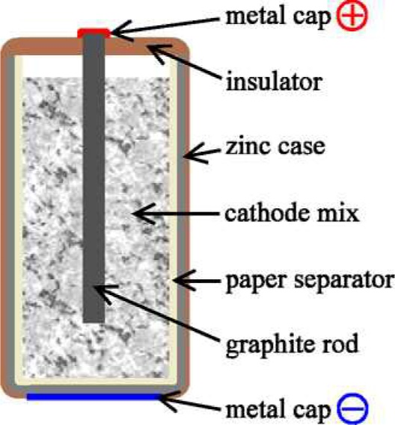
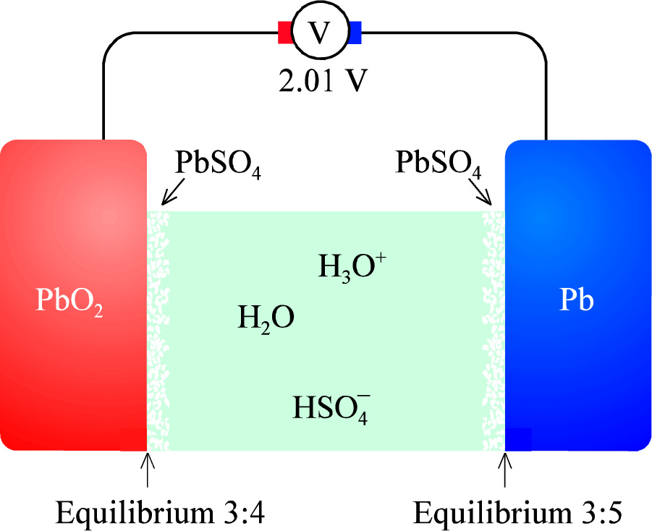
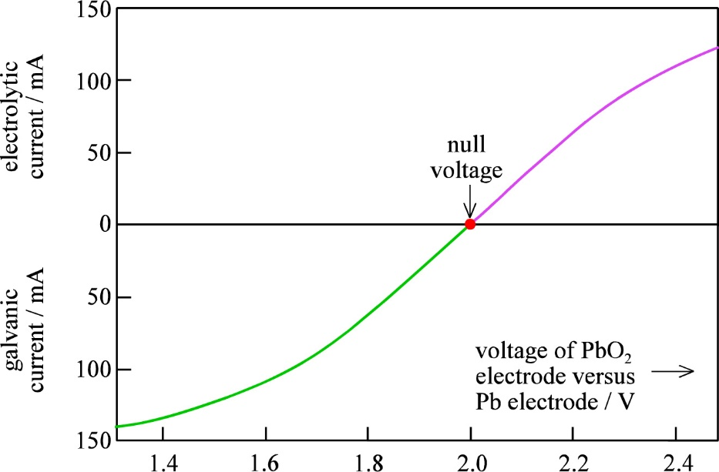
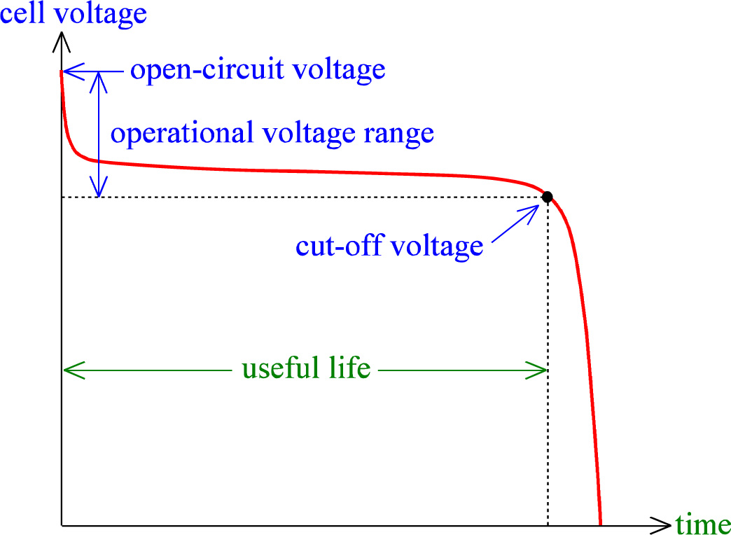
Batteries
Positive and negative electrodes
Positrode and negatrode
Cathode and anode
Nominal voltage
  = OCV fully charged
Cut-off voltage
Where is the null voltage?
Capacity (amount of charge)
  Coulomb, C. Or A s
  C = A s
  1 A h = 3600 A s = 3600 C
Energy
  Unit?
  Energy density
Power
  Unit?
  Power density

Slide 5
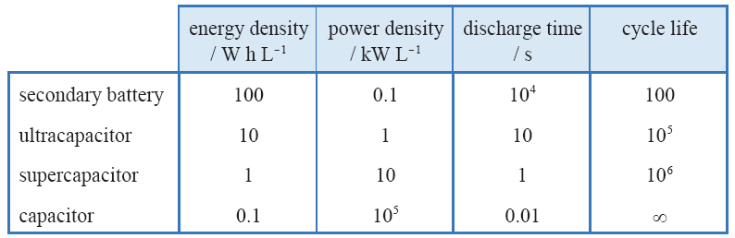
Storage
Battery: Chemistry
Ultracapacitor: Chemistry + electrode interface
Supercapacitor: Electrode interface
Capacitor: Dielectric

Slide 6
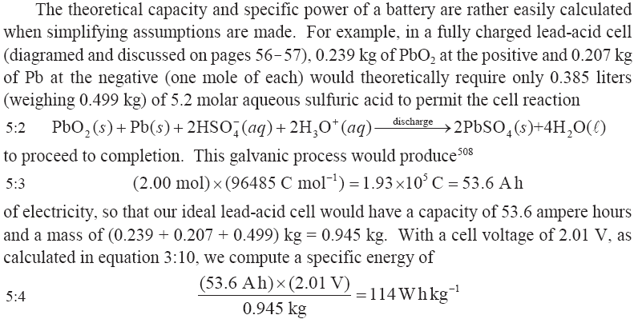
Lead acid battery

Slide 7
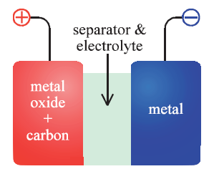


Primary batteries
Volta pile
Daniell cell
Leclanché wet cell with NH₄Cl(aq)
Dry cell
  NH₄Cl + ZnCl₂ paste
  C powder composite cathode

Slide 8
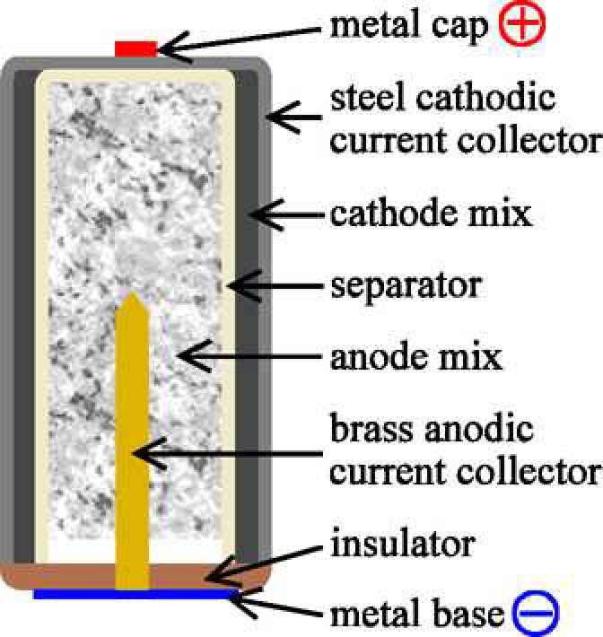
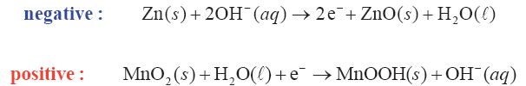
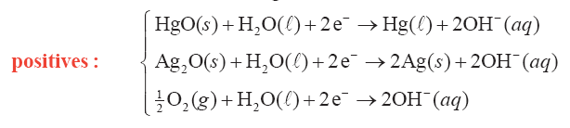
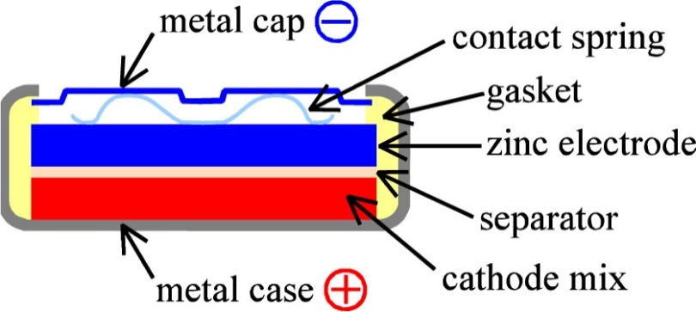
Alkaline batteries
In some ways an inversed design…
Other alkaline positrodes
Air battery

Slide 9
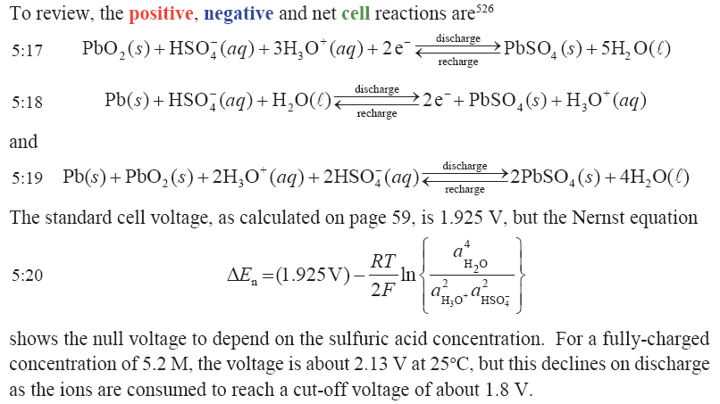
Secondary (rechargeable) batteries (accumulators)
Most widespread: Lead-acid battery.
Repeat from Ch. 3:

Slide 10
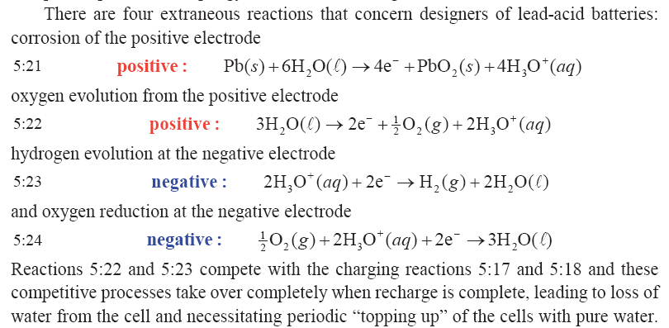
Lead acid batteries: Extraneous reactions
In modern, sealed batteries, diffusion of O₂ + reaction 5.24 replenishes the water.

Slide 11
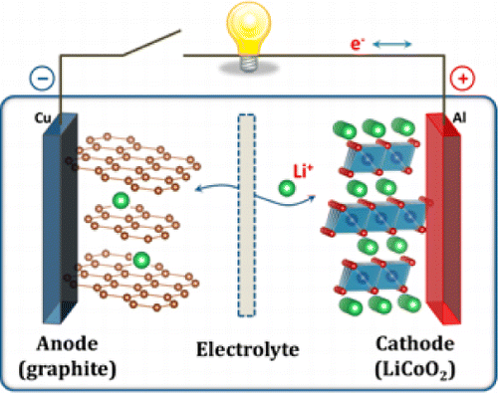
Li-ion batteries
The electrolyte used in most lithium-ion cells is a solution of LiClO₄ or LiAsF₆ in organic carbonates, absorbed in microporous polyolefin separator.
May be represented simple
or more realistic
Copyright 2013, ACS

Slide 12
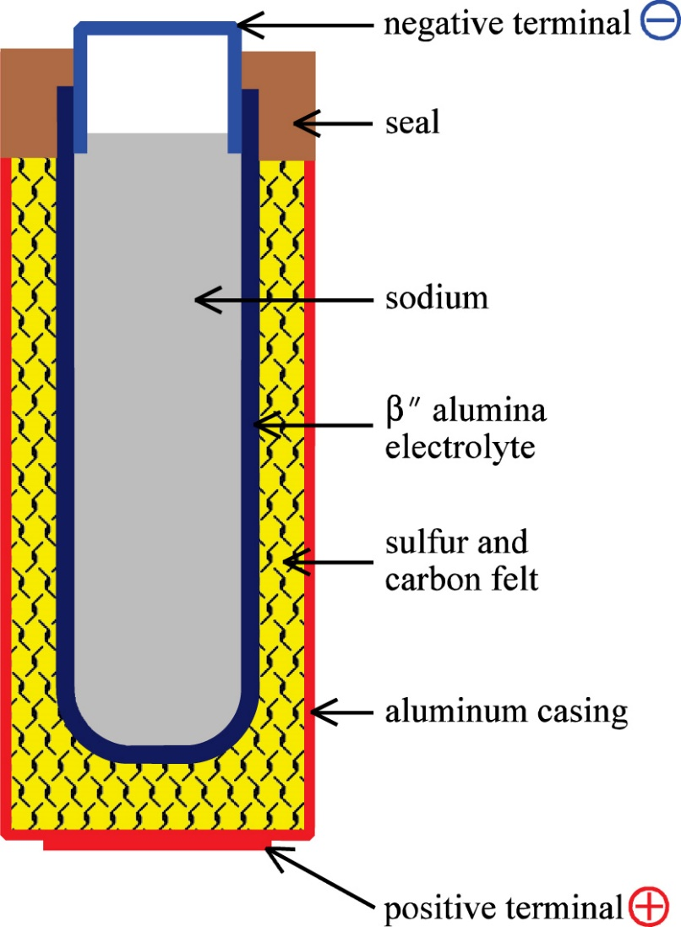
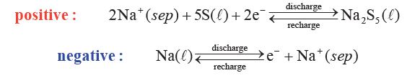
Na-S battery
Exercise: What is the total reaction and Gibbs expression?

Slide 13
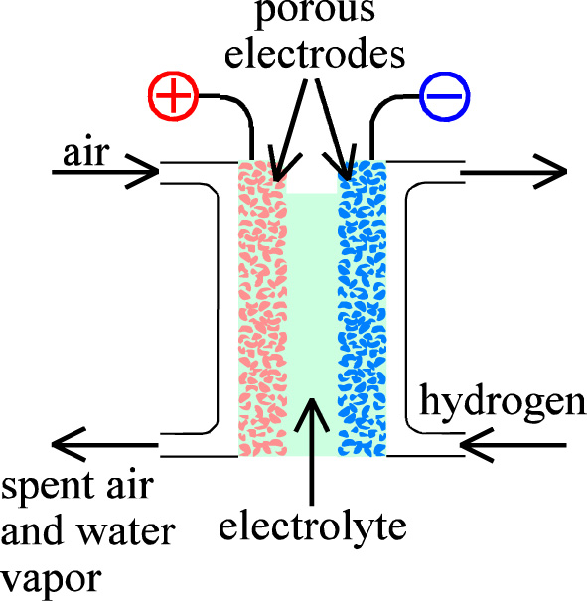
Fuel cells; continuous supply of fuel and oxidant air
Fuels:
  H₂
  Reformed CH₃OH
  Reformed CH₄
Electrolytes:
  Alkaline
  Acid (Phosphoric acid and PEM)
  Molten carbonate
  Solid oxide
  Proton ceramic

Slide 14
Heat balance of electrochemical processes; Fuel cell
q
ΔH_{react} + q + w_{el} = ΔH_{prod}
H₂ + ½ O₂ = H₂O
H₂(g) + ½ O₂(g) = H₂O(g)
(Lower heating value)
H₂(g) + ½ O₂(g) = H₂O(l)
(Higher heating value)
Electrical efficiency:
f_{el} = w_{el}/(ΔH_{prod} - ΔH_{react})
w_{el} = ΔG_{r} and f_{el} = ΔG_{r} /ΔH_{r}
= (ΔH_{r} – TΔS_{r})/ΔH_{r} = 1 – TΔS_{r}/ΔH_{r}
Electrical efficiency depends on whether one uses LHV or HHV
Faradaic efficiency f_{f} = Current over fuel used.
Fuel utilisation f_{u} = fuel spent over total fuel supplied (unspent fuel may be recirculated or afterburnt).
Total efficiency f_{t} = f_{el} * f_{f} *f_{u}
Electrochemical cell
ΔH_{react}
ΔH_{prod}
w_{el}

Slide 15
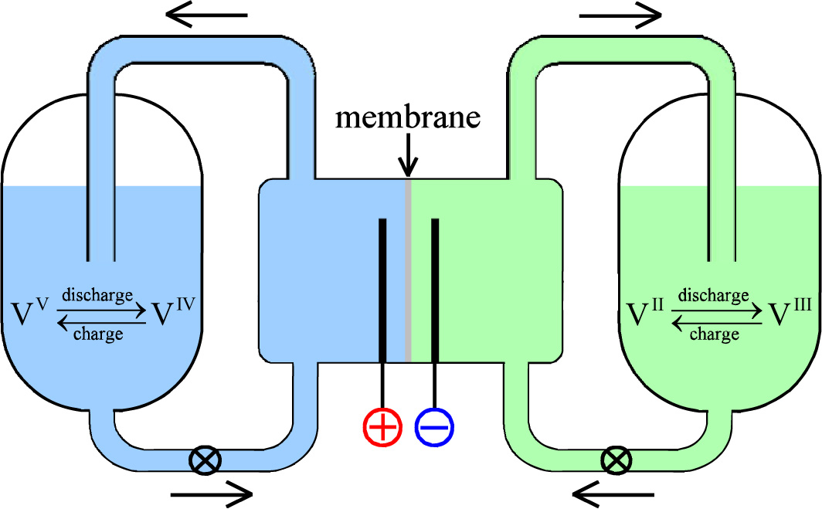
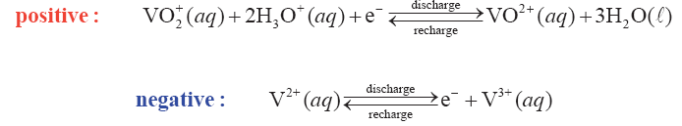
Redox flow battery
What are the electrodes?
What goes on in the membrane?

Slide 16
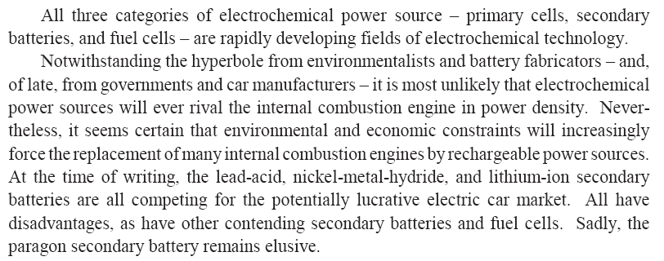
Ch. 5 Summary
Exercise for the class: Discuss each sentence, not least the last one. When was this written?

