Slide 1
KJM 3110 Electrochemistry
Chapter 6. Electrodes

Slide 2
Status and outlook
Till now, we have been introduced to electricity, chemistry and thermodynamics, electrochemical cells and their operating modes
  electrolytic cells (electricity to chemical energy)
  galvanic cells (chemical energy to electricity)
The electrode is the most important and unique part of electrochemistry
Now, we will through several chapters look at electrodes and what goes on there in increasing detail and depth
In Ch 6 “Electrodes” we concentrate on the thermodynamics of electrodes, the null, or open circuit, or Nernst voltage.
  Potentiometry, potentiometric sensors
  (We will not yet look at how it looks (atomically) at electrodes or what happens when we start to draw or apply current (kinetics).

Slide 3
Electrodes
The electrode of interest is called the working electrode (WE)
Potentials of individual electrodes cannot be measured. We can only measure differences
We need as a minimum one other electrode to apply or measure a voltage and pass or measure a current
The other electrode can be called a counter electrode (CE)
ΔE = E_{WE} – E_{CE}
In electrochemistry we often split the counter electrode so as to use 3 electrodes:
  WE Measure current and potential
  RE Reference electrode (reference potential)
  CE Supply current
ΔE = E_{WE} - E_{RE}
Source or load
I
U
WE
CE
Source or load
I
U
WE
RE
CE

Slide 4
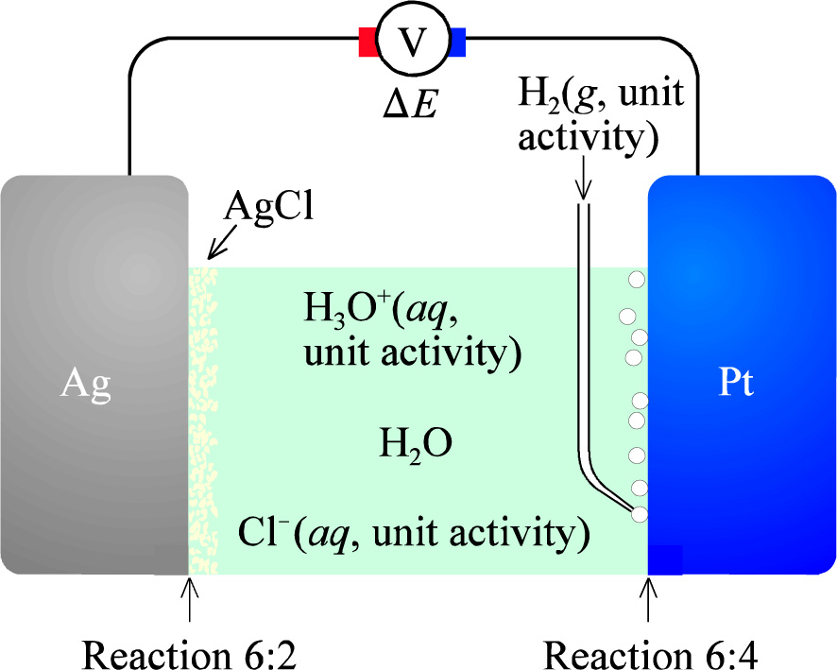
Reference electrodes
The reference electrode provides a stable reference potential, with no current drawn through it.
By defining the potential of one electrode, we can get a consistent system of electrode potentials
The Standard Hydrogen Electrode (SHE) is chosen as the standard reference electrode, to have a standard potential of 0 V.
A more practical reference is the Ag/AgCl electrode
  AgCl(s) + e⁻ ↔ Ag(s) + Cl⁻(aq)
It has a standard potential vs SHE of +0.22216 V.
These reference electrodes are suitable for aqueous cells only

Slide 5
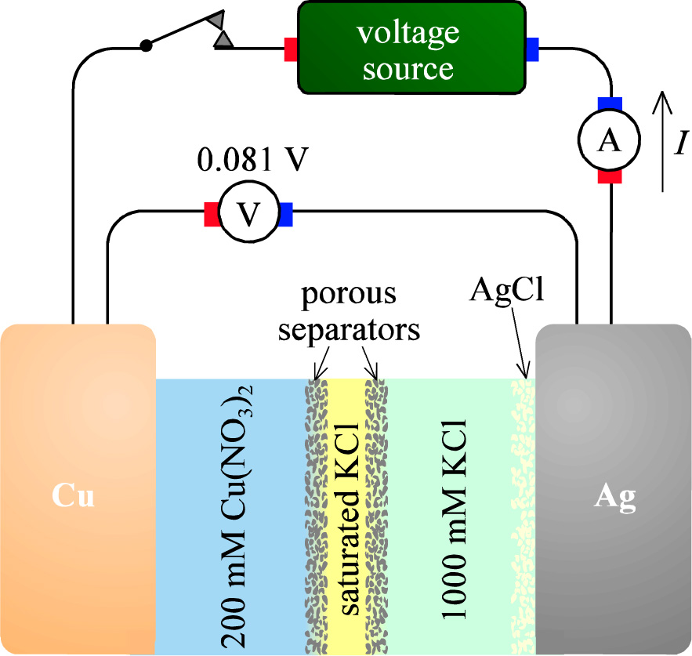

Measurement of a WE potential
The potential of a well-defined working electrode vs a well-defined counter electrode with known electrode potential

Slide 6



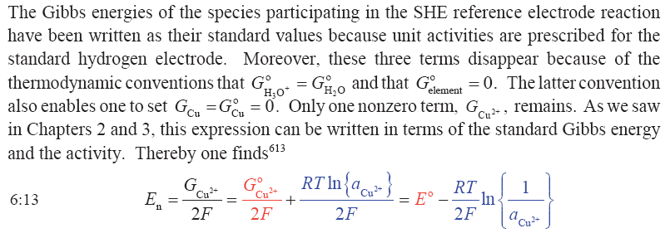
E and ΔG: The book dwells at the Cu²⁺/Cu cell…

Slide 7
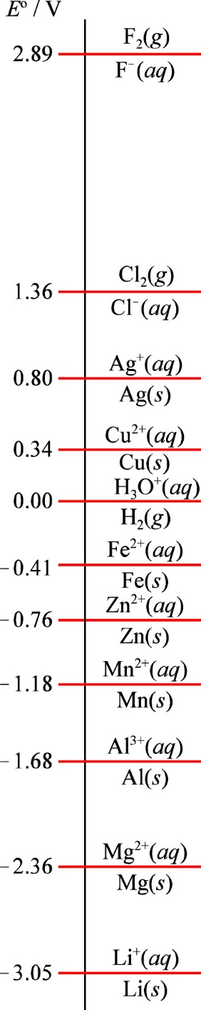
Standard electrode potentials

Slide 8
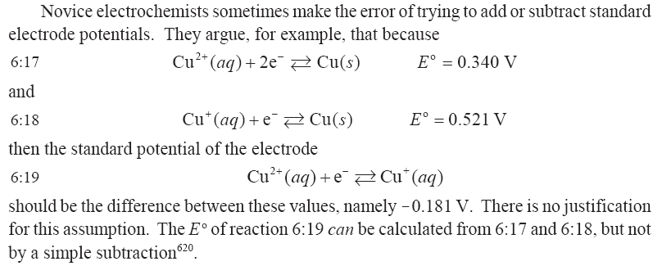
Play with G’s, not E’s…

Slide 9


The Nernst equation
For a cathodic (reduction) reaction
the half cell potential, defined as the potential of the reactant side vs the product side, is
Reaction quotient Q

Slide 10
The Nernst equation for cathodic vs anodic reaction
Cathodic (reduction):
Cu²⁺ + 2e⁻ = Cu
The voltage is that of the product side vs the reactant side:
E_{el} = E_{red} = E⁰_{red} – RT/nF ln(1/[Cu²⁺]) = 0.34 V - RT/nF ln(1/[Cu²⁺])
A higher [Cu²⁺] adds a smaller negative number, hence increases E_{el}
Anodic (oxidation):
Cu = Cu²⁺ + 2e⁻
E_{ox} = E⁰_{ox} – RT/nF ln[Cu²⁺] = -0.34 V - RT/nF ln[Cu²⁺]
A higher [Cu²⁺] adds a bigger negative number, hence increases |E|
But we measure the voltage still on the metal!
E_{el} = -E_{ox} = -E⁰_{ox} + RT/nF ln[Cu²⁺] = -(-0.34) V + RT/nF ln[Cu²⁺]
When a reaction is written anodically (as an oxidation), while the voltage is still measured as if it was a cathode, the signs reverse in a Nernst equation.

Slide 11
Check
Where does the Nernst equation come from, in words and equations?
What happens to the Nernst equation in the following cases:
  Standard state
  General state
  Equilibrium
To repeat: What are the values of Q in the three cases?

Slide 12

Know the 2.303 and the 59 mV ( ≈ 60 mV) of the Nernst equation
lnx = lnx*logx/logx = logx*lnx/logx = logx*ln10/log10 = logx*ln10 = logx*2.303
(R*298.15)/F)*2.303 = 0.059159 V = 59.159 mV

Slide 13
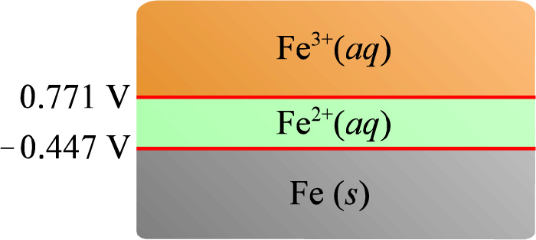

Simple element and ion(s) redox and dominance diagrams
E_{red} (V)
(No x axis)

Slide 14

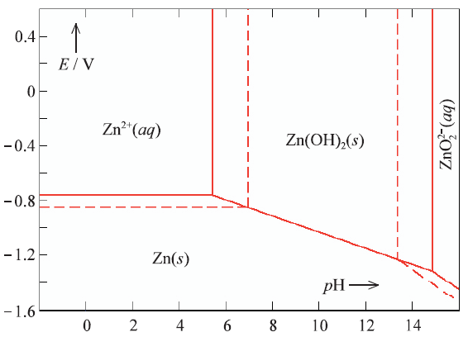
Pourbaix diagrams for redox containing H⁺ or OH⁻

Slide 15

Pourbaix diagrams for redox containing H⁺ or OH⁻
Horizontal lines: Only redox and potential
Vertical lines: Only acid/base (chemistry), example
Diagonal lines: Both

Slide 16
Check: Pourbaix diagram
Write the reactions for these two lines (without peeking in the book)

Slide 17
Check: Pourbaix diagram
Calculate the dependency of potential on pH for the phase stability line governed by

Slide 18
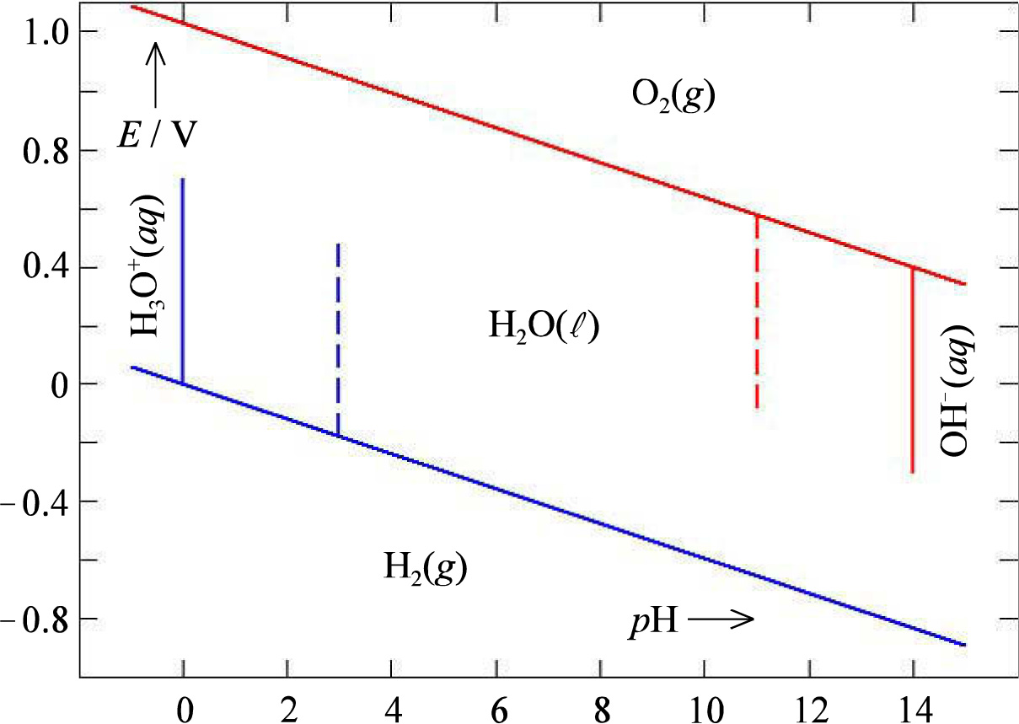
The very important O₂ / H₂O / H₂ Pourbaix diagram
?
The line for O₂(g) in the textbook is misplaced

Slide 19

Exercises: O₂ / H₂O / H₂ Pourbaix diagram
What are the lines?
Write reactions for the stability lines and derive the pH dependencies
Why are O₃(g), H₂O₂, or OH* not represented?
Sketch lines with 0.6 V overpotential required to run the half cell reactions at any appreciable speed

Slide 20
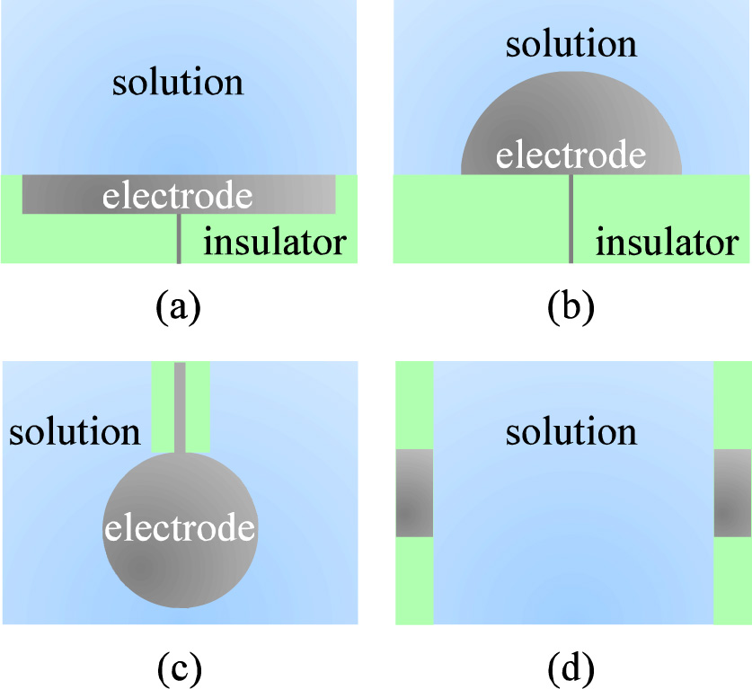
Working electrodes – materials and geometries
Active electrodes
vs
Inert electrodes
  Often catalytic
  Noble metals
  Graphite
  Glassy carbon
  Oxides
  Enzymes

Slide 21
Check
What do the electrodes on the previous slide have in common? (According to the text book)
Discuss advantages and disadvantages to the different geometries
How can we eliminate or reduce gradients in the activities in reactants and products?
Name some active electrodes
For each of the examples of classes of inert electrodes, name an example and why it may be interesting

Slide 22
Potentiometry
Measuring potentials at open circuit; thermodynamics
Connected to activities and concentrations via the Nernst equation
Measure vs suitable reference electrode
Ion-specific electrode, or ion-selective electrode (ISE)
Cu²⁺/ Cu and AgCl/Ag are examples of ISEs for Cu²⁺ and Cl⁻ ions, respectively. But strong interference from e.g. Ag⁺ and Br⁻ ions, respectively.

Slide 23
Simple ISEs
U
Cu
Cu
Cu²⁺ / Cu
Cu²⁺(aq) + e⁻ ↔ Cu(s)
AgCl / Ag
AgCl(s) + e⁻ ↔ Ag(s) + Cl⁻(aq)
CuSO₄(aq)
[Cu²⁺] = 1 M
[Cu²⁺] = ? M
U
Ag
Ag
KCl(aq)
[Cl⁻] = 1 M
[Cl⁻] = ? M
AgCl

Slide 24

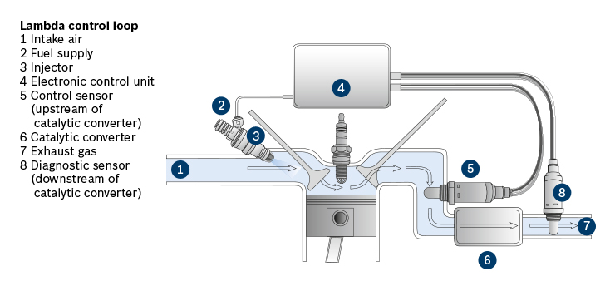
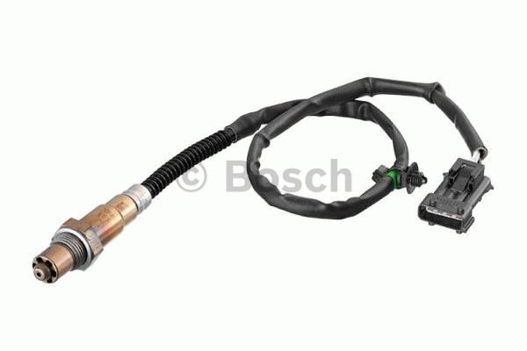
Solid electrolyte potentiometric sensors
pO₂ sensor
“Lambda” sond
U
Zr_{0.9}Y_{0.1}O_{1.95}
(YSZ)
O²⁻
v_{O}**
pO₂ = 0.21
pO₂ = ?

Slide 25
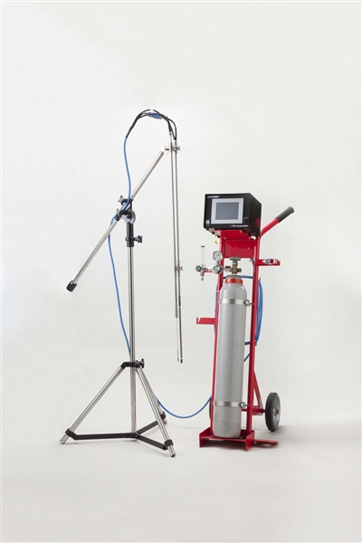
Solid electrolyte potentiometric sensors
pH₂ sensor
Japanese TYK “NOTORP” for pH₂ in molten aluminium based on proton conducting acceptor-doped CaZrO₃
U
CaZr_{0.9}Y_{0.1}O_{2.95}
(CZY)
H⁺
pH₂ = 1 atm
pH₂ = ?

Slide 26

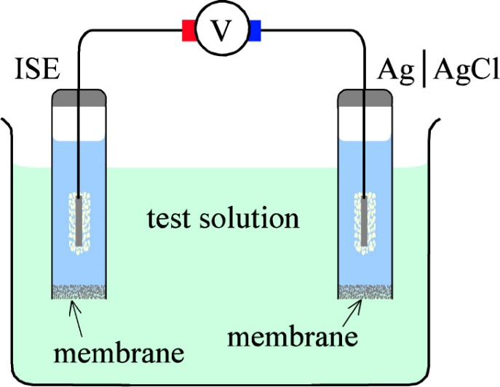
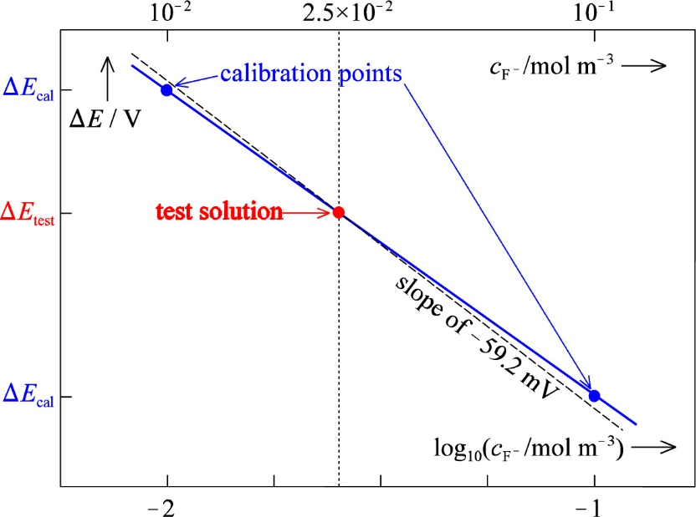

Ion-selective electrodes (ISEs)
We concentrate on one simple example; An ISE for F⁻ ions.
The ISE is a AgCl/Ag electrode in KCl + KF solution with known [F⁻]_{inner}
  The ISE membrane is selectively F⁻ conductive
Reference is a AgCl/Ag electrode in KCl, open to test solution with unknown [F⁻]_{outer}
  The reference membrane is open, e.g. a porous solid with a liquid junction inside
Everything is constant when [F⁻]_{outer} changes, except membrane (Donnan) potential difference
Calibration necessary

Slide 27
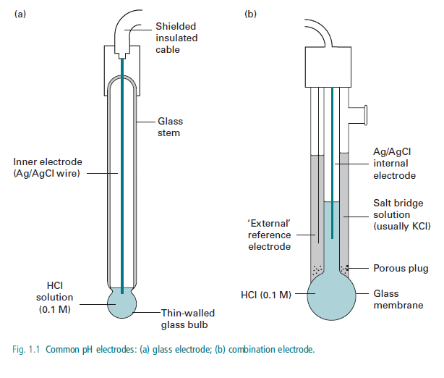
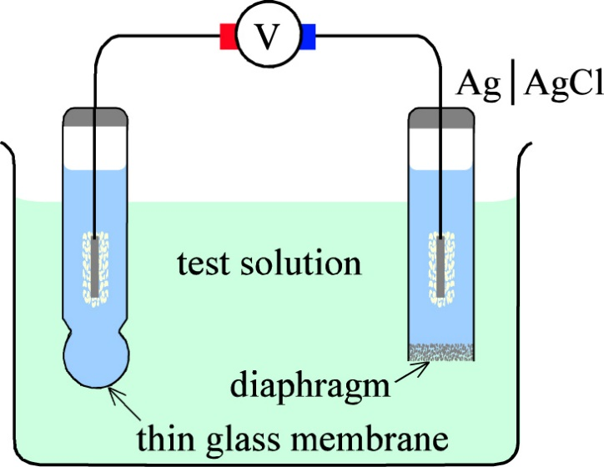
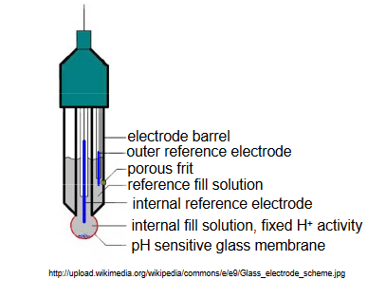
pH electrode
The pH electrode is an ISE where the membrane of the ISE is proton conducting
Glass exhibits a very small proton conductivity
Thin glass membrane offers sufficient proton conduction
  But the impedance of the pH electrode is still very high: noise and fluctuations

Slide 28
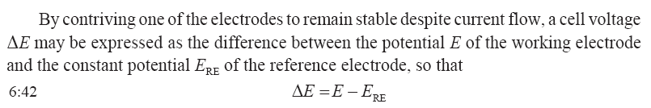


Ch. 6 Summary
Activities:
Concentrations and partial pressures:
ISEs utilise potentials over ion selective membranes:

