Slide 1
KJM 3110 Electrochemistry
Chapter 8. Transport
2022

Slide 2
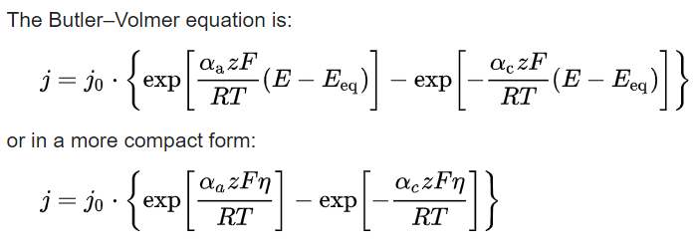

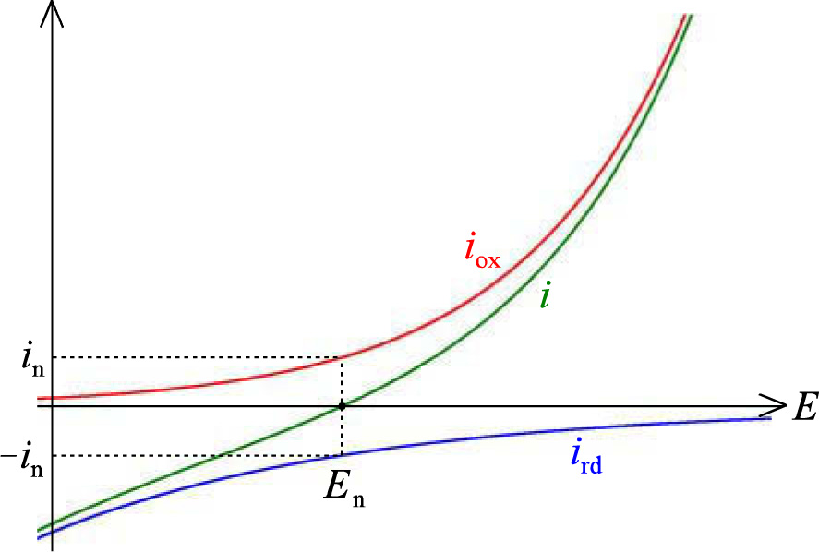
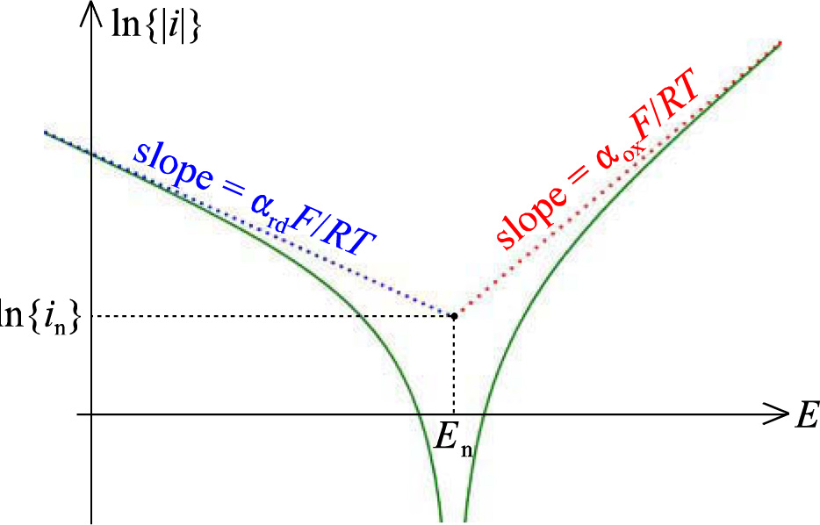
Recap Ch 7. Electrode reactions
Butler-Volmer equation
I-E (or I-V or I-U or Butler-Volmer) plot Tafel plot

Slide 3
Status
Till now, we have been introduced to electricity, chemistry and thermodynamics, electrochemical cells; electrolytic cells (electricity to chemical energy) and galvanic cells (chemical energy to electricity).
We have looked at the thermodynamics of electrodes, and ways to describe it in tables and graphs.
We have looked at the use of thermodynamics in potentiometric electrodes, in particular ion selective electrodes (ISEs).
We have looked at faradaic and kinetic aspects of electrode reactions:
  The relationship between chemicals, ions, molecules, moles) converted and charge passed; Faraday’s law
  Kinetics of the charge transfer; Butler-Volmer, i-E and Tafel log|i|-E plots
Now we’ll (move into the electrolyte and) learn about transport.

Slide 4

Transport
In traditional aqueous electrochemistry and other liquid electrolyte electrochemistry, the transport in question is the transport of ions and molecules, reactants and products, in the liquid electrolyte.
(In the electrode material itself we have mainly transport of electrons only, a different and usually not rate limiting kind of transport.)
In solid-state electrochemistry we may additionally often encounter transport of ions, atoms and molecules in and on electrode materials, and in the gas phase.
In any case, we will be deriving a master equation for transport, the flux density of species by migration, diffusion, and convection:
Note that the three contribute in parallel.

Slide 5
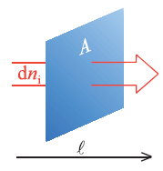



Flux density
Transport is motion of a solute through space.
Flux density j_{i} is the number (or moles) of particles of species i passing a cross-sectional unit area:
Flux density is mean (net) velocity times concentration:
Current density i arises from flux density j by multiplication of charge, summed over all species i:
We use i for current density, I for current, and j for flux density. But others use j for current…
In literature, and our book, i means both current density and species 😐

Slide 6
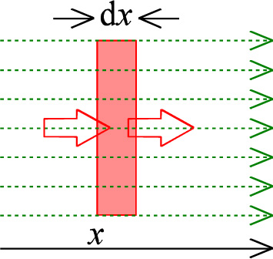


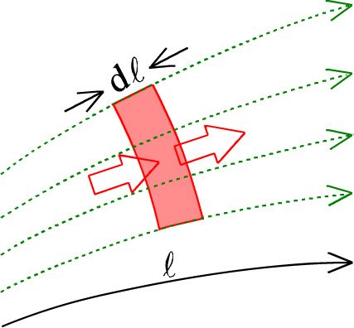
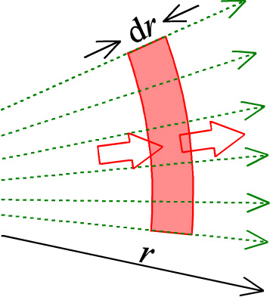

Transport, conservation laws, continuity equations
Parallel (linear) transport
Read and understand textbook equations 8:4 – 8:6
They lead up to
For non-parallel transport the area A of the equi-concentration surface changes with length l:
For spherical transport:
The one to remember and understand. Corresponds to Fick’s 2nd law of diffusion.

Slide 7



A reaction may add or subtract species
If the reaction
occurs throughout the medium, it makes an addition to the standard
to become
where the k’ represent forward (→) and backward (←) rate constants

Slide 8
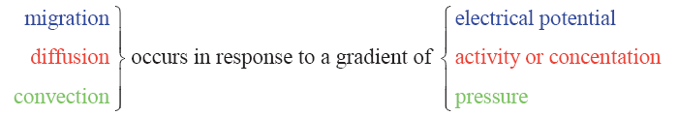
Transport - overview
Net motion is always downhill the gradient
  Exception: Negatively charged species migrate up the electrical potential gradient
  Terms to be aware of that seem to break with the general rule: Self (random) diffusion and “Uphill” diffusion.
Diffusion and migration have the same basis: Thermally driven Brownian motion (liquids) and self (random) diffusion.
  Migration: Net movement by electrical force
  Diffusion: Net movement by concentration gradient. (This is chemical diffusion.)
Convection
  Forced convection (stirring, pumping, sonication)
  Natural convection (vibrations, density gradients, temperature gradients)

Slide 9

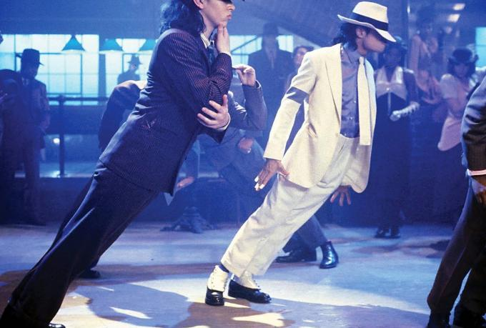
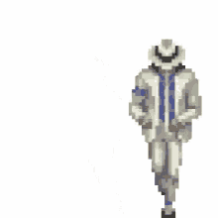
Migration – mobility - conductivity
High diffusivity and mobility: Easy to move
Low diffusivity and mobility: Hard to move

Slide 10
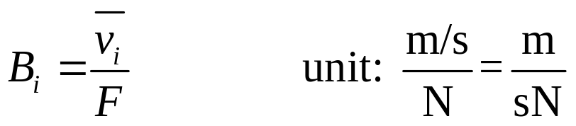
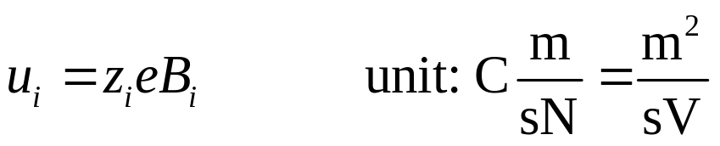


Migration and mobility
With mobility is here meant charge mobility u, as opposed to mechanical mobility B:
Charge mobility is then mean velocity per unit electrical field:
Migratory flux:

Slide 11
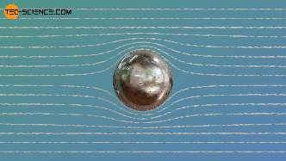
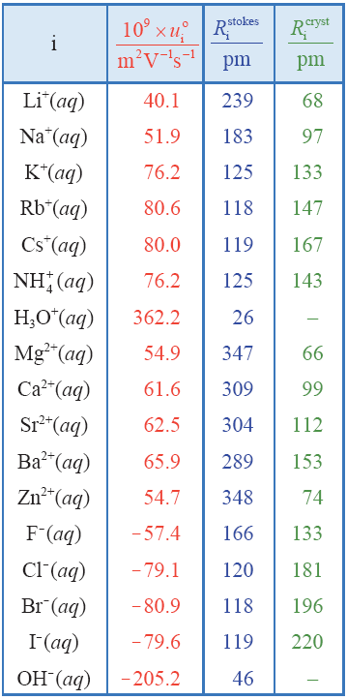
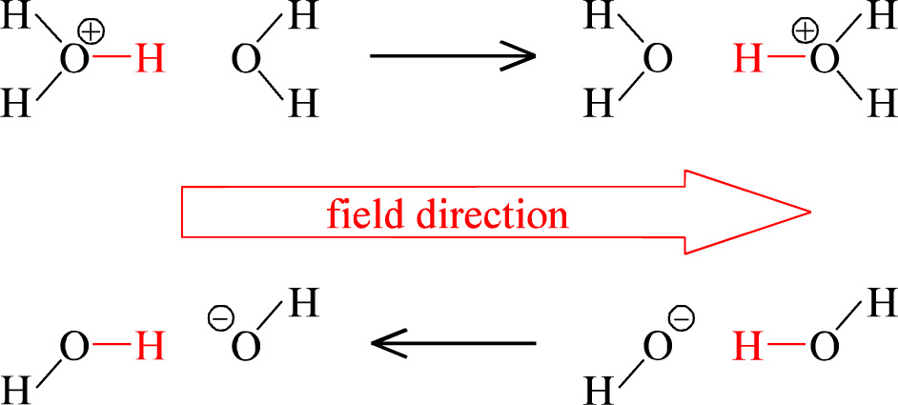
Mobility
Mobilities can be estimated from Stokes’ law.
  This gives rise to empirical Stokes radii of ions.
Deviate from radii we measure in crystals.
  Small and highly charged ions drag hydration water molecules; appear bigger – have smaller mobilities than anticipated
H₃O⁺ and OH⁻ are also moving and dragging water, but additionally exhibit Grotthuss proton hopping

Slide 12

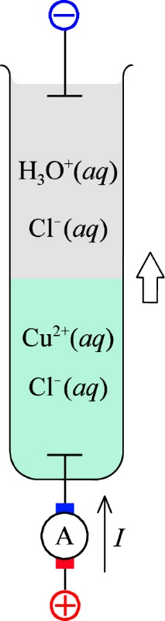

Mobility and conductivity
Mobility decreases with increasing concentration
  Interactions between ions and medium
  Electrophoretic effect and relaxation effect
Conductivity from charge, mobility, and concentration of all cations and anions
Conductivity is a positive number
  Operate with signs on z_{i} and u_{i}, (both negative for negative ions)
  or consider absolute values of both
Example from the textbook: Conductivity of Ca(NO₃)₂(aq)
  Textbook:
Individual mobilities not easy to determine
  Conductivity measurements
  Moving boundary (Eq. 8:19)

Slide 13
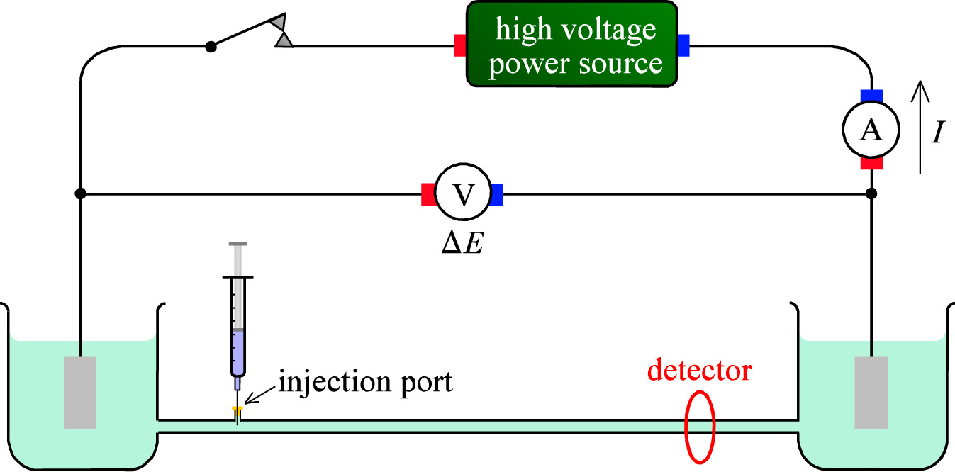
Electrophoresis
Separation based on different mobilities
Example experiment for positively charged ions or particles
Many detectors. Identification + quantification.
Columns, capillaries, gels, paper

Slide 14
Diffusion - diffusivity

Slide 15


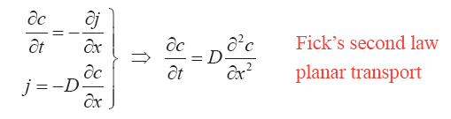
Fick’s laws
Diffusion flux is proportional to a gradient in activity
Almost always a response to a gradient in concentration
If the flux lines are parallel (l becomes x), and if D is independent of c,

Slide 16

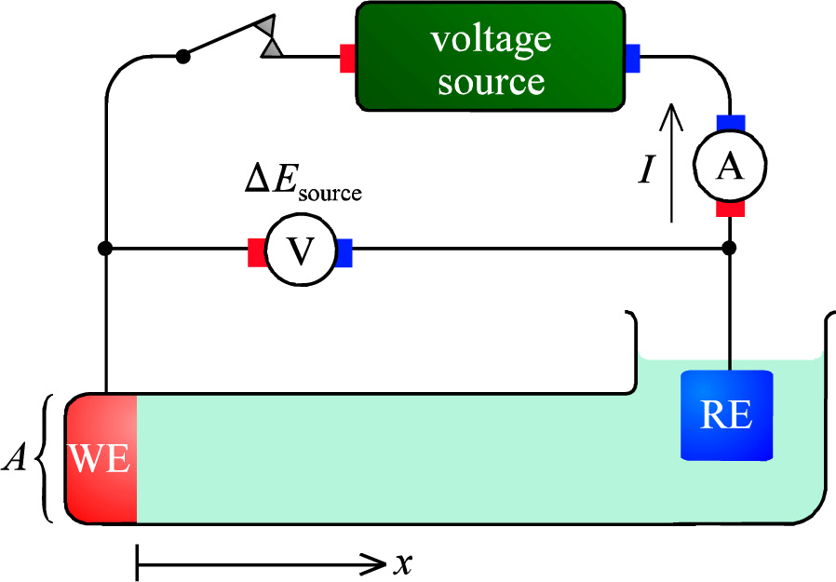


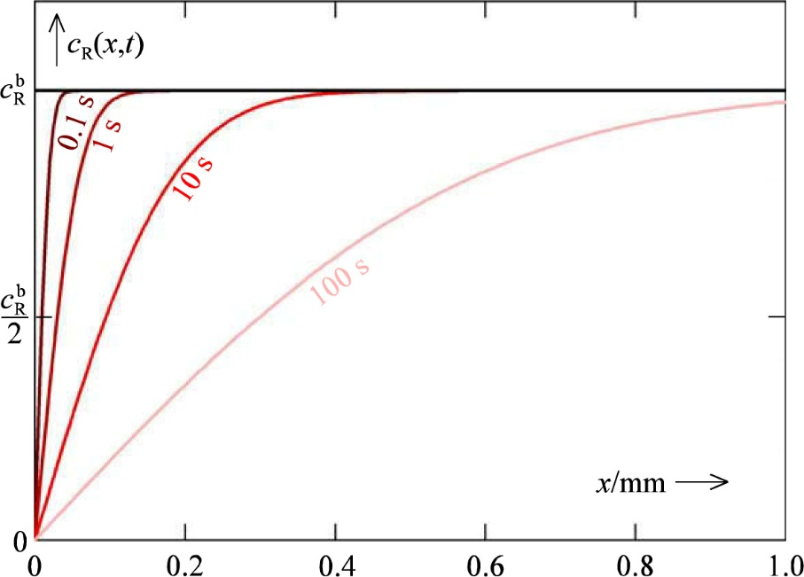
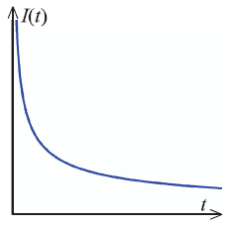

Solutions to Fick’s 2nd law
Need 3 integrations, 3 boundary conditions
Example: Potential-leap experiment
  Reduced species R oxidised at WE
Fick’s 2nd law
Boundary conditions in Eqs. 8:24, 8:25, 8:27; see plot yield solution (concentration profile):
Small t: Fick’s 1st law yields flux & current

Slide 17
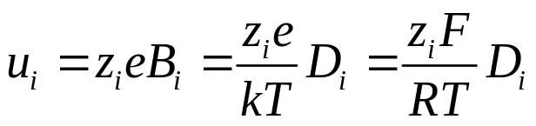


Diffusion and migration
Mobilities and diffusivity of a species are both related to the same thermally driven transport and the same friction against moving
Related through the Nernst-Einstein equation:
Textbook:
If we have both chemical potential gradients (concentration gradients) and electrical potential gradients, the combined forces and fluxes of diffusion and migration can – via the Nernst-Einstein equation – be summed in the Nernst-Planck equation
This is easily rewritten in terms of mobility, charge mobility, or conductivity.

Slide 18
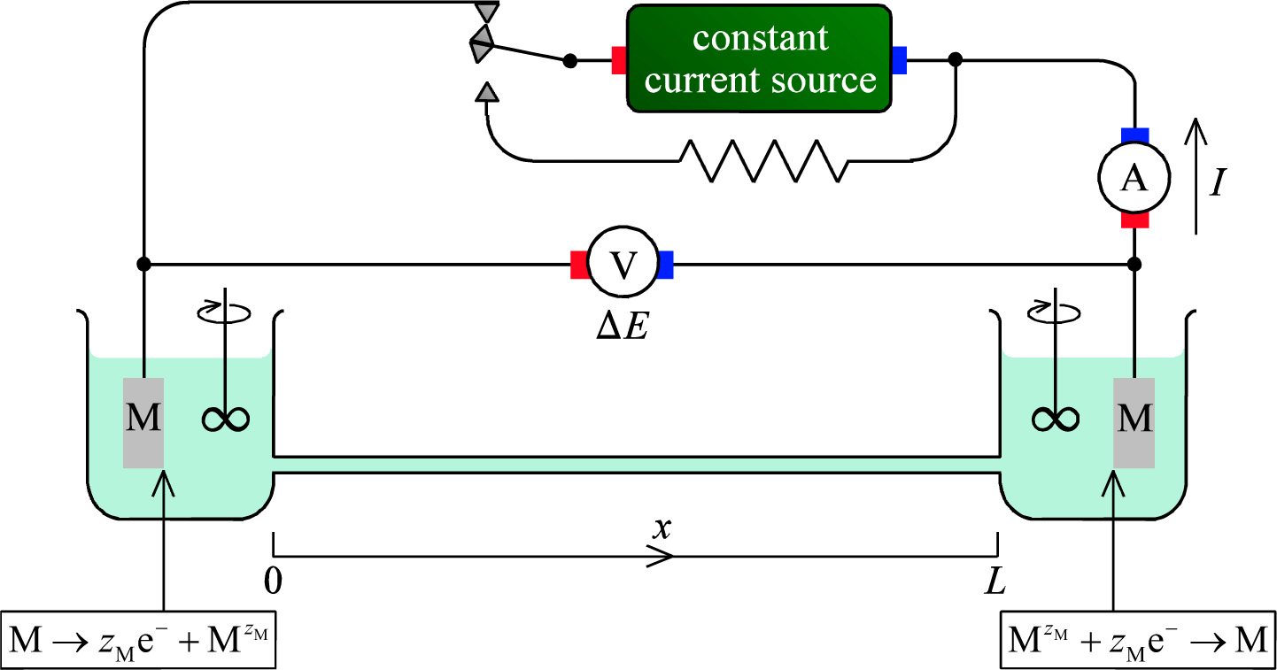
Example of diffusion counterbalancing migration
Experiment: Steady state net flux (and production and consumption) of cations M^{z+}
Anions A^{y-} must have zero net flux: Migration counterbalanced by diffusion
There must hence be a concentration gradient at steady state
Measureable by ΔE

Slide 19
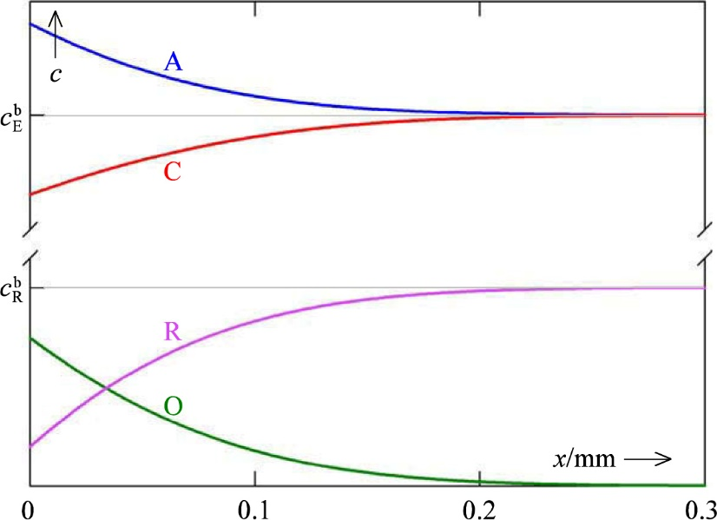

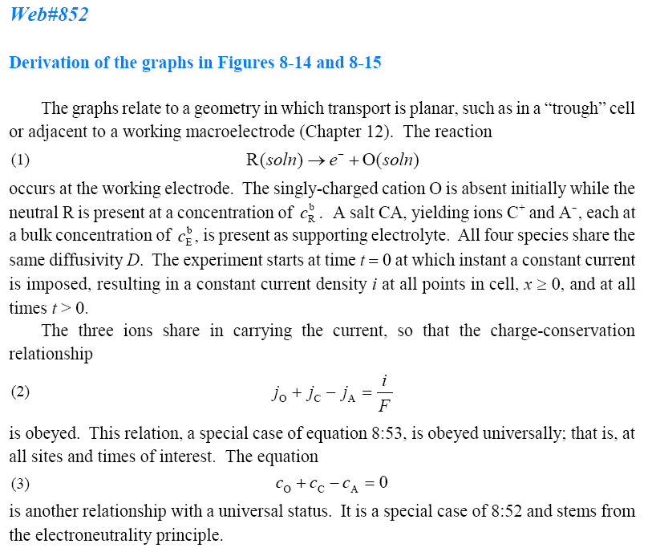




The experiment of Web#852
Electrode reaction oxidises neutral R to charged O⁺:
Supporting electrolyte: CA
Initial (t = 0): i = 0
Diffusivities of all species: D
t > 0: i(x,t) = constant
Electroneutrality:

Slide 20
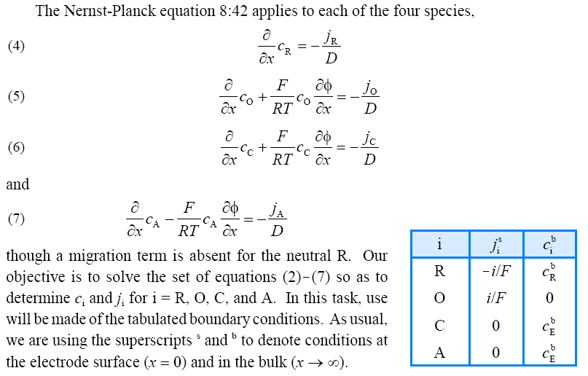
Apply Nernst-Planck

Slide 21
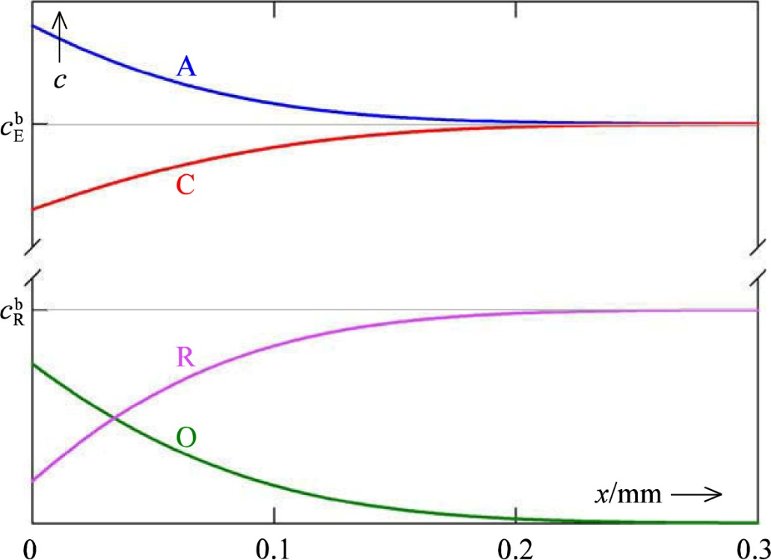
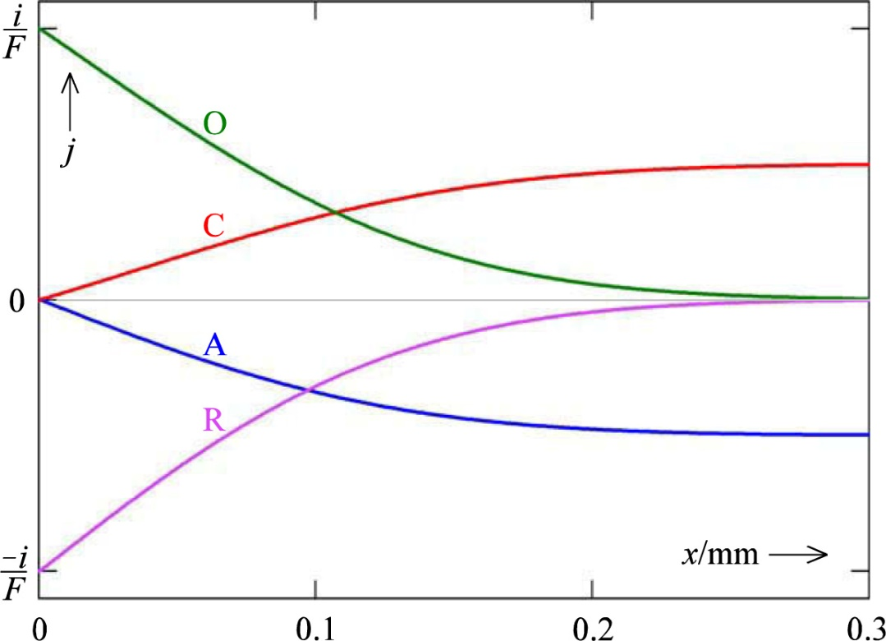
Concentration and current density profiles
Notice:
  Concentration of O⁺ is zero in the bulk
  Current of electroactive (redox active) species near electrode, but of supporting ions in the bulk
  Neutral R in our case has a flux j_{R}, but no current. O⁺ takes on all the current alone near the electrode.

Slide 22
Check
The above version of the Nernst-Planck equation describes diffusion and migration in terms of the diffusivity.
Rewrite it in terms of charge mobility u_{i}.
Rewrite it in terms of conductivity κ_{i} (or σ_{i})

Slide 23
Convection: Hydrodynamics

Slide 24

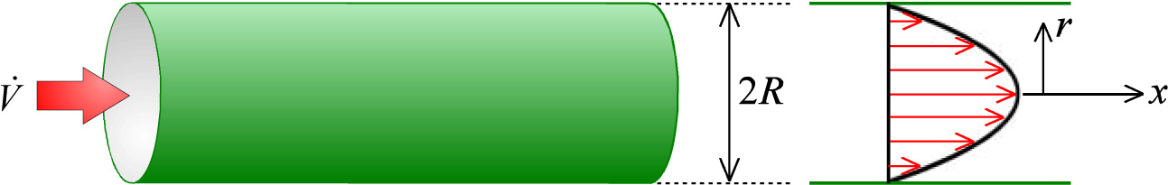
Convective flow in a tube
Laminar flow
Poiseuille flow
Flow varies through radius
Typical of investigative electrochemistry
Turbulent (chaotic) flow
Typical of (favoured in) electrosynthesis

Slide 25

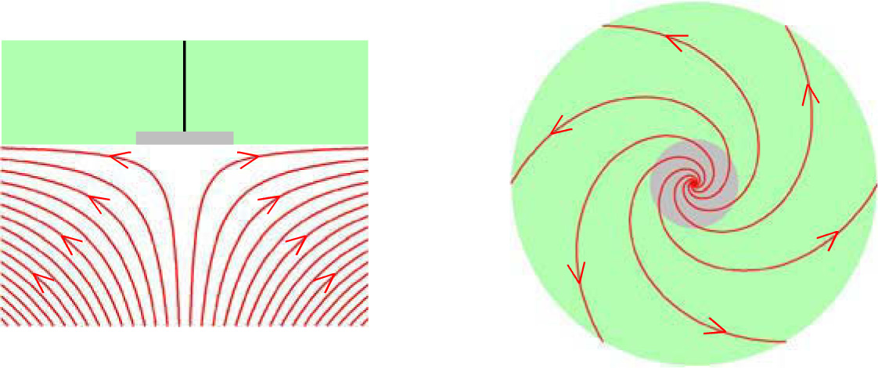
Rotating disk electrode
Typically, Pt or glassy carbon embedded in insulating disk of teflon®.
High rotating (angular) velocity.
Same friction that stops flow in the tubular case creates flow here.
Flow has contributions from convection and diffusion:

Slide 26


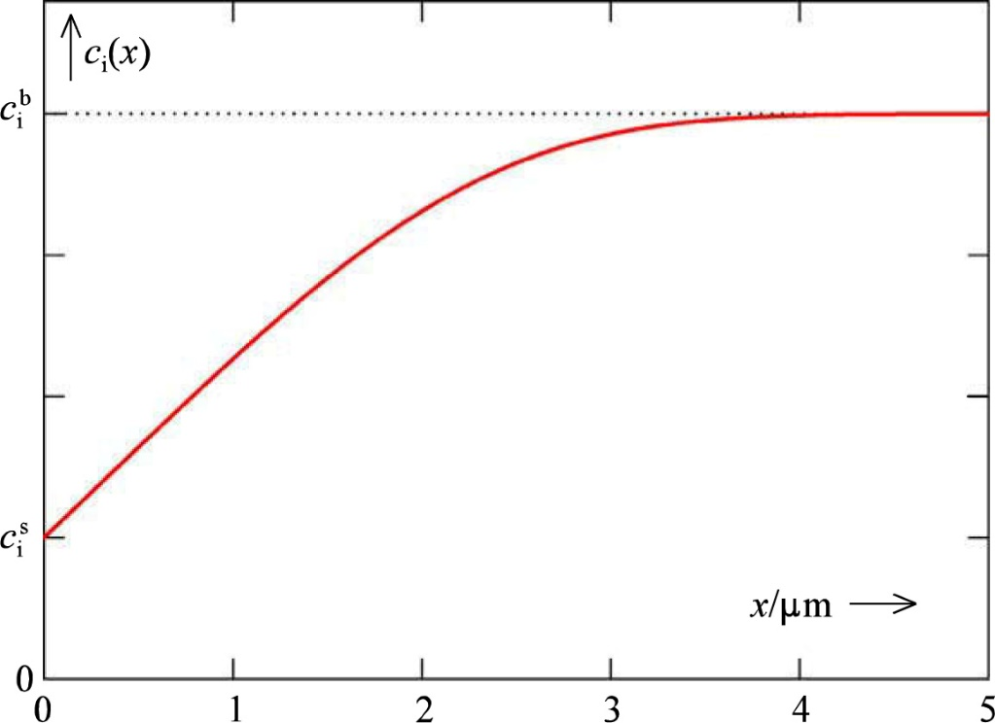
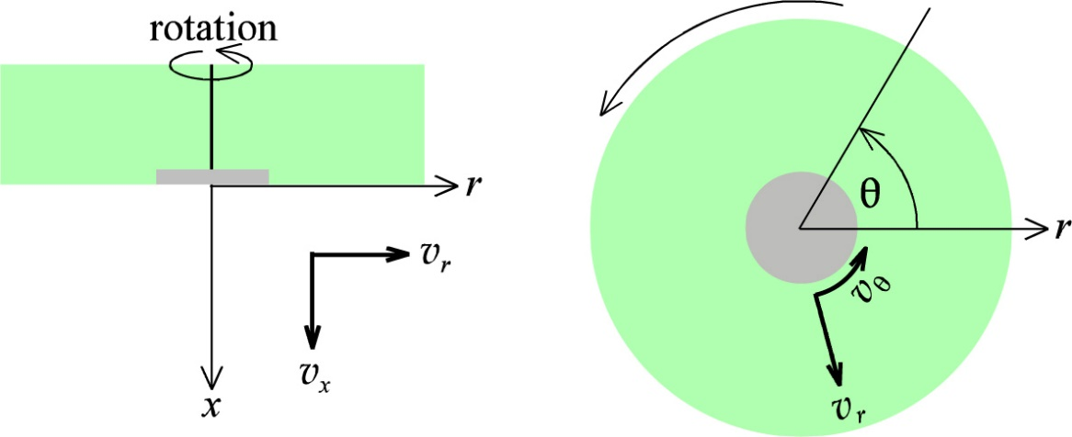
Fick’s 2nd law for rotating disk electrode
Diffusion augmented by convection
Solution yields concentration at electrode and profile, based on diffusivity, density, rotation, speed, viscosity

Slide 27

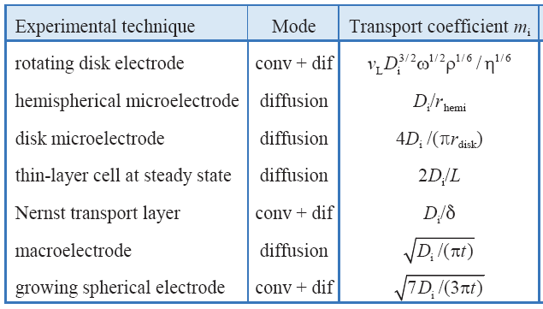
Transport coefficient
The electrode surface (s) and the bulk (b) are often central «fixed» points.
Flux between them often proportional to the concentration difference by a constant (coefficient)
Rotating disk electrode

Slide 28
Summary Ch. 8 Transport

