Slide 1
KJM 3110 Electrochemistry
Chapter 9. Green Electrochemistry

Slide 2

Ch. 8 Transport:
Check from previous chapters:
  What are the driving forces for electrochemical reactions?
  What processes are required for the electrochemical reactions to proceed?
  What are the factors, processes, or properties that limit the rate?
  In what forms do you expect these limitations to emerge?

Slide 3
Green electrochemistry
In this chapter
more
Environment
Health
Biology
than
Energy and climate

Slide 4
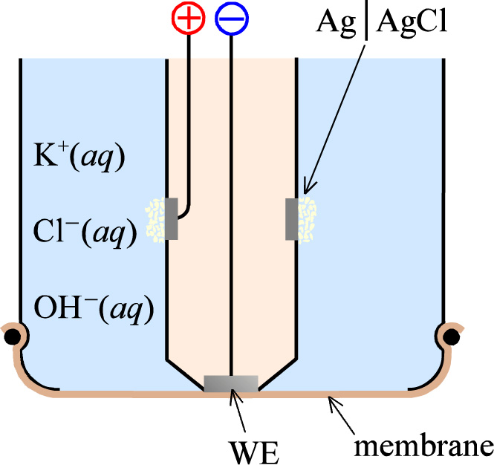
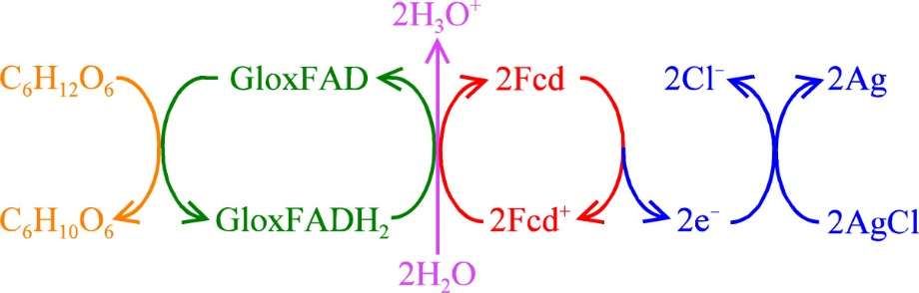
Sensors
Read in the textbook about conductivity and pH sensors for detection of NH₃, CO₂, etc. in e.g. water.
Clark cell for detection of O₂(g) in water or blood.
Amperometric sensor

Slide 5
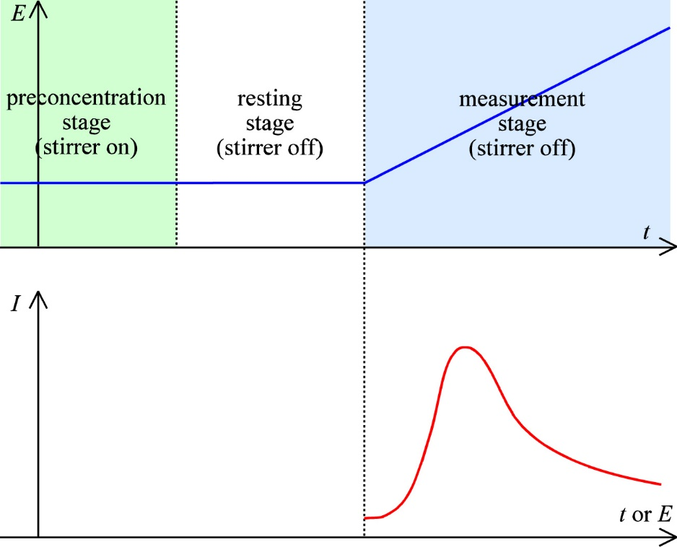


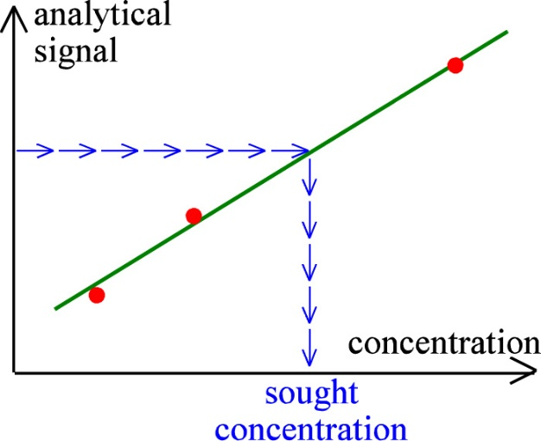
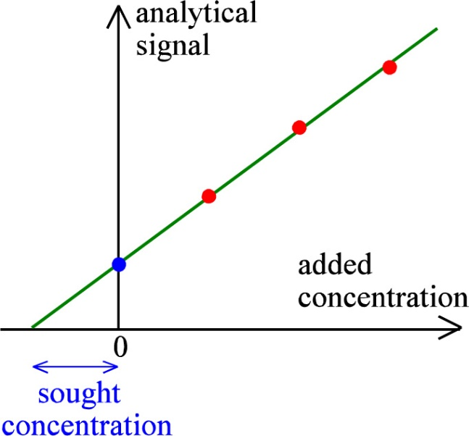

Stripping analysis
Deposition and stripping currents of analysed cations or of other ions at particular voltages
Dropping Hg electrodes
Solid electrodes with Hg co-deposited
Standardisation
Standard additions

Slide 6
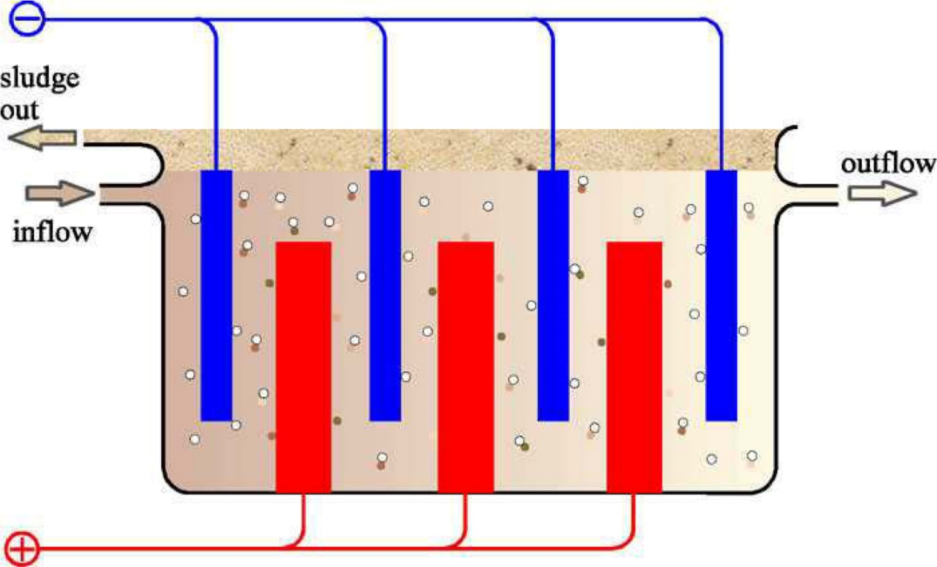
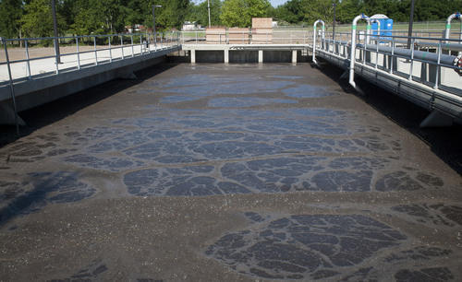
Electrochemical water purification
Pollutants adsorb at colloidal Al hydroxide particles forming a sludge.

Slide 7
Electrochemical water purification
Create active oxidising species
  H₂O₂, O₃
Air electrode
  Air through porous carbon electrode – gas diffusion electrode
  Anode: Create ozone O₃ anodically

Slide 8
Check
Suggest by writing half cell reactions how ozone O₃ may be formed from O₂ in air anodically.

Slide 9
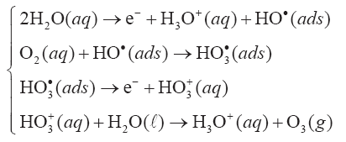
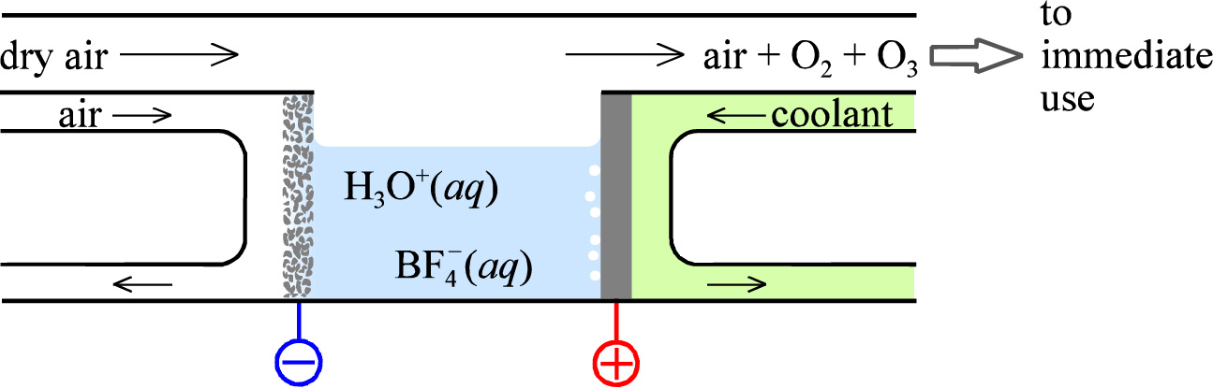
Ozone generation
Cooled glassy carbon anode
BF₄⁻ supporting anion
3H₂O + O₂ → 2e⁻ + 2H₃O⁺ + O₃

Slide 10
On-site electrosynthesis
Ultrapure chemicals, e.g. H₂
Toxic chemicals, e.g. AsH₃

Slide 11
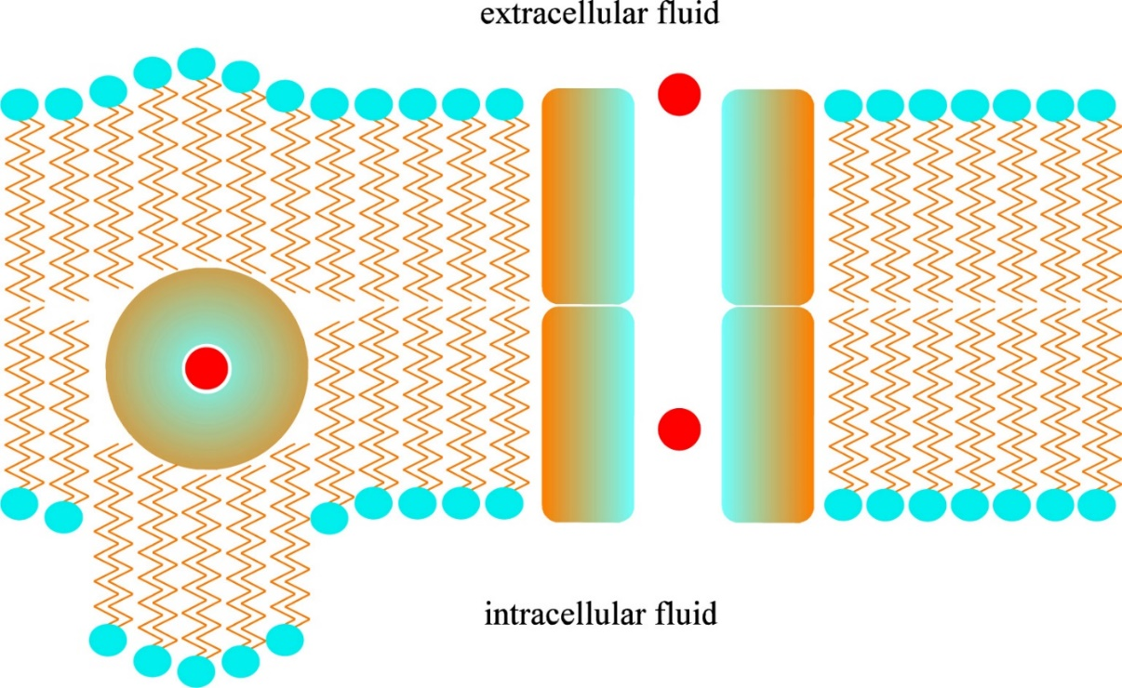
Bioelectrochemistry
Lipid bilayer cell wall membranes
Ions in ionophore spheres
  Ionophore is an entity that reversibly binds (and can carries) ions
Transmembrane channels
Proton (H₃O⁺) conducting

Slide 12
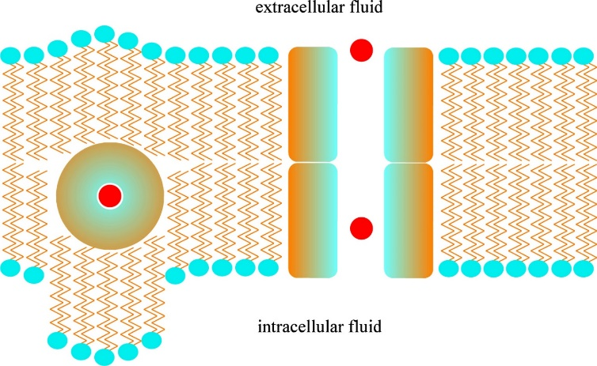


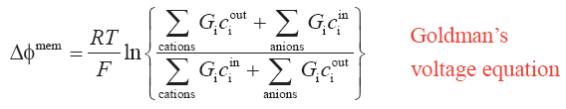
Goldman’s equations
Diffusion and migration across the membrane
Current
Voltage at net zero current, for monovalent ions:
G_{i} is permeation
These equations are not for exams

Slide 13
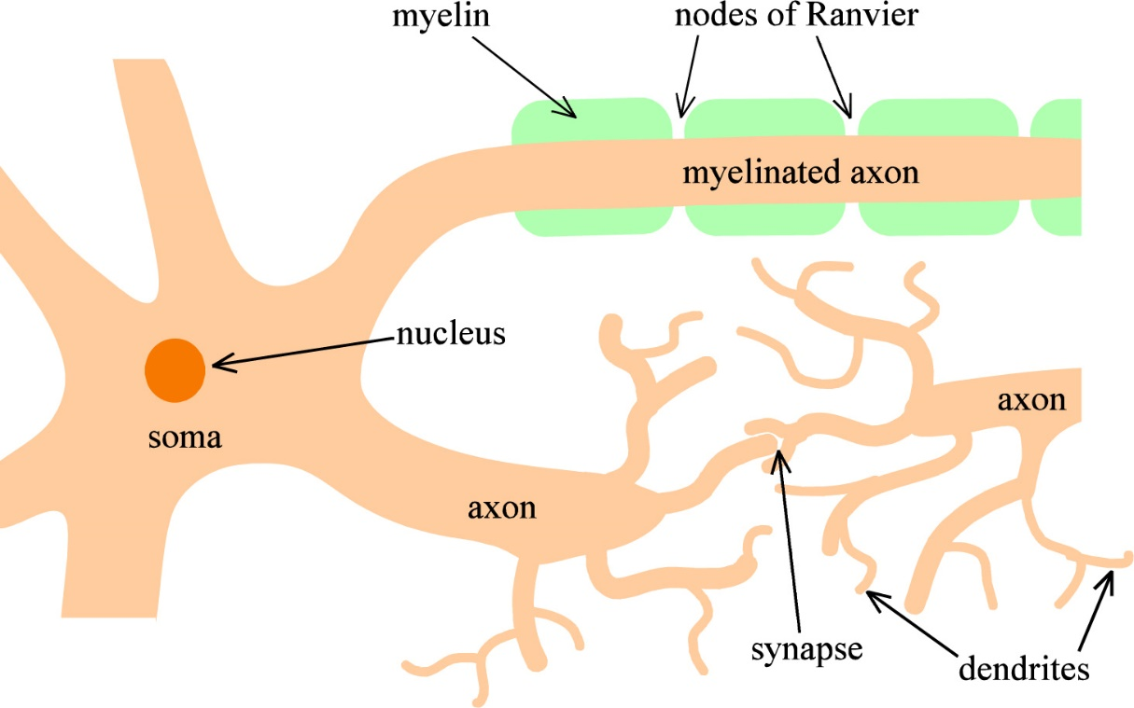
Nerve cells
K⁺ and Na⁺ have widely different concentrations and permeabilities G
Gives rise to -70 mV resting potential of nerve cells
“Nerve impulses are transmitted within a single nerve cell electrically and between two nerve cells chemically.”

Slide 14
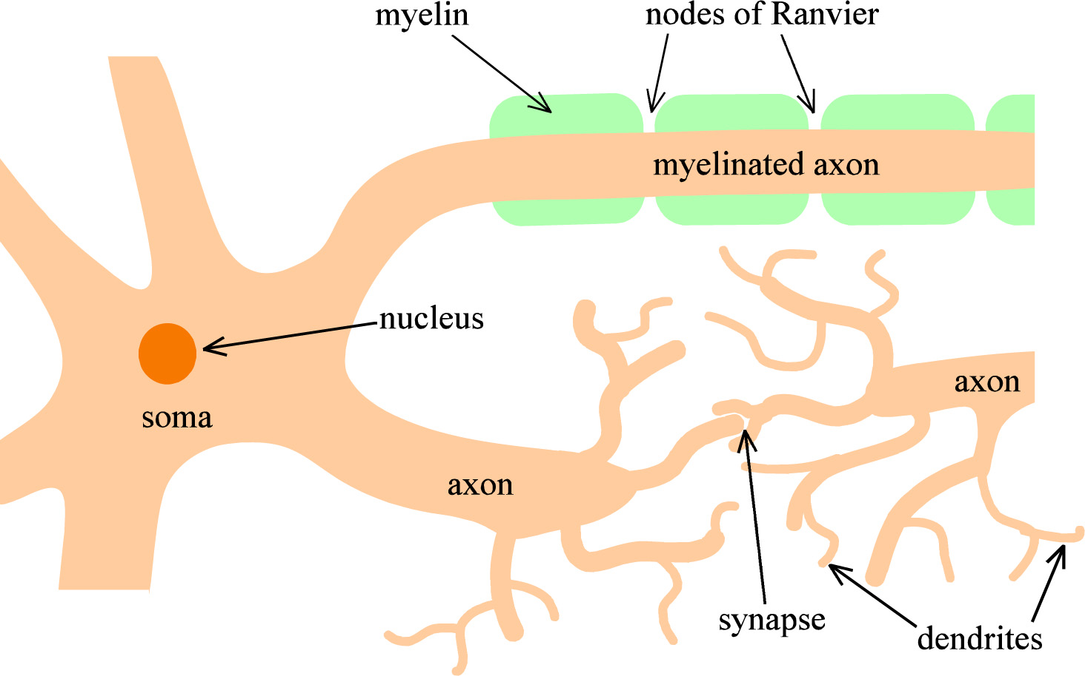
Suggestion
Explain and discuss your way in pairs or groups from page 190 top to the end of the chapter. Draw sketches along the way.

Slide 15
Summary Ch. 9 Green Electrochemistry
In this chapter, we learned little of new principles, but have seen some ways to use the ones we know for “green” electrochemistry.
  “Green” meaning sensors, purification, and bio-electrochemistry
Sensors: Here more amperometric, while we in Ch. 6 concentrated on potentiometric.
  Learn one
Purify water: By developing bubbles, or species like H₂O₂.
  Learn one
Ionic transport through bio-membranes
  Interesting relevance in how nerve cells work

