Slide 1
KJM 3110 Electrochemistry
Chapter 1. Electricity

Slide 2
Electricity
In this chapter we will familiarise ourselves with the most fundamental concepts of electricity itself
Charge
Electrostatic force
Electrical work
Potential and voltage
Capacitance
Current
Conductance and resistance
DC and AC voltage, current, and impedance
Different disciplines, textbooks, articles, teachers use different symbols for many of these entities. For instance, e vs q, q vs Q, f vs F, V vs U vs E, i vs I…
We could try to be completely consistent here.
Instead we allow variations, to train ourselves for reality, but aim to always define and/or make clear what we mean.
We try to stay true to the convention in science that variables and constants are written in italic. Example: V = 1.5 V or better U = 1.5 V i = I/A = 2 A/cm²

Slide 3
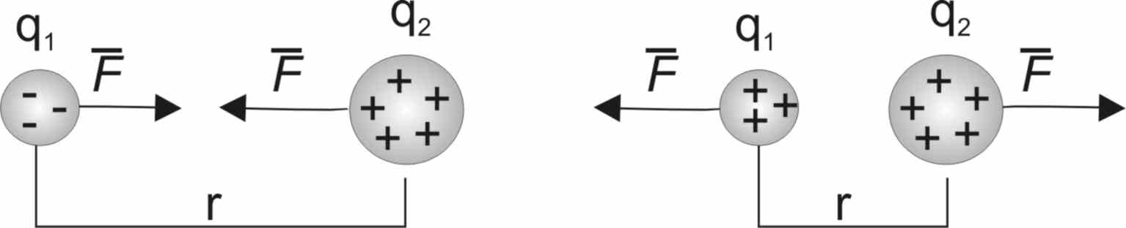
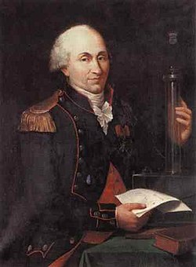
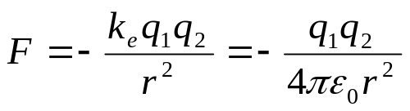
Electrical charge
Charge is a physical property of matter that causes repulsive or attractive forces between objects of charge of the same or opposite sign.
Charge is quantized in multiples of e
The unit of electrical charge is C, coulomb
e = 1.602×10⁻¹⁹ C
As symbol of charge we use, for instance, q.
A proton has charge e
An electron has charge –e
Neutrons have charge 0
(Quarks have charges that are multiples of e/3)
Force between charges F
Dielectric permittivity of vacuum ε₀ = 8.854x10⁻¹² C²/Nm²
Charles-Augustin de Coulomb
(1736-1806)

Slide 4
Electroneutrality
Charges of equal sign repel each other
Tend to get max distance
Net charge seeks to external boundaries (surfaces, interfaces)
Interior (bulk) phases remain electroneutral
Electroneutrality: Sum of negative and positive charges balance (cancel) each other

Slide 5
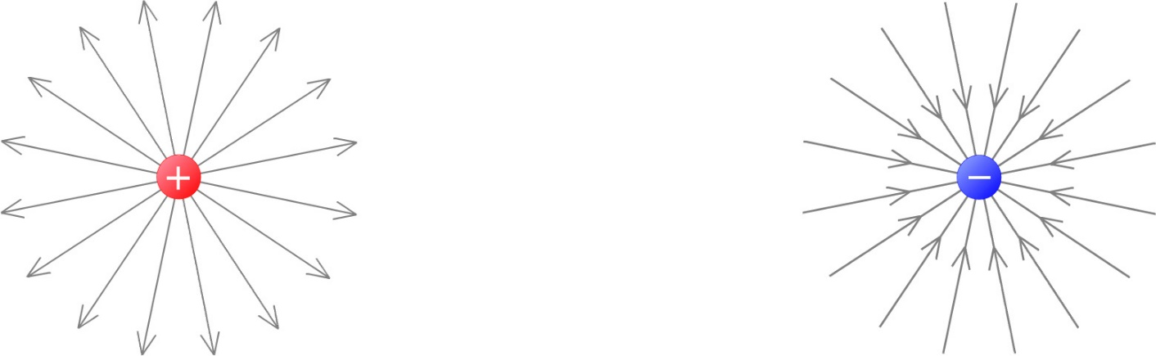



Electrical field; field strength X
Field strength X defined as force F per charge Q_{test} of a test particle
Field strength has direction
Spherical field – inverse square law
$$X=\frac{F}{Q_{test}}$$
$$F=\frac{−Q_{1}Q_{2}}{{4πεr^{2}}_{}}$$
$$X=\frac{F}{Q_{2}}=\frac{{−Q}_{1}}{{4πεr^{2}}_{}}$$

Slide 6
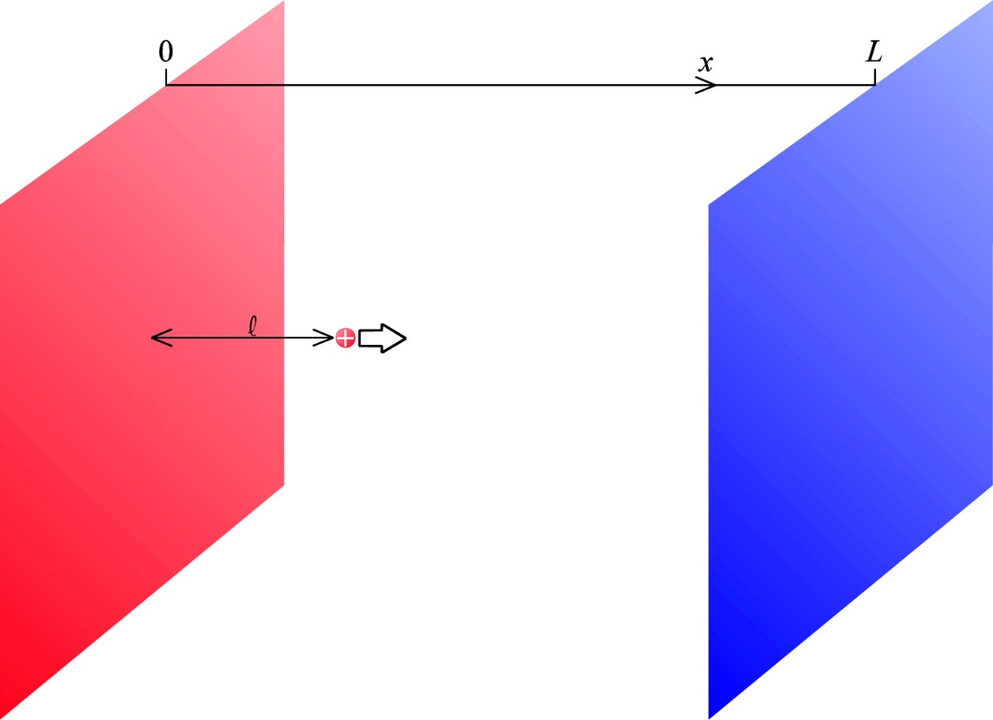

Electrical field; field strength X
Planar field
  Charge density of plates q (C/m²)
  Test charge feels both attraction and repulsion
  Independent of distance l (why, qualitatively?)
  Total field strength:
$$X=\frac{q}{ε_{}}$$

Slide 7
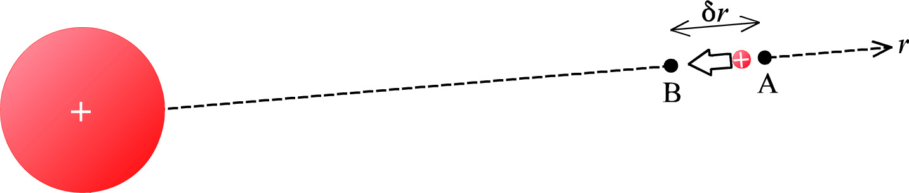

Electrical work
Work to move a charge in the field = force x distance: w = F δr
X = F/ Q_{test} → F = Q_{test} X → w = Q_{test} X δr
Textbook:
In this example, the travel δr is negative, the force is negative, and the work we do ends up positive

Slide 8



Electrical potential ϕ or φ
Electrical potentials exist everywhere
At A and B we have φ_{A} and φ_{B}
The difference between two potentials at A and B is given by the work it takes to move a charge Q_{test} from A to B
This defines a difference in potentials Δφ, i.e., a voltage U.
In differential form:
Unit of potential and voltage is V (volt). 1 V = 1 J/C

Slide 9
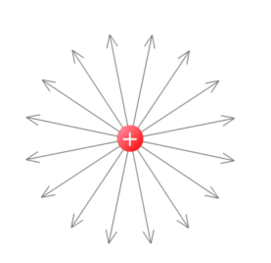


Potential difference (voltage) over small and larger distances
Small distance – constant field
Large distance - must integrate over the field.
Spherical symmetry:
Here, r_{B} and r_{A} are the distances to the centre of the spherical charge

Slide 10
Homogeneous matter (bulk) and interfaces
We can only measure the potential and work of moving a charged particle within a homogeneous (bulk) phase.
If we move it across a boundary, other energy changes than the electrical work also apply.
Generally speaking we don’t have inert probes of those extra changes.
In bulk there is no net charge. Net charge appears at inhomogeneities and interfaces.
  Which length scale are we talking about, and why?

Slide 11



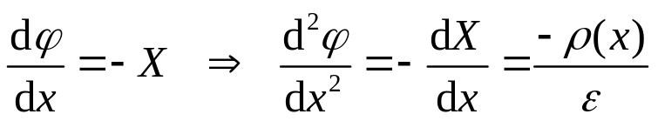


Poisson’s equation; How potential varies in space at a distance from a net charge
Planar case; areal charge densities q₀ and q_{L}
Field at distance l involves areal charge density of plates q plus volumetric charge density ρ of dielectric
Differentiation yields field gradient and in turn Poisson’s equation: Double derived of potential given by charge density and permittivity.
For spherical case we would obtain

Slide 12
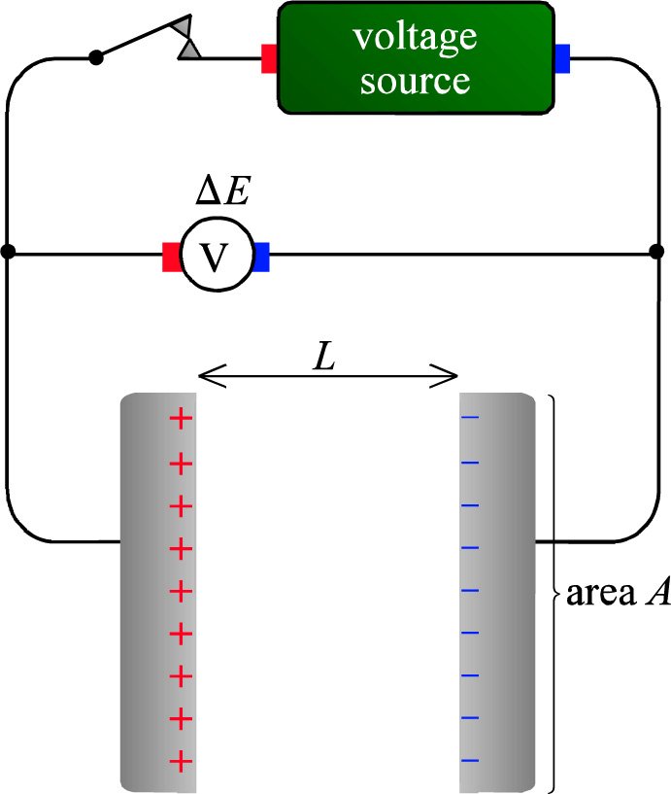
Responses to electrical fields, i.e. voltage:
Conductance and capacitance
Conductance, conductors: Long range transport of charge
Capacitance, dielectrics: Short range transport (polarisation) of charge
Electronic devices to supply voltage, measure voltage, break and make conductors in circuits

Slide 13
Conductance
Matter
  Solid (materials, crystalline, amorphous))
  Liquid (many types - see textbook)
  Gas (plasma)
Insulators (dielectrics)
Conductors
  Electronic conductors
    Metals
    Semiconductors
      Conduction band electrons
      Valence band (electron) holes
  Ionic conductors
    Anionic, cationic
    Crystalline: Defects: Vacancy, interstitial
Do we have concepts and names for the many intermediate cases?
Solid-liquid
Liquid-gas
Insulators-conductors
Ionic-electronic
…

Slide 14

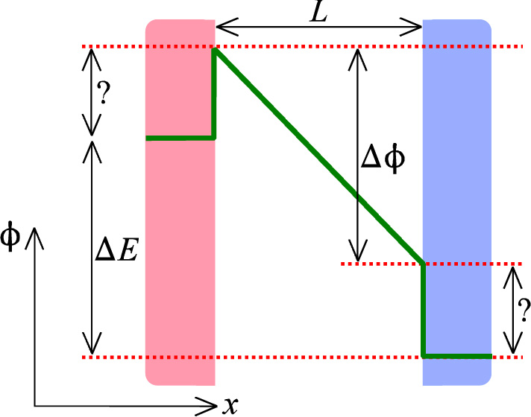
Potentials through a dielectric
Potentials
Related to work
Measureable within phases, but not between them
Potential differences denoted with different symbols
  Which?
  Why?

Slide 15


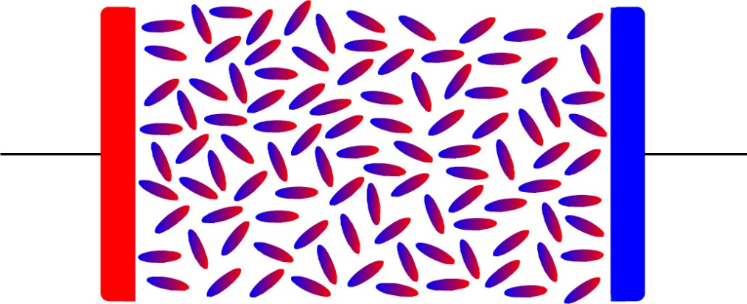
Capacitor, capacitance
Stored charge Q
Capacitance C
Unit of C is farad (F = C/V)
ε = ε_{r} ε₀
  ε_{r} Relative permittivity (unitless, >1)
  ε₀ Vacuum permittivity

Slide 16
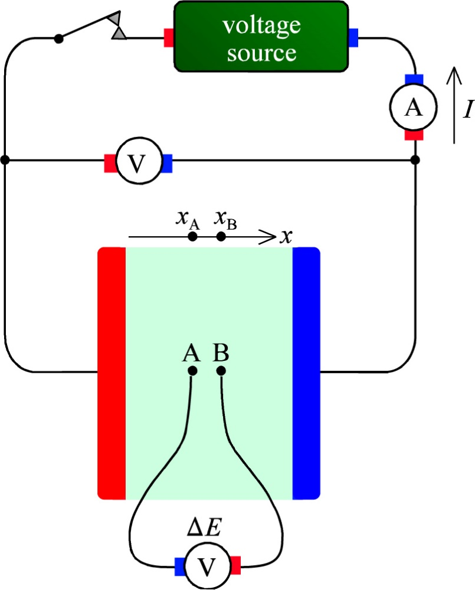
Current, conductor, conductance
Voltage U (V, volt) gives rise to current I (A, Ampere)
Current is charge per time I = Q/t, 1 A = 1 C/s
Current density i (A/m²) = I/A
Note: Unit A (ampere) and variable A (area)
Conductivity σ or κ (S/m) = i/X (Ohm’s law)
Conductance G
Resistivity ρ (ohm m)
Resistance R (ohm)
You need to practice and master the conversions between these.
Make new versions of Ohm’s law!
Sign ambiguity…(see textbook)

Slide 17
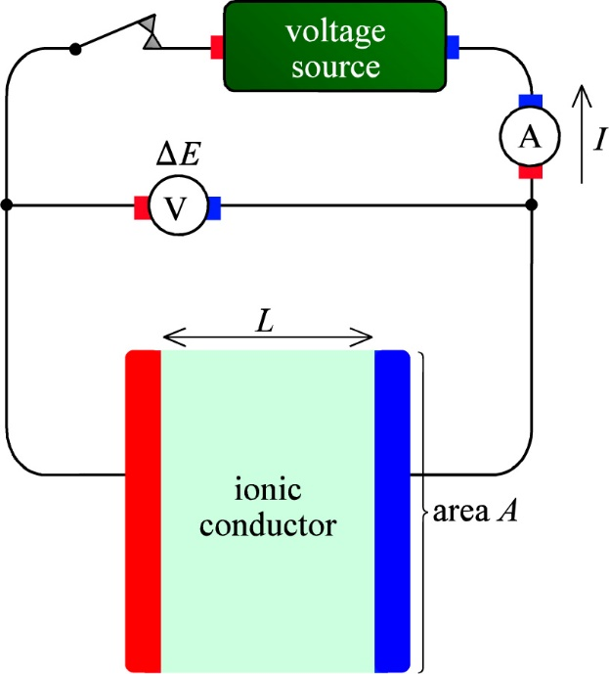
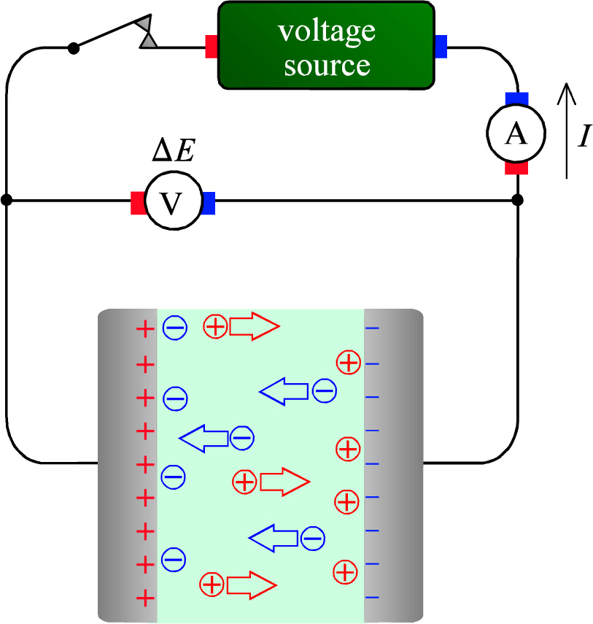
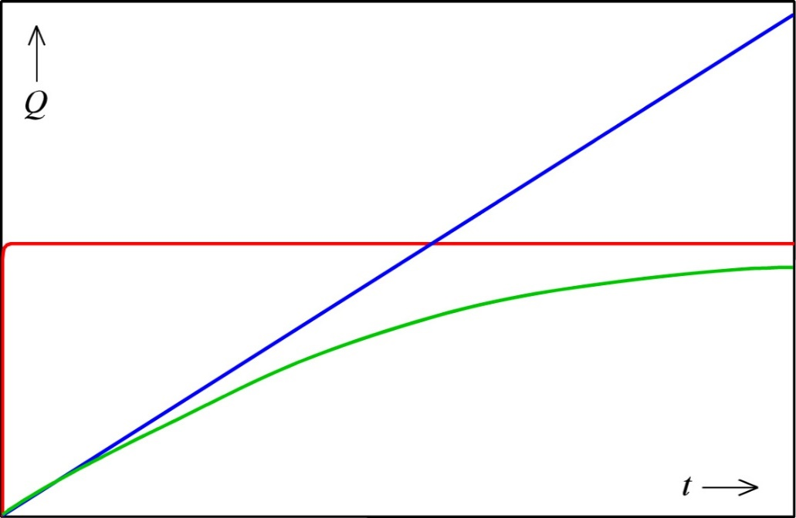
Transport in an electrochemical cell
Ionic conductor (electrolyte)
Charge in insulator, electronic, ionic conductor
Charge accumulation in double layers

Slide 18
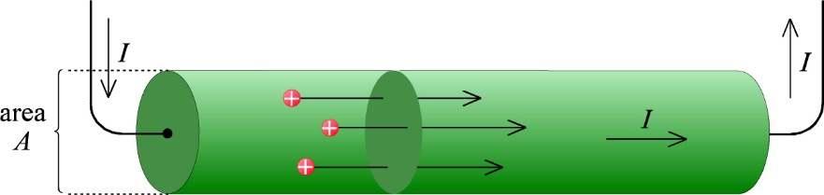
Mobility
Mechanical mobility B expresses how easy it is to move a species of drift velocity v by a force F
v = B F
Current density is obtained by multiplication with concentration and charge
i = ze c v = ze c B F
Charge mobility (often just called mobility) is defined as u = ze B:
i = ze c B F = u c F
In electrical field, F = ze X
i = u c F = ze u c X
Conductivity is charge x charge mobility x concentration: σ = ze u c
i = σ X (Ohm’s law)
All these equations are for one charge carrier.
How do they compare with Eqs. 1.24-1.28 in the textbook?

Slide 19
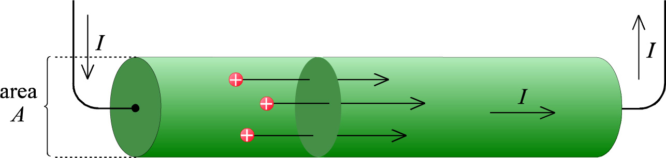
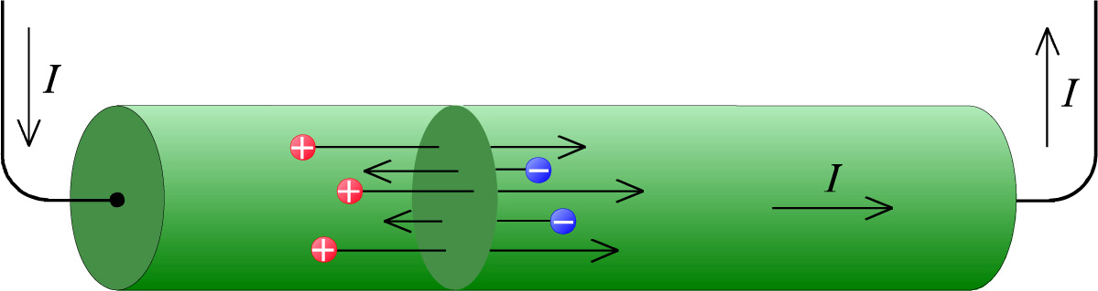

Partial conductivity, total conductivity, transport number
Partial conductivities sum to total conductivity
Transport number (transfer number) is the ratio of the partial to the total conductivity

Slide 20
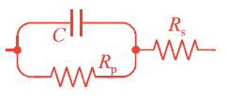
Remaining parts of Ch. 1 we leave for the future for now
Electrical circuits
Models of electrochemical behaviour
AC signals
AC impedance, Fourier transforms
Real and imaginary contributions, loss, and power dissipated
You may want to come back and read about them when needed

Slide 21




Summary – four selected important concepts
Charge and field
Charge capacitance of insulator (dielectric)
Current transport in a conductor
Conductivity

