Slide 1
KJM 3110 Electrochemistry
Chapter 10. Electrode polarisation

Slide 2

Electrode reaction: Limitations and possibilities
There are 3 contributions to limit the rate of an electrode reaction (3 «frictions» or barriers):
  Ohmic: Ionic conduction
  Kinetics of the electrode reaction itself (usually electron transfer)
  Transport of reactants and products
    There are 3 contributions to facilitate this transport (3 paths, or drivers)
u
σ
k
D
v

Slide 3
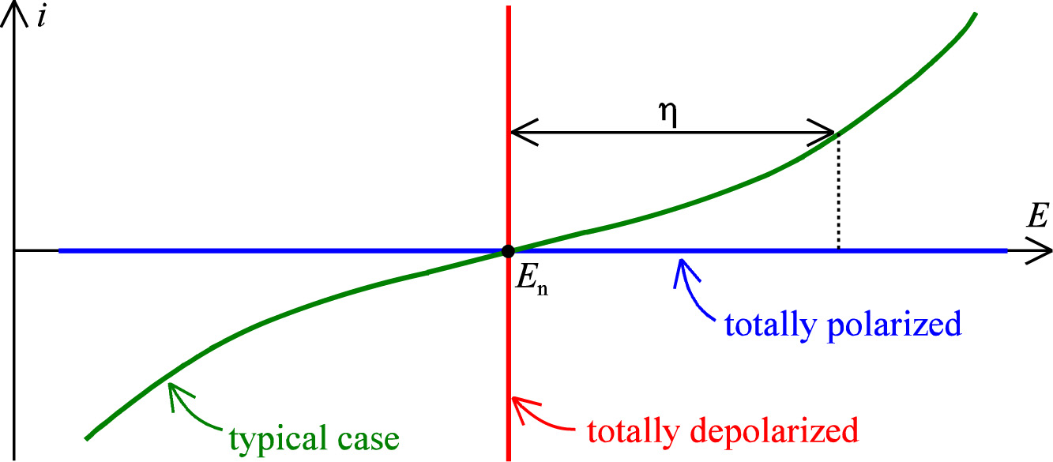
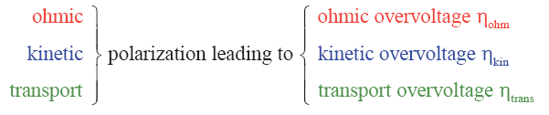
Electrode polarisation, overvoltage

Slide 4
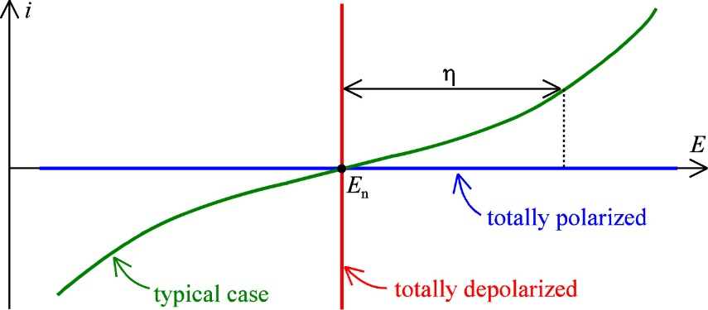
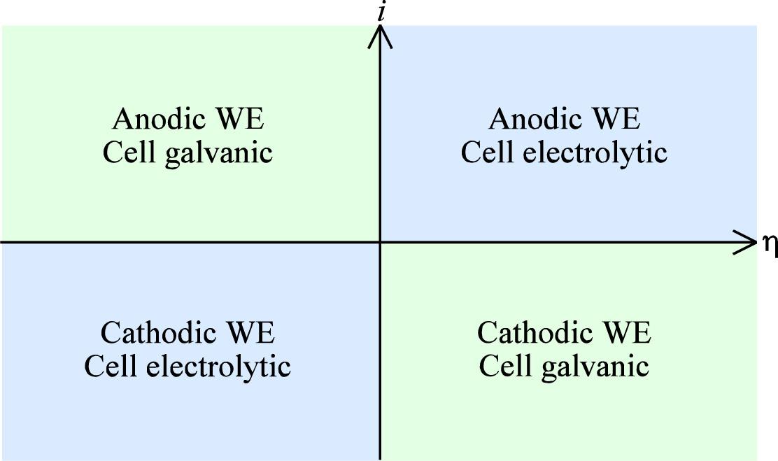
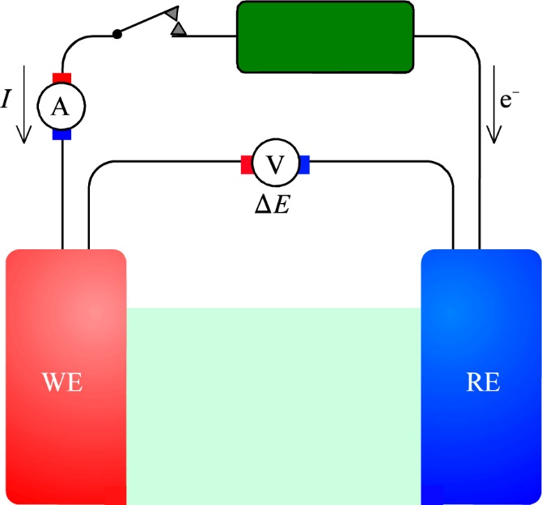
Sign (+ or -) of current in an electrochemical cell
The textbook assigns positive current in an electrochemical cell as that arising from an anodic reaction at the working electrode.
Moreover, in plots, upward and right are positive.
M → M²⁺ + 2e⁻

Slide 5



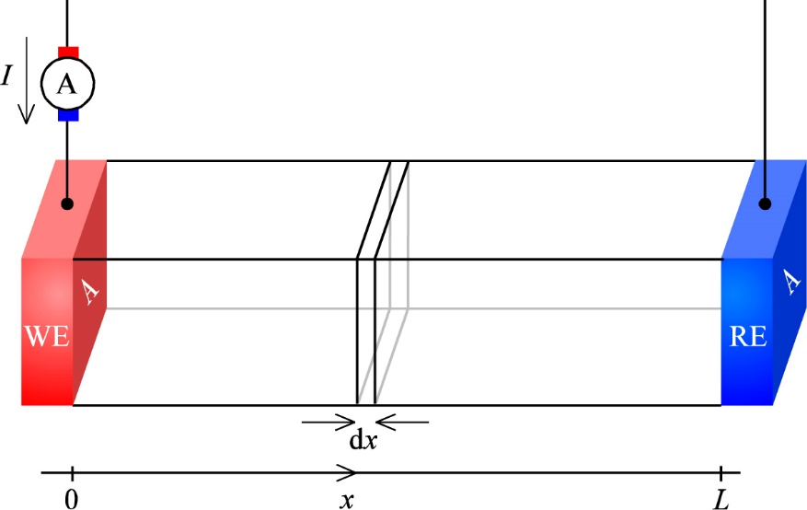
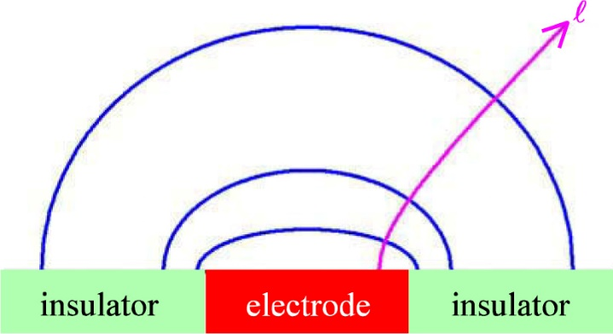
Ohmic polarisation
Case of disk electrode
Case of trough geometry

Slide 6
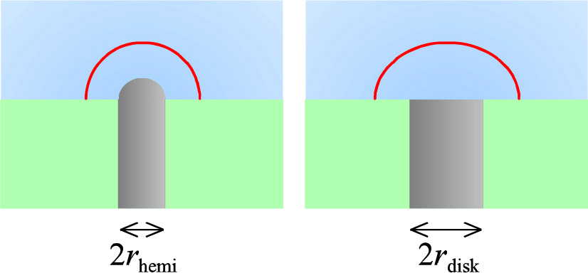
Two common electrodes in aqueous electrochemistry
Read about them in the textbook
a) – j) of how to reduce the ohmic overvoltage
Just as much as the electrochemist tries to eliminate the ohmic part, the study of ionic conductivity requires that we eliminate the electrode part.

Slide 7



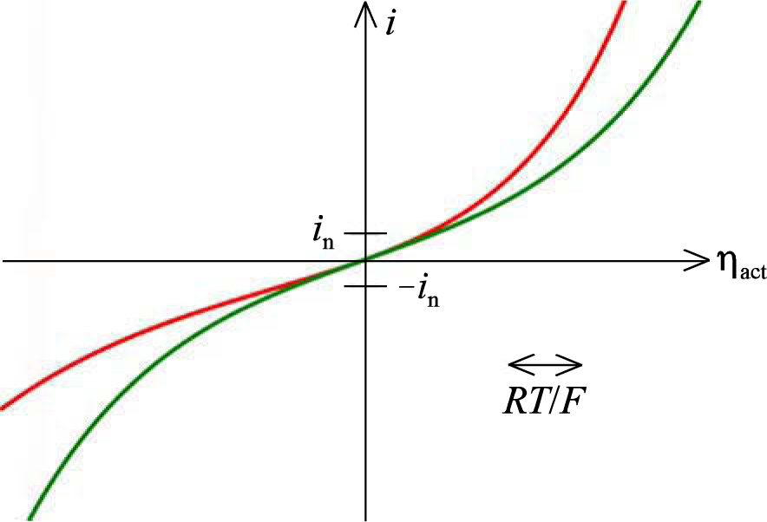
Kinetic polarisation
Current density limited by electrode reaction rate
If there is no concentration polarisation,
Driven by thermal energy over the activation barrier
Requires reactants both ways
Driven by overpotential
α=0.35
α=0.50

Slide 8

Charge transfer resistance
At small overpotentials, it can be shown that

Slide 9
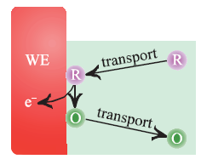


Transport polarisation
«Even when both R and O are transported by the same mechanism, there is an important distinction between the transport of a reactant and of a product in that there is a limit to the rate of transport of the reactant, but not of the product.”
  What does it mean? Is it always correct?

Slide 10



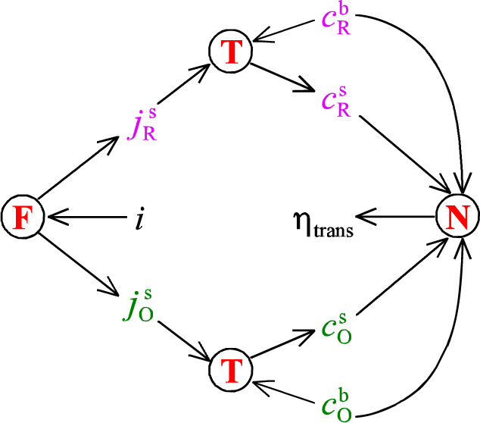
Transport polarisation
X
> 0

Slide 11





Transport overvoltage
From Ch. 8: Simple relationship for transport
Faraday’s law:
Combine with
Yields

Slide 12
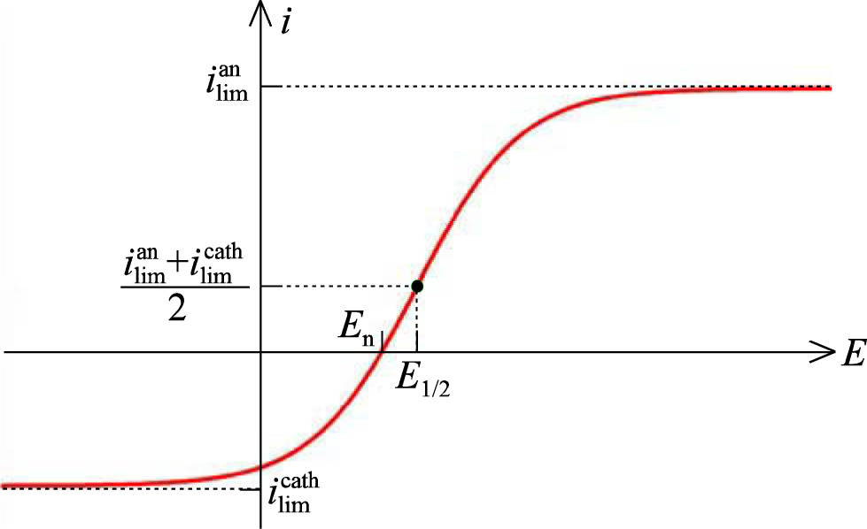


Limiting currents

Slide 13
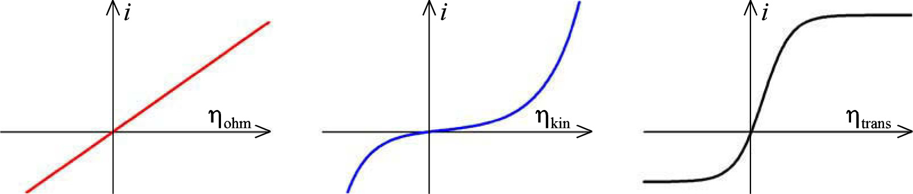

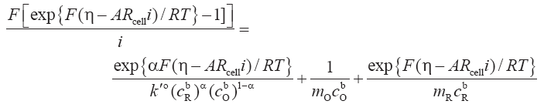
Ohmic + kinetic + transport limitations
Overpotential sums with the ohmic one
But kinetic and transport interact and do not sum in a simple manner

Slide 14
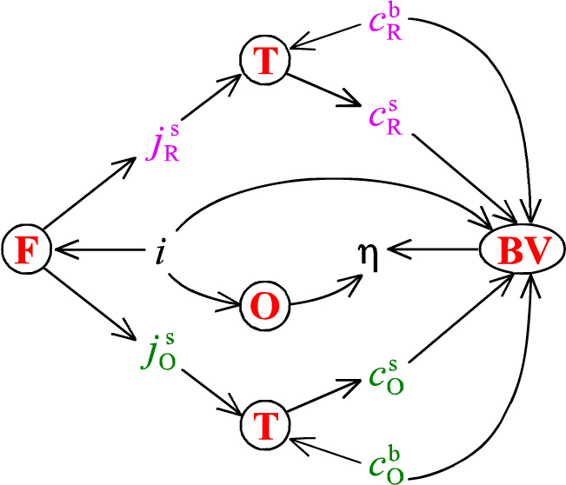
Interplay between the three polarisations
X

Slide 15
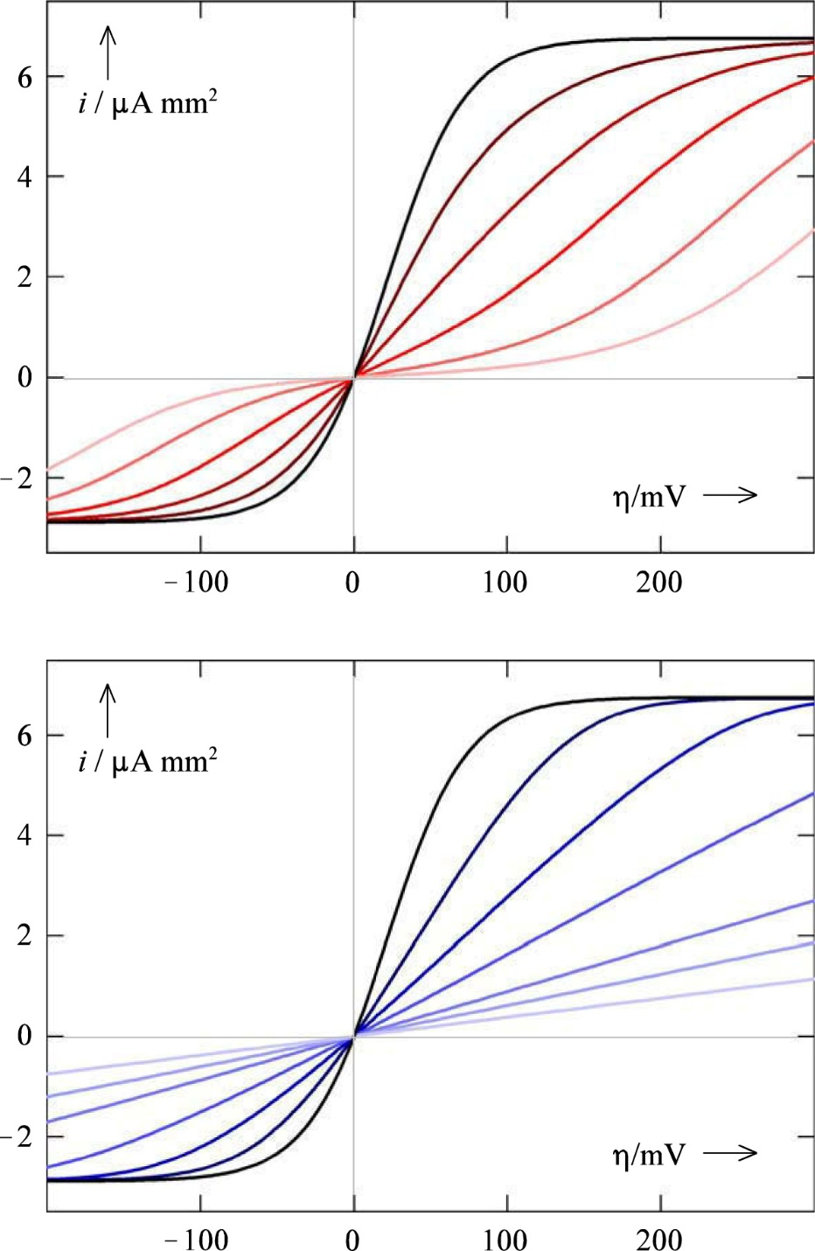
i-η plots
Transport + kinetic
Transport + ohmic

Slide 16
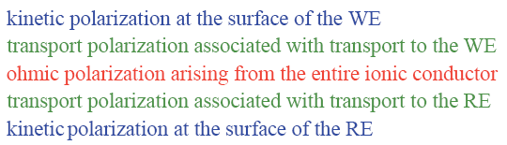
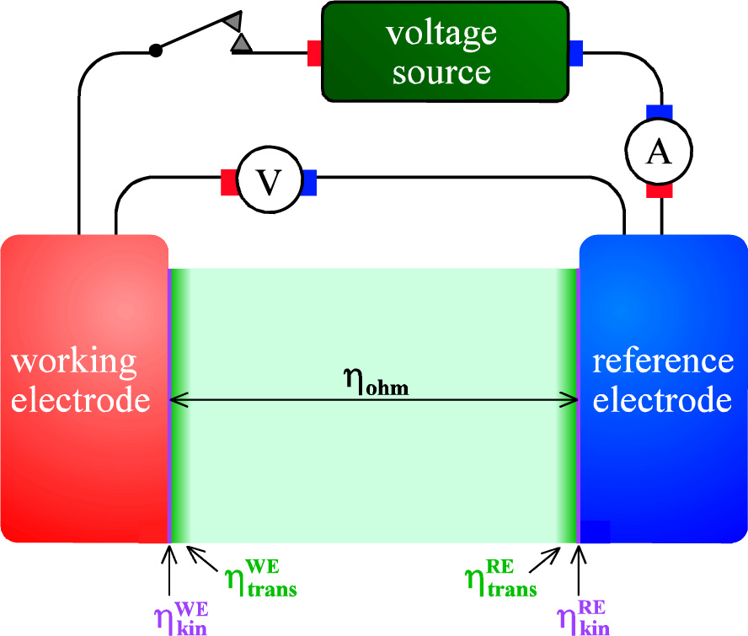
Two-electrode cell

Slide 17

Three-electrode cell
RE potential measured by separate, third electrode
Eliminates CE polarisations
Ohmic polarisation still remains
Potentiostat feeds E = E_{WE}-E_{RE} back to voltage source to keep E constant (potentiostat)
May alternatively feed current back to keep that constant (galvanostat)

Slide 18
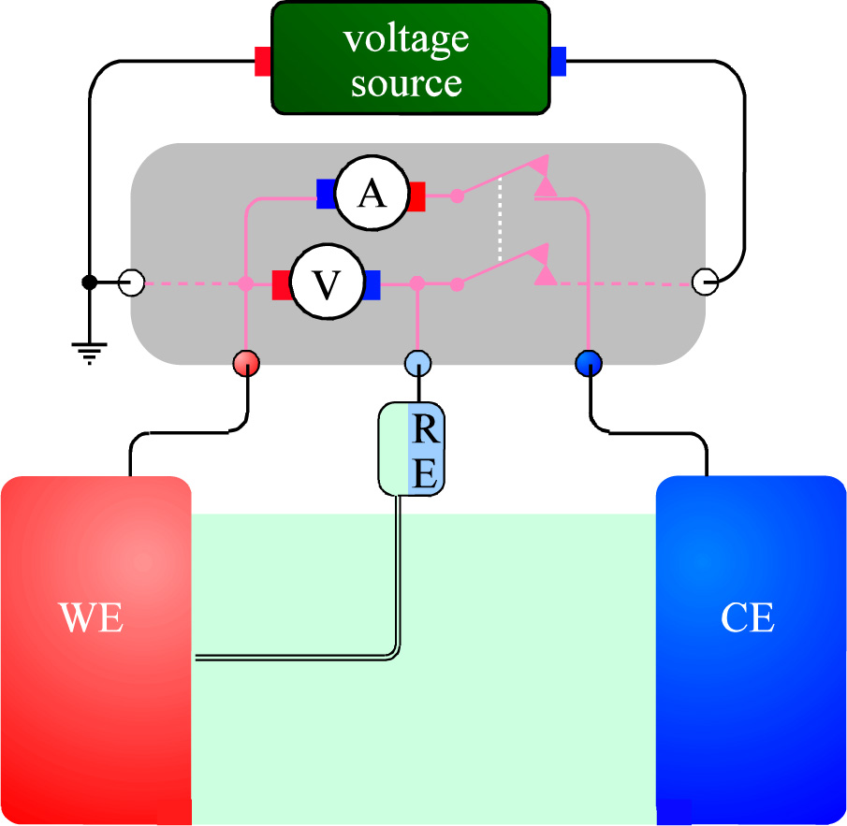
3 electrode cell with potentiostat
Luggin capillary RE minimises ohmic resistance
The switch opens the circuit, allowing measurement of the open circuit potential
Allows the potentiostat to set the WE electrode to a potential relative to the open circuit potential, i.e. to the desired overpotential.

Slide 19
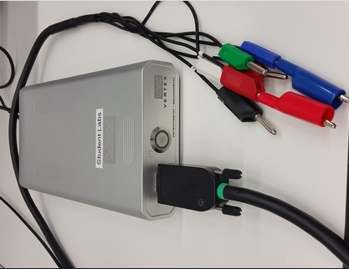
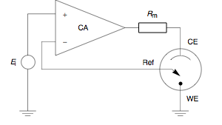
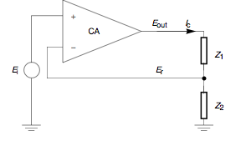
Potentiostat
3 electrode cell
Can be represented by two resistances
Set potential source E_{i} to control amplifier (CA) input (+)
Reference electrode E_{r} to CA inverting input (-)
Runs a current I_{c} to maintain E_{r} = E_{i}

Slide 20
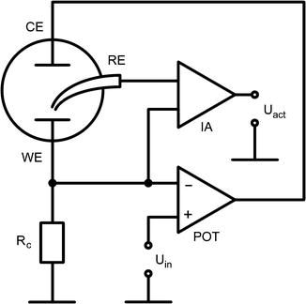
Galvanostat
Set potential to the (+) input of the POT amplifier drives it to yield a certain current through the cell, generating a potential over R_{c} to the inverting (-) input.
E = E_{WE} – E_{RE} taken through IA

Slide 21


Summary Ch. 10 Electrode polarisation
Next: Corrosion

