Slide 1
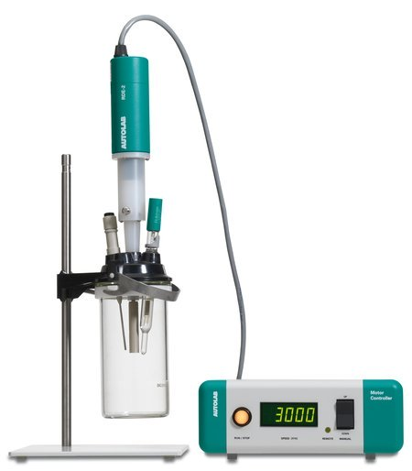
KJM 3110 Electrochemistry
Chapter 12. Steady-state voltammetry
2022-04-19

Slide 2
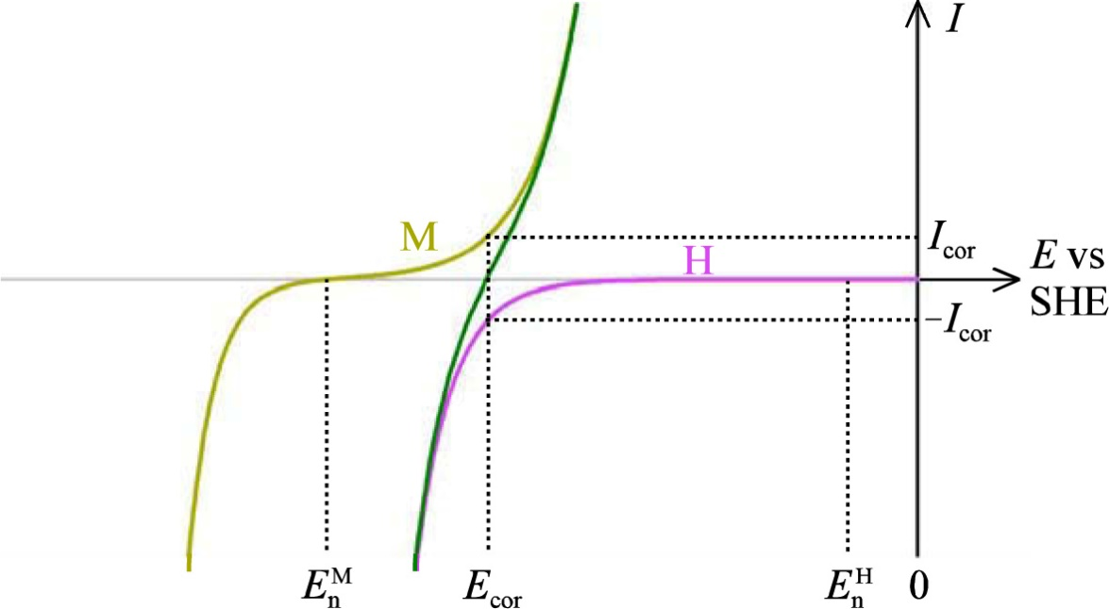
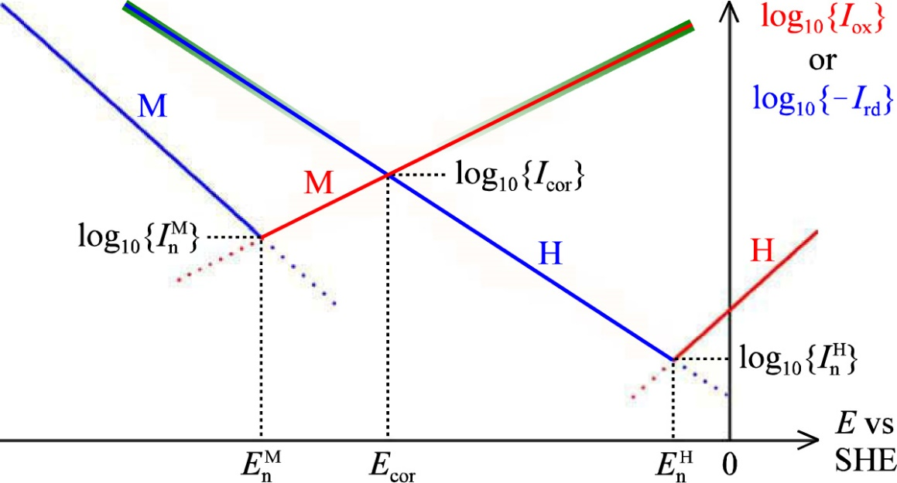
Ch. 11 Corrosion - Summary
Spend time on understanding the BV mixed corrosion potential plot and the corresponding Tafel plot
The slope is 1/b (Tafel slope)
Fe corrosion: Effects of Fe(II) and Cl⁻, pits and crevices
Cathodic and anodic protection
Stress corrosion, fatique

Slide 3
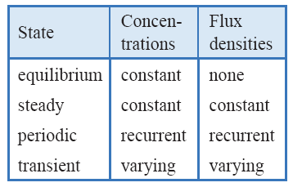
Electrochemical experiments
Equilibrium
  Concentrations are constant. Net fluxes are zero.
Steady state
  Concentration gradients are constant.
  Concentrations are constant with time.
  Net fluxes are non-zero and constant.
  This chapter
Periodic state
  Concentrations and net fluxes change with time periodically
  Chapter 15
Transient state
  Concentrations and net fluxes change with time, non-periodically
  Chapter 16 (touched in Ch. 8: Potential step - Cottrell)

Slide 4
Voltammetry – setting the scene
Previously
  Presence of both reduced and oxidised species – of both reactant and product
    Ni/Ni²⁺
    [Fe(CN)₆]⁴⁻/[Fe(CN)₆]³⁻
  Electrode polarisation curves around OCV
  Concentrations assumed to remain constant
Now
  Presence of reactant only
  OCV undefined
  Reaction can only run in one direction
  Concentration gradients (steady-state or transient)

Slide 5
Voltammetry – setting the scene
Textbook paragraphs (a) to (q). Excerpts:
Experiment and model
3-electrode cells (Working, Reference, Counter)
Liquid electrolyte: Ionic conductor – often supporting electrolyte
Single reactant at known concentration – no parasitic reactants
Size and shape of electrode; convection
(j)-(k) Commonly we have initial absence of product: OCV and η undefined.
Potential program: Step, steps, ramps: Resulting current.
  More rarely: Current program with resulting potential.
Parasitic uncompensated ohmic resistance and capacitive currents suppressed
  Remains are modelled or neglected
Voltammogram: Most commonly I vs E
Compare voltammogram(s) with model voltammogram(s)

Slide 6
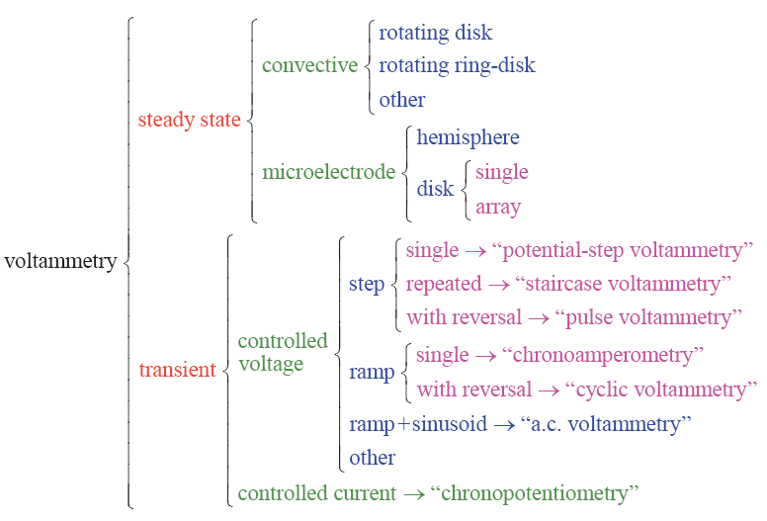
Voltammetry (and potentiometry)
}
This chapter

Slide 7
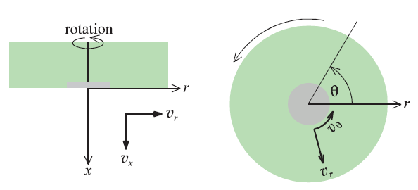
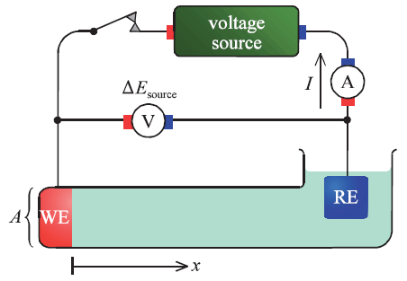
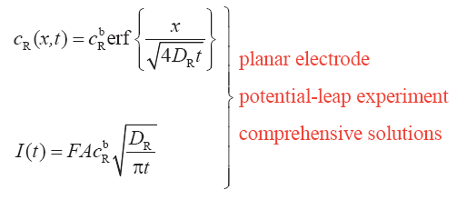
Microelectrodes and macroelectrodes
Steady state can be promoted by convection
  and a large cell volume
In the absence of convection, ”steady state can be established only at an electrode surface that is small in all its linear dimensions”.
  What it means will now be illustrated.
Reconsider from Ch. 8, the linear potential-leap experiment (a macroelectrode):

Slide 8
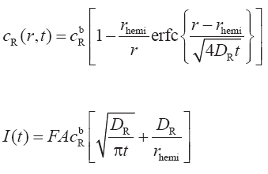
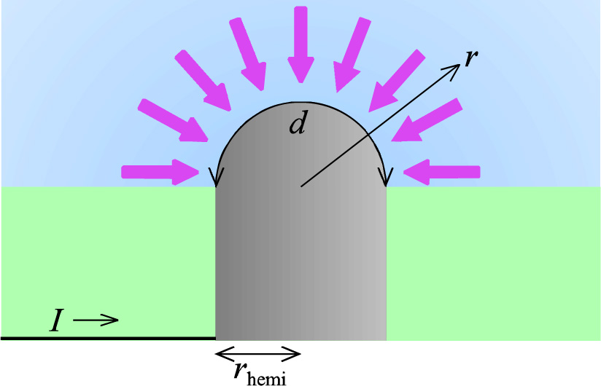
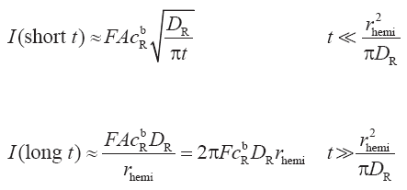
Hemispherical micro- and macroelectrodes
Same experiment – potential leap – zero concentration at interface
Similar simple solution
Further simplification for short
and
long times

Slide 9
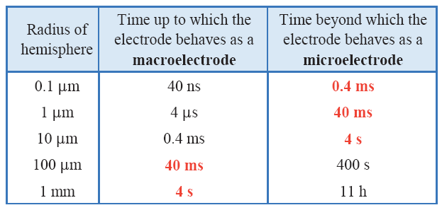
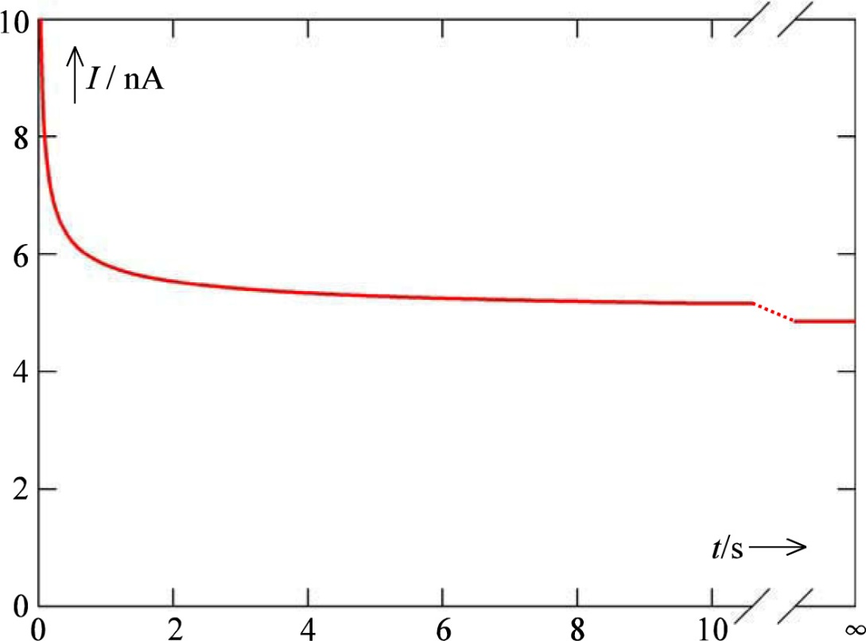
Hemispherical micro- and macroelectrodes
Macroelectrode
  Behaves as if it were large and planar
  Diffusion controlled time dependent current (not steady-state)
  Large electrodes may be studied as macroelectrodes up to a short time.
Microelectrode
  Diffusion-controlled steady-state
  Concentration gradient continues to change in the bulk, but remains constant near the electrode
  Small electrodes may be studied as microelectrodes (steady-state) after a short time.

Slide 10
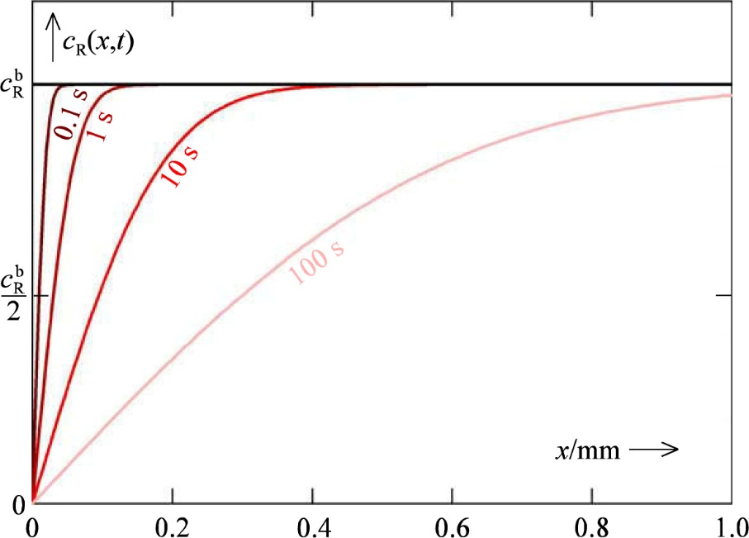
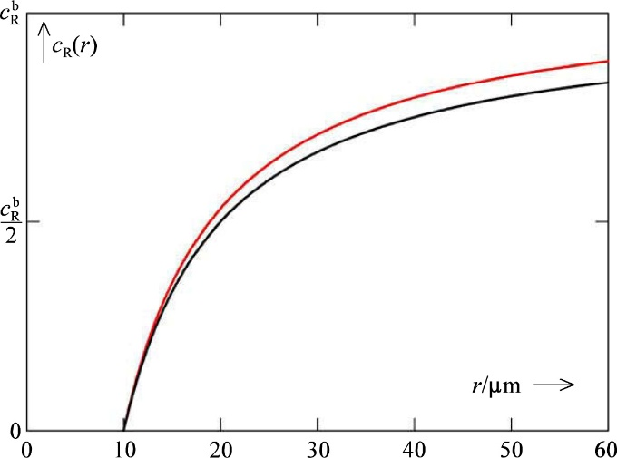
Hemispherical micro- and macroelectrodes
Macroelectrode
  Behaves as if it were large and planar
  Diffusion controlled time dependent current (not steady-state)
  Large electrodes may be studied as macroelectrodes up to a short time.
Microelectrode
  Diffusion-controlled steady-state
  Concentration gradient continues to change in the bulk, but remains constant near the electrode
  Small electrodes may be studied as microelectrodes (steady-state) after a short time.

Slide 11
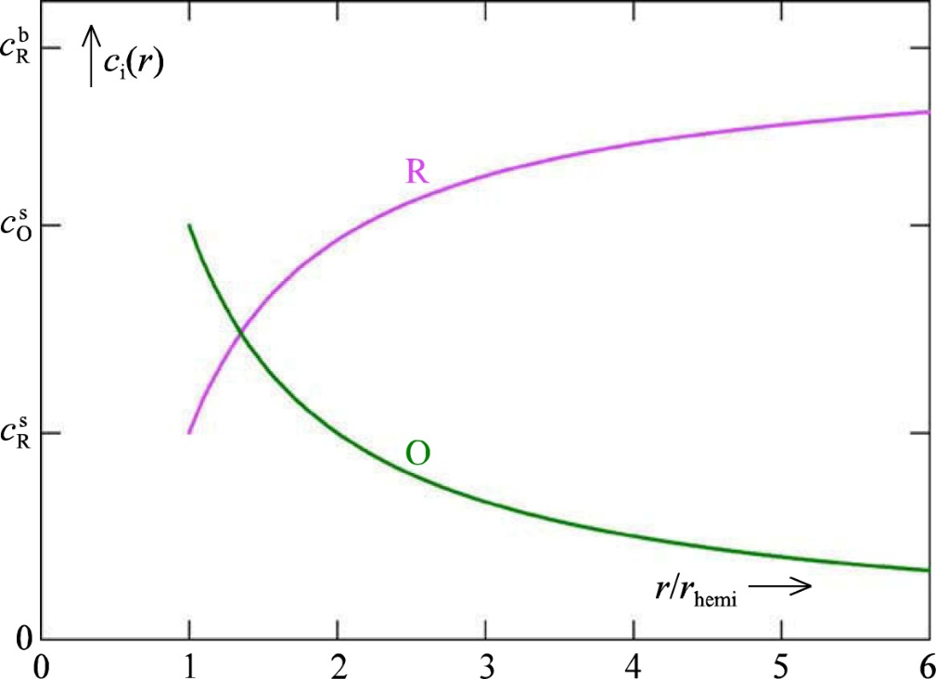

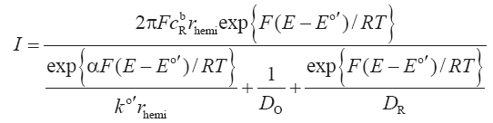
Steady state potential step; reversibility
Previously (potential leap) looked at reactant (e.g. R) depletion
Now (potential step) also considers product (O) concentration profile.
Fick’s law for both; complicated…
The book decides to consider only steady-state:
Diffusion limited (Nernstian):
Kinetically limited:

Slide 12
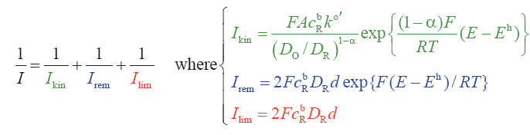
Reciprocal sum formula («harmonic sum»)
Normal expression
Reciprocal (harmonic) sum
Note that the overall current is not a sum of currents, but limited by a sum of polarisations, each characterised by a limiting current as if that polarisation was the only limiting one.
Removal controlled current. Should be D_{O}?

Slide 13
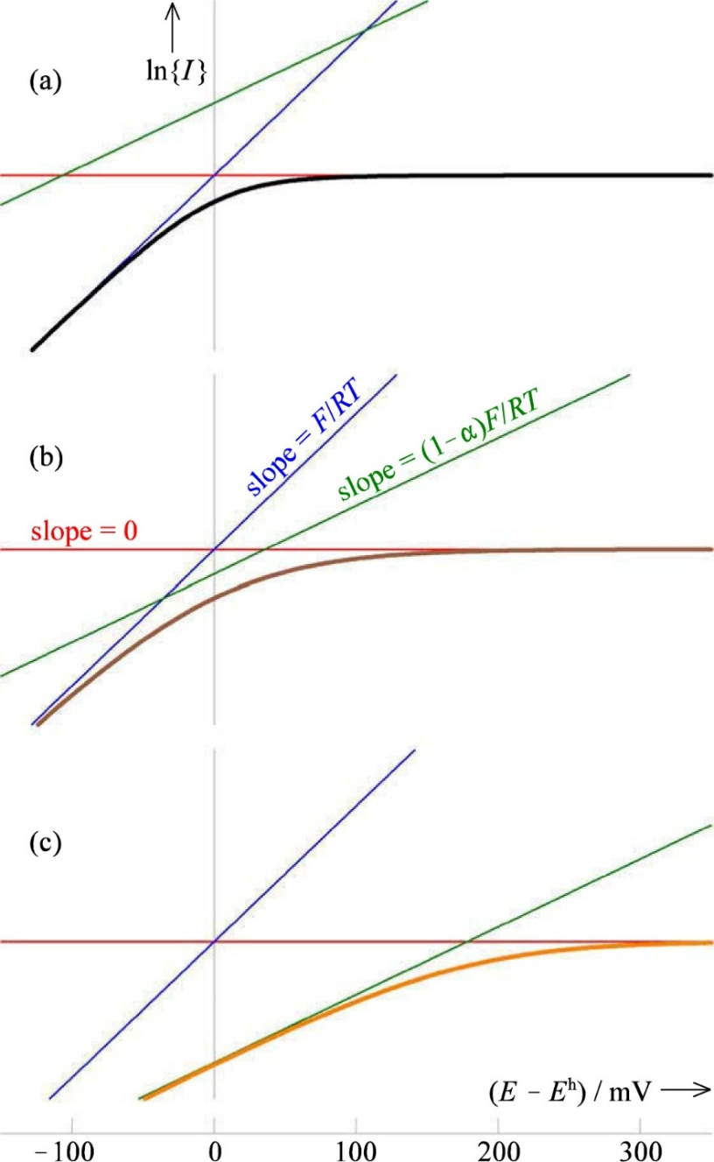

Steady state polarisation; reversibility
Steady state voltammograms
Reversibility index (kinetics/diffusivity)
Smallest current dominates
Limiting transport of reactant (here R) always dominates at high positive potential
(a) Reversible
(b) Quasireversible
(c) Irreversible
Note: This figure has logarithmic current
Note the 6 colours of lines!

Slide 14
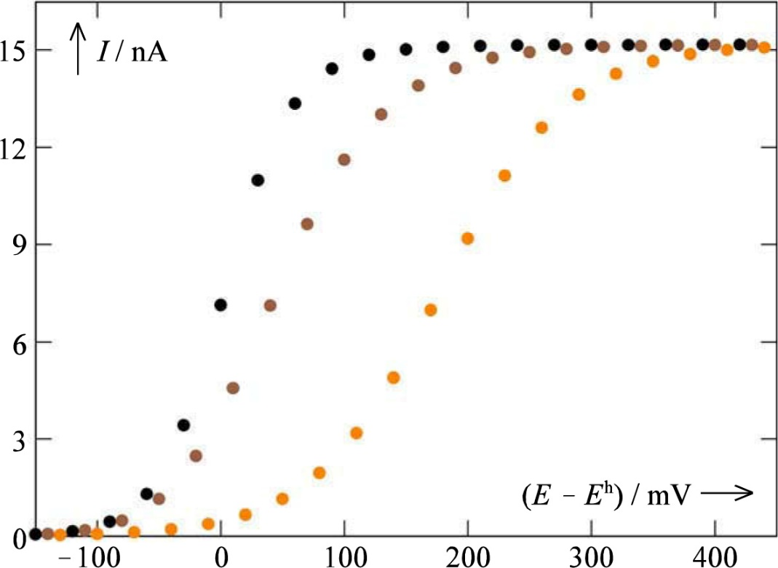
Steady state polarisation; reversibility
Steady state voltammograms
Note the 6 colours of lines!
Rev
Quasi
Irrev

Slide 15
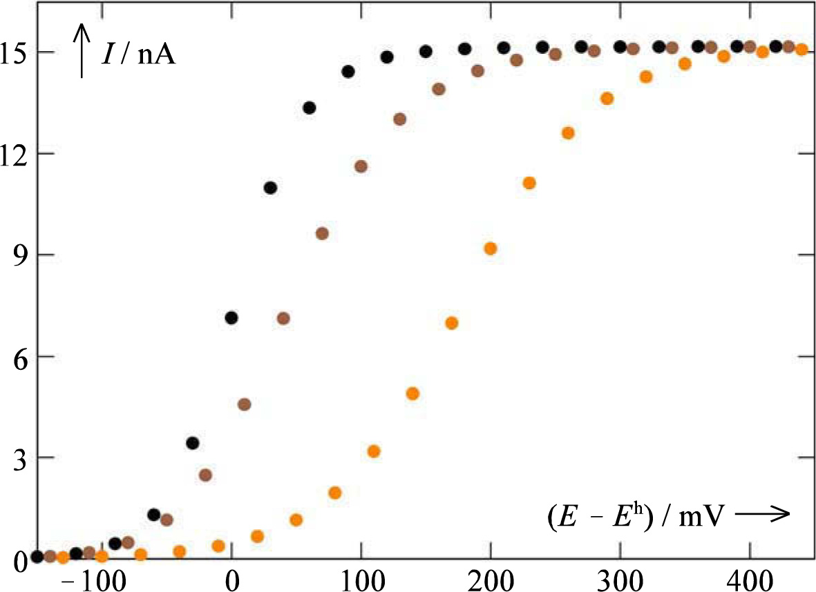
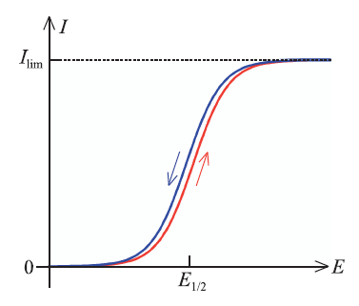
Steady state polarisation; reversibility
Linear voltammogram
Steady state
  Reversible
  Quasireversible
  Irreversible
Near-steady state voltammetry
Rev
Quasi
Irrev

Slide 16
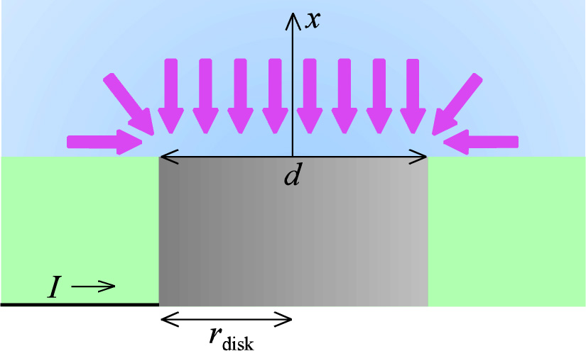
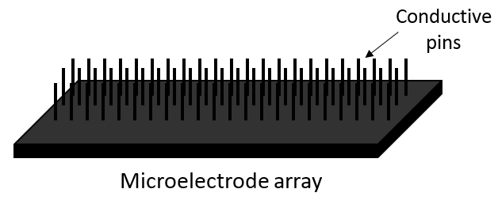
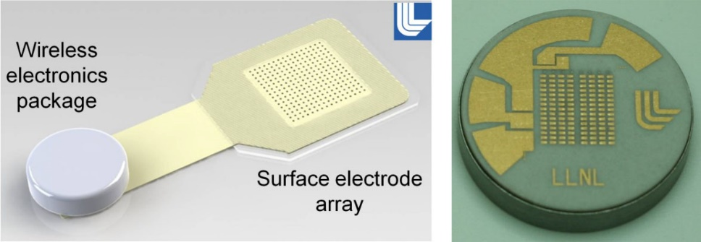
Disk electrode
Easy to make and to clean
Awkward (but possible) to model.
We skip the model here – not curriculum.
Microelectrodes make small currents – hard to measure
Microelectrode arrays of equally shaped (and modelled) disk microelectrodes connected in parallel easier to measure.
  Microelectrode arrays also used as arrays of individually connected electrodes – especially for life sciences

Slide 17
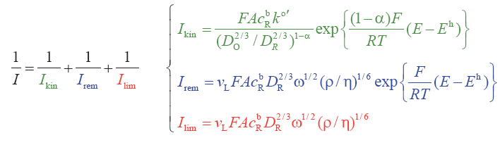
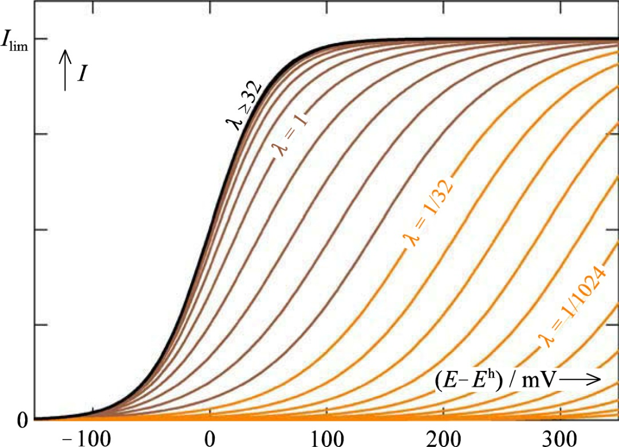
Rotating disk voltammetry
10-1000 Hz rotating speed
Mathematics similar to hemispherical electrode
Reciprocal sum of limiting currents
I_{rem} large and may be neglected
Nernstian (reversible) half-wave potential
Reversibility index
  Reversible
  Quasi-reversible
  Irreversible

Slide 18

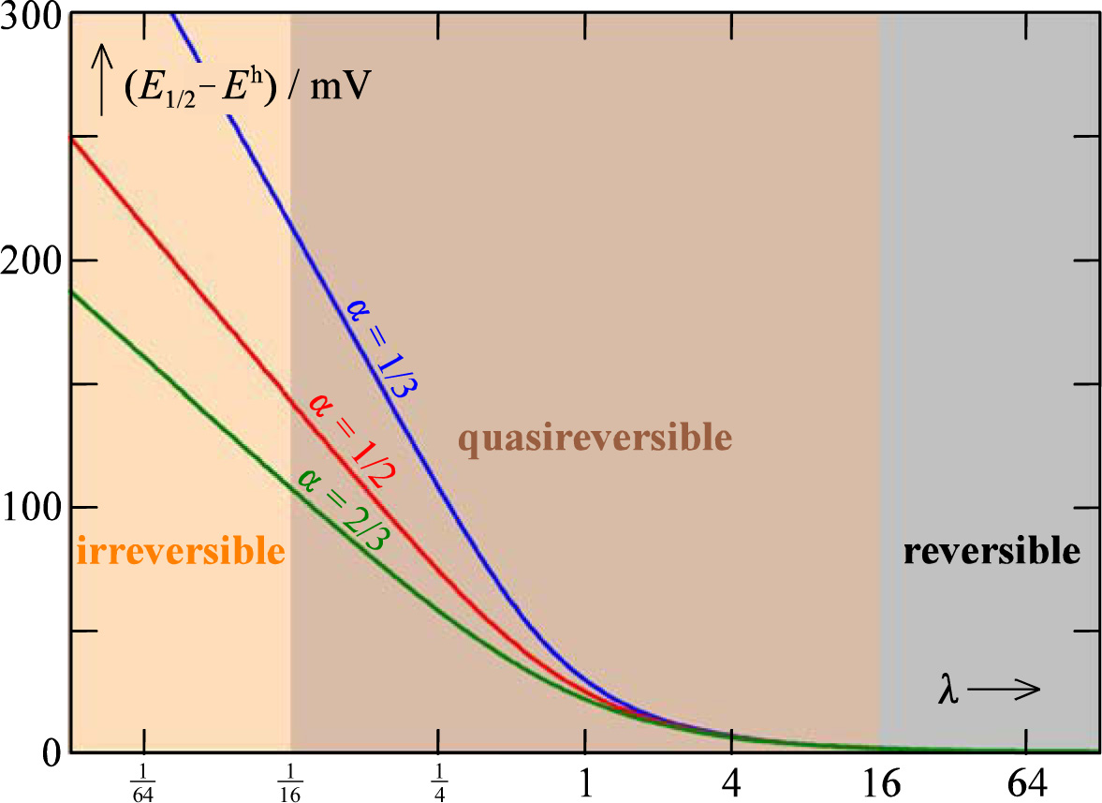
Rotating disk voltammetry
Half-wave potential deviates at increasing irreversibility

Slide 19

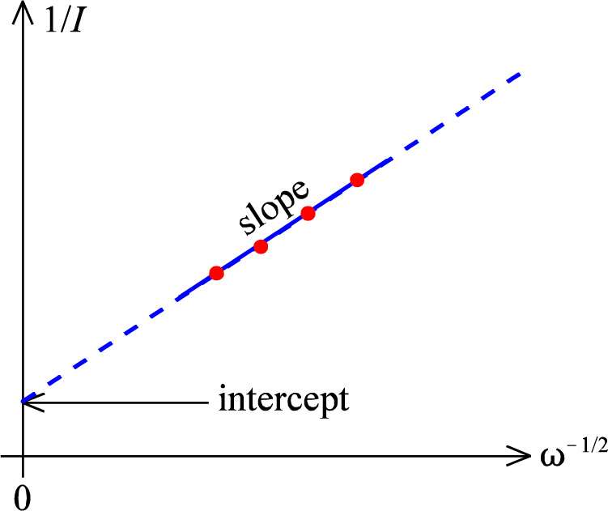
Rotating disk voltammetry
Neglecting a large I_{rem}
Koutecký-Levich plot of I vs 1/√ω (at constant E) yields:
  kinetic parameter as the intercept (infinitely high rotating speed) and
  diffusion parameter as the slope
Plots at varying E yield additional parameters

Slide 20
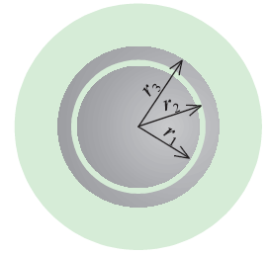
Rotating ring-disk electrode
Two working electrodes
Ring working electrode collects and measures products
Requires use of a bipotentiostat
Not further treated in the book. Not part of the curriculum.

Slide 21
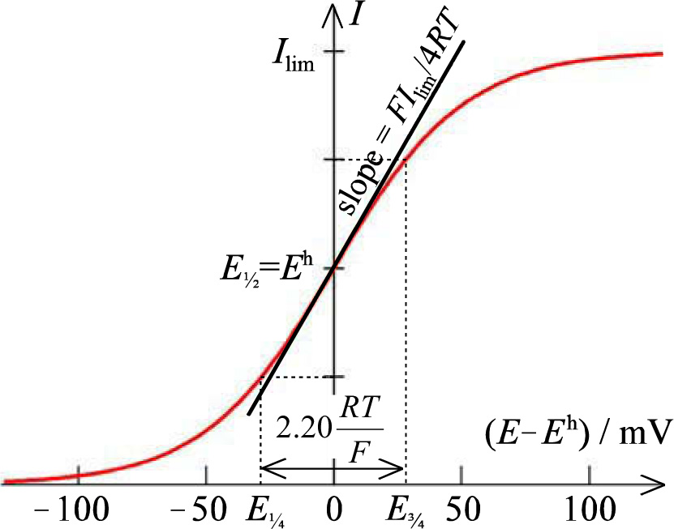




Reversible voltammograms
Reversible wave. Three equivalent functions:
Reversible waves contain no information about kinetics
Half-wave potential deviates from formal potential by the ratio of transport

Slide 22



Reversible voltammograms
Three indications of reversibility
Slope
Tome’s criterion
Linearisation
  Quasi- and irreversible kinetics yield subnernstian slopes

Slide 23
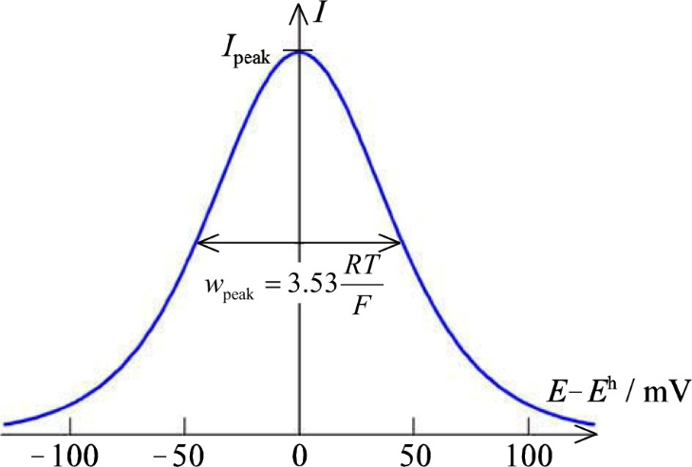
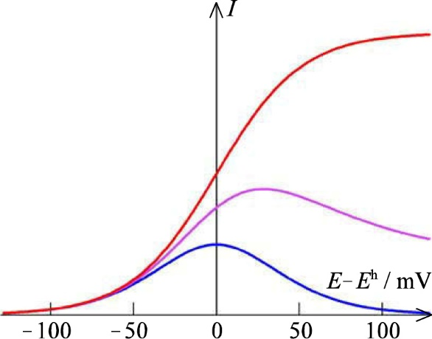
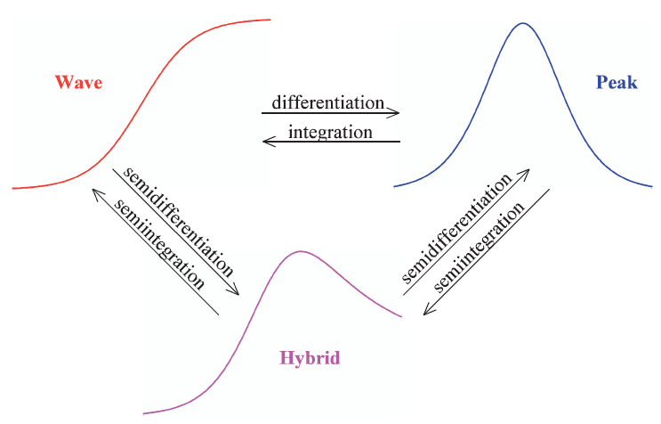
Remaining part of Ch. 12 refers to non-steady state voltammetry: Not curriculum
Waves, hybrid, peaks
Semidifferentiation and -integration
  Mathematically
  Computationally
  Electronically
    Transmission line

Slide 24
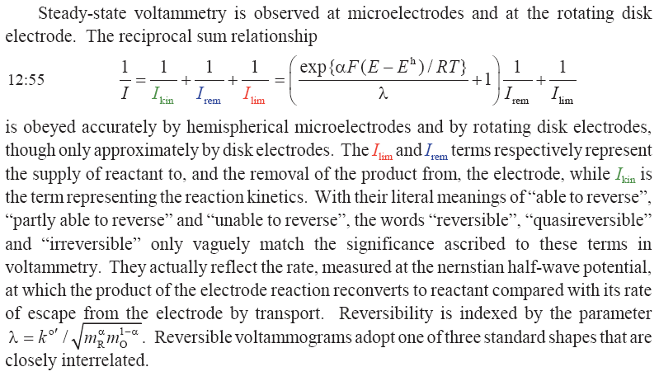
Summary Ch. 12 Steady-state voltammetry

