Slide 1
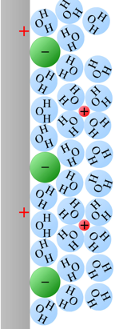
KJM 3110 Electrochemistry
Chapter 13
The
Electrode
Interface

Slide 2
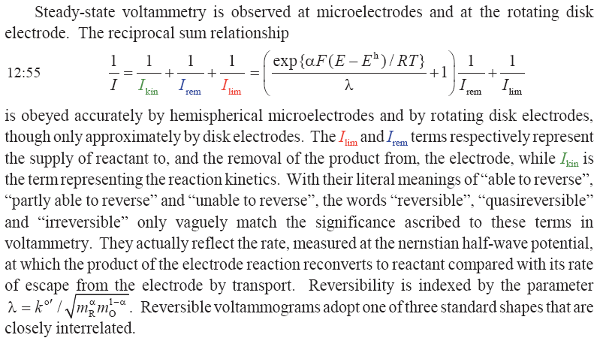
Summary Ch. 12 Steady-state voltammetry

Slide 3
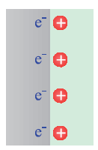
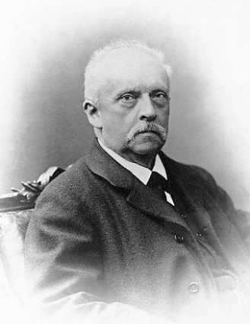
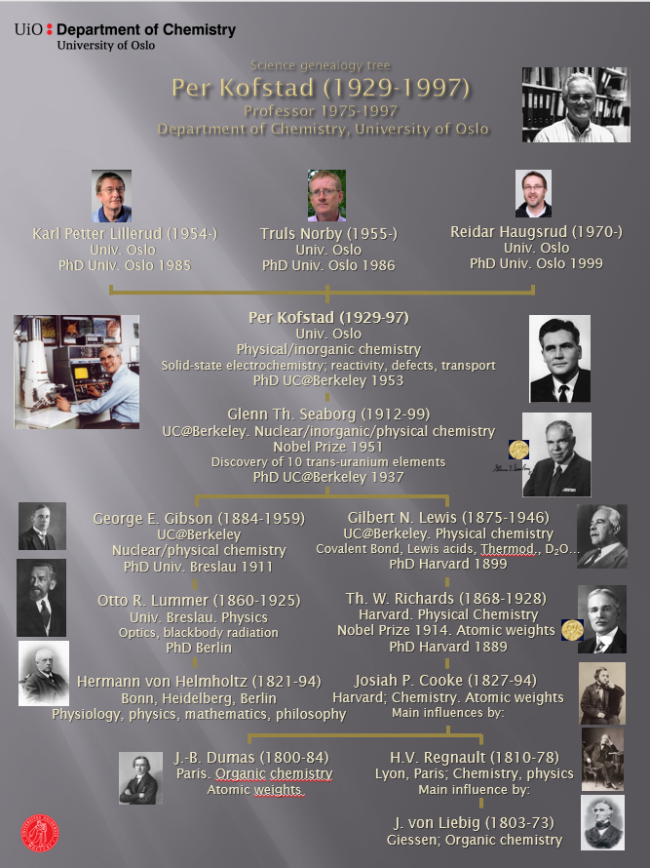

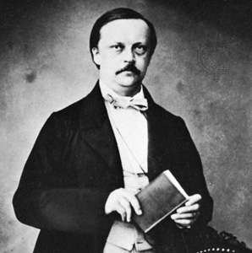
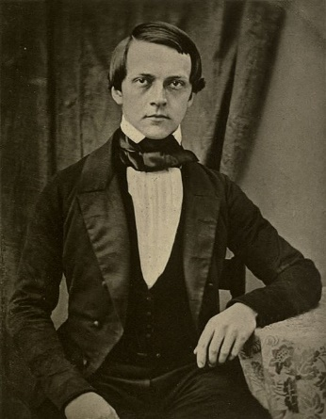
First model of the double layers: Helmholtz
Electric field due to polarisation of a blocking electrode interface
Small distance, large capacitance
Area specific capacitance
Phenomenological model
Charged layer called Helmholtz layer

Slide 4
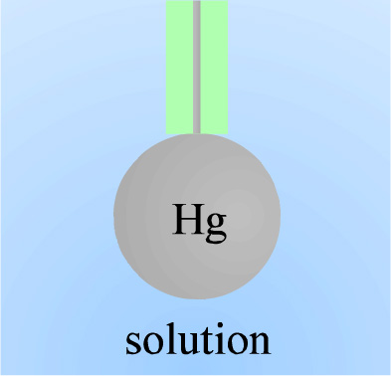

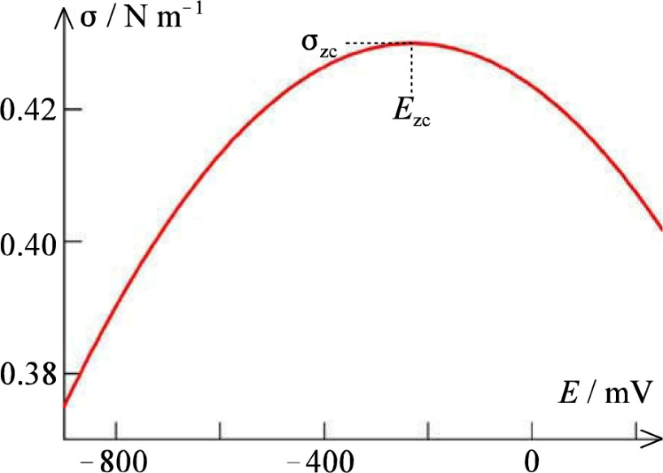


Interfacial energy
Surface tension σ
Interfacial (surface) energy proportional to σA
Charge, Lippmann equation
q is the charge on the electronic conductor
Equally big and of opposite sign on the electrolyte side
Differentiate Lippmann
Parabolic tension σ vs E
Electro-capillary curves
Point of zero charge E_{sc}

Slide 5
Three ways to measure the capacitance
A) Measure and doubly differentiating the electrocapillary curve
  Requires liquid-liquid interface
B) AC EIS (or DC transient methods)
  Any interface
C) Measuring the current flowing to an expanding electrode held at constant potential
  Textbook eq. 13:6
  Requires liquid-liquid interface

Slide 6


Capacitance may vary with potential
Differential capacitance
Integral capacitance

Slide 7



Gouy-Chapman model
Helmholtz:
  Counterions directly at the interface
  Constant capacitance – independent of potential or ion concentration
Gouy-Chapman:
  Counterions in a diffuse layer
  Equilibrium concentration distribution is a result of higher entropy vs higher energy
  Poisson
  Charge neutrality
  Combination yields electric field at surface

Slide 8
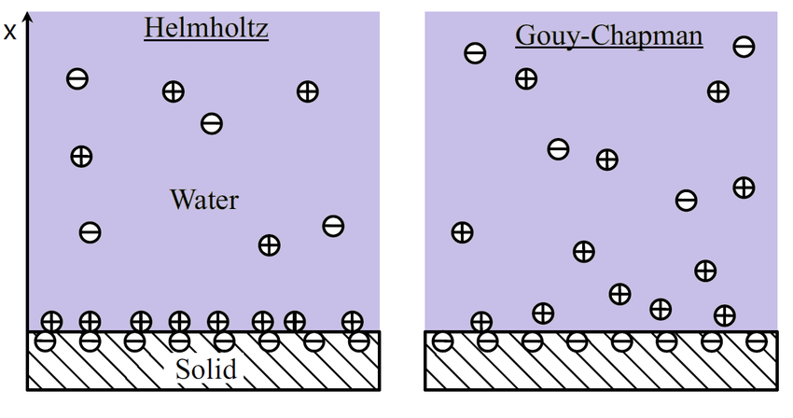
Simple Helmholtz vs more accurate Gouy-Chapman

Slide 9


Boltzmann distribution
Temperature-dependent distribution
Exercise:
Rewrite the left- and rightmost expressions to find an expression for c_{i}(x)
Discuss the terms and their effect on the concentration profile of species i.
$$c_{i}\left(x\right)= c_{i}\left(∞\right) exp⁡\left\{−\frac{z_{i}F}{RT}φ\left(x\right)\right\}$$

Slide 10
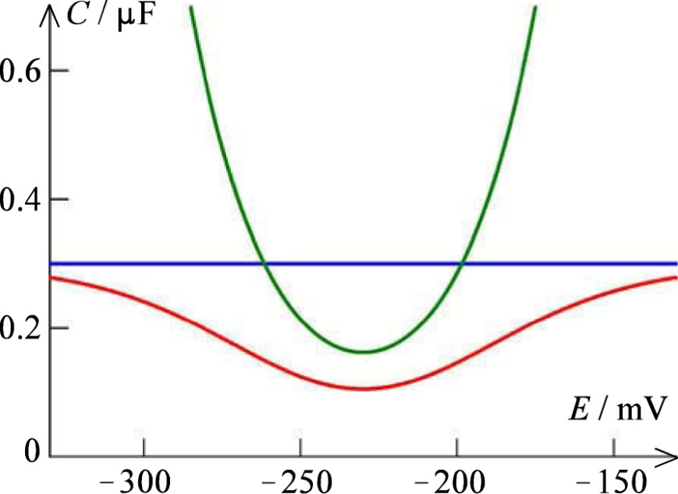

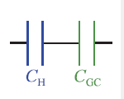

Boltzmann distribution
Allows calculation of the capacitance (Gouy-Chapman model)
Stern: Compact (Helmholtz) + diffuse (GC) layers

Slide 11
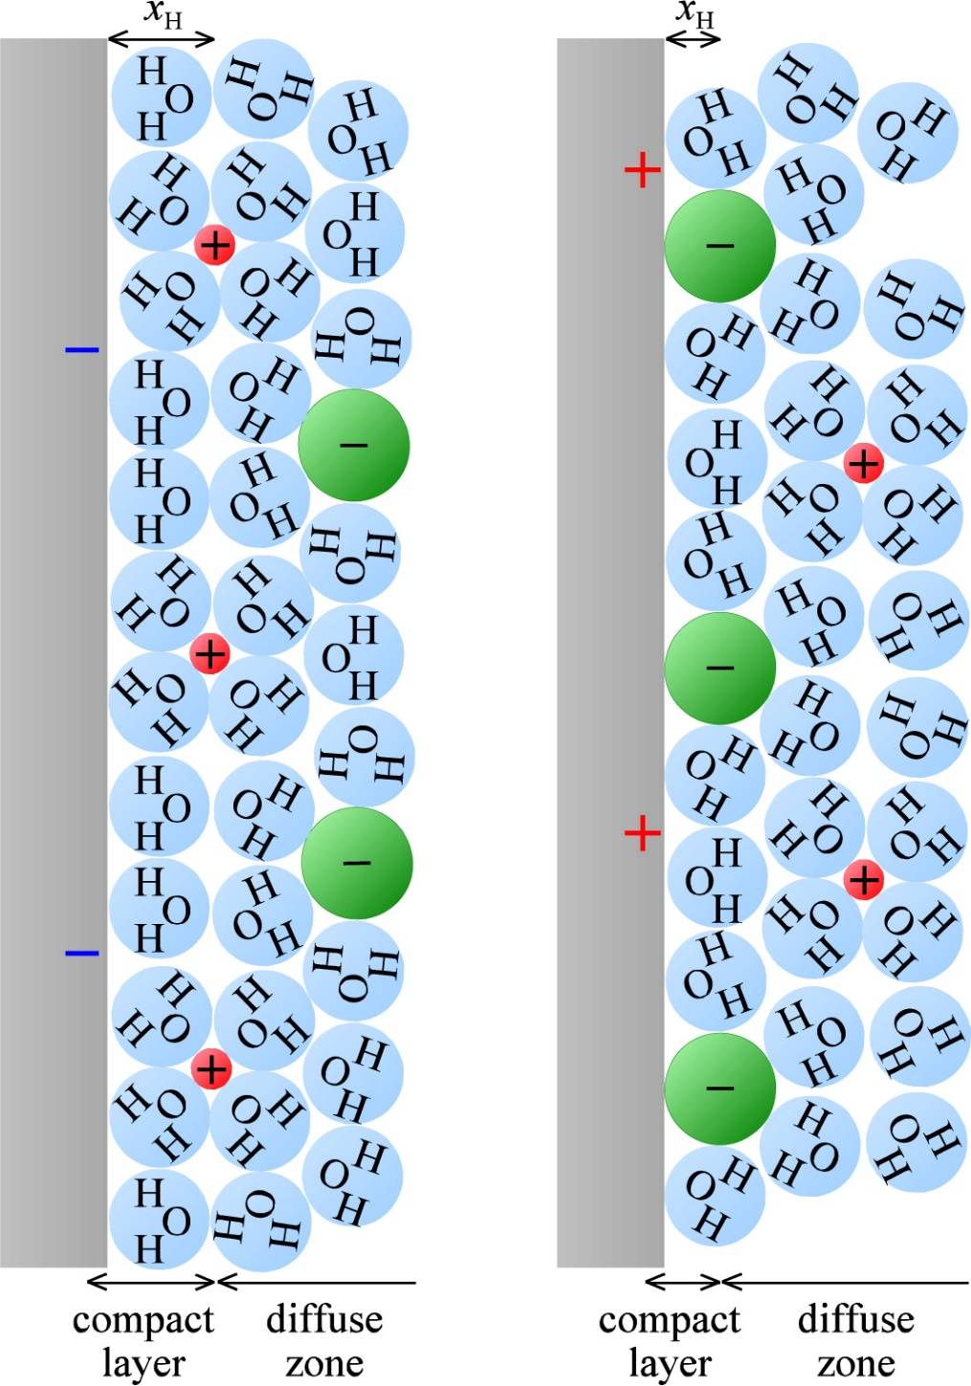
Stern refinement
Different thickness of the compact layers on the two sides
  Anions pack better (less hydrated)

Slide 12
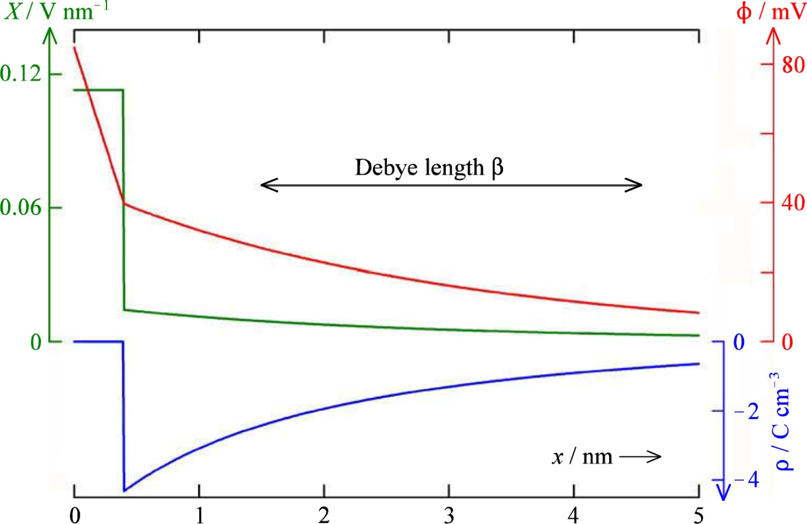
Stern model
Potential
Field
Charge density

Slide 13
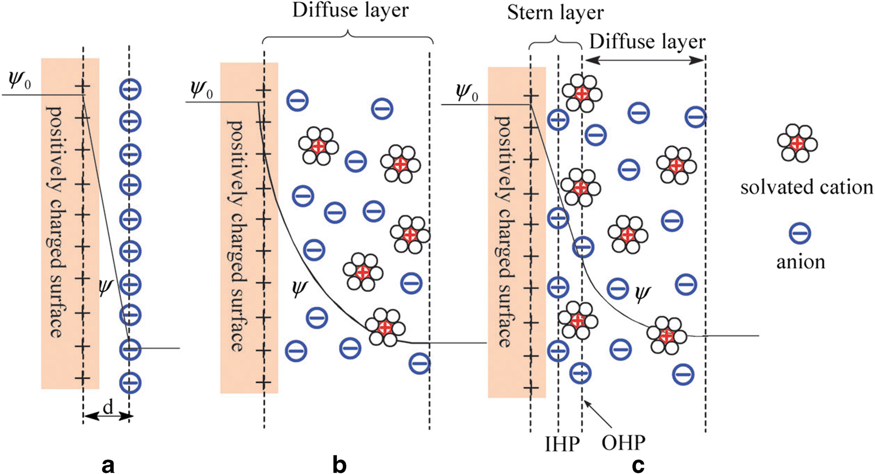
Helmholtz – Gouy-Chapman - Stern

Slide 14
Liquid vs solid state electrodes
Liquid: Guy-Chapman
  Anions and cations distribute in the diffuse layer
Solid: Mott-Schottky
  Immobile ions may remain constant (frozen) through the diffuse layer
  Often metal cations in solid-state oxide ion or proton conducting electrolytes
    E.g. Y³⁺ dopants in ZrO₂ or BaZrO₃
  Charge taken up only by the mobile ion (or defects, e.g. oxygen vacancies or protons)

Slide 15
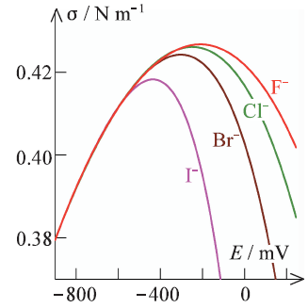
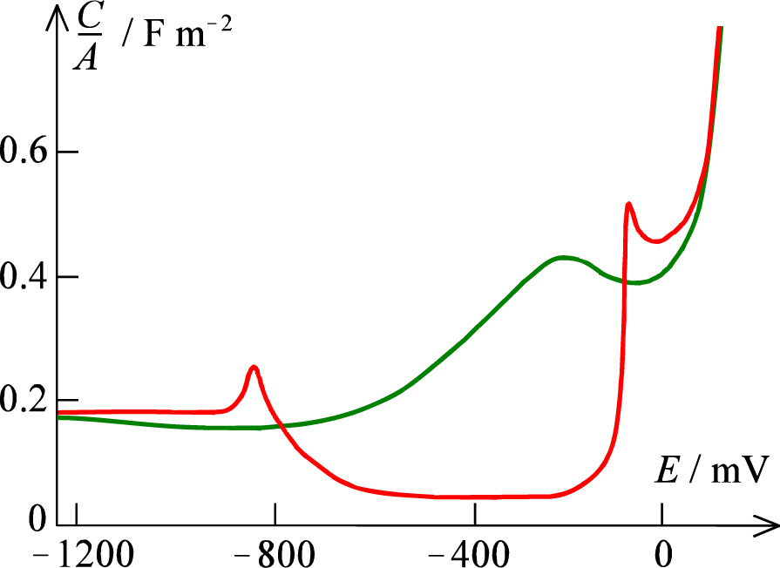
Adsorption
Till now, we have discussed a clean surface in an electrolyte
Ions may adsorb because of charge
Different ions adsorb differently (selectively)
Now, we will allow adsorption of more species («Invasion of the interface»)
The energy of the adsorbate is lower at the interface than deep in the solution
Example: Pentanol + KCl on Hg
  AC measurement of capacitance
  Adsorbate dominates interface until forced away at high positive or negative potentials favouring anions or cations

Slide 16






Adsorption equilibria
Surface concentration, mol/m²
Equilibrium
  Concentrations
Henry isotherm
  Coverage (θ << 1)
Langmuir isotherm
  Including θ → 1
Frumkin isotherm
Tempkin isotherm
Surface coverage adsorption coefficient
The term «isotherm» comes from a tradition of studying adsorption vs. partial pressure at constant temperature
Frumkin and Tempkin isotherms take into account multiple energies of adsorption, e.g. in multiple layers of adsorbate

Slide 17





Surface-confined reaction
Electrochemical reaction between two strongly adsorbed species
For the entire film with a concentration of surface sites Γ_{max}
Current leads to change in coverages:
Nernst voltage
Inversion, coverage:

Slide 18


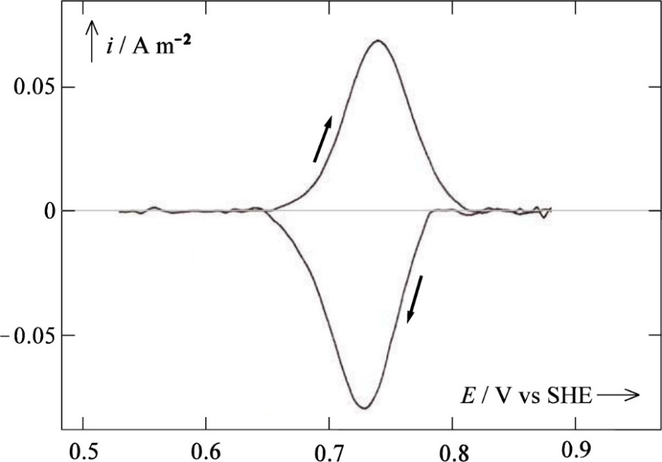

Surface-confined reaction - voltammetry
No species require transport
Linear scan from initial state with only R present
Coverage vs time
Voltammetry
  Linear scan
  Peak
  Current increases by voltage
  , but peaks and drops
  because of lack of reactants

Slide 19
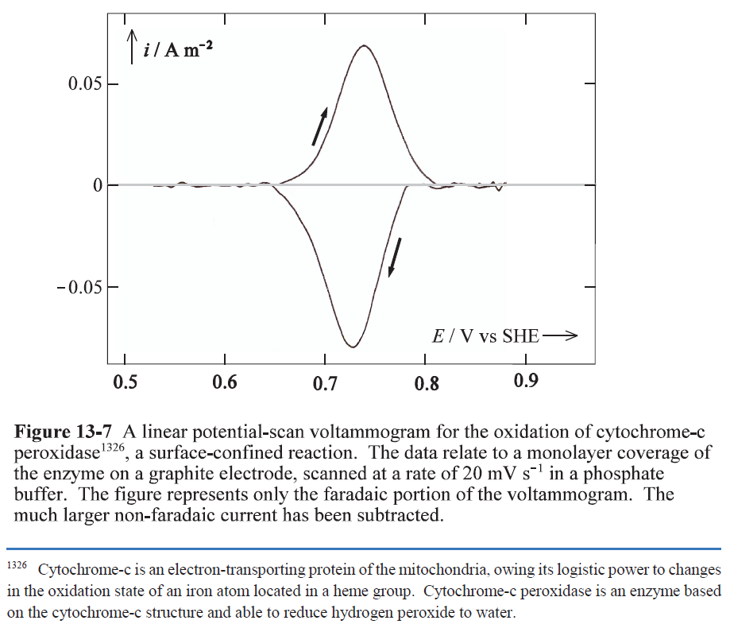

Slide 20


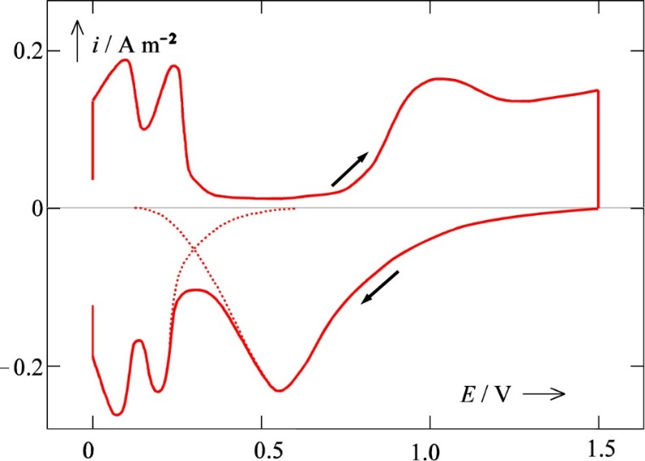
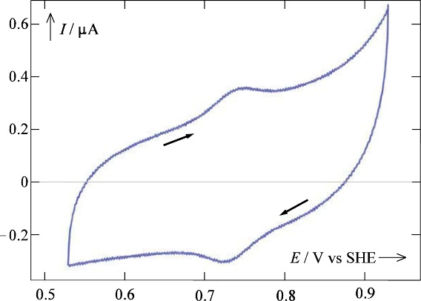
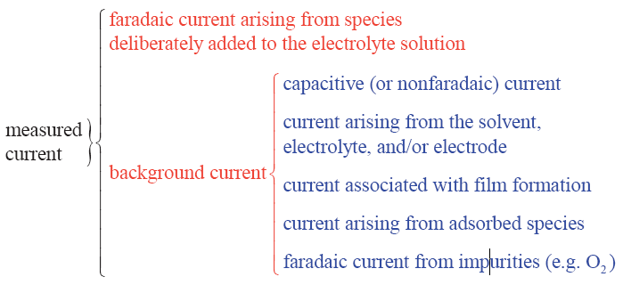
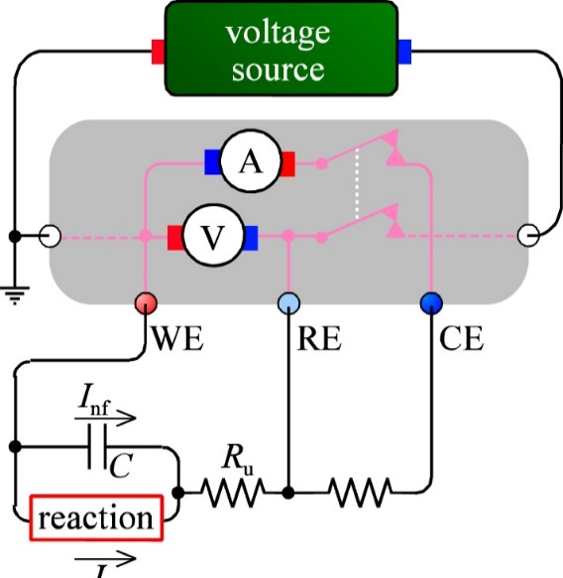
Effects of the interface on E and I
Non-faradaic: Charging the interface
Example: Pt in H₂SO₄(aq)
  Layer of PtO
The interface changes both E and I from the pertinent ones

Slide 21
Further details pages 273-280; Not curriculum
Strategies for reducing effects of non-faradaic currents (a) – (n)
Strategies for reducing uncompensated resistance (a) – (i)
Frumkin effects on equilibrium and kinetics; Reactants at finite distance x_{H}

Slide 22
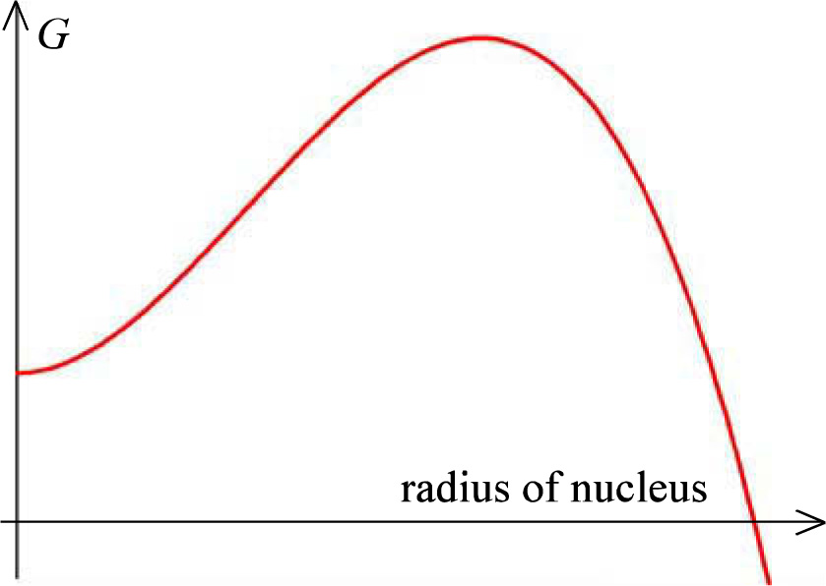

Nucleation and growth; bubbles
When the reaction creates a new phase, like a solid, or bubbles of gas:
Nucleation
Growth
Metastable product (reactant(s) of the new phase)
Initial increase in G
Ex.: High pressure in small bubbles

Slide 23

Nucleation and growth; Crystals
Nucleation rate
The rest of Ch. 13 is not curriculum
Overvoltage

Slide 24
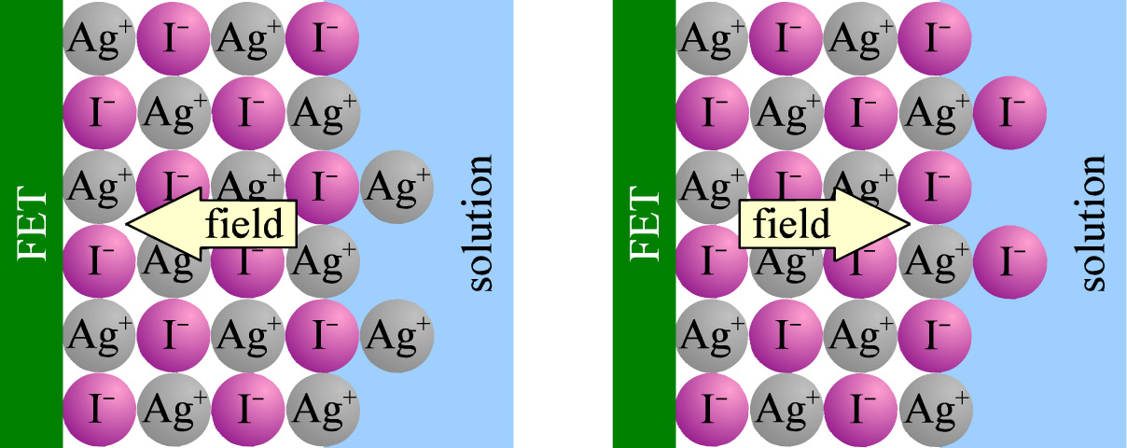
Multilayer crystallisation – ISFET, CHEMFET
FET = Field Effect Transistor
Ion Selective (IS) or CHEMical sensing FET
Also not curriculum (but interesting ☺ )

Slide 25
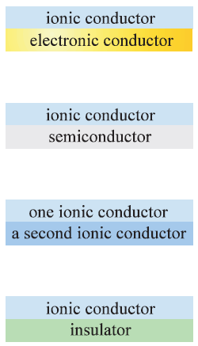
Summary Ch. 13 The electrode interface
Interface
  Large capacitance
  Compact and diffuse adsorption layers
  Non-faradaic currents
  Adsorption
  Next chapter: Other interfaces
ionic conductor
metal

