Slide 1
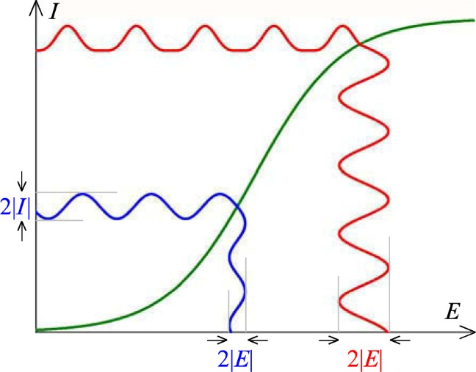
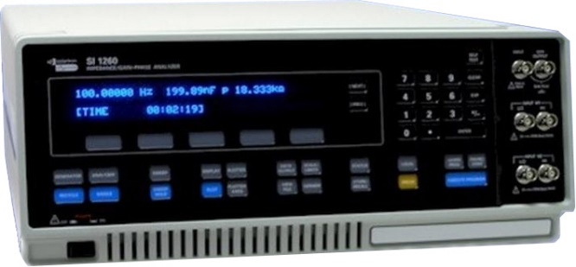
KJM 3110 Electrochemistry
Chapter 15
Electrochemistry with Periodic Signals
Most figures from the textbook we use for the course, via its web resources:

Slide 2
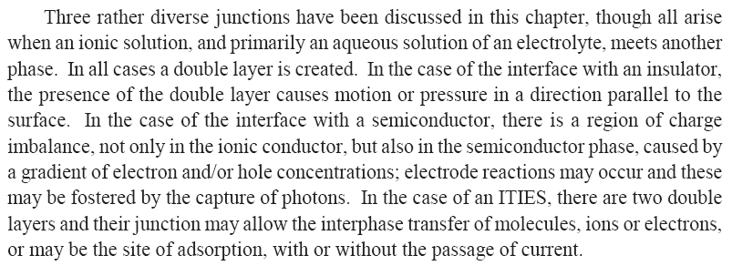
Ch. 14 Other interfaces - Summary

Slide 3
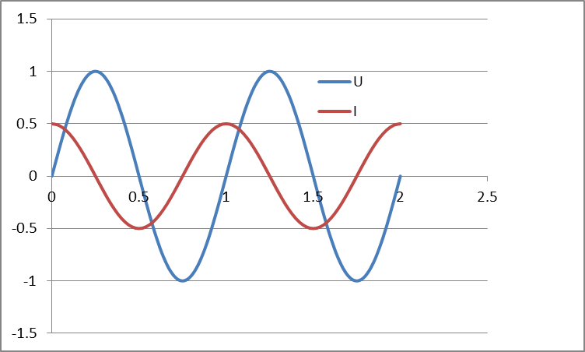


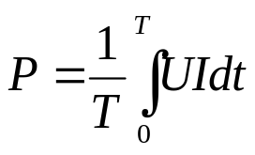
AC voltage and current. Impedance and power.
AC voltage
the amplitude can be expressed as
  Amplitude U₀
  Peak-to-peak voltage, U_{p-p} = 2U₀
  Root mean square (rms) voltage
  U_{rms} = U₀/√2 = U_{p-p}/(2√2)
Resulting AC current can have a different amplitude and phase angle as a result of the impedance:
Impedance Z* = U* / I*
Instantaneous power P = U* I*
Power integrated over time:

Slide 4



Textbook’s introduction to periodicity
Direct current (DC) vs alternating current (AC)
Sinusoidal case:
Angular frequency is ω = 2πf
Phase angle φ
What is the periodicity P here?

Slide 5
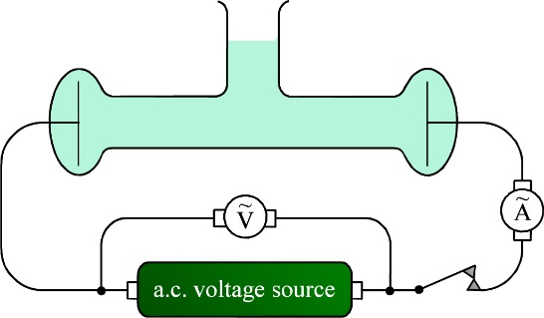





Conductivity cell
Conductivity of the electrolyte
Calibrate the geometrical factors by using a 1 M KCl solution
AC measurement: Current
Will generate voltages over an electrochemical cell
over R:
over C:
Phase shifts? Amplitude ratios?

Slide 6



Faradaic effects of AC
Impedance, harmonics, rectification
The treatment that follows aims to show that there are two contributions to electrode impedance: Kinetics and transport
Apply AC current, measure AC voltage, or vice versa
Impedance Z (equivalent to resistance R in DC)
Faradaic effects
  Apply (small) AC voltage
  Reaction
  Response on concentrations

Slide 7


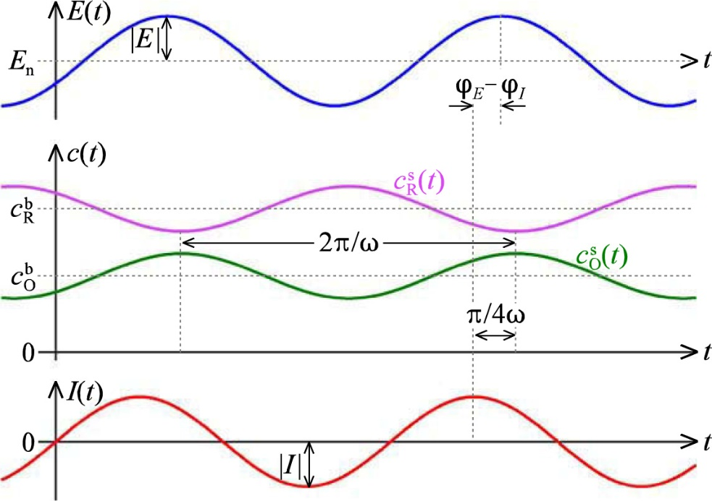
Faradaic effects of AC
Impedance, harmonics, rectification
Oscillating current changes the concentrations of reactants and products
Semi-integration yields
The product and reactant concentrations are shifted -45° and +135°, respectively, i.e., 180° apart.
Total concentration close to constant
Semi-integration is not curriculum, but leads to concentrations ±π/4 out of phase

Slide 8

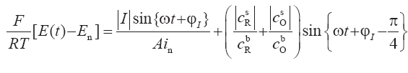
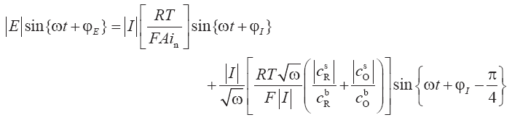

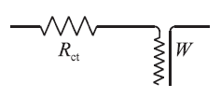
Relation to voltage – Butler-Volmer
From Ch. 7, a version of the Butler-Volmer equation:
Charge transfer resistance R_{ct} in phase
Warburg element W
(transmission line) _{R/C = W}² out of phase

Slide 9


The R_{ct}W impedance

Slide 10
The Warburg impedance
W (unit of ohm s^{-1/2})
Reflects a combination of
  Diffusion
  Chemical capacitance
Appears in AC circuits to represent the impedance of mass transport
  In series with the charge transfer resistance
Imposes a complex impedance Z_{W}(ohm) = W/√(2ω) - jW/√(2ω)
Has a constant, frequency independent phase shift of –π/4 (-45°)

Slide 11

Reversibility index λ
What we have done here is to perturb a reaction which reacts with kinetic and mass transport limitations (R_{ct} and W, respectively)
Reversible: R_{ct} very small, λ >> 1
Quasireversible λ ≈ 1
Irreversible: R_{ct} large, λ << 1. No faradaic periodicity.
Reversibility index for AC impedance

Slide 12

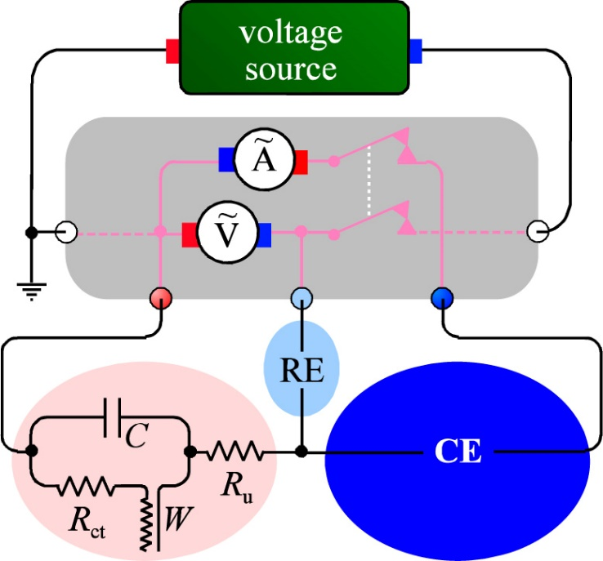
AC impedance measurement
Electrochemical impedance spectroscopy (EIS)
Impedance spectrometer (frequency response analysers)
  E.g. Solartron SI 1260 FRA
  0-3 V rms AC 0.01 mHz – 32 MHz, -42 - +42 V DC
Electrode electrical elements
  R_{u} uncompensated electrolyte resistance (ohmic)
  R_{ct} charge transfer resistance (kinetics)
  W Warburg impedance (diffusion)
  C Capacitance (double layers)

Slide 13

Deviations from ideality at large perturbations
Small perturbations, linear range (blue)
  Near-ideal response
Larger perturbations, non-linear range (red)
  Non-ideal response
  Rectification
  Harmonics
    Response contains features sharper (of frequencies higher) than the perturbation frequency
    Overharmonics (integer multiple of perturbation frequency)

Slide 14
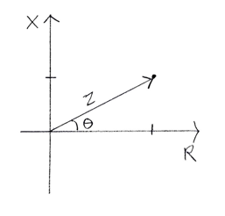
AC impedance representations
Impedance has magnitude but also contains a phase angle between E and I
Vector in 2-dimensional Z space
In-phase and out-of-phase components
Real part Z’
Imaginary part jZ’’
Z = Z’ + jZ’’ or Z* = Z’ + jZ’’ Complex numbers j =√-1 or j² = -1
The value of Z – often denoted |Z| – is the length of the vector:
|Z| = √(Z²) = √(Z’²+Z’’²) = √(Z’²–(jZ’’)²) = √((Z’+jZ’’)(Z’-jZ’’))
Z’’
Z’
Complex conjugate

Slide 15
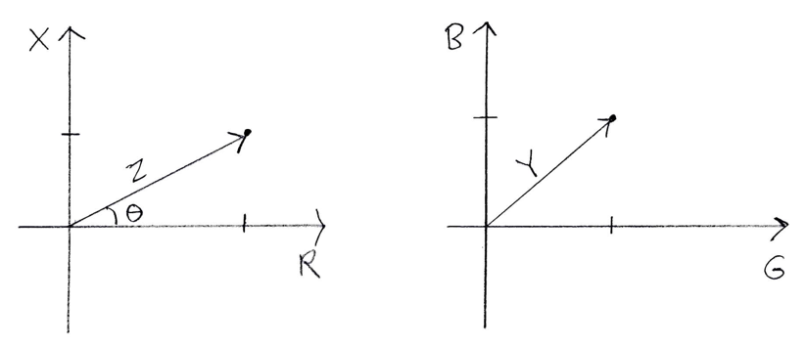
Complex impedance Z* and admittance Y*
Z* = U*/I* = Z/ + jZ// = R + jX
  Z* Complex impedance
  |Z| Impedance
  R Resistance
  X Reactance
Y* = 1/Z* = I*/U* = Y/ + jY// = G + jB
  Y* Complex admittance
  |Y| Admittance
  G Conductance
  B Susceptance

Slide 16
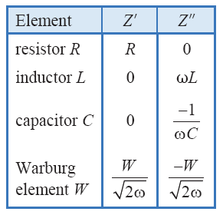
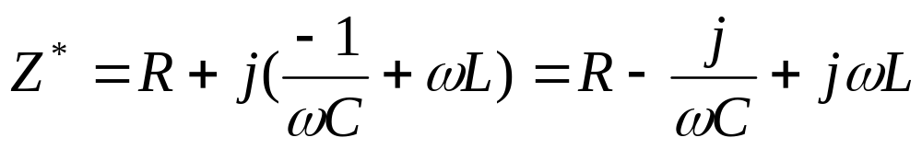
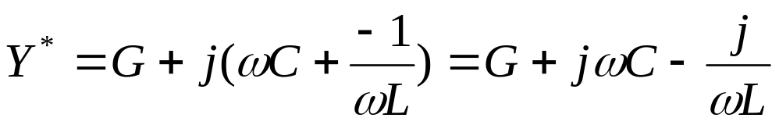
Impedance and admittance of discrete elements
Series RCL
Z* = Z/ + jZ// = R + jX
Parallel (RCL)
Y* = Y/ + jY// = G + jB
Resonance for (RC) when G = ωC or C=G/ω or ω=1/(RC)

Slide 17
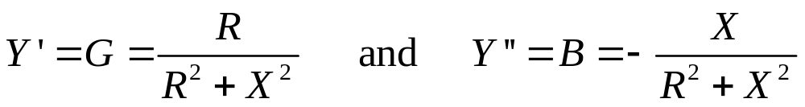
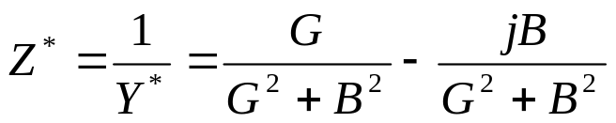
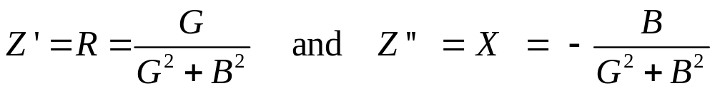
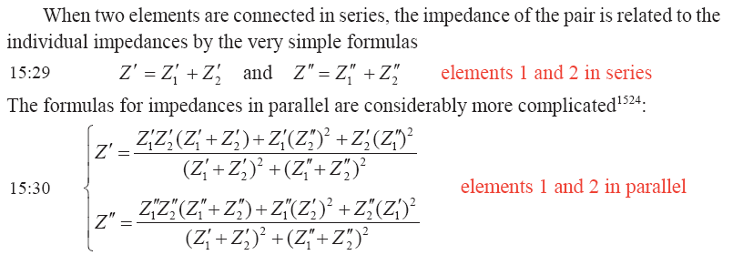
Y*=1/Z* and Z*=1/Y*

Slide 18
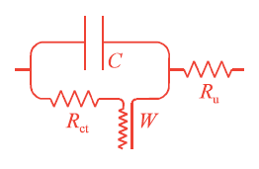
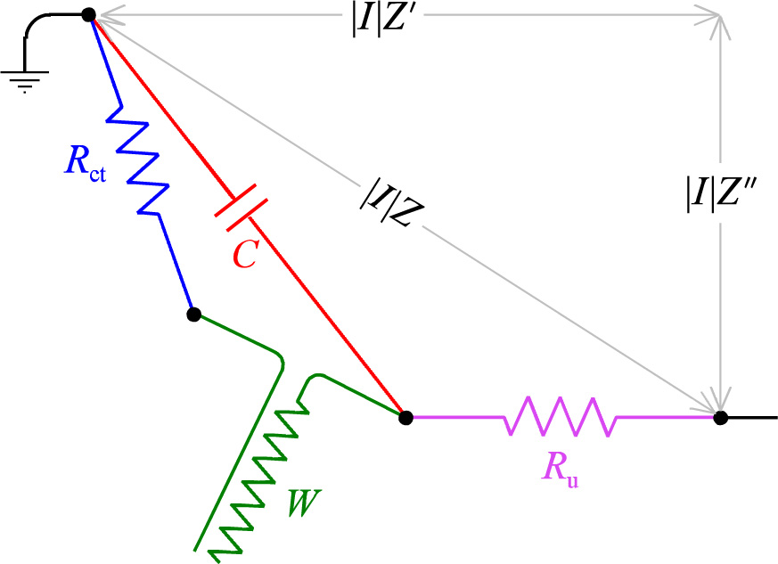
Randles-Erschler circuit
R_{u}(C(R_{ct}W))

Slide 19
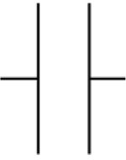


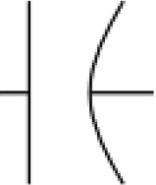
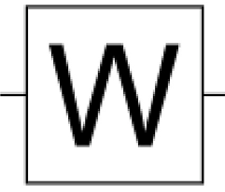
Equivalent circuit of a simple electrochemical cell
L_{s} series inductance
R_{electrolyte}
C_{geom}
R_{ct} charge transfer resistance
C_{dl} double layer capacitance
R_{mt} mass transfer resistance
C_{ch} chemical capacitance
L_{s} series inductance
R_{electrolyte}
C_{geom}
R_{ct} charge transfer resistance
Q_{dl} double layer capacitance constant phase element (CPE)
R_{mt} mass transfer resistance
W Warburg impedance: CPE with 45° phase angle
C_{dl}
C_{geom}
L_{s}
C_{ch}
R_{mt}
R_{electrolyte}
R_{ct}
Q_{dl}
C_{geom}
L_{s}
W
R_{ct}
R_{mt}
R_{electrolyte}

Slide 20

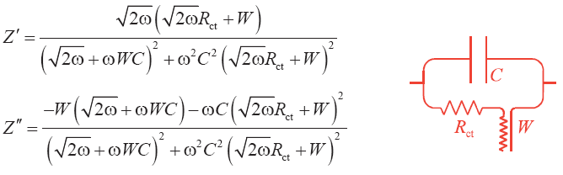
Build the circuit impedance
Add R_{ct} and W in series, real and imaginary parts separate:
Add C in parallel:

Slide 21
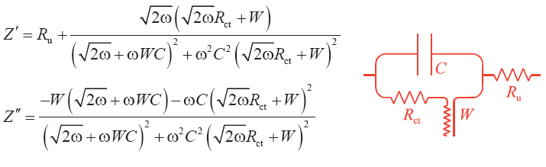
Build the circuit impedance
Add R_{u} in series (has only real part):

Slide 22
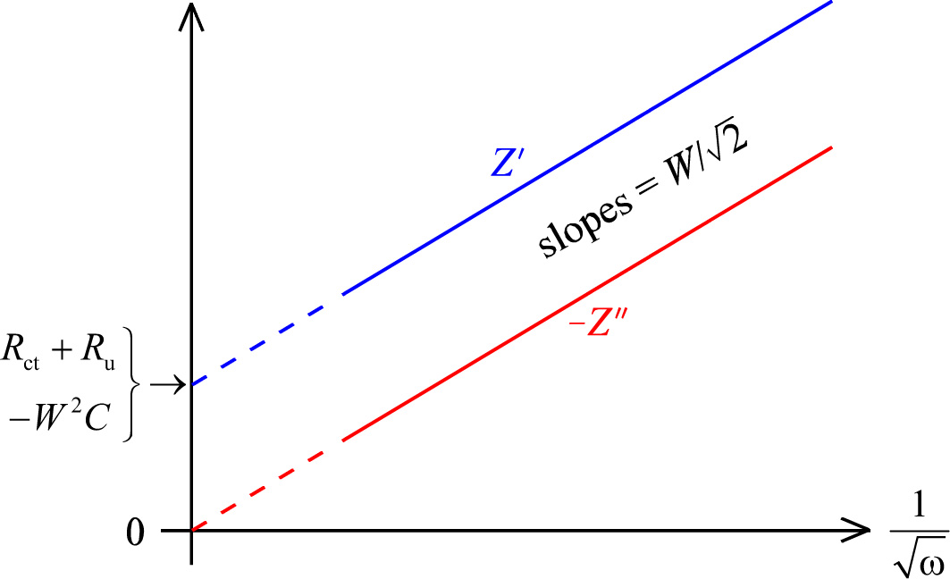
Deconvolute and parameterise the circuit
Low frequencies

Slide 23
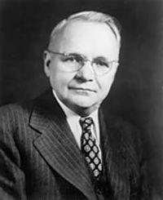
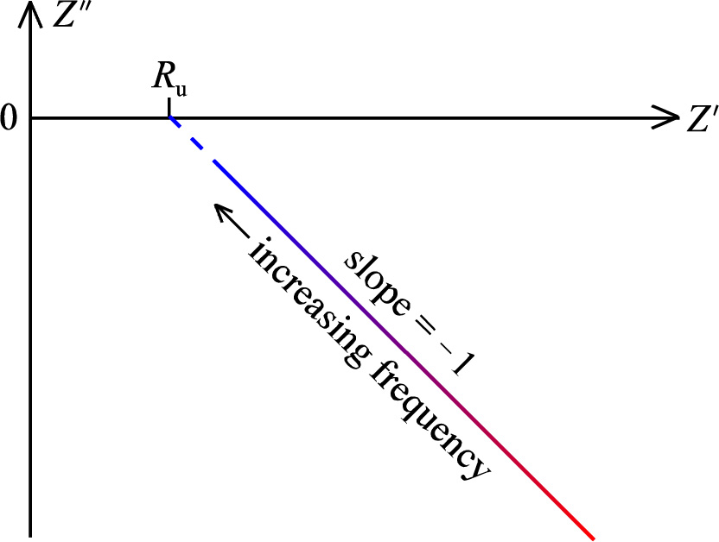
«Impedance plots»
Imaginary part Z’’ vs real part Z’
Or often –Z’’ vs Z’
Argand diagram
Sluyters plot
Cole-Cole plot
Nyquist plot
Reversible, R_{ct} negligible
Harry Nyquist
1889-1976

Slide 24
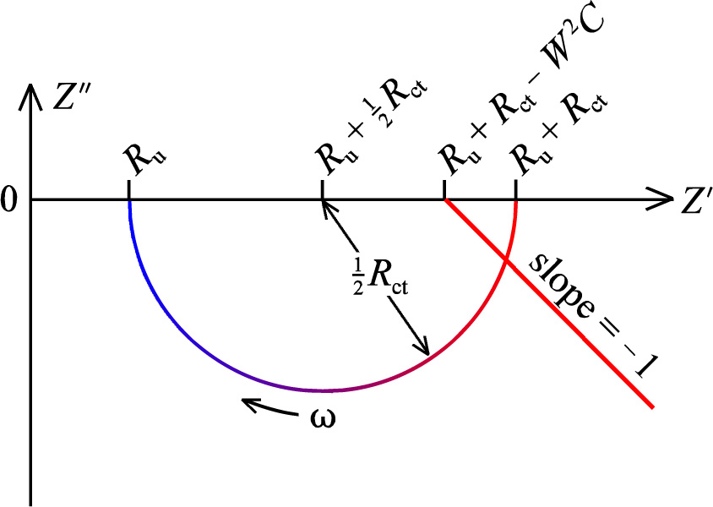
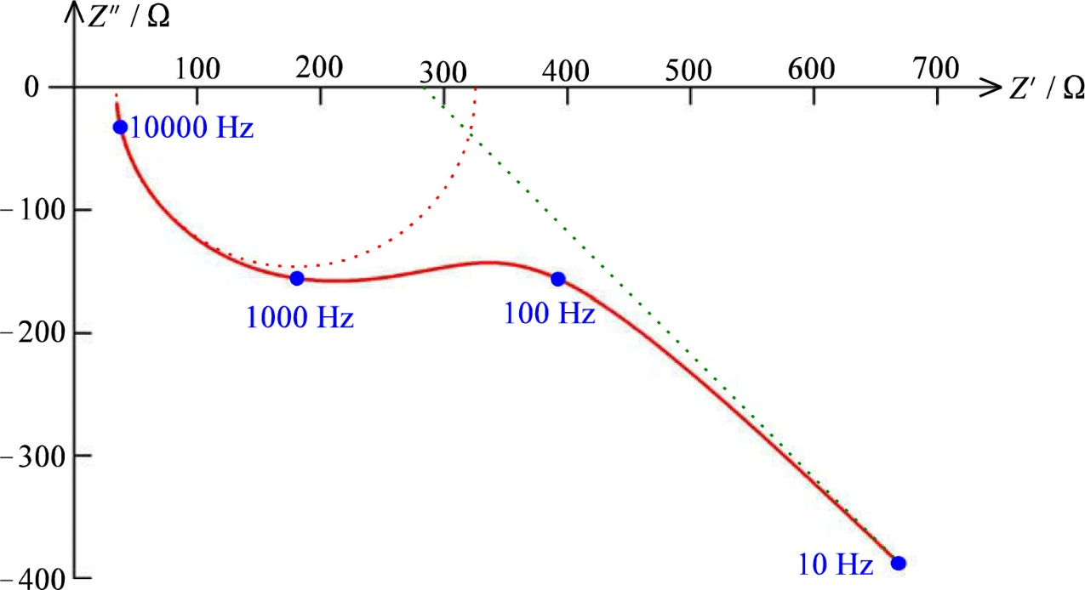
The Z semicircle: (RC)
Irreversible
Fast diffusion; W is negligible
R_{u}(R_{ct}C)
Forms a semicircle distanced from origo
Case dominated by only W shown as a straight line
Case with all components significant over a large frequency range
Frequency is a so-called dependent variable

Slide 25
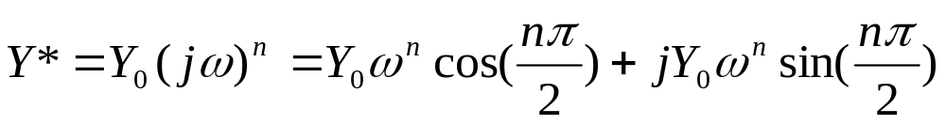
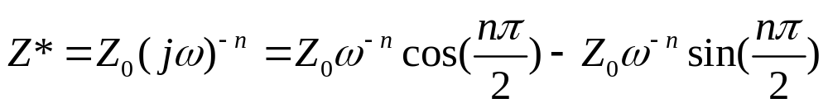
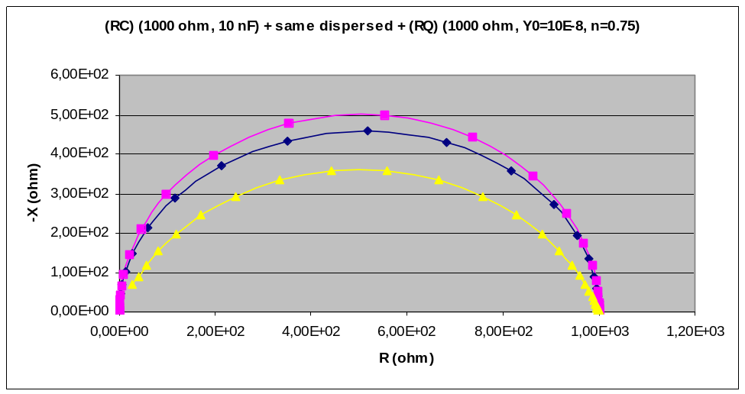
Constant phase elements (CPE)
Constant phase elements (CPE); symbol Q
Mathematically mimics the impedance of real, non-ideal, processes and components; dispersions in time constants
Q has admittance
and, by inversion, impedance
where Z₀ = 1/Y₀
n = 1 Capacitor
n = 0 Conductor/Resistor
n = -1 Inductance
n = 0.5 Warburg element
Values in between: Intermediate behaviours

Slide 26
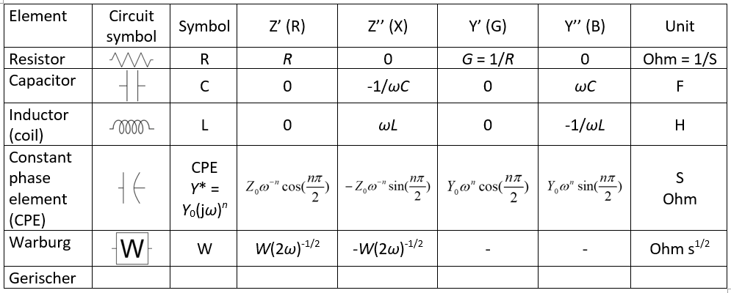
Circuit elements overview table

Slide 27
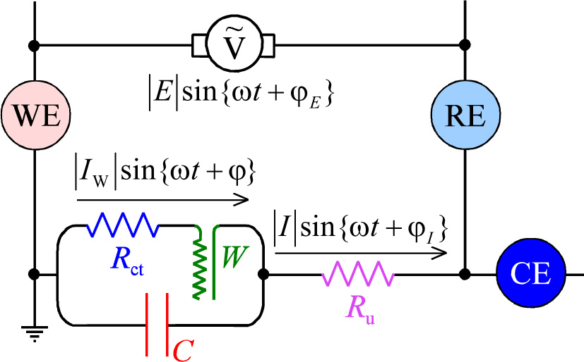
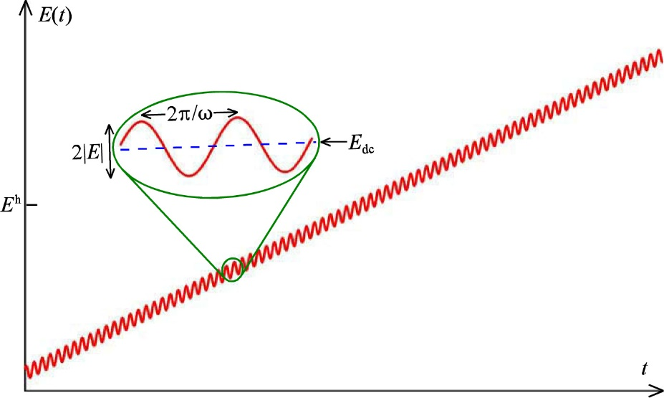
AC voltammetry (qualitative approach only)
«Discriminating against capacitive current»
Superimpose typically 10 mV AC on e.g. +/- 150 mV DC voltammogram
AC current response to AC voltage perturbation
  In-phase with voltage is faradaic
  Out-of-phase is capacitive

Slide 28
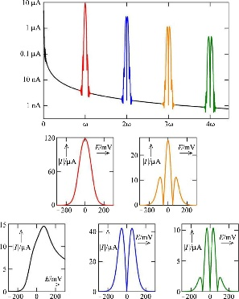
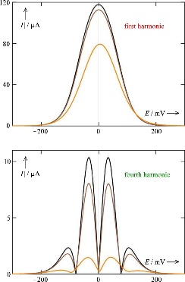
Fourier transform voltammetry
Not curriculum
Fourier transforms convert between frequency and time domains
Example:
An impedance spectrum reflects a circuit’s transient current-voltage relationships in the frequency domain
In the current interruption technique, we polarise the circuit to steady state current, then interrupt it so that current is zero while the voltage decays from all capacitances over the respective resistors. The decay curve contain all the same information, from high to low frequencies, as the impedance spectrum.
One can generate the other and vice versa by Fourier transforms.

Slide 29
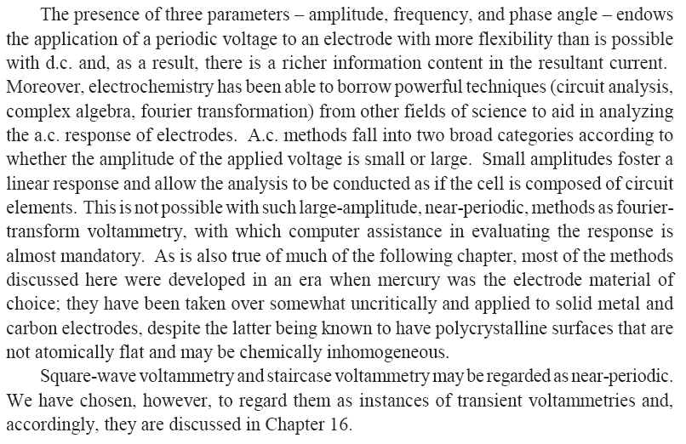
Summary Ch. 15
Electrochemistry with Periodic Signals

