Slide 1
KJM 3110 Electrochemistry
Chapter 16
Transient voltammetry
Mandatory curriculum from page 346 Ramped potentials
Most figures from the textbook we use for the course, via its web resources:

Slide 2
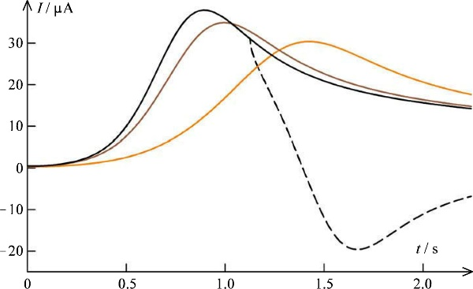

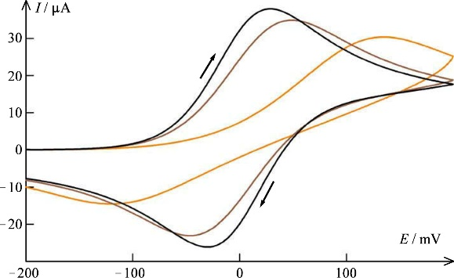
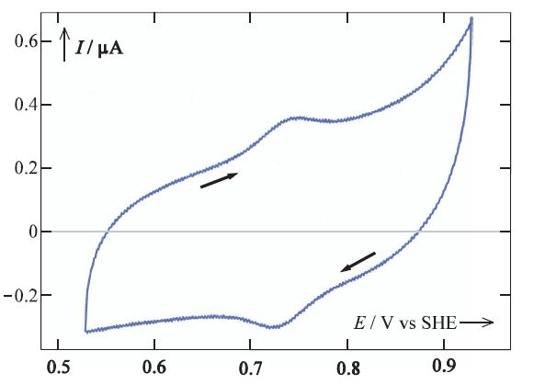
Linear-scan voltammetry and cyclic voltammetry
(Linear) scan, sweep, or ramp of voltage (potential)
Linear scan voltammetry
  Plot of resulting current vs time
Cyclic voltammetry
  “Cycles” back to the starting point
  Reversal time
  Reversal potential, switching potential
  Plot of current vs potential
Ultimate cyclic voltammetry
  Repeats the cycling until pattern becomes the same

Slide 3
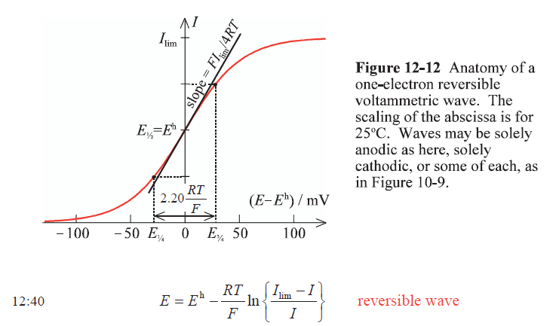
Linear scan voltammetry
(Linear) scan, sweep, or ramp
Start at a potential where nothing happens. Scan through the reaction.
The response in current depends on the electrode.
Case of a reversible electrode: Kinetics is fast. Diffusion controls.
It can be a steady-state reversible wave
The current goes up because the voltage drives the reaction
The current saturates because of limiting diffusion of reactants to the electrode surface

Slide 4
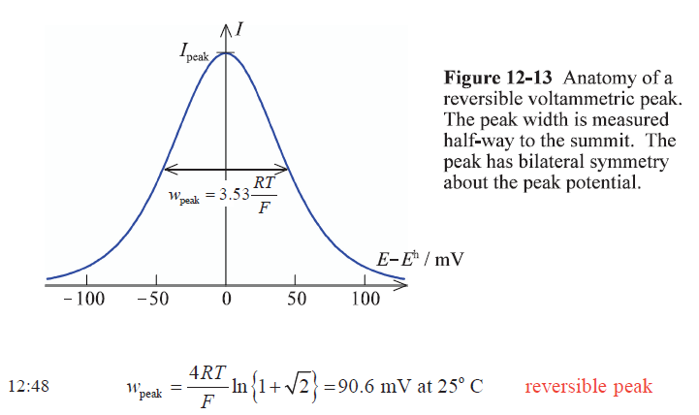
Linear scan voltammetry
(Linear) scan, sweep, or ramp
Start at a potential where nothing happens. Scan through the reaction.
The response in current depends on the electrode.
Case of a reversible electrode: Kinetics is fast. Diffusion controls.
Or a transient reversible peak,
Because of the finite rate of the scan, we go empty on reactants
The current goes up because the voltage drives the reaction
The current peaks and goes back because we run out reactants, due to limiting diffusion

Slide 5
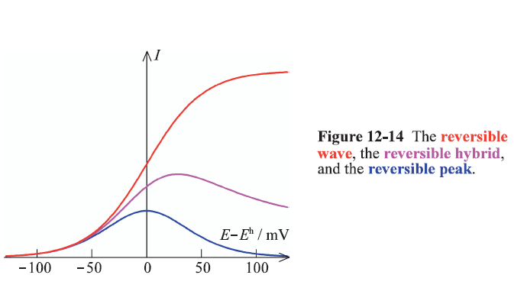

Linear scan voltammetry
(Linear) scan, sweep, or ramp
Start at a potential where nothing happens. Scan through the reaction.
The response in current depends on the electrode.
Case of a reversible electrode: Kinetics is fast. Diffusion controls.
Transient reversible peak, reversible hybrid, or reversible peak.

Slide 6
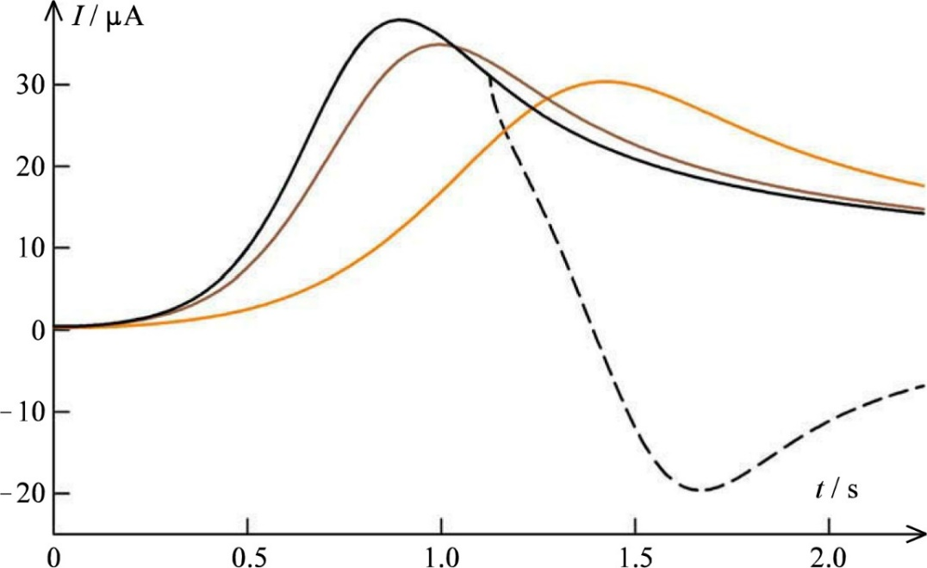
Linear scan voltammetry
(Linear) scan, sweep, or ramp
Start at a potential where nothing happens. Scan through the reaction.
The response in current depends on the electrode.
Reversible hybrid (black): Kinetics is fast. Diffusion controls.
Quasireversible hybrid (brown)
Irreversible hybrid (light brown): Kinetics is slow and controls
The current goes up because the voltage drives the reaction
The current peaks and goes back because we run out reactants, due to limiting diffusion
The limiting kinetics of the irreversible electrode requires more voltage to drive the current high enough to drive the reaction empty of reactants. Diffusion limitation eventually still comes in at the end.

Slide 7
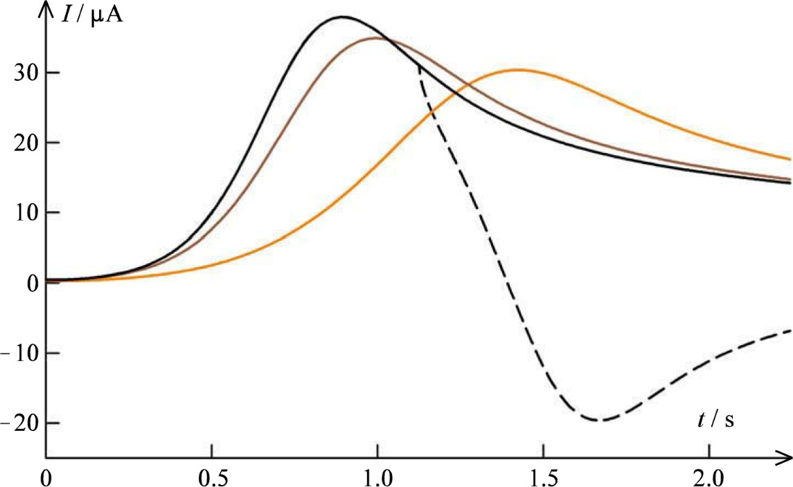
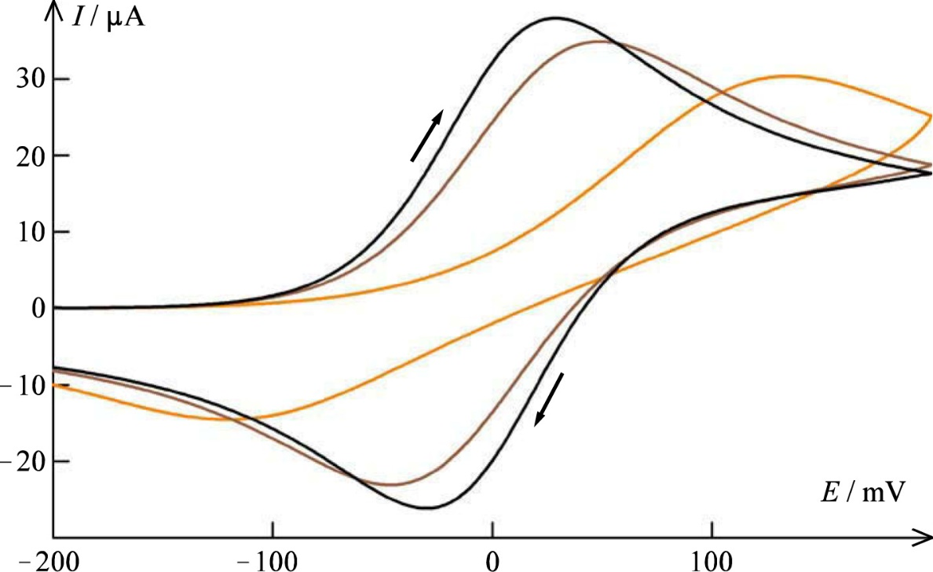

Cycliv voltammetry
Linear hybrid scan
  Reversible
  Quasireversible
  Irreversible
Cyclic hybrid scan
  Reversible
  Quasireversible
  Irreversible
  Isosceles triangle shapes

Slide 8
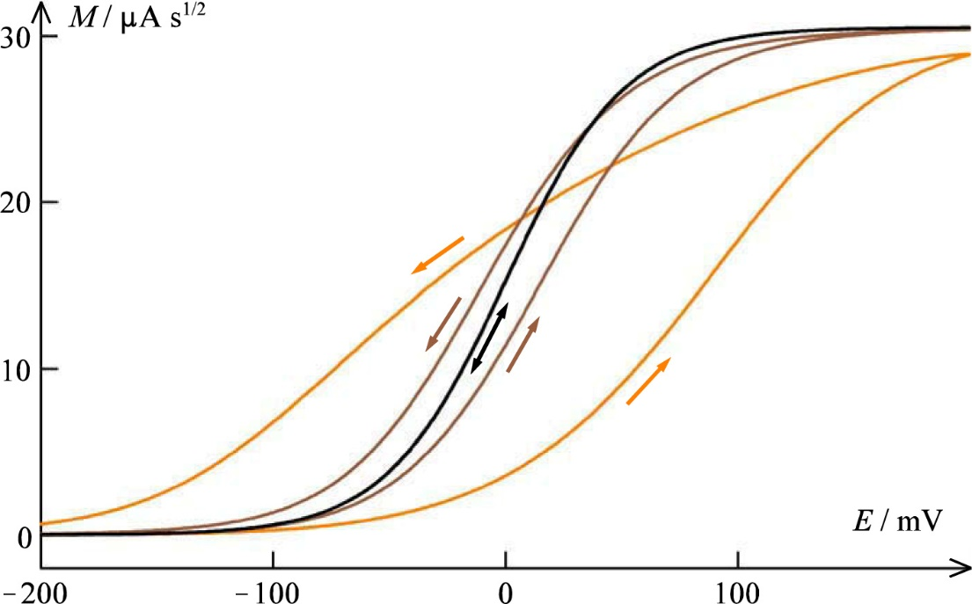
We skip the parts on semiintegration…. Pages 351-353
X
“Semiintegration can be a valuable adjunct to cyclic voltammetry but, notwithstanding facilities being built into many commercial instruments, it is seldom employed.”
Figure 16.14 The result of semiintegrating the voltammograms from Figure 16-13.

Slide 9

Cyclic voltammetry (CV) – what you need to know
Hard to analyse analytically
Provides information about:
  Number of steps (peaks)
  Character and reversibility (shape)
  Kinetics and transport (shape, offset)
  Charge (integral of peaks)
Plus EE and EC schemes
  To be explained later…

Slide 10
Multiple electron transfers
Some reactions are single-electron
  R = O + e⁻
  Fe²⁺ = Fe³⁺ + e⁻
  Ag + Cl⁻ = AgCl + e⁻
But many are multi-electron
  Ni = Ni²⁺ + 2e⁻
  H₂ = 2H⁺ + 2e⁻
  2H₂O = O₂ + 4e⁻ + 4H⁺
All aspects of electrochemistry are affected by multi-electron transfers
  But the book has chosen to focus ONLY on single-electron transfer (R = O + e⁻)
  Only in Ch. 16 it moves on to multi-electron transfer
  “because electrochemists prefer to use CV to study multiple-electron transfers”

Slide 11

EE scheme: Electrochemistry + Electrochemistry
2-electron transfers
Substrate (=reactant) species S, in the bulk S_{b}
Intermediate species I
Product P
Electron transfers – red arrows
Diffusion – blue arrows
We disregard disproportionation and comproportionation. (But what are they?)

Slide 12
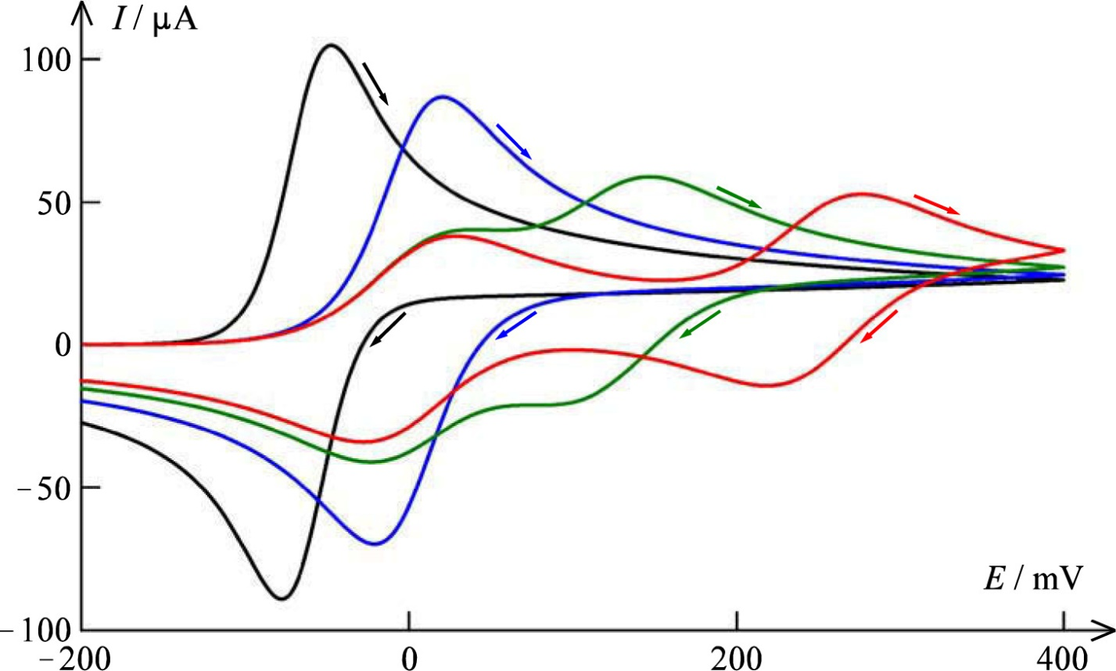
A CV example of two-electron reactions
Formal potentials E^{0’}₁ and E^{0’}₂ (mV)
Black 0 -125 2nd easier than 1st . Behaves like one 2-e⁻ process
Blue 0 0 Occurs at the same potential, like one 2-e⁻ process
Green 0 125
Red 0 250

Slide 13
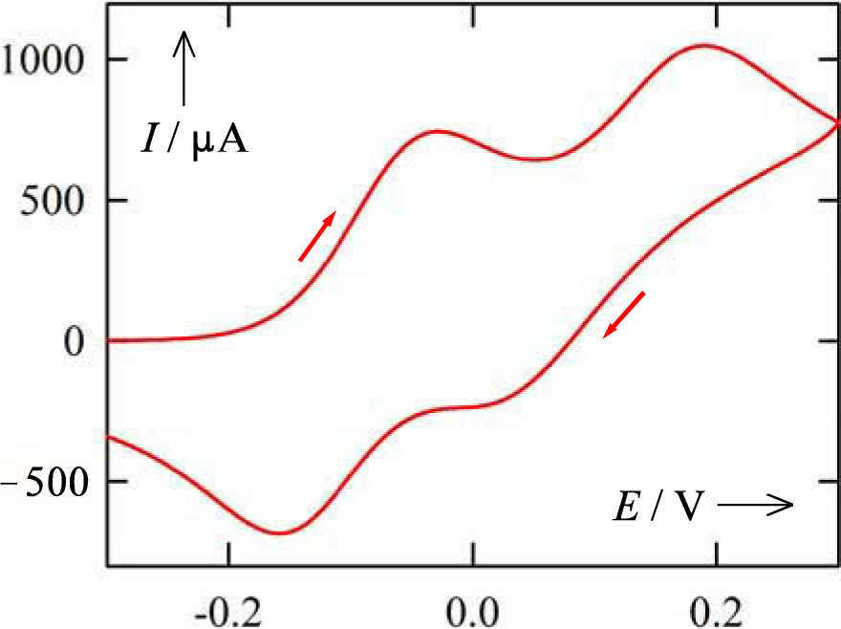
Another example of a 2-electron transfer electrode reaction

Slide 14
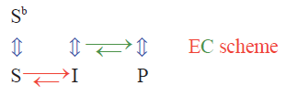
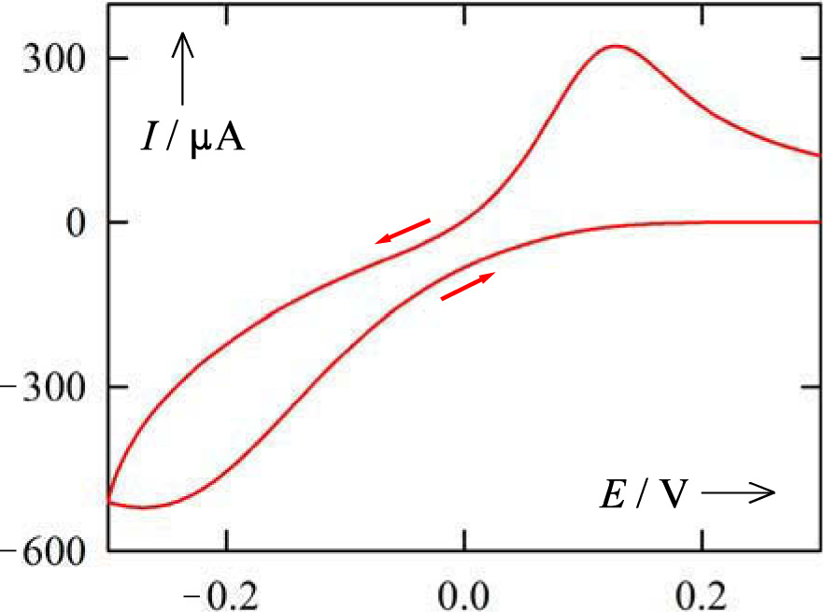
EC scheme: Electrochemistry + Chemistry
Electron transfer + Chemical reaction
Green arrows show reaction via diffusion
Treatment assuming equidiffusivity
No further detail here of the basis for the example in this figure.

Slide 15

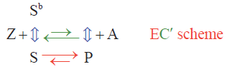
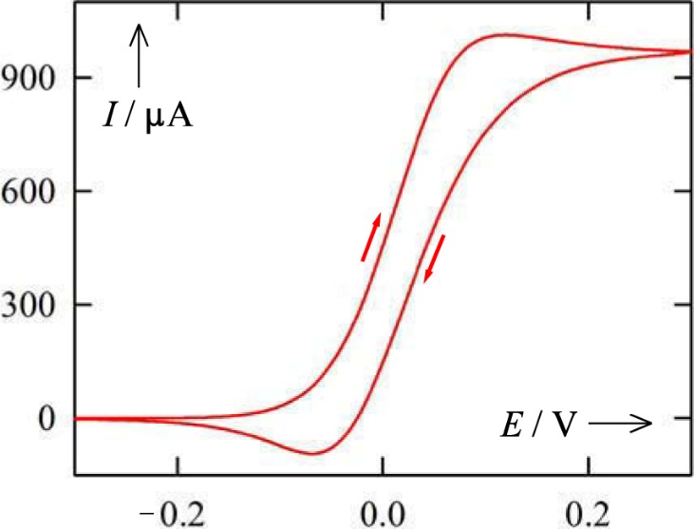
EC’ scheme: catalytic Electrochemistry + Chemistry
Homogeneous reaction
Mediator S
Electrochemically reacts to P
P + A → Z + S
  faster than
A → Z

Slide 16
Further schemes not treated and not curriculum
Also, “Controlling current instead of potential” is not curriculum.

Slide 17
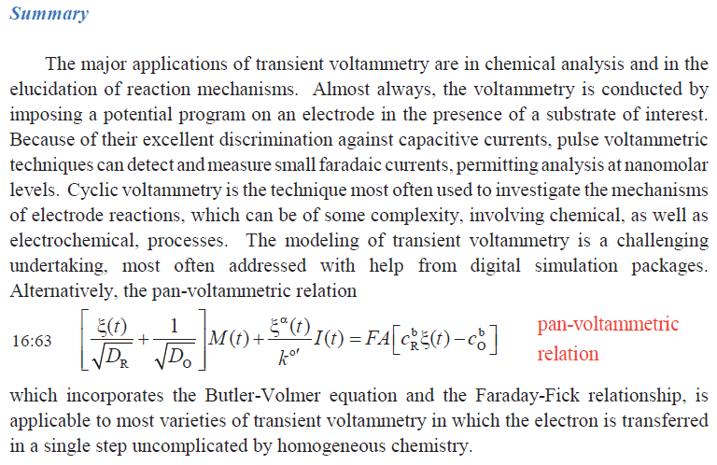

Slide 18
Cyclic voltammetry (CV) – what you need to know
Hard to analyse analytically
Provides information about:
  Number of steps (peaks)
  Character and reversibility (shape)
  Kinetics and transport (shape, offset)
  Charge (integral of peaks)
Plus EE and EC schemes

