Slide 1
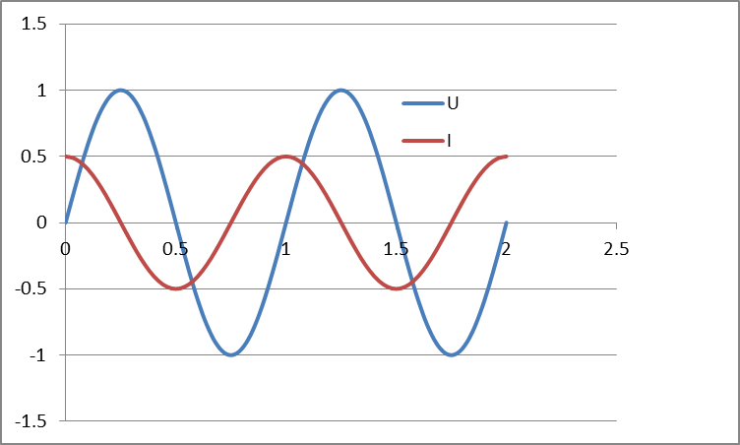
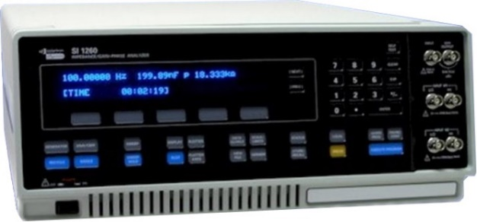
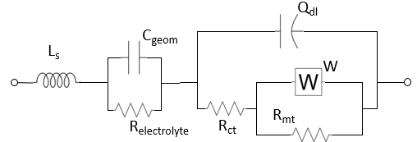
KJM 3110 Electrochemistry
Electrochemical Impedance Spectroscopy (EIS)
Some figures are from the textbook we use for the course, via its web resources:

Slide 2
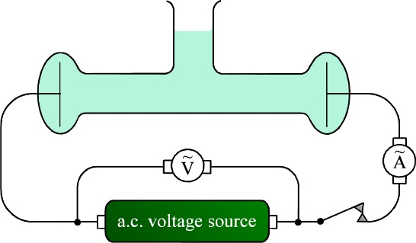
Time constants – resistance and capacitance
Cell (or half cell if 3 electrodes) at equilibrium
  Open circuit voltage (OCV) = U_{N}
Step increase in current or voltage:
    Current runs through all elements
    Charges capacitors
    Runs through resistances and builds overpotentials
  Ohmic (wires)
    Metallic conduction
    No capacitance
    Instantaneous (0 s)
  Dielectric (liquid and solid electrolytes)
    Ionic conductivity
    Bulk. Small capacitance (pF/cm)
    Fast (μs)
  Electrode interface (double layer)
    Charge transfer resistance
    Atomic layers. Large capacitance (μF/cm²)
    Slow (s)
  Chemical compositional changes (reactions, adsorption, intercalation)
    Mass transfer and diffusion
    Very large capacitances (>mF)
    Very slow (1000 s)
Example: The Cottrell experiment to measure diffusion
One may also do the opposite: Steady state current. Then break. Overpotentials decay with different speeds. Current interruption voltammetry

Slide 3
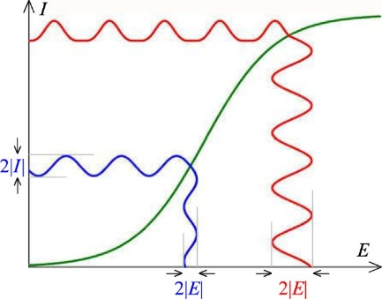
Electrochemical Impedance Spectroscopy (EIS)
Cell (or half cell if 3 electrodes) at equilibrium
  Open circuit voltage (OCV) = U_{N}
AC perturbations of voltage or current:
    Current runs through all elements
    Charges capacitors
    Runs through resistances and builds overpotentials
  Ohmic (wires)
    Metallic conduction
    No capacitance
    Very high frequencies (GHz)
  Dielectric (liquid and solid electrolytes)
    Ionic conductivity
    Bulk. Small capacitance (pF/cm)
    High frequencies (MHz)
  Electrode interface (double layer)
    Charge transfer resistance
    Atomic layers. Large capacitance (μF/cm²)
    Low frequencies (Hz)
  Chemical compositional changes (reactions, adsorption, intercalation)
    Mass transfer and diffusion
    Very large capacitances (>mF)
    Very low frequencies (to DC) (mHz)
By varying the frequency, we get the response of one element at the time and can delineate them.

Slide 4


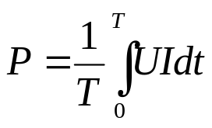
AC voltage and current. Impedance and power.
AC voltage
the amplitude can be expressed as
  Amplitude U₀
  Peak-to-peak voltage, U_{p-p} = 2U₀
  Root mean square (rms) voltage
  U_{rms} = U₀/√2 = U_{p-p}/(2√2)
Resulting AC current can have a different amplitude and phase angle as a result of the impedance:
Impedance Z* = U* / I*
Instantaneous power P = U* I*
Power integrated over time:

Slide 5
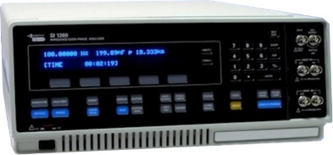
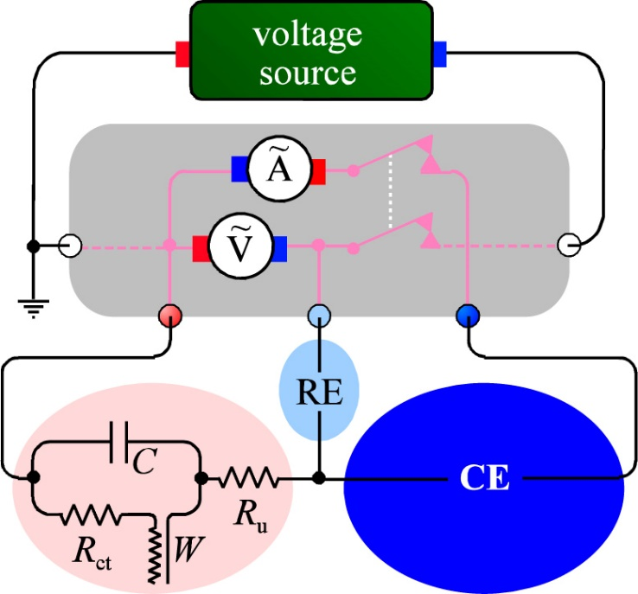
AC impedance measurement
Electrochemical impedance spectroscopy (EIS)
Impedance spectrometer (frequency response analysers)
  E.g. Solartron SI 1260 FRA
  0-3 V rms AC 0.01 mHz – 32 MHz, -42 - +42 V DC
Electrode electrical elements
  R_{u} uncompensated electrolyte resistance (ohmic)
  R_{ct} charge transfer resistance (kinetics)
  W Warburg impedance (diffusion)
  C Capacitance (double layers)

Slide 6
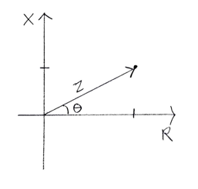
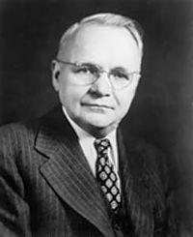
AC impedance representations
Impedance has magnitude but also contains a phase angle between U and I
Vector in 2-dimensional Z space
In-phase and out-of-phase components
Real part Z’
Imaginary part jZ’’
Z = Z’ + jZ’’ or Z* = Z’ + jZ’’ Complex numbers j =√-1 or j² = -1
The value of Z – often denoted |Z| – is the length of the vector:
|Z| = √(Z’²+Z’’²) = √(Z’²–(jZ’’)²) = √((Z’+jZ’’)(Z’-jZ’’))
Z’’
Z’
Harry Nyquist
1889-1976
Complex conjugate

Slide 7
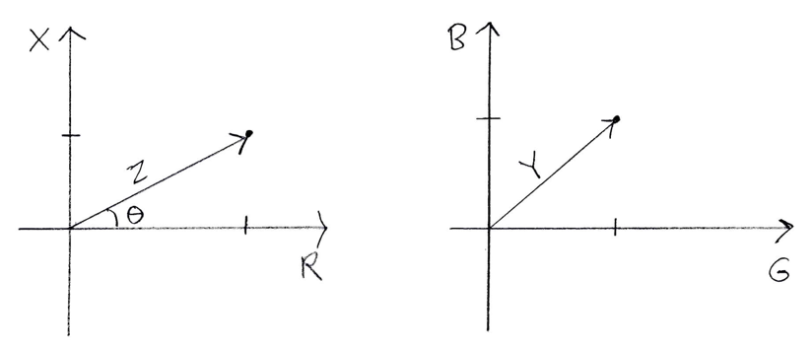
Complex impedance Z* and admittance Y*
Z* = U*/I* = Z/ + jZ// = R + jX
  Z* Complex impedance
  |Z| Impedance
  R Resistance
  X Reactance
Y* = 1/Z* = I*/U* = Y/ + jY// = G + jB
  Y* Complex admittance
  |Y| Admittance
  G Conductance
  B Susceptance

Slide 8
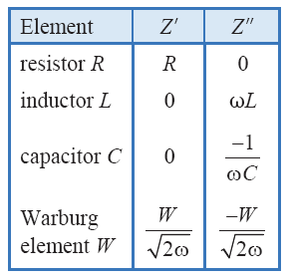
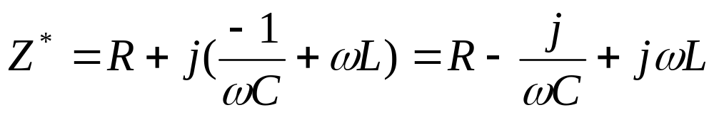
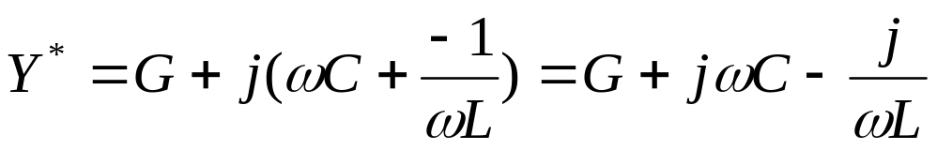
Impedance and admittance of discrete elements
Series RCL
Z* = Z/ + jZ// = R + jX
Parallel (RCL)
Y* = Y/ + jY// = G + jB
Resonance for (RC) when G = ωC or C=G/ω or ω=1/(RC)

Slide 9
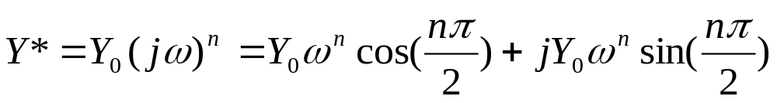
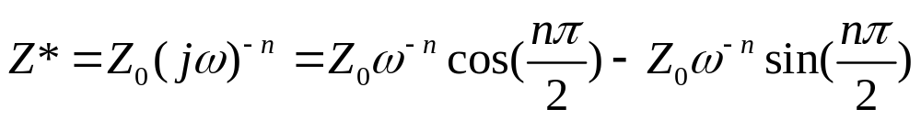
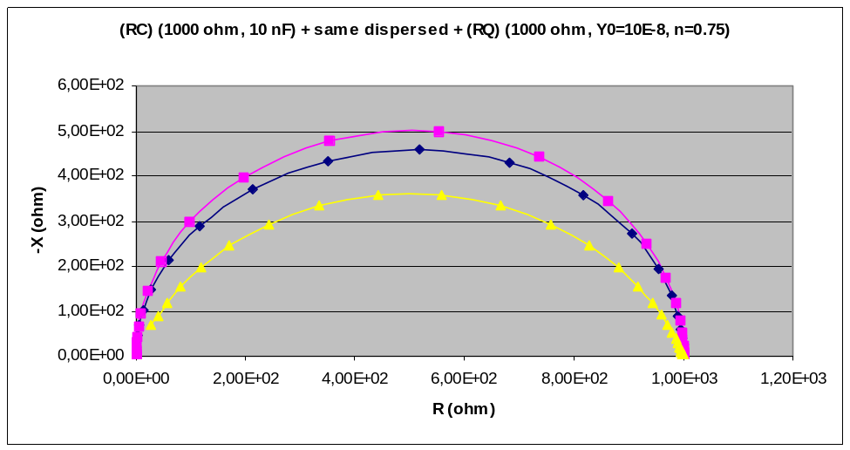
Constant phase elements (CPE)
Constant phase elements (CPE); symbol Q
Mathematically mimics the impedance of real, non-ideal, processes and components; dispersions in time constants
Q has admittance
and, by inversion, impedance
where Z₀ = 1/Y₀
n = 1 Capacitor
n = 0 Conductor/Resistor
n = -1 Inductance
n = 0.5 Warburg element
Values in between: Intermediate behaviours

Slide 10
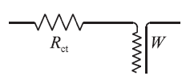
The Warburg impedance
W (unit of ohm s^{-1/2})
Reflects a combination of
  Diffusion
  Chemical capacitance
Appears in AC circuits to represent the impedance of mass transport
  In series with the charge transfer resistance
Imposes a complex impedance Z_{W}(ohm) = W/√(2ω) - jW/√(2ω)
Has a constant, frequency independent phase shift of –π/4 (-45°)

Slide 11
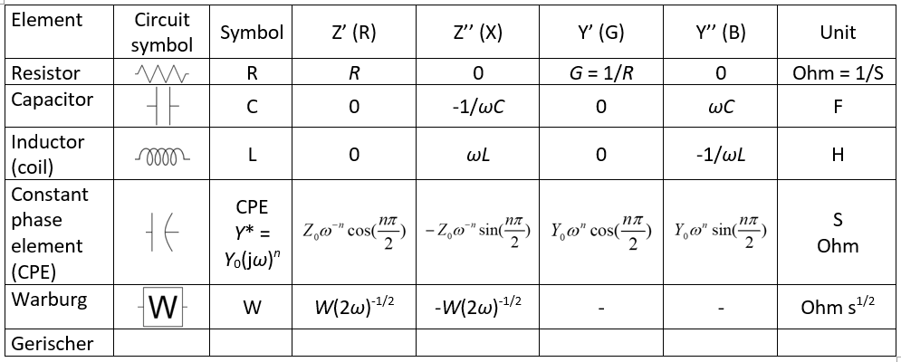
Circuit elements overview table

Slide 12
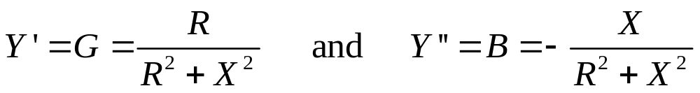
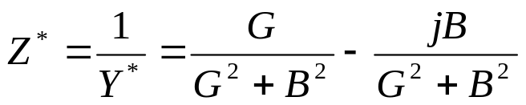
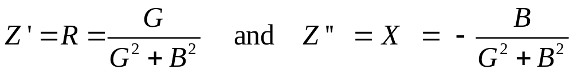
Y*=1/Z* and Z*=1/Y*

Slide 13
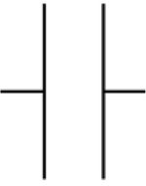


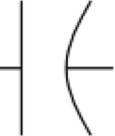
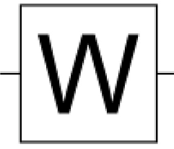
Equivalent circuit of a simple electrochemical cell
L_{s} series inductance
R_{electrolyte}
C_{geom}
R_{ct} charge transfer resistance
C_{dl} double layer capacitance
R_{mt} mass transfer resistance
C_{ch} chemical capacitance
L_{s} series inductance
R_{electrolyte}
C_{geom}
R_{ct} charge transfer resistance
Q_{dl} double layer capacitance constant phase element (CPE)
R_{mt} mass transfer resistance
W Warburg impedance: CPE with 45° phase angle
C_{dl}
C_{geom}
L_{s}
C_{ch}
R_{mt}
R_{electrolyte}
R_{ct}
Q_{dl}
C_{geom}
L_{s}
W
R_{ct}
R_{mt}
R_{electrolyte}

Slide 14
EIS exercise
Do the exercises in the spreadsheet
  Frontpage – Frequencies - RCL
Must understand to add impedances in series and admittances in parallel
Must know how to convert Z* to Y* and vice versa
At the same RLC sheet:
  Calculate the Z* = Z’ + jZ’’ parameters for a series RL circuit of your R and L elements
  Calculate the Y* = Y’ + jY’’ parameters for a parallel (RC) circuit of your R and C elements
  Recalculate the (RC) circuit into its series Z* = Z’ + jZ’’ representation
  Make three Nyquist plots (imaginary vs real parts) of the three data sets.
    Feel free to plot –Z’’ instead of Z’’ if it makes you happier ☺
Make a new sheet called Cell
  Copy the frequencies part to this like it was done for the RCL sheet.
  Make a table of inputs for values of all the elements (see next page)
  Calculate the impedance spectrum of the circuit: Start from the right. Convert between Y* and Z* as needed.
  Plot the Z* Nyquist plot of it.
    Play with the frequency range ☺ . Recognise all elements?
    Voluntary 1: Plot the Y* plot.
    Voluntary 2: Plot a Bode plot of parameters vs log f.

