Slide 1
KJM 3110 Electrochemistry
Lab 1
Introduction to potentiostat and selected experiments

Slide 2
Electrodes
The electrode of interest is called the working electrode (WE)
We need as a minimum one other electrode to apply or measure a voltage and pass or measure a current
The other electrode can be called a counter electrode (CE)
In electrochemistry we often split the counter electrode so as to use 3 electrodes:
  WE Measure current and potential
  RE Reference electrode (reference potential)
  CE Supply current
Potentials of individual electrodes cannot be measured - we can only measure differences
  2 electrodes: ΔU_{cell} = φ_{WE} – φ_{CE}
    Comprises OCV_{WE-CE} and the overpotentials of both the WE and CE and all of the electrolyte
  3 electrodes: ΔU_{WE} = φ_{WE} - φ_{RE}
    Comprises an OCV_{WE-RE} and the overpotential of the WE and part of the electrolyte
Source or load
I
U
WE
CE
Source or load
I
U
WE
RE
CE

Slide 3
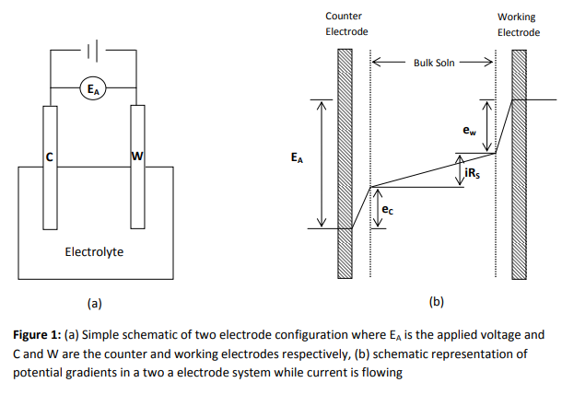
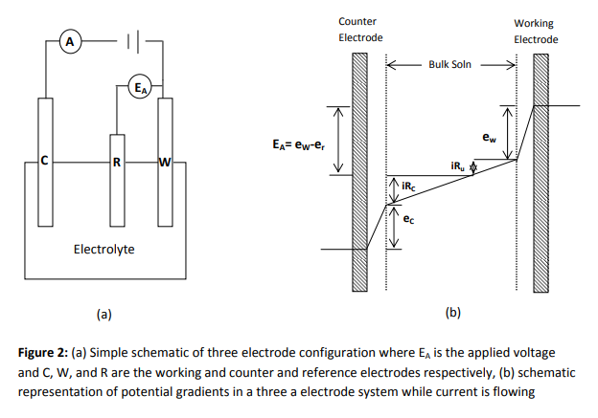
2 and 3 electrodes
Note that WE and CE are swapped right-left
Shows schematically the overpotentials as potential drops in WE, CE, and the electrolyte
In the 3-electrode case, the RE is placed in the middle of the electrolyte and measures part of the electrolyte IR drop and the WE overpotential drop.

Slide 4
Potentiostat – seen like a power supply
Source or load
I
U
Power supply
  Two terminal connection to the cell
  Source: Supplies a specified current or voltage
  Measures current and voltage between WE and CE
Potentiostat – a most simple view of a «power supply»
  Three terminal connection to the cell
  Source: Supplies a voltage and current between WE and CE
  Measures current
  Measures and maintains voltage between WE and RE
  Potentiostat used with ony two electrodes
  Source: Supplies a voltage and current between WE and CE
  Measures current
  Measures and maintains voltage between WE and CE
  A main feature of a potentiostat is to keep a specified voltage constant: potentio-stat
WE
CE
Source or load
I
U
WE
RE
CE
Source or load
I
U
WE
CE

Slide 5
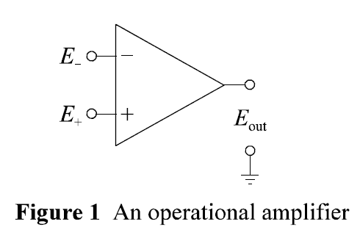
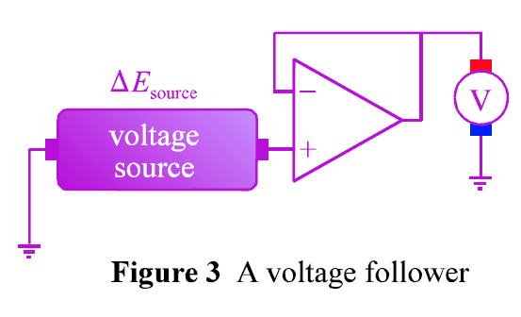
Operational amplifier (op-amp)
Transistor: A voltage supplied to the middle of a pnp or npn semiconductor device opens the conduction between the end contacts: Gives current and an amplified voltage out.
Operational amplifier: Circuit with several transistors
  Positive and negative inputs
  High input resistance, e.g. 100 Mohm
  Low output resistance, e.g. 1 ohm
  Driven by DC power (not shown here)
  Amplification: Typically 10,000,000 times
  Various feedback modes
    E.g. output to negative input: E_{out} = E₊ - E₋ (voltage follower)

Slide 6

Potentiostat – an oversimplified schematic
U_{s}
+
U_{i}=IR
-
R
U_{i}
WE
RE
CE
I

Slide 7
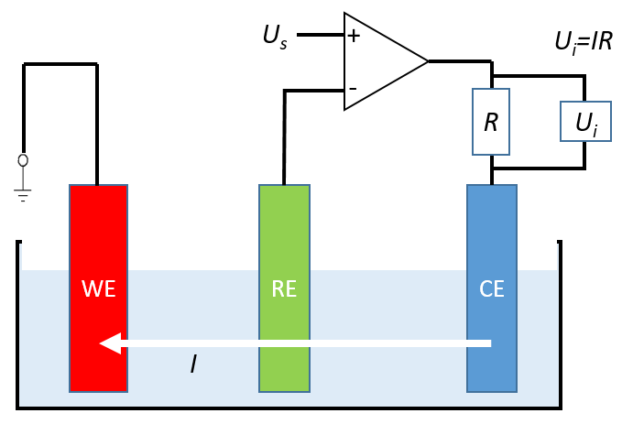
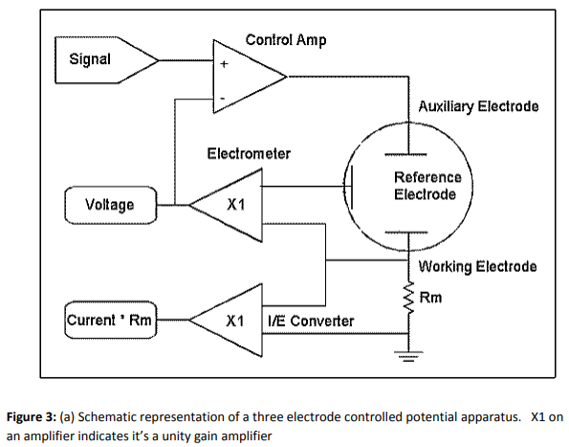
A more complete schematic
“Signal” sets the desired voltage
“Electrometer” is a very high resistance op-amp feeding the voltage between the RE and WE back to the negative input of the control amplifier – keeping that voltage constant.
The “I/E converter” takes the voltage over the R_{m} load resistance to measure the current from U = IR_{m}
CE
RE
WE

Slide 8
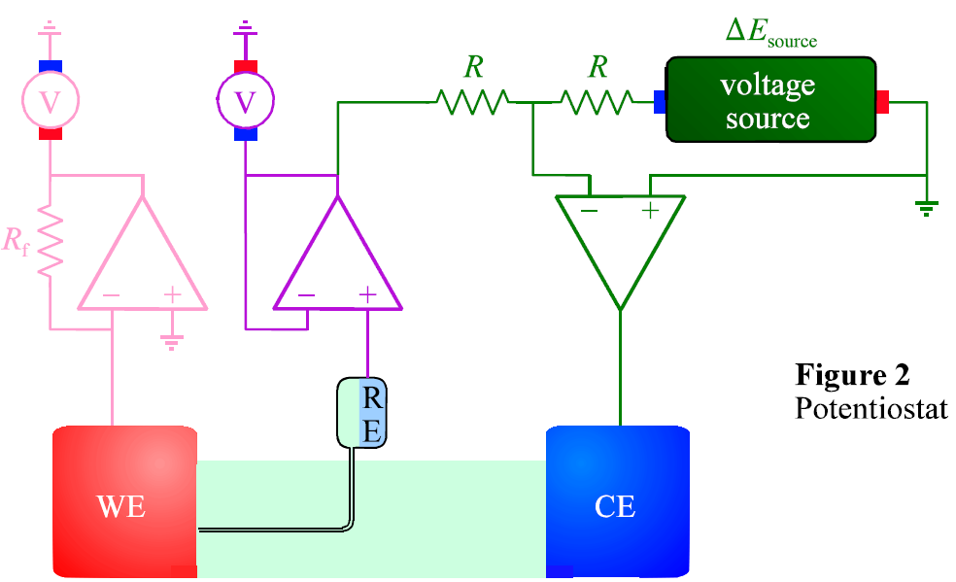
The potentiostat as explained in the textbook
Web material # 1029
RE
CE
WE

Slide 9
Lab 1 b), c), and d) use a 3-electrode potentiostat
Source
I
U
WE
RE
CE

Slide 10
Lab 1 b) Ni deposition: 3 electrodes
Find OCV (vs SHE) from Pourbaix
It is negative
Find it vs Ag/AgCl
  Subtract 0.222 V
Add negative overpotential to drive (cathodic) reduction
  Suggested -1.45 V
Source
I
U
WE
RE
CE
Ni²⁺
Ti foil or FTO glass with growing Ni layer
Ag/AgCl
Ni “foam”

Slide 11
Lab 1 b) Ni deposition: 2 electrodes
Find OCV
  It is essentially Ni²⁺/Ni vs Ni²⁺/Ni… 0
Add negative overpotential to drive (cathodic) reduction
  Total should be less negative than for 3 electrodes
  But now, also the overpotential of the CE anode needs to be added…
Source
I
U
WE
CE
Ni²⁺
Ti foil or FTO glass with growing Ni layer
Ag/AgCl
Ni “foam”

Slide 12
Lab 1 c) H₂ evolution: 3 electrodes
Source
I
OCV should be -0.222 V
Add negative overpotential to drive (cathodic) reduction
  Suggested -2 V.
  Why?
  Potentiostat limited to -1.7…
Solution needs
  Supporting electrolyte
  H⁺ ions
U
WE
RE
CE
?
Ti foil or FTO glass
+ Ni
Pt
Ag/AgCl

Slide 13
Lab 1 d) Cottrell: 3 electrodes
Measure OCV of redox couple
[Fe(CN)₆]³⁻/[Fe(CN)₆]⁴⁻
Add large negative overpotential to drive (cathodic) reduction to denude electrode of reactant
Diffusion limited current
  Suggested 0.7 V more negative
Source
I
U
WE
RE
CE
[Fe(CN)₆]³⁻
Glassy C
Ag/AgCl

